Slide 1

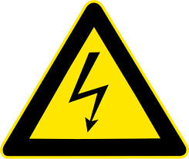

Straight Jet Regime
Polymer Solution
Polymer Melt
+
+
Chaotic Jet Regime
+
+
Free Flow Regime
Evaporation
Cooling
Z
Y
X
Stationary Collector
Stationary Collector
+
+
Collector Regime
+
+
+
+
+
+
X-Y-Z
Motion Control
Z
Y
U_{T} = 0 mm/s
U_{T} > 0 mm/s
U_{T} = U_{CR}
U_{T} >> U_{CR}
X

Slide 2



a
Straight Jet Regime
Polymer Solution
Polymer Melt
+
+
Chaotic Jet Regime
+
+
Free Flow Regime
Evaporation
Cooling
Stationary Collector
Stationary Collector
b
Collector Regime
+
+
+
+
+
+
X-Y-Z
Motion Control
$U_{c}$ > 0 mm/s
$U_{c}$ = $U_{cr}$
$U_{c}$ >> $U_{cr}$

Slide 3




GPJet
0010101000101010
+
+
Computer Vision Module
Machine Learning Module
Physics
Module
I. Gaussian Process Regression
II. Multi-fidelity Modeling
III. Active Learning
IV. Bayesian Optimization

