Slide 1
2-6 Families of Functions
Algebra 2
Prentice Hall, 2007
Think… “The Function Family”

Slide 2

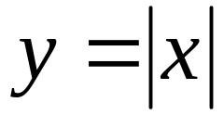
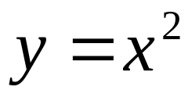
Definitions
A Family of Functions is made up of functions with certain characteristics.
A parent function is the simplest form of a function.
  Examples:
  (line with slope 1 passing through origin)
    (a V-graph opening up with vertex at origin)
    (a U-graph opening up with vertex at origin)

Slide 3
Definitions
Offspring of parent functions are:
  Translations (or shifts of the parent)
  Stretches (or skinnier versions of the parent)
  Shrinks (or fatter versions of the parent)
  Reflections (or flipped versions of the parent)

Slide 4
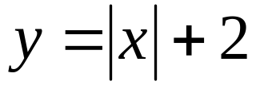
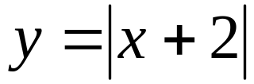
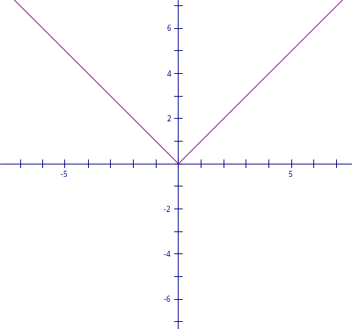
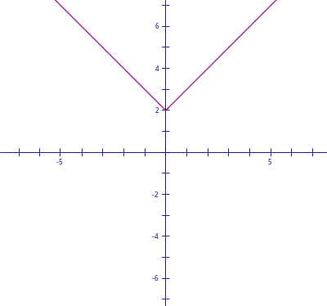
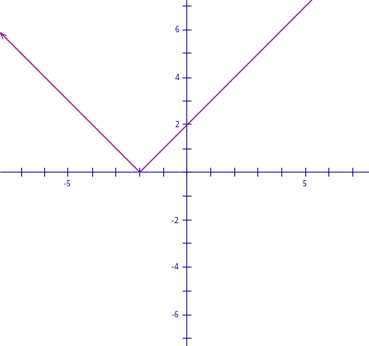
Translations
Translations are shifts up/down, left/right, or a combination of the 2.
The graph is the same size & shape as the parent, but moved to a new location.
Ex:
Parent | Offspring

Slide 5
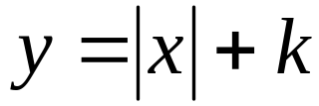
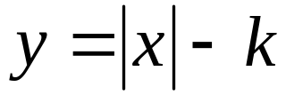
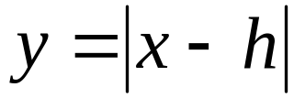
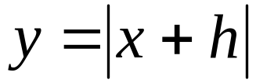
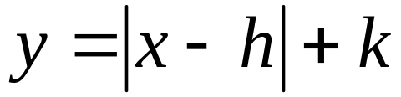
Translation Functions
If the parent function is , then translation offspring would be:
  shift up k units
  shift down k units
  shift right h units
  shift left h units
What kind of translation is ?
  Shift up k and right h
NOTE: shift left/right according to “k” only when the coefficient of x is 1!!!

Slide 6
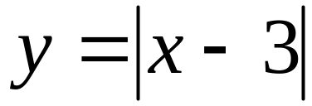
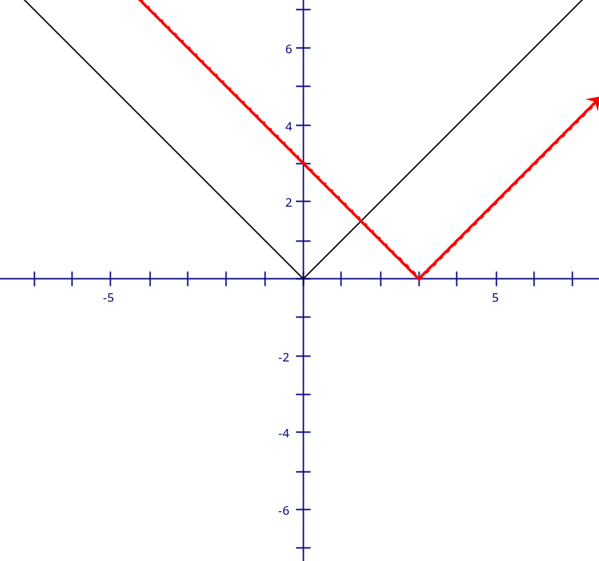
Examples
Ex. 1 Graph
  Remember what the parent looks like and go from there…
  …the parent shifted right 3 units!

Slide 7
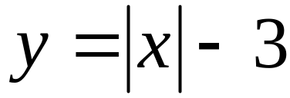
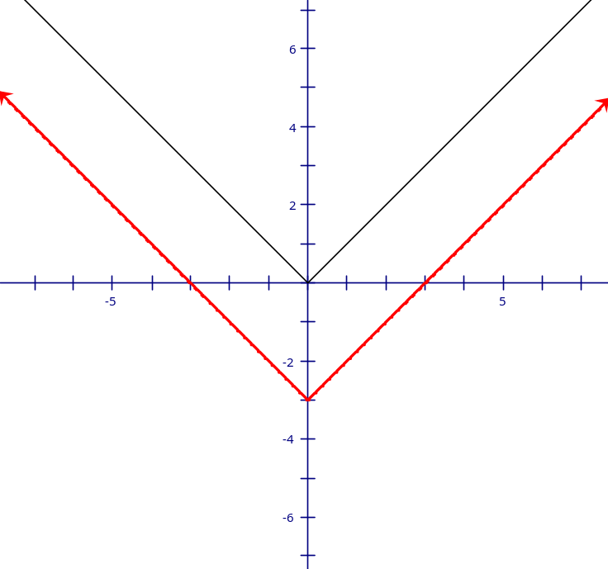
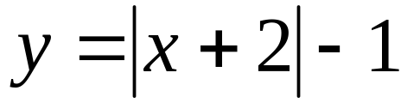
Examples
Ex. 2 Graph
  The parent shifted down 3 units.
What would look like?

Slide 8
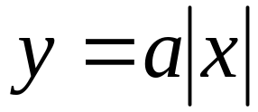

Stretches
A stretch multiples all the y-values by the same factor greater than 1, thereby the graph vertically (making it skinnier than the parent!)
If the parent function is , then stretched offspring would be …
… provided .
stretching

Slide 9

Shrinks
A shrink reduces all the y-values by the same factor less than 1, thereby the graph vertically (making it fatter than the parent!)
If the parent function is , then shrunken offspring would be …
… provided .
compressing

Slide 10
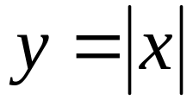
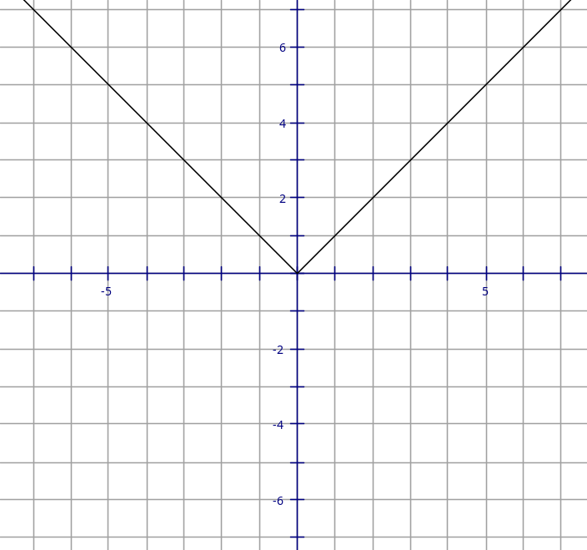
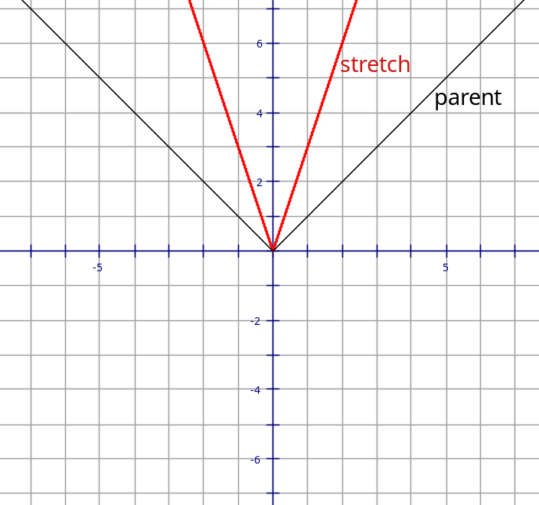
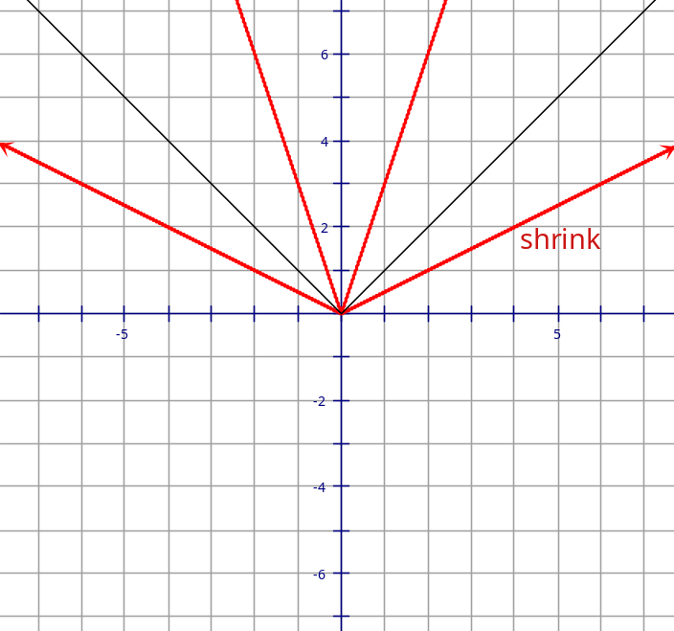
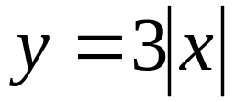
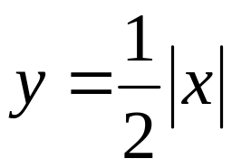
Examples
Graph the parent function:
Graph the offspring:
  Stretch:
    y’s are 3 times bigger
  Shrink:
    y’s are half as big

Slide 11
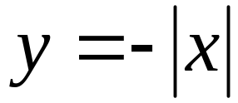
Reflections
A reflection over the x-axis changes the y-values to their opposites…(i.e. the parent flips!)
If the parent function is , then a reflection offspring would be:
  reflection over the x-axis ( )

Slide 12

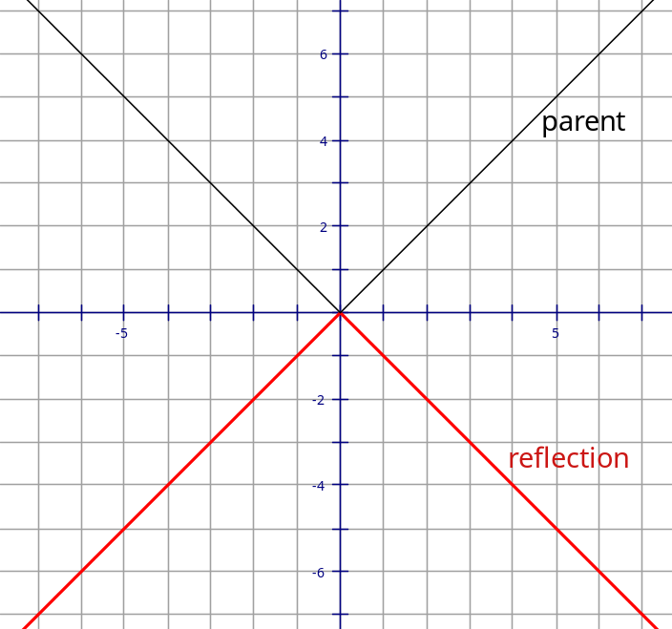
Example
Graph the parent function:
Graph the reflection offspring:

Slide 13
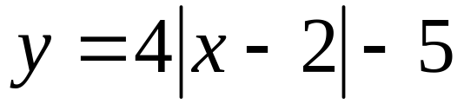
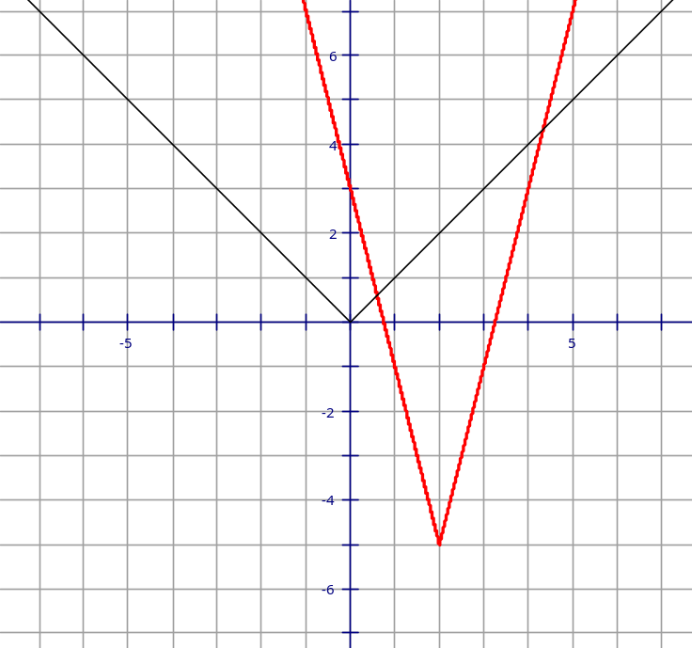
Just for kicks…
Describe this “offspring”:

Slide 14
Homework
2-6 PRWS 2-6 Families of Functions

