Slide 1
Wrangling/Feature Engineering

Slide 2
Overview
Cleaning/Pre-processing
Imputing
Removing outliers
Fix imbalanced target
Feature Engineering
Creating new features (encoding/interactions/flag etc.)
Choosing features

Slide 3
Common Imputing Methods
Median/mean – used on numerical and normally distributed variables
Mode (most_frequent) – used on categorical variables
Constant – used on categorical variables / numerical variables
Target (advanced) – used on both. Imputes by examining the relationship between the column and the target
Use SimpleImputer class

Slide 4
Common Encoding Method
One Hot – shows true/false value. It works as an “activation” of each class.
If a feature belongs to this class, will the target value be high/low/unaffected?
Counting – shows the frequency of each class
Ordinal/Label – shows the order of a class. It can only be used on categorical data that has intrinsic order (e.g. univ degree).

Slide 5
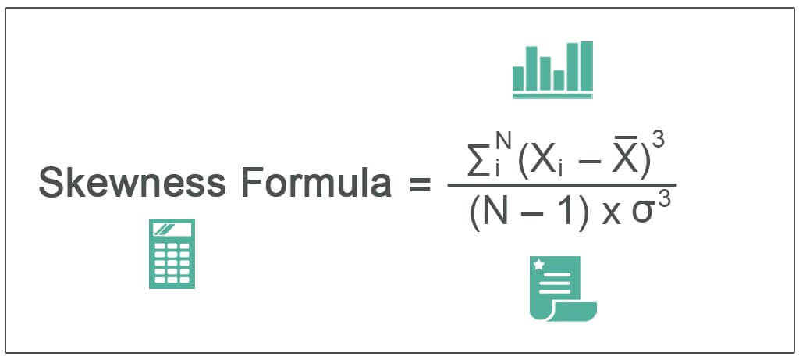
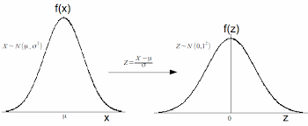
Why standardize?
Linear regression assumes normal distribution of variables – vulnerable to small errors if not
Regularization models require normalization – comparison of predictors must be fair
Easy to filter out outliers

Slide 6
Outlier Detecting Methods
Visual inspection
Statistical methods with a threshold
Z-score
IQR
ML methods
isolation forest
local outlier factor

Slide 7
Implementation tip1: transformers and estimators
Any classes that have two methods below are considered as transformers. They are usually used to preprocess data columns.
fit()
transform()
Examples: SimpleImputer, StandardScaler, OneHotEncoder
Any classes that have these two methods are considered as an estimator. They are ML algorithms.
fit()
predict()
Examples: LinearRegression, RidgeRegression, DecisionTreeClassifier

Slide 8
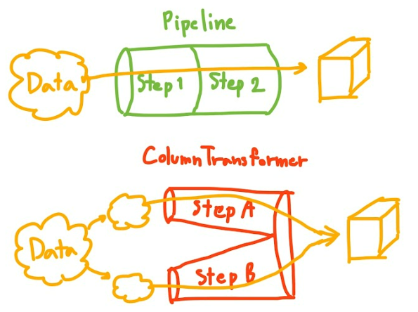
Implementation tip2: Pandas Pipeline vs. ColumnTransformer (Independent)
Used to apply multiple transformers, estimators, functions etc.
Streamlines the running process (on test data, or on new data); however, might not be suitable during wrangling/feature engineering
ColumnTransformer splits columns and apply specified transformer for each of them in parallel (kind of)
Pipeline applies transformers sequentially to specified columns
https://www.freecodecamp.org/news/machine-learning-pipeline/

Slide 9
Three ways to pick features

Slide 10
Why picking many features is better?

