Slide 1







TACK: Improving Wireless Transport Performance by Taming Acknowledgments
Tong Li♥, Kai Zheng♥, Ke Xu$♠$, Rahul Arvind Jadhav♥,
Tao Xiong♥, Keith Winstein$♦$, Kun Tan♥
acm sigcomm
August 10–14, 2020
$$♥$$
♠
♦
Notes:
Hi, I am Tong Li from Huawei. Today I am going to introduce TACK:
Improving Wireless Transport Performance by Taming Acknowledgments.

Slide 2


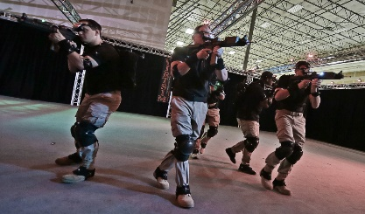
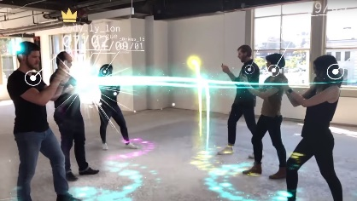
High Speed Rails (HSRs)
Wireless local area network (WLAN) demands high throughput
100
Mbps
200
Mbps
500
Mbps
30
Mbps
92
Mbps
Average
Peek
UHD VR
2018
2023
Ultra-high-definition
(UHD) wireless projection
Application Requirements | UHD Cameras (Security) | UHD Streaming | VR Streaming | Self Driving Vehicle Diagnostics | Cloud Gaming | UHD IP Video | 8K Wall TV | HD VR | UHD VR
Average (Mbps) | 16 | 16 | 17 | 20 | 30 | 51 | 100 | 167 | 500
Source: Cisco Annual Internet Report, 2018–2023
VR interactive gaming
8K Videos from Youtube | Asteroid Discovery | NORWAY | The Las Vegas Strip | TOKYO HDR Time Lapse | Angel Falls, Venezuela | Tigers Go For A Swim | Henosis(8K Short Film)
Average (Mbps) | 81.0 | 81.1 | 129.1 | 62.8 | 57.7 | 72.0 | 40.6
Peek (Mbps) | 206.9 | 196.9 | 134.2 | 83.2 | 81.3 | 72.1 | 71.1
AR interactive gaming
Source: Huawei iLab, 2017
Notes:
High-throughput transport over WLAN becomes a demanding requirement
with the emergence of applications such as UHD wireless projection,
VR/AR-based interactive gaming, and so on.
However,
the current WLAN connection speed is still far from satisfactory for UHD-video-based applications.

Slide 3


TCP ACKs cause internal interference
ACK: ACKnowdedgement
External Interference
Internal Interference
TCP forward path：Data packets
TCP backward path：
ACK packets
External Interference：Between wireless devices on the same channel
Internal Interference： Between data packets and ACKs in the same connection
Notes:
Most modern WLANs are based on the IEEE 802.11 standards.
It is well-studied that medium access overhead in WLAN can significantly reduce TCP throughput,
this is because TCP ACKs cause internal interference on the same connection.

Slide 4
ACKs cause similar medium access overhead
Inter-frame space
(IFS)
Contention window
(random back off)
Last frame
Next frame
Time
Extra overhead for sending each packet
independent with packet size
Medium acquisition overhead in WLAN based on the IEEE 802.11 medium access control (MAC) protocol
Notes:
It is also well-studied that the overhead for sending each packet is independent with packet size,
ACKs cause almost similar medium access overhead despite the much smaller size.
As a result, the internal interference between data packets and ACKs is non-negligible.

Slide 5
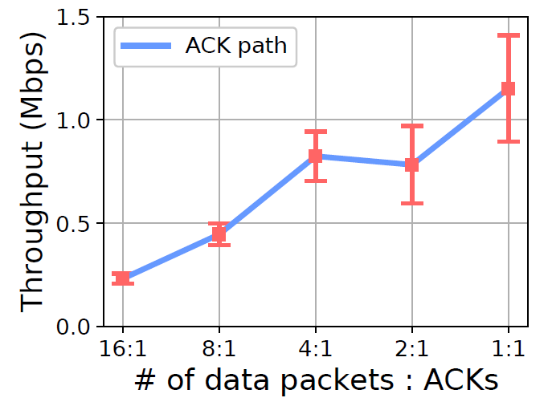
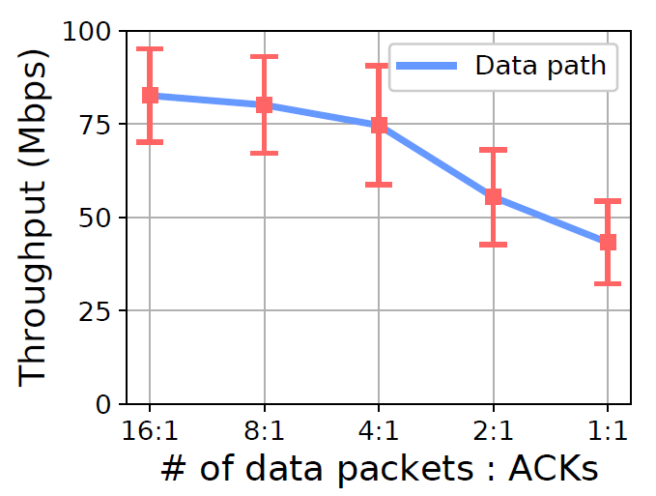
Reducing ACK frequency improves throughput
ACK frequency increases
(a) ACK throughput
(b) Data throughput
Experiments for contention between data packets and ACKs over 802.11n wireless links
*Data is collected by a UDP-based simulation tool Ackemu (https://github.com/fillthepipe/ackemu)
Notes:
To explain the internal interference more clearly,
we conduct emulations over wireless links.
Basically, TCP sends an ACK for every one or two packets which is frequent.
As shown in the left figure,
【】the throughput on the ACK path is relatively low,
however, as shown in the right figure,
【】the throughput on the data path decreases significantly with the increase of ACK frequency.

Slide 6
But, simply reducing ACK frequency hurts TCP performance
Reducing ACK frequency has both “positive effect” and “negative effect”
“A TCP receiver which does not generate an ACK for every second full-sized segment exhibits a "Stretch ACK Violation".
--- 1999, RFC 2525, Vern Paxson et.al
Positive Effect
throughput (Mbps)
Negative Effect
TCP’s transport control depends on frequent ACKs
Goodput
of legacy TCP
Ideal goodput with reduced ACK frequency
Actual goodput with reduced ACK frequency but without advancements
Notes:
In wireless scenarios,
reducing ACK frequency has a “positive effect” on the transport performance
due to the reduced contentions.
Unfortunately, simply reducing ACK frequency hurts TCP performance,
which is called “negative effect”.
This “negative effect” is because that TCP’s transport control depends on frequent ACKs
and the packet-clocking algorithms are impacted when ACK frequency is excessively reduced.

Slide 7
So, let’s tame the acknowledgements
Goal:
Seek the optimal ACK frequency
with corresponding improvements in transport mechanism to avoid the “negative effect”
Notes:
In this case, acknowledgements should be tamed.
This paper aims to seek the optimal ACK frequency
with corresponding improvements in transport mechanism
to avoid the “negative effect”.

Slide 8
Takeaways
TCP’s delayed ACK is far from being optimal
Our way of avoiding “negative effect” is a TACK-based acknowledgement mechanism
An approximately minimized ACK frequency works better than expected
Notes:
And here are the takeaways.
First,
legacy TCP’s delayed ACK can not ensure minimal ACK frequency,
it is far from being optimal.
Second,
our way of avoiding “negative effect” is not only TACK,
but also a TACK-based acknowledgement mechanism.
Third,
a transport protocol applying an approximately minimized ACK frequency works better than expected.

Slide 9
Takeaways
TCP’s delayed ACK is far from being optimal
Our way of avoiding “negative effect” is a TACK-based acknowledgement mechanism
An approximately minimized ACK frequency works better than expected
Notes:
Let’s start from the first one.

Slide 10
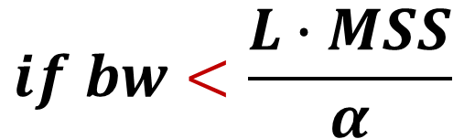
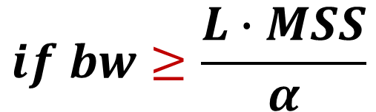
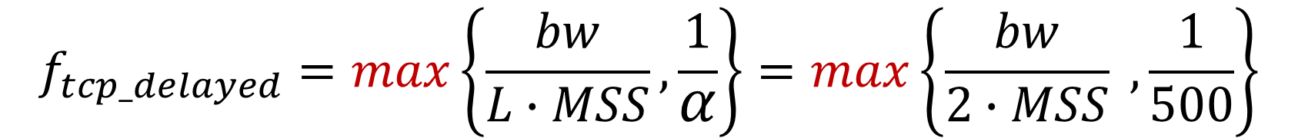
Delayed ACK is not bounded or not minimized under bandwidth change
ACK frequency Modeling:
RFC 1122 & RFC 5681
$$f_{tcp_delayed}=max\left\{\frac{bw}{L∙MSS},\frac{1}{α}\right\}=max\left\{\frac{bw}{2∙MSS} , \frac{1}{500}\right\}$$
$$if bw≥\frac{L∙MSS}{α}$$
$$if bw<\frac{L∙MSS}{α}$$
(Byte-counting ACK)
(Periodic ACK)
bw: data throughput
MSS: maximum segment size
L: number of full-sized packets counted before sending an ACK
𝛼: time interval between two ACKs
f: ACK frequency with unit of Hz, i.e., number of ACKs per second
Notes:
Legacy TCP alternatively adopts delayed ACK,
in which a data receiver may delay sending an ACK for every L full-sized incoming packets
or by a given time interval.
【】when data throughput is high,
the ACK frequency still might be large.
【】On the other hand, when data throughput is low,
the ACK frequency is always as high as that in the case of a high throughput,
which wastes resources.
This reveals that the frequency of TCP’s delayed ACK is not bounded
or not minimized under bandwidth change.
In other words,
TCP’s delayed ACK is far from being optimal.

Slide 11
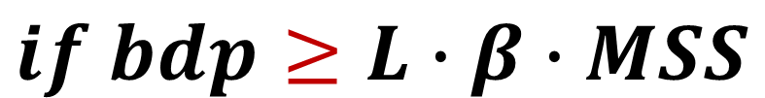
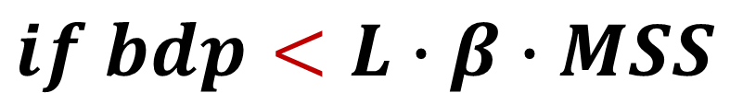
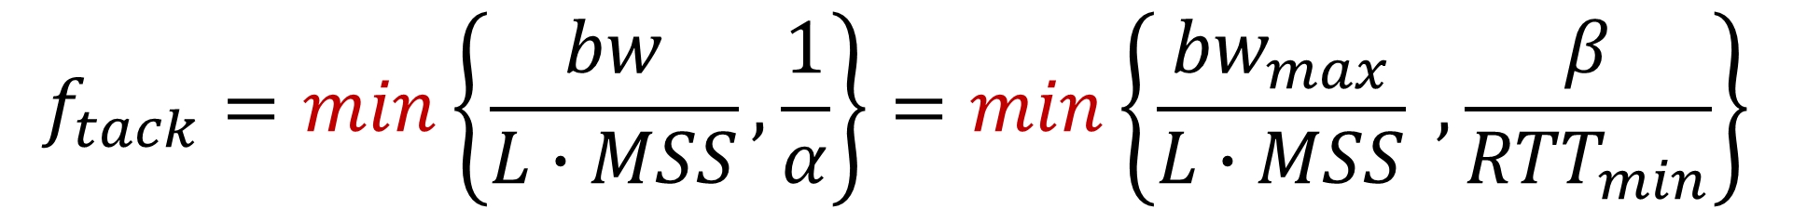
Tame ACK (TACK)
$$f_{tack}=min\left\{\frac{bw}{L∙MSS},\frac{1}{α}\right\}=min\left\{\frac{{bw}_{max}}{L∙MSS} , \frac{β}{{RTT}_{min}}\right\}$$
$$if bdp<L∙β∙MSS$$
$$if bdp≥L∙β∙MSS$$
(Byte-counting ACK)
(Periodic ACK)
${bw}_{max}$: the maximum bandwidth estimate
${RTT}_{min}$: the minimum RTT estimate
$β$: the number of ACKs per ${RTT}_{min}$
$bdp$: the bandwidth and delay product (${bw}_{max}×{RTT}_{min}$)
Notes:
We propose TACK,
a new acknowledgement whose frequency is decided by bdp
(the bandwidth and delay product).
The frequency of TACK is the minimum value between byte-counting ACK and periodic ACK.
【】Specifically, TACK applies periodic ACK when bdp is large,
【】and falls back to byte-counting ACK when bdp is small.
In this case, when data throughput is high,
the ACK frequency is bounded. On the other hand,
when data throughput is low,
the ACK frequency is reduced proportionally.

Slide 12
Takeaways
TCP’s delayed ACK is far from being optimal
Our way of avoiding “negative effect” is a TACK-based acknowledgement mechanism
An approximately minimized ACK frequency works better than expected
Notes:
To conclude,
our first takeaway is that TCP’s delayed ACK is far from being optimal.
This is because TCP adopts a “max” function other than a “min“ function.
However, our work in this paper has demonstrated that
a “min“ function is also able to achieve good transport performance.
The key is to avoid TACK’s “negative effect”.

Slide 13
Takeaways
TCP’s delayed ACK is far from being optimal
Our way of avoiding “negative effect” is a TACK-based acknowledgement mechanism
An approximately minimized ACK frequency works better than expected
Notes:
Then we give the second takeaway:
Instead of simply applying TACK,
a carefully designed TACK-based acknowledgement mechanism is the way to avoid TACK’s “negative effect”.

Slide 14
How to avoid TACK’s “negative effect”?
Issues in loss recovery
Issues in round-trip timing
Issues in send rate control
Reducing ACK frequency enlarges feedback delay upon loss events. ACK loss or retransmission loss doubles the delay
Generating only one RTT sample among multiple packets is likely to result in biases
CC: The fewer ACKs sent, the larger the bursts of packets released
FC: Delay acknowledging packet receipts and reporting rwnd, resulting in feedback lags and bandwidth under-utilization
Notes:
Here we list several major issues to handle in terms of loss recovery, round-trip timing,
and send rate control including congestion control and flow control.
For detailed case studies of these issues,
please refer to the paper.

Slide 15
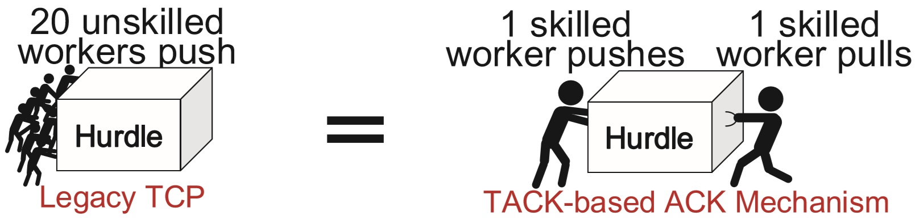
Features of TACK-based acknowledgement mechanism
More types of ACKs
Apart from the ACK type of TACK, also introduce the ACK type of IACK (“Instant ACK”）
IACK and TACK are complementary
More necessary information carried in ACKs
Carry more contiguous range of lost packets when ACK loss rate has reached a critical level
Sync ACK delay, timestamp, loss rate, delivery rate, etc. between endpoints
Less number of ACKs, but are exactly what are required by transport
IACK is instant event-driven , whose frequency is usually low and negligible
The design rationale: an analogy
Notes:
To solve these issues,
we propose a full TACK-based acknowledgement mechanism.
There are some notable features of this mechanism
which are important for reasoning about the differences from legacy TCP.
First, apart from the ACK type of TACK,
we also introduce the ACK type of IACK
to assure timely feedback upon instant events.
IACK and TACK are complementary.
IACK assures timely signaling
while TACK acts as the last resort mechanism in the case of ACK loss.
Second, when the loss rate on the ACK path has reached a critical level,
TACK should carry more information
such as contiguous range of lost packets or received packets.
With more types of ACKs and more necessary information carried in ACKs,
the TACK-based acknowledgement mechanism
therefore is able to send less number of ACKs
but are exactly what are required by transport.

Slide 16
TACK-based protocol design
Advancements in loss recovery
Packet number, TACK+IACK
Advancements in round-trip timing
One-way delay as auxiliary
Advancements in send rate control
Congestion control: Pacing
Flow control: IACK
Data
Sender
Data
Receiver
5
6
7
8
Send
Buffer
1
2
3
4
Receive
Buffer
Loss Recovery
Monitor
Receive
Round-trip Timing
Feedback
Handling
TACK-based ACK Mechanism
TACK/IACK
Send
Send Rate Control
Data Packet
For more details,
please refer to the paper.
Goal: Decrease TCP’s dependence on frequent ACKs
Notes:
We further give the protocol design of the TACK-based acknowledgement mechanism,
in which the advancements in loss recovery, round-trip timing, and send rate control
are the most key reasons
that TCP’s dependence on frequent ACKs has decreased.
For more technical details,
please refer to the paper.

Slide 17
Takeaways
TCP’s delayed ACK is far from being optimal
Our way of avoiding “negative effect” is a TACK-based acknowledgement mechanism
An approximately minimized ACK frequency works better than expected
Notes:
To summarize,
applying TACK significantly reduces ACK frequency and improves performance ideally.
However, simply applying TACK probably falls short.
What we really want,
for WLAN,
is a full TACK-based acknowledgement mechanism
that overcomes the hurdles for applying TACK,
using an approximately minimized ACK frequency to support efficient transport.

Slide 18
Takeaways
TCP’s delayed ACK is far from being optimal
Our way of avoiding “negative effect” is a TACK-based acknowledgement mechanism
An approximately minimized ACK frequency works better than expected
Notes:
We have conducted experiments on both wired and wireless links.
The results show our third takeaway:
A transport protocol applying an approximately minimized ACK frequency works better than expected.

Slide 19
Evaluation
TCP-TACK implementation
TCP-TACK: A TCP implementation that applies TACK and deploys the advancements as specified above
Co-design the receiver-based BBR as a TACK-based congestion controller
𝐿 = 2, 𝜷=4
Experiment setup
TCP BBR represents TCP using BBR as congestion controller and RACK as loss detection algorithm
New BPF socket option, BPF_SOCK_OPS_ACK_THRESH_INIT, to allow changing the TCP ACK frequency (https://github.com/fillthepipe/TcpAckThinning)
Wireless tests are in a public room with over 10 additional APs and over 100 wireless users at peak time. Ping test shows that the RTT varies between 4 to 200 ms and slight burst losses exist
Notes:
We implement TCP-TACK, a TCP implementation
that applies TACK and deploys the advancements as specified above.
We co-design the receiver-based BBR as a TACK-based congestion controller.

Slide 20
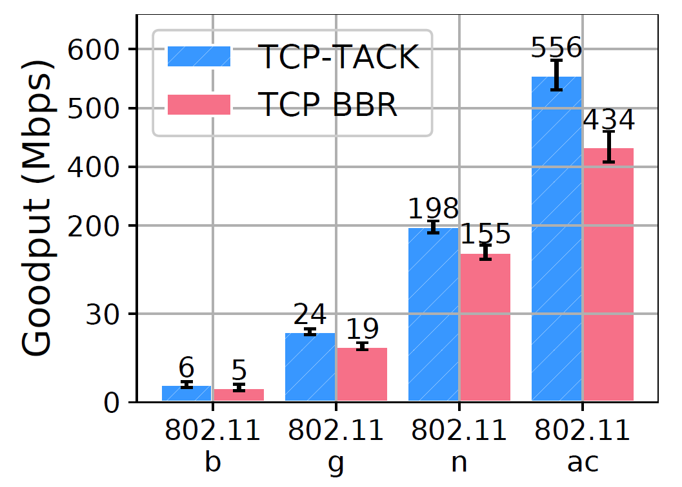
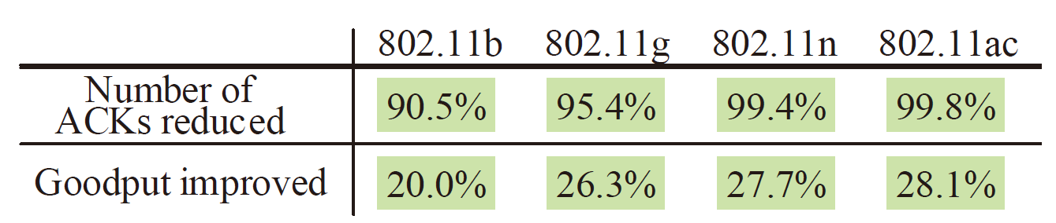
TACK-based protocol in WLAN
Percentage of goodput improvement of
TCP-TACK over TCP-BBR in WLAN
Notes:
Here is the result.
TCP-TACK achieves significant advantages over legacy TCP in WLAN scenarios
due to less contention between data packets and ACKs.
Specifically, TCP-TACK reduces over 90% of ACKs
and also obtains an improvement of 28% on goodput.

Slide 21
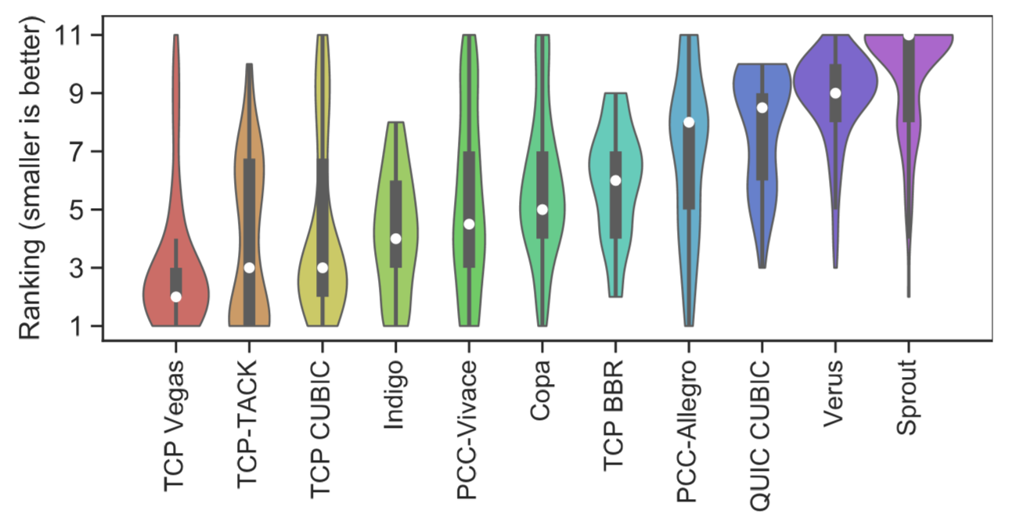
TACK-based protocol in WAN
Violin-plots of performance ranking
(Results are from data traces during 200 days: https://pantheon.stanford.edu/summary)
Notes:
We further find TCP-TACK performs equally well as high-speed TCP variants
in wide area network scenarios,
this is attributed to the advancements of the TACK-based protocol design
in loss recovery, round-trip timing, and send rate control.
This reveals that an approximately minimized ACK frequency works better than expected.

Slide 22
Takeaways
TCP’s delayed ACK is far from being optimal
TACK adopts a “min” instead of a “max” to assure the minimized ACK frequency in the context of network dynamics
Our way of avoiding “negative effect” is a TACK-based acknowledgement mechanism
With more types of ACKs and more necessary information carried in ACKs, less number of ACKs are required
An approximately minimized ACK frequency works better than expected
TACK-based protocol provides a good replacement of legacy TCP in WLAN, and also works well in WAN scenarios.
TACK and its corresponding improvements in transport mechanism can also be adopted into other stacks (e.g., QUIC) to compensate for scenarios where the acknowledgement overhead is non-negligible
tcpm wg: https://tools.ietf.org/html/draft-li-tcpm-advancing-ack-for-wireless-00
quic wg: https://tools.ietf.org/html/draft-li-quic-optimizing-ack-in-wlan-00
Notes:
I would like to conclude today’s talk by summarizing the takeaways.
First, TCP’s delayed ACK is far from being optimal.
Instead,
TACK adopts a “min” function to assure the minimized ACK frequency
in the context of network dynamics.
Second,
our way of avoiding TACK’s “negative effect” is a TACK-based acknowledgement mechanism,
in which we define more types of ACKs
and carry more necessary information in ACKs,
and then we are able to send less number of ACKs.
Third,
an approximately minimized ACK frequency works better than expected.
TACK-based protocol provides a good replacement of legacy TCP in WLAN
and also works well in WAN scenarios.
Moreover,
TACK and its corresponding improvements in transport mechanism
can also be adopted into other stacks such as QUIC
to compensate for scenarios
where the acknowledgement overhead is non-negligible.
This work is also being discussed in IETF working groups,
please get in touch
and we will be happy to discuss with you.

Slide 23
Thank You! Email: li.tong@huawei.com Q & A
Notes:
Thank you for your watching!

