Slide 1







TACK: Improving Wireless Transport Performance by Taming Acknowledgments
Tong Li♥, Kai Zheng♥, Ke Xu$♠$, Rahul Arvind Jadhav♥,
Tao Xiong♥, Keith Winstein$♦$, Kun Tan♥
acm sigcomm
August 10–14, 2020
$$♥$$
♠
♦
Notes:
Hi, I am Tong Li from Huawei. Today I am going to introduce TACK:
Improving Wireless Transport Performance by Taming Acknowledgments.

Slide 2


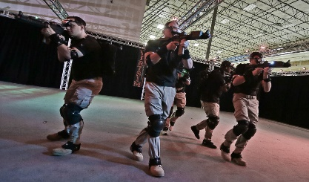

High Speed Rails (HSRs)
Wireless local area network (WLAN) demands high throughput
100
Mbps
200
Mbps
500
Mbps
30
Mbps
92
Mbps
Average
Peek
UHD VR
2018
2023
Ultra-high-definition
(UHD) wireless projection
Application Requirements | UHD Cameras (Security) | UHD Streaming | VR Streaming | Self Driving Vehicle Diagnostics | Cloud Gaming | UHD IP Video | 8K Wall TV | HD VR | UHD VR
Average (Mbps) | 16 | 16 | 17 | 20 | 30 | 51 | 100 | 167 | 500
Source: Cisco Annual Internet Report, 2018–2023
VR interactive gaming
8K Videos from Youtube | Asteroid Discovery | NORWAY | The Las Vegas Strip | TOKYO HDR Time Lapse | Angel Falls, Venezuela | Tigers Go For A Swim | Henosis(8K Short Film)
Average (Mbps) | 81.0 | 81.1 | 129.1 | 62.8 | 57.7 | 72.0 | 40.6
Peek (Mbps) | 206.9 | 196.9 | 134.2 | 83.2 | 81.3 | 72.1 | 71.1
AR interactive gaming
Source: Huawei iLab, 2017
Notes:
High-throughput transport over WLAN becomes a demanding requirement
with the emergence of applications such as UHD wireless projection,
VR/AR-based interactive gaming, and so on.
Particularly, the average throughput requirement is 100 Mbps of an 8K video,
whose peak throughput requirement might reach 200 Mbps.
For a UHD VR-based application, the throughput even reach 500 Mbps.
It is reported that the average WLAN connection speed in 2018 was 30 Mbps
and will be more than triple by 2023.
Which, however, is still far from satisfactory for UHD-video-based applications.

Slide 3


TCP ACKs cause internal interference
ACK: ACKnowdedgement
External Interference
Internal Interference
TCP forward path：Data packets
TCP backward path：
ACK packets
External Interference：Between wireless devices on the same channel
Internal Interference： Between data packets and ACKs in the same connection
Notes:
Most modern WLANs are based on the IEEE 802.11 standards.
It is well-studied that medium access overhead in WLAN can significantly reduce TCP throughput,
this is because TCP ACKs cause internal interference on the same connection.

Slide 4
ACKs cause similar medium access overhead
Inter-frame space
(IFS)
Contention window
(random back off)
Last frame
Next frame
Time
Extra overhead for sending each packet
independent with packet size
Medium acquisition overhead in WLAN based on the IEEE 802.11 medium access control (MAC) protocol
Notes:
When frames are operated in the MAC layer,
the time period including the inter-frame space and a random back-off period is the extra overhead
between completion of the last frame and starting of the next frame.
【】Since the extra overhead for sending each packet is independent with packet size,
ACKs cause almost similar medium access overhead despite the much smaller size.
As a result, the internal interference between data packets and ACKs is non-negligible.

Slide 5
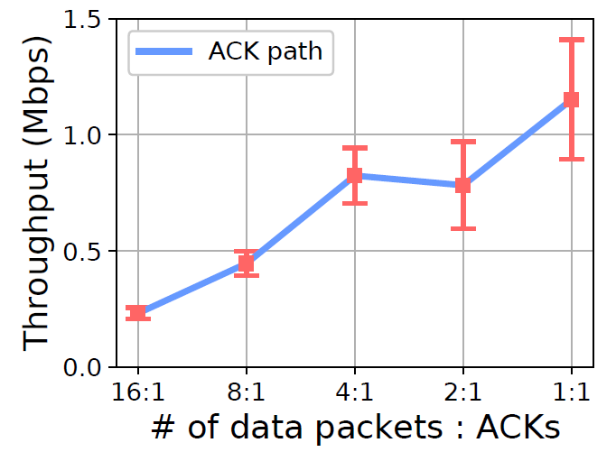
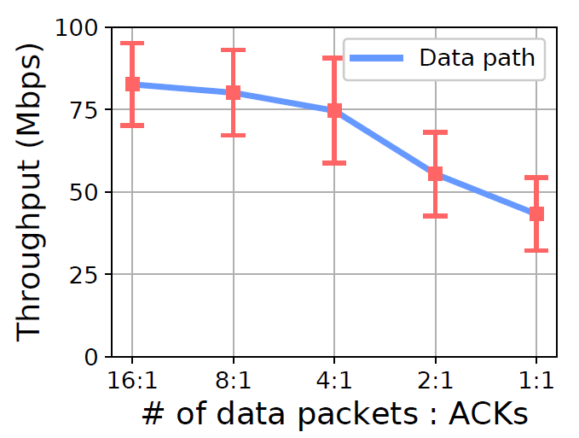
Reducing ACK frequency improves throughput
ACK frequency increases
(a) ACK throughput
(b) Data throughput
Experiments for contention between data packets and ACKs over 802.11n wireless links
*Data is collected by a UDP-based simulation tool Ackemu (https://github.com/fillthepipe/ackemu)
Notes:
To explain the internal interference more clearly,
we conduct emulations over wireless links.
Basically, TCP sends an ACK for every one or two packets which is frequent.
As shown in the left figure,
【】the throughput on the ACK path is relatively low,
however, as shown in the right figure,
【】the throughput on the data path decreases significantly with the increase of ACK frequency.

Slide 6
But, simply reducing ACK frequency hurts TCP performance
Reducing ACK frequency has both “positive effect” and “negative effect”
“A TCP receiver which does not generate an ACK for every second full-sized segment exhibits a "Stretch ACK Violation".
--- 1999, RFC 2525, Vern Paxson et.al
Positive Effect
throughput (Mbps)
Negative Effect
TCP’s transport control depends on frequent ACKs
Goodput
of legacy TCP
Ideal goodput with reduced ACK frequency
Actual goodput with reduced ACK frequency but without advancements
Notes:
In wireless scenarios,
reducing ACK frequency has a “positive effect” on the transport performance
due to the reduced contentions.
Unfortunately, simply reducing ACK frequency hurts TCP performance,
which is called “negative effect”.
This “negative effect” is because that TCP’s transport control depends on frequent ACKs
and the packet-clocking algorithms are impacted when ACK frequency is excessively reduced.

Slide 7
So, let’s tame the acknowledgements
Goal:
Seek the optimal ACK frequency
with corresponding improvements in transport mechanism to avoid the “negative effect”
Notes:
In this case, acknowledgements should be tamed.
This paper aims to seek the optimal ACK frequency
with corresponding improvements in transport mechanism
to avoid the “negative effect”.

Slide 8
Takeaways
TCP’s delayed ACK is far from being optimal
Our way of avoiding “negative effect” is a TACK-based acknowledgement mechanism
An approximately minimized ACK frequency works better than expected
Notes:
And here are the takeaways.
First,
legacy TCP’s delayed ACK can not ensure minimal ACK frequency,
it is far from being optimal.
Second,
our way of avoiding “negative effect” is not only TACK,
but also a TACK-based acknowledgement mechanism.
Third,
a transport protocol applying an approximately minimized ACK frequency works better than expected.

Slide 9
Takeaways
TCP’s delayed ACK is far from being optimal
Our way of avoiding “negative effect” is a TACK-based acknowledgement mechanism
An approximately minimized ACK frequency works better than expected
Notes:
Let’s start from the first one.

Slide 10




Two ways to reduce ACK frequency (f)
Byte-counting ACK
Periodic ACK
$$f=\frac{bw}{L∙MSS}$$
$$f=\frac{1}{α}$$
Data
ACK
$$α$$
ACK
ACK
(L=2)
$$α$$
(L=1)
(L=3)
ACK
f: ACK frequency with unit of Hz, i.e., number of ACKs per second
L: number of full-sized packets counted before sending an ACK
MSS: maximum segment size
bw: data throughput
𝛼: time interval between two ACKs
Notes:
ACK frequency can be denoted by f with the unit of Hz,
that is, the number of ACKs per second,
which can be reduced in two fundamental ways:
byte-counting ACK and periodic ACK.
【】Byte-counting ACK reduces ACK frequency by sending an ACK
for every two or more incoming full-sized packets.
The frequency is proportional to data throughput.
【】We can also reduce ACK frequency by sending an ACK for each time interval,
that is, periodic ACK.

Slide 11
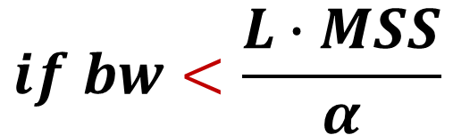
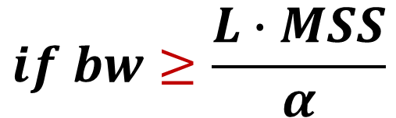
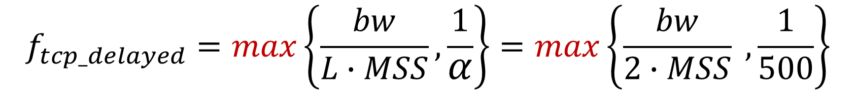
Delayed ACK is not bounded or not minimized under bandwidth change
ACK frequency Modeling:
RFC 1122 & RFC 5681
$$f_{tcp_delayed}=max\left\{\frac{bw}{L∙MSS},\frac{1}{α}\right\}=max\left\{\frac{bw}{2∙MSS} , \frac{1}{500}\right\}$$
$$if bw≥\frac{L∙MSS}{α}$$
$$if bw<\frac{L∙MSS}{α}$$
(Byte-counting ACK)
(Periodic ACK)
bw: data throughput
MSS: maximum segment size
L: number of full-sized packets counted before sending an ACK
𝛼: time interval between two ACKs
f: ACK frequency with unit of Hz, i.e., number of ACKs per second
Notes:
Legacy TCP alternatively adopts delayed ACK,
in which a data receiver may delay sending an ACK for every L full-sized incoming packets
or by a given time interval.
As recommended in RFCs,
L is limited up to 2 and ⍺ is tens to hundreds of milliseconds,
and varies in different Linux distributions.
【】when data throughput is high,
the ACK frequency still might be large.
【】On the other hand, when data throughput is low,
the ACK frequency is always as high as that in the case of a high throughput,
which wastes resources.
This reveals that the frequency of TCP’s delayed ACK is not bounded
or not minimized under bandwidth change.
In other words,
TCP’s delayed ACK is far from being optimal.

Slide 12
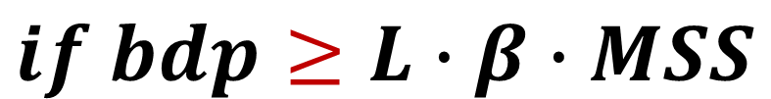
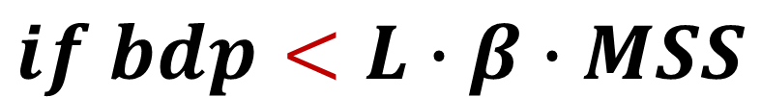
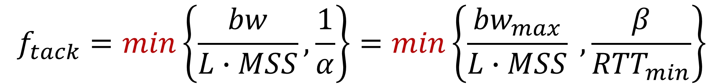
Tame ACK (TACK)
$$f_{tack}=min\left\{\frac{bw}{L∙MSS},\frac{1}{α}\right\}=min\left\{\frac{{bw}_{max}}{L∙MSS} , \frac{β}{{RTT}_{min}}\right\}$$
$$if bdp<L∙β∙MSS$$
$$if bdp≥L∙β∙MSS$$
(Byte-counting ACK)
(Periodic ACK)
${bw}_{max}$: the maximum bandwidth estimate
${RTT}_{min}$: the minimum RTT estimate
$β$: the number of ACKs per ${RTT}_{min}$
$bdp$: the bandwidth and delay product (${bw}_{max}×{RTT}_{min}$)
Notes:
We propose TACK,
a new acknowledgement whose frequency is decided by bdp
(the bandwidth and delay product).
The frequency of TACK is the minimum value between byte-counting ACK and periodic ACK.
【】Specifically, TACK applies periodic ACK when bdp is large,
【】and falls back to byte-counting ACK when bdp is small.
In this case, when data throughput is high,
the ACK frequency is bounded. On the other hand,
when data throughput is low,
the ACK frequency is reduced proportionally.

Slide 13
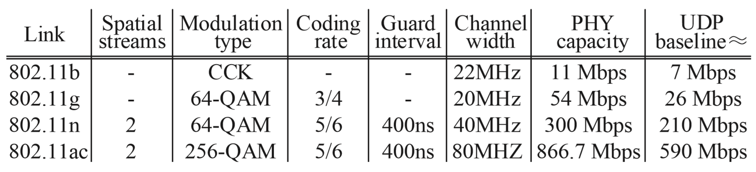
How is TACK’s “positive effect”?
Various wireless links: IEEE 802.11 b/g/n/ac
Method
To better estimate TACK’s “positive effect”, we build a UDP-based simulation tool Ackemu to assure that there is no “negative effect”
Ackemu (https://github.com/fillthepipe/ackemu)
Ackemu sender keeps sending 1518-byte UDP packets
When trigger condition is met, Ackemu receiver sends one 64-byte UDP packet as an ACK
Notes:
First, we estimate TACK’s “positive effect” over various wireless links,
we build a UDP-based tool to assure that there is no “negative effect”.
The sender keeps sending large UDP packets,
and the receiver has implemented various ACK thinning technologies including TACK.
When the trigger condition is met,
the receiver sends one small UDP packet as an ACK.

Slide 14
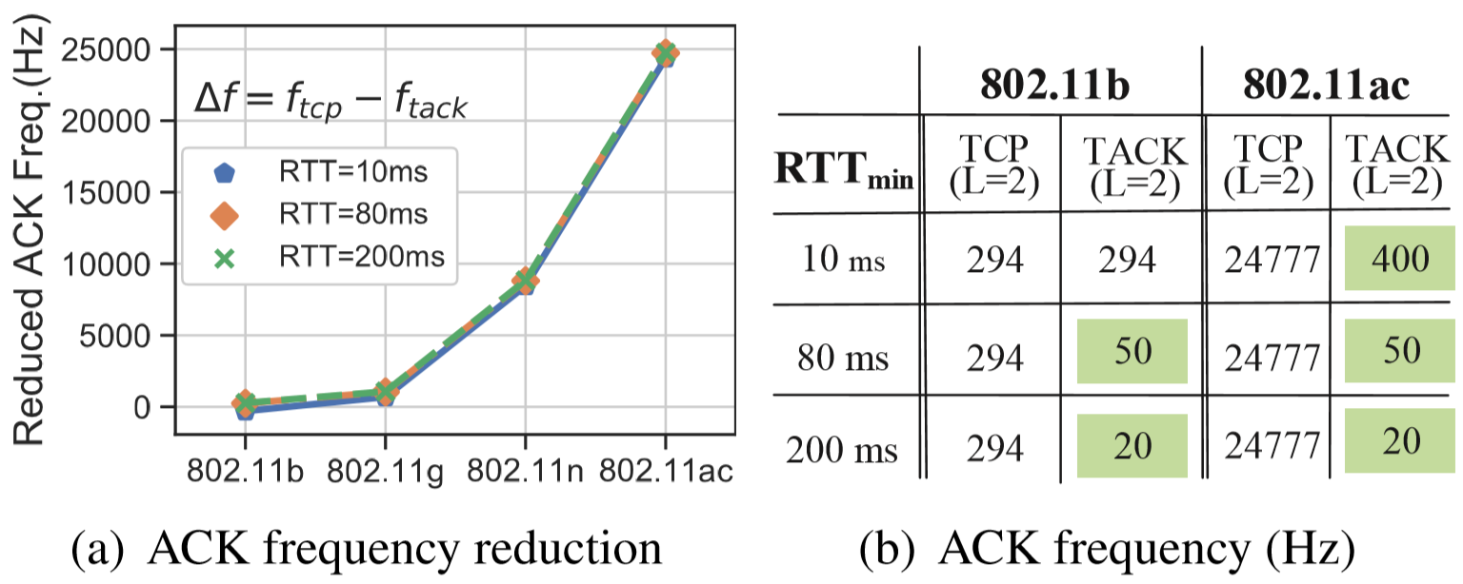
TACK reduces ACK frequency significantly
PHY rate increases
Quantitative analysis of TACK frequency over IEEE 802.11 b/g/n/ac wireless links
Notes:
The result is that
more number of ACKs are reduced in the case of a faster physical rate.
【】For example, TACK has the same frequency as TCP’s delayed ACK
over 802.11b links with a small RTT.
【】However, for the 802.11ac links,
the frequency of TACK has dropped two orders of magnitude when RTT is 10ms
【】and three orders of magnitude when RTT is 80 ms.

Slide 15
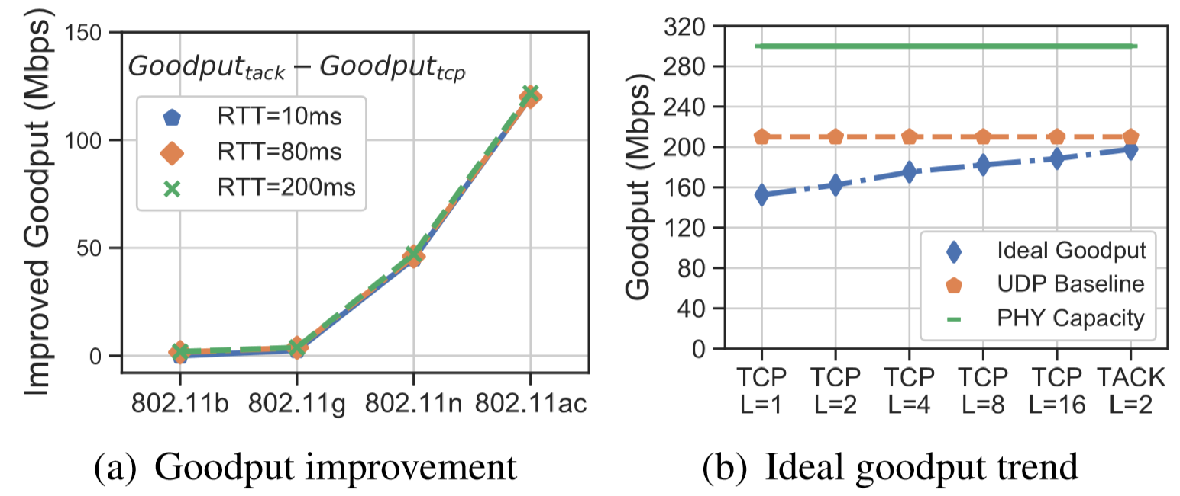
Ideally, TACK approaches transport upper bound
transport upper bound
(RTT=80 ms, IEEE 802.11n)
Transport upper bound: Transport control will not be impacted by reducing ACK frequency
Notes:
Ideally, links with faster physical rates increase goodput improvement.
TACK approaches the transport upper bound with a minimized ACK frequency.

Slide 16
Takeaways
TCP’s delayed ACK is far from being optimal
Our way of avoiding “negative effect” is a TACK-based acknowledgement mechanism
An approximately minimized ACK frequency works better than expected
Notes:
To conclude,
our first takeaway is that TCP’s delayed ACK is far from being optimal.
This is because TCP adopts a “max” function other than a “min“ function.
However, our work in this paper has demonstrated that
a “min“ function is also able to achieve good transport performance.
The key is to avoid TACK’s “negative effect”.

Slide 17
Takeaways
TCP’s delayed ACK is far from being optimal
Our way of avoiding “negative effect” is a TACK-based acknowledgement mechanism
An approximately minimized ACK frequency works better than expected
Notes:
Then we give the second takeaway:
Instead of simply applying TACK,
a carefully designed TACK-based acknowledgement mechanism is the way to avoid TACK’s “negative effect”.

Slide 18
How to avoid TACK’s “negative effect”?
Issues in loss recovery
Issues in round-trip timing
Issues in send rate control
Reducing ACK frequency enlarges feedback delay upon loss events. ACK loss or retransmission loss doubles the delay
Generating only one RTT sample among multiple packets is likely to result in biases
CC: The fewer ACKs sent, the larger the bursts of packets released
FC: Delay acknowledging packet receipts and reporting rwnd, resulting in feedback lags and bandwidth under-utilization
Notes:
Here we list several major issues to handle in terms of loss recovery, round-trip timing,
and send rate control including congestion control and flow control.
Next, we will give some case studies to better understand these issues.

Slide 19
Enlarged delay in loss recovery
Sender
Receiver
Receiver’s APP
ACK2
Packet 1
Packet 3
ACK3
Packet 1~11
ACK3
Packet 2
ACK3
delay of packet reassembling
ACK3
Retransmit Packet 3
Packet 12
Packet 3~11
Packet 12
Packet 3 blocks the head of line (8 subsequent packets)
Case study: Legacy TCP
Notes:
It is well-known that head-of-line blocking incurs high delay of packet reassembling
and thus leads to transport performance decline.
In the case of legacy TCP,
the loss of packet 3 blocks the head of line with 8 subsequent packets.

Slide 20
Enlarged delay in loss recovery
Sender
Receiver
Receiver’s APP
TACK1
Packet 1
Packet 3
…
Packet 2
Packet 1~100
delay of packet reassembling
…
TACK2
Retransmit Packet 3
Packet 3
Packet 101
Packet 3~100
Packet 3 blocks the head of line (97 subsequent packets)
Case study: TACK
Notes:
Since TACK might be excessively delayed.
Applying TACK will further enlarge this delay incurred by head-of-line blocking.
In the case of TACK,
the loss of packet 3 blocks the head of line with 97 subsequent packets.
When loss occurs during the TACK interval,
the excessive TACK delay disturbs loss detection,
resulting in costly retransmission timeouts.
TACK loss further aggravates this problem.

Slide 21
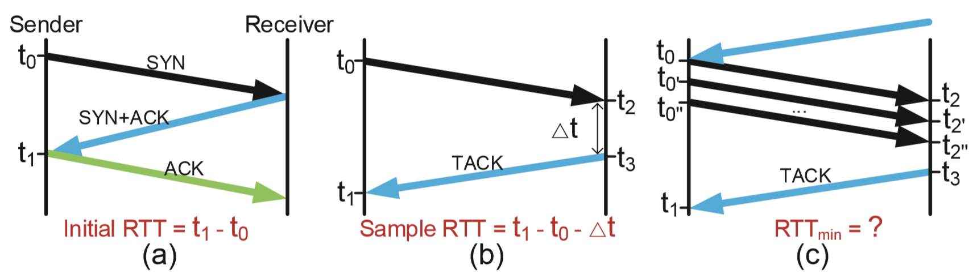
Biased round-trip timing
TACK-based round-trip timing: A case study
Notes:
In terms of round-trip timing,
the initial RTT can be computed during handshakes,
【】after that, the sender calculates an RTT sample upon receiving a TACK.
【】The problem here is that
multiple data packets might be received during the TACK interval,
generating only one RTT sample among multiple packets is likely to result in biases.
For example, a larger minimum RTT estimate
or a smaller maximum RTT estimate.
In general, the higher the throughput, the larger the biases.

Slide 22
Burst send pattern
ACK Interval
ACK
ACK
Data packet
Data packet
Frequent ACK
ACK1
ACK2
ACK3
ACK4
ACK5
ACK6
ACK7
time
ACK Interval
Infrequent ACK
TACK1
TACK2
time
Burst send pattern
Notes:
Third, for congestion control,
a burst of packets can be sent in response to a single delayed ACK.
Since TACK might be excessively delayed,
the burst send pattern may cause larger buffer requirement,
higher loss rate,
and longer queueing delay if not carefully handled.

Slide 23
Delayed send window update
Sender
Receiver
Application
rwnd=0
TACK1
RcvBuffer
buffered data
RcvBuffer released
AWND
free buffer space
Stop sending
Delayed update
rwnd=100
TACK2
Data packets
Receive buffer
Delayed send window update
Notes:
For send window update,
TCP ACKs report the announcement window in the TCP header for flow control.
Reducing ACK frequency might also lead to feedback lags
and bandwidth under-utilization.
For example, assume TACK is sent every 50 ms.
TACK1 notifies a zero window due to the receive buffer runs out,
upon receiving this TACK, the sender stops sending data.
In the case that the receiver buffer is released 5 ms after sending TACK1 due to loss recovery,
the sender continues to be blocked for another 45 ms until TACK2 is sent,
and thus wastes opportunity of sending data.
TACK loss further aggravates this issue.

Slide 24

Features of TACK-based acknowledgement mechanism
More types of ACKs
Apart from the ACK type of TACK, also introduce the ACK type of IACK (“Instant ACK”）
IACK and TACK are complementary
More necessary information carried in ACKs
Carry more contiguous range of lost packets when ACK loss rate has reached a critical level
Sync ACK delay, timestamp, loss rate, delivery rate, etc. between endpoints
Less number of ACKs, but are exactly what are required by transport
IACK is instant event-driven , whose frequency is usually low and negligible
The design rationale: an analogy
Notes:
To solve these issues,
we propose a full TACK-based acknowledgement mechanism.
There are some notable features of this mechanism
which are important for reasoning about the differences from legacy TCP.
First, apart from the ACK type of TACK,
we also introduce the ACK type of IACK
to assure timely feedback upon instant events.
IACK and TACK are complementary.
IACK assures timely signaling
while TACK acts as the last resort mechanism in the case of ACK loss.
Second, when the loss rate on the ACK path has reached a critical level,
TACK should carry more information
such as contiguous range of lost packets or received packets.
With more types of ACKs and more necessary information carried in ACKs,
the TACK-based acknowledgement mechanism
therefore is able to send less number of ACKs
but are exactly what are required by transport.

Slide 25
TACK-based protocol design
Advancements in loss recovery
Packet number, TACK+IACK
Advancements in round-trip timing
One-way delay as auxiliary
Advancements in send rate control
Congestion control: Pacing
Flow control: IACK
Data
Sender
Data
Receiver
5
6
7
8
Send
Buffer
1
2
3
4
Receive
Buffer
Loss Recovery
Monitor
Receive
Round-trip Timing
Feedback
Handling
TACK-based ACK Mechanism
TACK/IACK
Send
Send Rate Control
Data Packet
Goal: Decrease TCP’s dependence on frequent ACKs
Notes:
We further give the protocol design of the TACK-based acknowledgement mechanism,
in which the advancements in loss recovery, round-trip timing, and send rate control
are the most key reasons
that TCP’s dependence on frequent ACKs has decreased.

Slide 26
Advancements in round-trip timing
RTT samples
Design Rationale: Variation of OWD reflects the variation of RTT
20 | 16 | 22 | 15 | 30
Accuracy
Data
packet
ACK
This paper
Sender
Receiver
Per-packet RTT sampling
Legacy way: sender-side RTT sampling
Better
RTT_{min} sample
OWD samples
15
10 | 11 | 20 | 7.5 | 8
RTT sampling of the largest acked packet
Carry timestamps for a packet who achieves OWD_{min}
Sender
Receiver
0
This paper: receiver-side one-way delay (OWD) sampling without maintaining too many states
Overhead
Notes:
Take the minimum RTT estimation as an example.
The legacy way of sender-side RTT sampling is either inaccurate or expensive.
In this paper, we sample the one-way delay at the receiver,
and the TACK carries the timestamps for a packet
who achieves the minimum one-way delay.
The sender then generates the minimum RTT sample according to this TACK.
【】Because TACK only carries the necessary information,
the TACK-based protocol design not only reduces overhead,
but also ensures accuracy.

Slide 27
Other advancements in TACK-based protocol design
Advancements in loss recovery
Packet number enables receiver-based loss detection
IACK speeds up loss recovery on lossy data path
TACK assures loss recovery robustness on bidirectionally lossy path
Advancements in send rate control
Pacing
An IACK updating the AWND should be sent without delay when encountering an abrupt change of receive buffer
For more details, please refer to the paper
Notes:
For other advancements in TACK-based protocol,
we adopt a receiver-based loss detection,
in which the packet number, the IACK, and the TACK play different roles.
Packet number enables receiver-based loss detection,
IACK speeds up loss recovery,
and TACK assures loss recovery robustness.
In order to control the amount of sent data,
TACK-based congestion controller should integrate with pacing
instead of the burst send pattern.
Also, an IACK updating the announcement window should be sent without delay
when the receive buffer runs out.
For more details, please refer to the paper.

Slide 28
Takeaways
TCP’s delayed ACK is far from being optimal
Our way of avoiding “negative effect” is a TACK-based acknowledgement mechanism
An approximately minimized ACK frequency works better than expected
Notes:
To summarize,
applying TACK significantly reduces ACK frequency and improves performance ideally.
However, simply applying TACK probably falls short.
What we really want,
for WLAN,
is a full TACK-based acknowledgement mechanism
that overcomes the hurdles for applying TACK,
using an approximately minimized ACK frequency to support efficient transport.

Slide 29
Takeaways
TCP’s delayed ACK is far from being optimal
Our way of avoiding “negative effect” is a TACK-based acknowledgement mechanism
An approximately minimized ACK frequency works better than expected
Notes:
We have conducted experiments on both wired and wireless links.
The results show our third takeaway:
A transport protocol applying an approximately minimized ACK frequency works better than expected.

Slide 30
Evaluation
TCP-TACK implementation
TCP-TACK: A TCP implementation that applies TACK and deploys the advancements as specified above
Co-design the receiver-based BBR as a TACK-based congestion controller
𝐿 = 2, 𝜷=4
Experiment setup
TCP BBR represents TCP using BBR as congestion controller and RACK as loss detection algorithm
New BPF socket option, BPF_SOCK_OPS_ACK_THRESH_INIT, to allow changing the TCP ACK frequency (https://github.com/fillthepipe/TcpAckThinning)
Wireless tests are in a public room with over 10 additional APs and over 100 wireless users at peak time. Ping test shows that the RTT varies between 4 to 200 ms and slight burst losses exist
Notes:
We implement TCP-TACK, a TCP implementation
that applies TACK and deploys the advancements as specified above.
We co-design the receiver-based BBR as a TACK-based congestion controller.

Slide 31
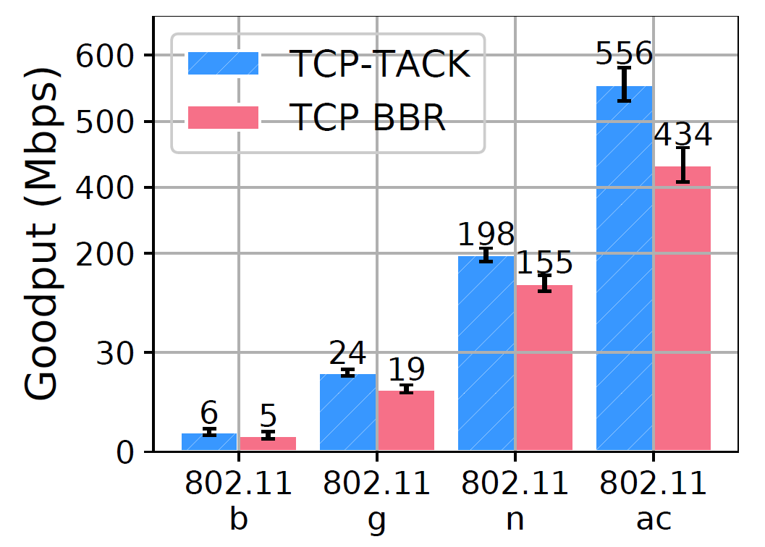
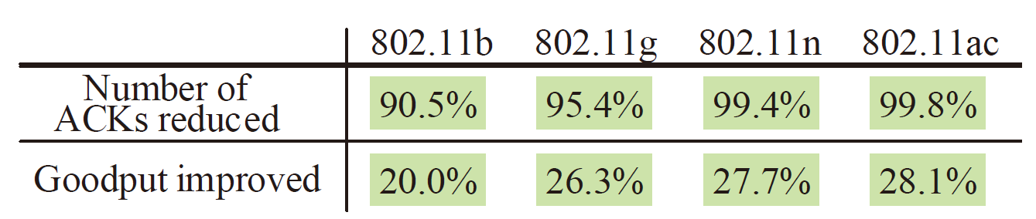
TACK-based protocol in WLAN
Percentage of goodput improvement of
TCP-TACK over TCP-BBR in WLAN
Notes:
Here is the result.
TCP-TACK achieves significant advantages over legacy TCP in WLAN scenarios
due to less contention between data packets and ACKs.
Specifically, TCP-TACK reduces over 90% of ACKs
and also obtains an improvement of 28% on goodput.

Slide 32
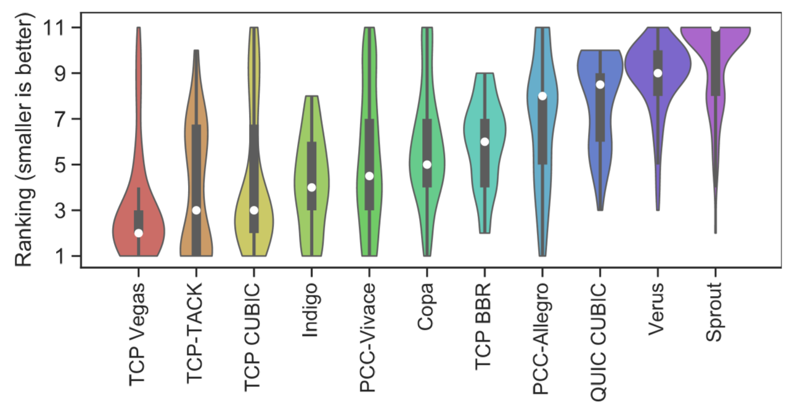
TACK-based protocol in WAN
Violin-plots of performance ranking
(Results are from data traces during 200 days: https://pantheon.stanford.edu/summary)
Notes:
We further find TCP-TACK performs equally well as high-speed TCP variants
in wide area network scenarios,
this is attributed to the advancements of the TACK-based protocol design
in loss recovery, round-trip timing, and send rate control.
This reveals that an approximately minimized ACK frequency works better than expected.

Slide 33
Takeaways
TCP’s delayed ACK is far from being optimal
TACK adopts a “min” instead of a “max” to assure the minimized ACK frequency in the context of network dynamics
Our way of avoiding “negative effect” is a TACK-based acknowledgement mechanism
With more types of ACKs and more necessary information carried in ACKs, less number of ACKs are required
An approximately minimized ACK frequency works better than expected
TACK-based protocol provides a good replacement of legacy TCP in WLAN, and also works well in WAN scenarios.
TACK and its corresponding improvements in transport mechanism can also be adopted into other stacks (e.g., QUIC) to compensate for scenarios where the acknowledgement overhead is non-negligible
tcpm wg: https://tools.ietf.org/html/draft-li-tcpm-advancing-ack-for-wireless-00
quic wg: https://tools.ietf.org/html/draft-li-quic-optimizing-ack-in-wlan-00
Notes:
I would like to conclude today’s talk by summarizing the takeaways.
First, TCP’s delayed ACK is far from being optimal.
Instead,
TACK adopts a “min” function to assure the minimized ACK frequency
in the context of network dynamics.
Second,
our way of avoiding TACK’s “negative effect” is a TACK-based acknowledgement mechanism,
in which we define more types of ACKs
and carry more necessary information in ACKs,
and then we are able to send less number of ACKs.
Third,
an approximately minimized ACK frequency works better than expected.
TACK-based protocol provides a good replacement of legacy TCP in WLAN
and also works well in WAN scenarios.
Moreover,
TACK and its corresponding improvements in transport mechanism
can also be adopted into other stacks such as QUIC
to compensate for scenarios
where the acknowledgement overhead is non-negligible.
This work is also being discussed in IETF working groups,
please get in touch
and we will be happy to discuss with you.

Slide 34
Thank You! Email: li.tong@huawei.com Q & A
Notes:
Thank you for your watching!

