Slide 1
Review about covidtoday website

Slide 2
Contents
01
Reasons
02
An overview about website
03
Some website’s feature
04
What can you get ?

Slide 3
The Black Order Team
Stay Hungry, Stay Foolish

Slide 4
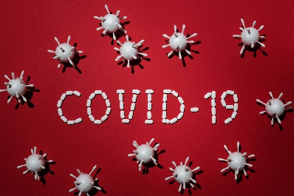
Reason
Faced to
A way that people can update the info about this pandemic
Lack of info

Slide 5
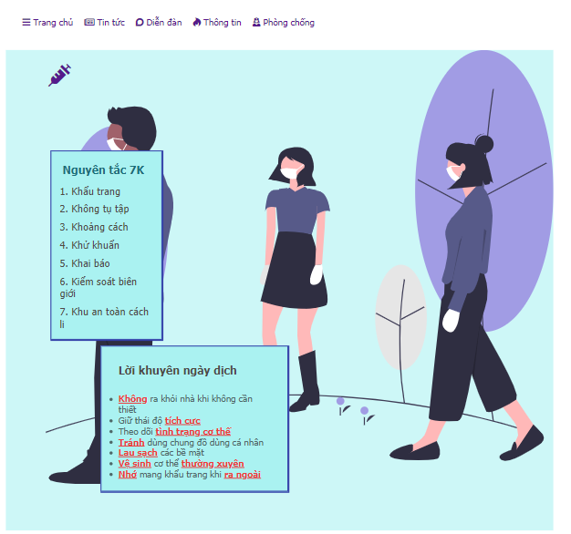
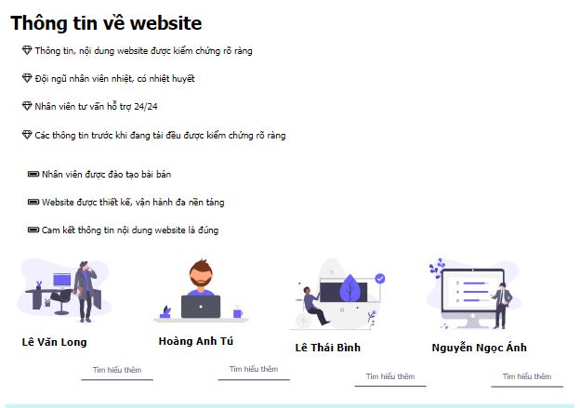
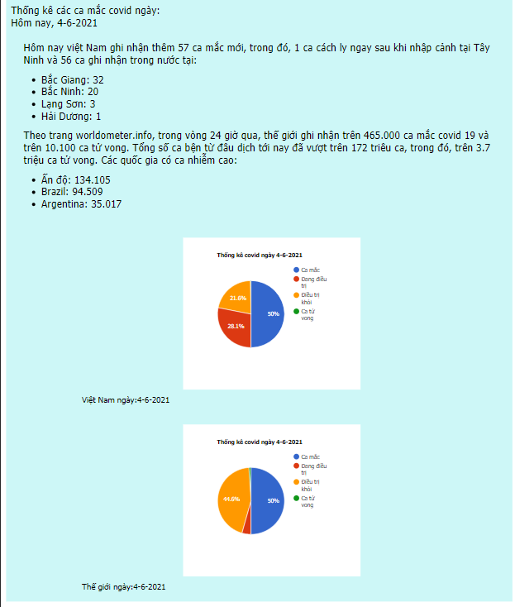
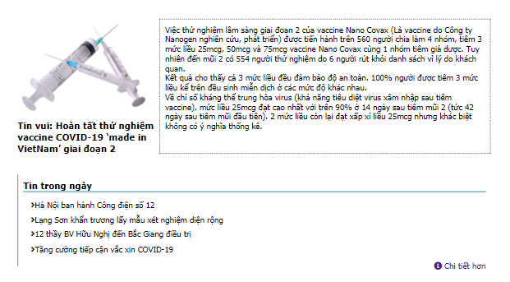
An overview about website
Website Layout

Slide 6
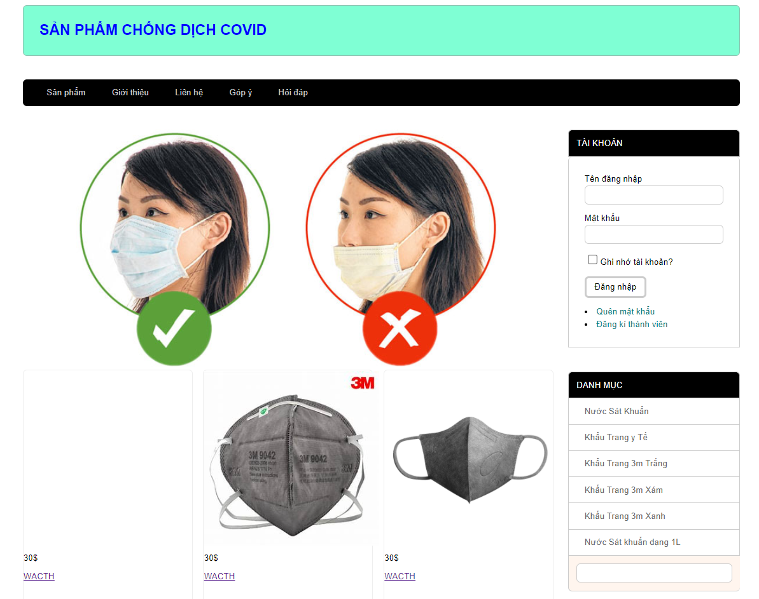
An overview about website
Some necessary thing

Slide 7
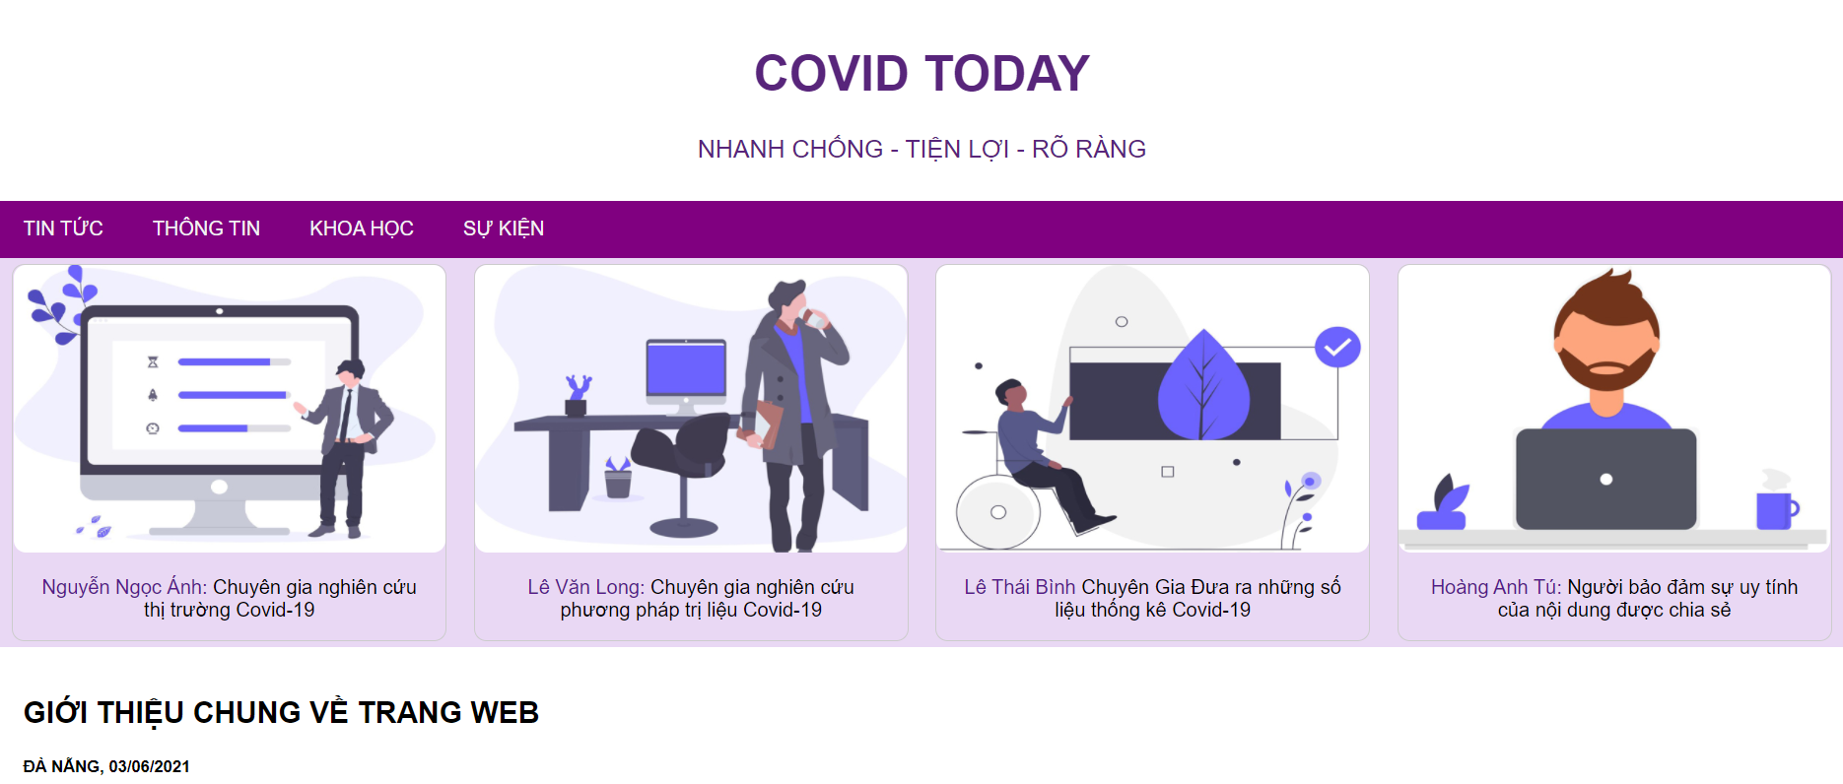
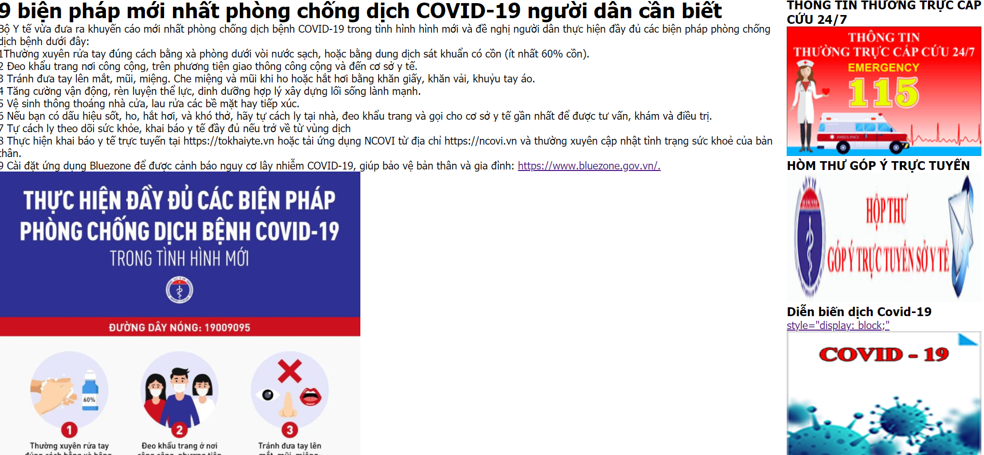
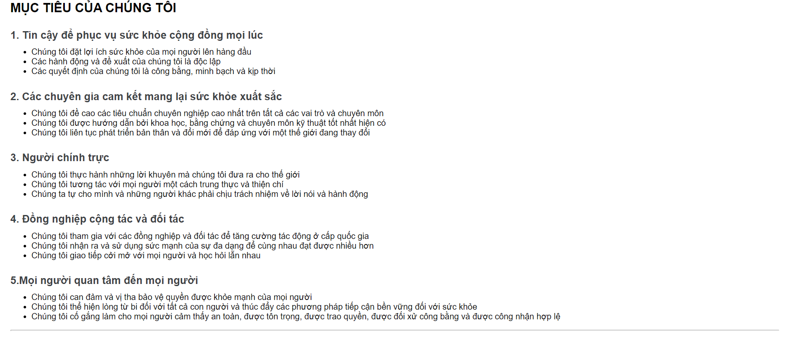
An overview about website
Some general infomation
Solution prevent your self

Slide 8
Nội Dung

Slide 9
Nội Dung

Slide 10
Thank you
For watching our presentation!

