Slide 1
COVID TODAY
- WEBSITE -

Slide 2
Contents
01
Nguyen Ngoc Anh
INTRODUCE & THE REASON WHY WE CREATE THIS WEBSITE
02
Le Van Long
AN OVERVIEW ABOUT WEBSITE
03
Le Thai Binh
OUR WEBSITE GOAL
04
Hoang Anh Tu
WHAT CAN YOU GET FROM THIS WEBSITE?

Slide 3
The Black Order Team
Stay Hungry, Stay Foolish

Slide 4

1. THE REASON WHY WE CREATE THIS WEBSITE
Faced to
A way that people
can update the info about this pandemic
Lack of info

Slide 5




Some technology used in website

Slide 6
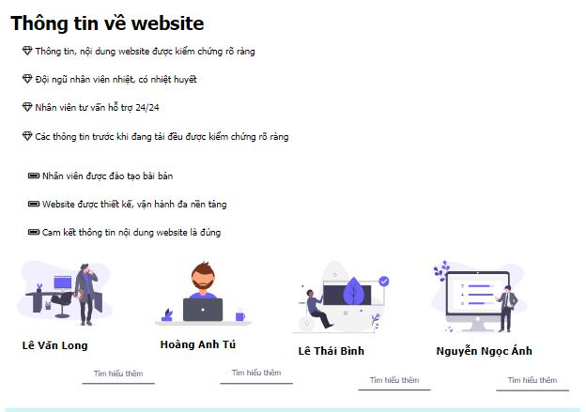
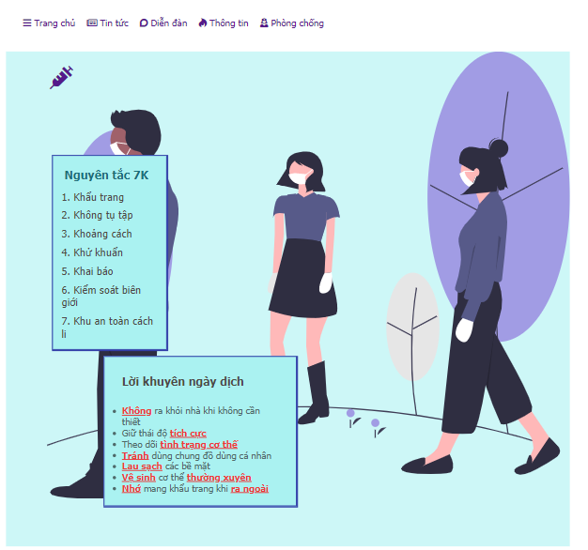
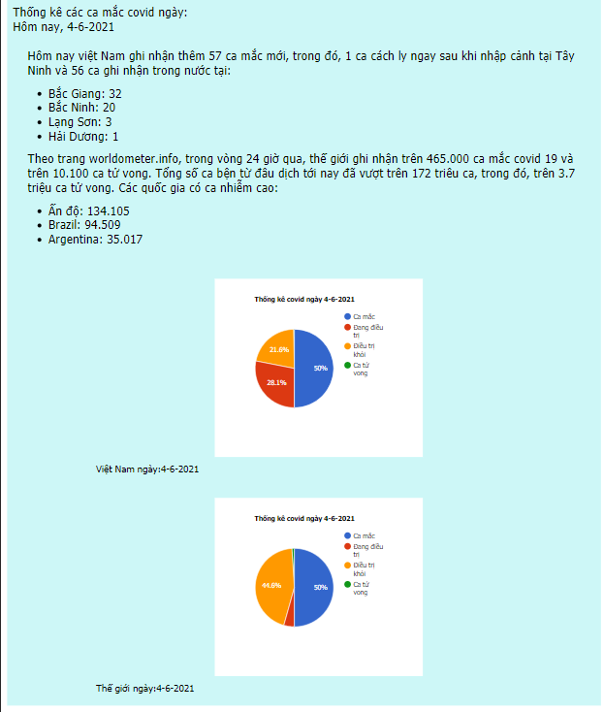
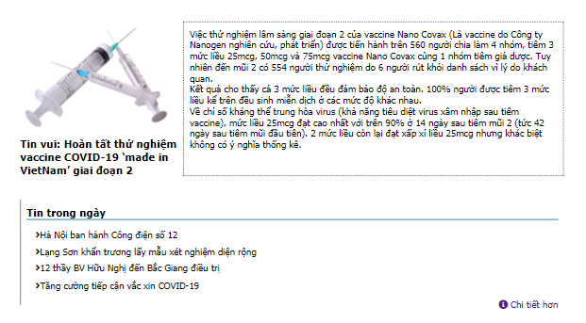
2. AN OVERVIEW ABOUT WEBSITE
Website Layout

Slide 7
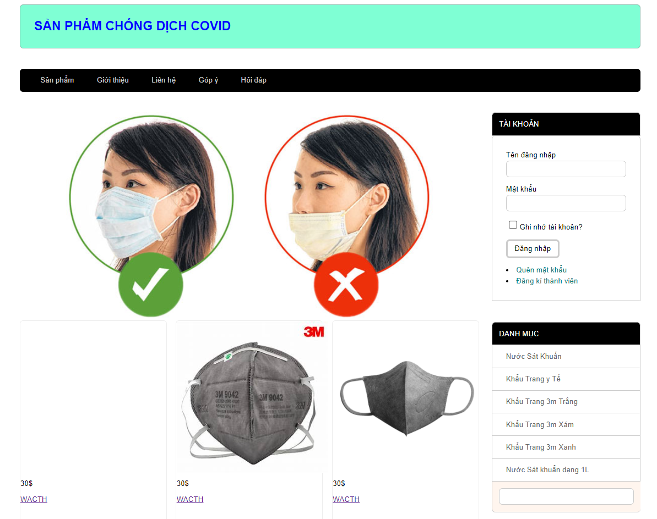
2. AN OVERVIEW ABOUT WEBSITE
Some necessary thing

Slide 8
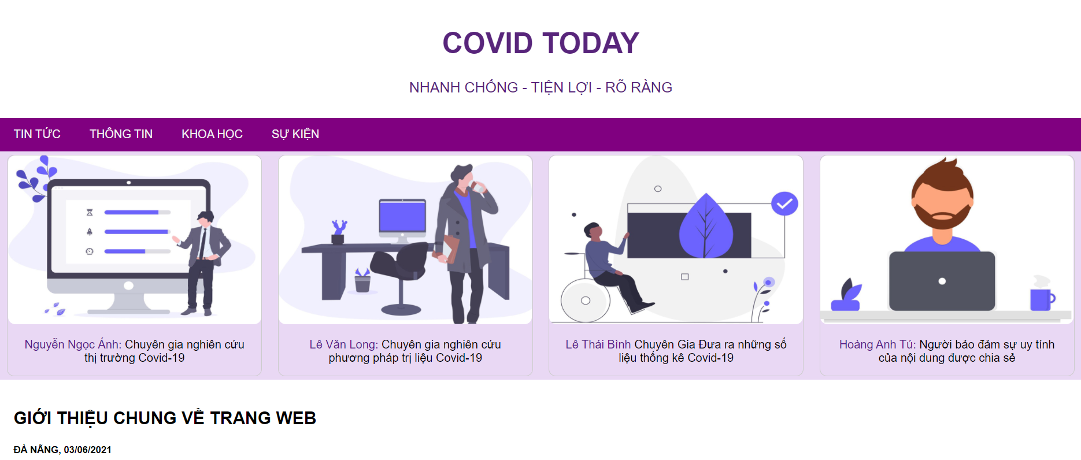
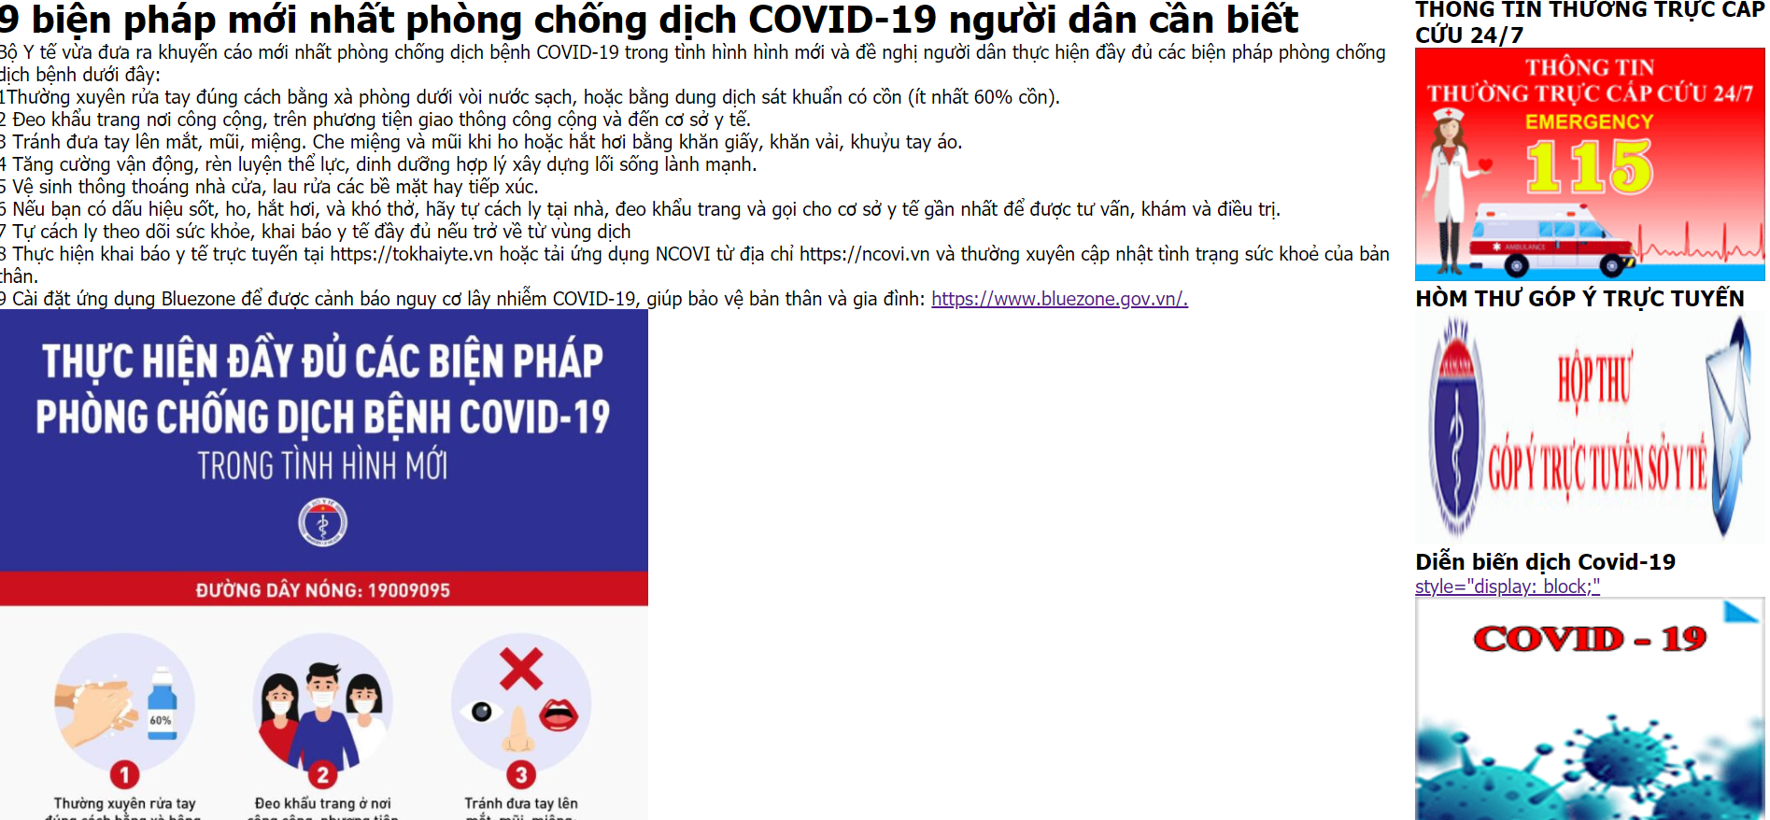
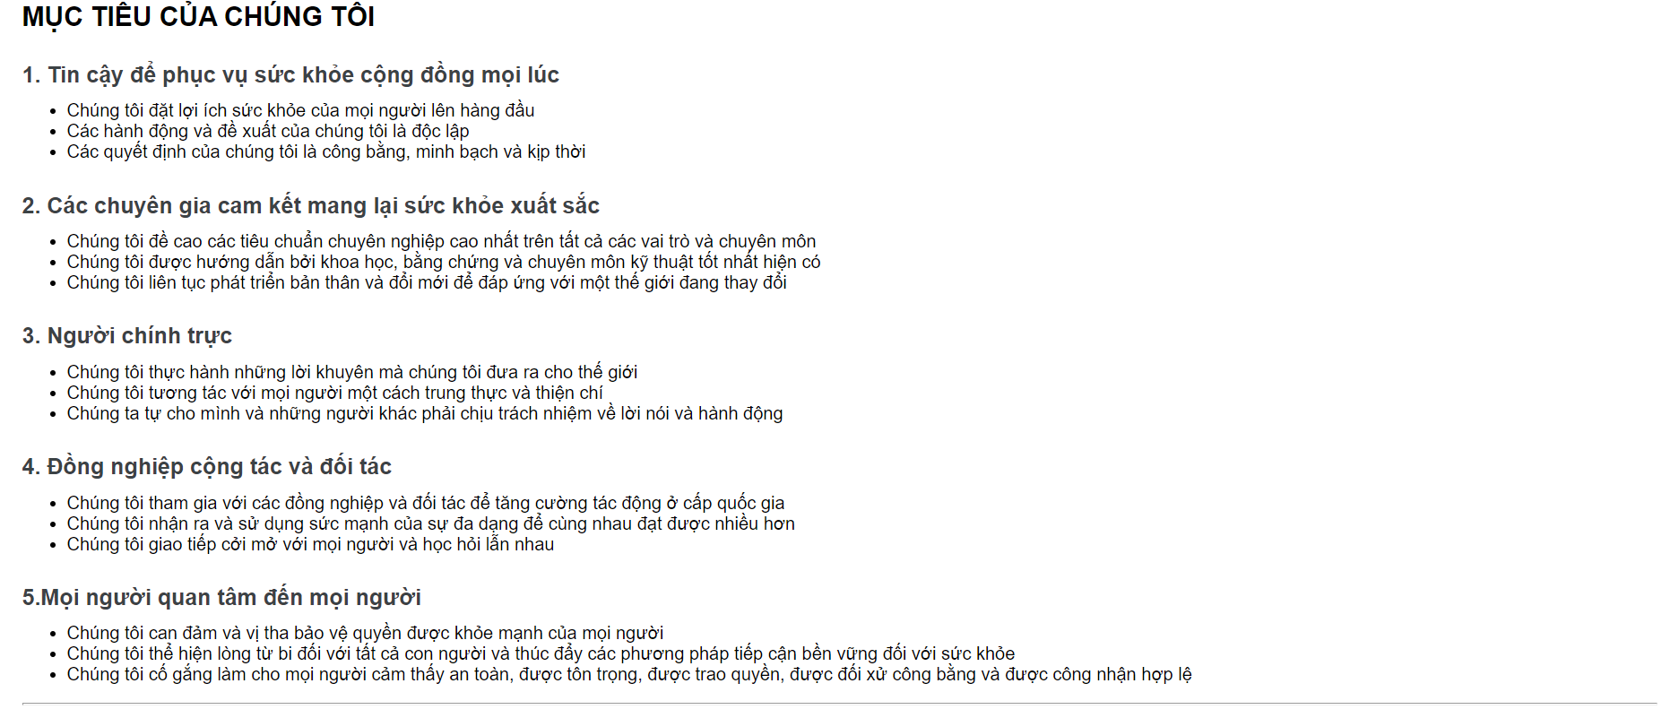
2. AN OVERVIEW ABOUT WEBSITE
Some general infomation
Solution prevent your self

Slide 9





3. OUR WEBSITE GOAL
1.Trusted to serve public
health at all times
3. Persons of integrity
5. People caring about
people
2. Professionals committed
to excellence in health
4. Collaborative colleagues
and partners

Slide 10

4. WHAT CAN YOU GET FROM THIS WEBSITE?
1. Know more about the information of covid-19

Slide 11
4. WHAT CAN YOU GET FROM THIS WEBSITE?
2. Know what method to prevent the corona viruts

Slide 12
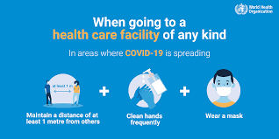
4. WHAT CAN YOU GET FROM THIS WEBSITE?
3. Learn about how to live a life better to protect ourself

Slide 13
Thank you
For watching our presentation!

