Slide 1

Object oriented programming in python
Day 6

Slide 2
Outline
Classes, Objects and Methods

Slide 3
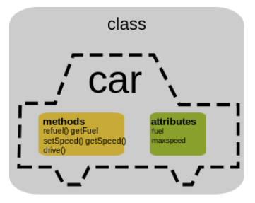
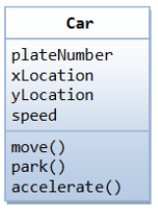
Classes, Objects and Methods
In object-oriented programming, a class is a blueprint for creating objects (a particular data structure), providing initial values for state (member variables or attributes), and implementations of behavior (member functions or methods). we can define a class in Python as being a blueprint for individual objects with same or exact behavior.
Attributes (or) member variables
Member functions (or) Methods

Slide 4
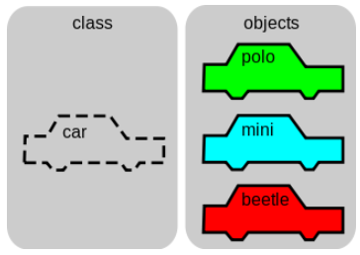
Classes, Objects and Methods
User Defined Objects are created using class keyword. The diagram shows how a car object can be template for many other car instances. An object in Python is one instance of a class and it can be programmed to perform the functions that have been defined in the class.
An instance is a specific object created from a particular class. So, now in the image there are three instances polo, mini, beetle
Go to python program – creating classes and objects to understand more

