Slide 1
類神經網路 期末報告
湯京祐 M10515069
高凱昱 M10515091
易洋 M10515801

Slide 2
概要
方法 (feature extraction & selection, data normalization, data filtering, model selection)
工具及平台
現在遇到的問題
精進的部分

Slide 3
feature extraction
“time_window”
eg.[00:00:00,00:20:00)
“hour”
eg. “0”
weather features (table 7)
binding
“starting_time”
eg. [2016/10/18 00:02 ]
(table 5) /
“time” (table 6)
extracting
“date”
eg. “2016/10/18 ”
“weekday”
eg. “2”
“holiday”
eg. “FALSE”

Slide 4
feature selection
task1
inter_id, toll_id, (date & time features), weather features (from table7)
task2
toll_id, direction, (date & time features), weather features (from table7)

Slide 5
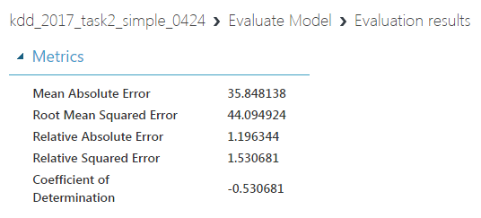
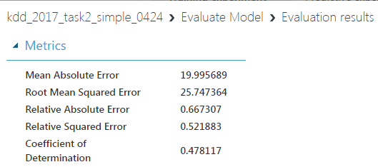
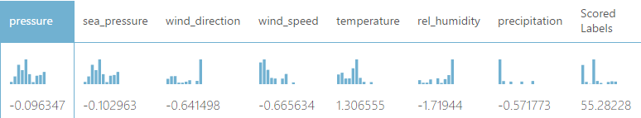
data normalization
normalization includes time features
without time features…

Slide 6
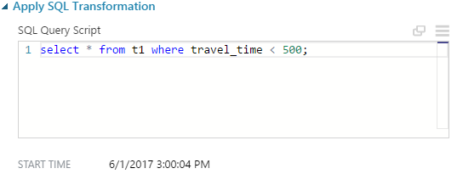
data filtering
e.g.
select ‘travel_time’ < 500

Slide 7
model selection
Bayesian Linear Regression (Azure ML)
Boosted Decision Tree Regression (Azure ML)

Slide 8
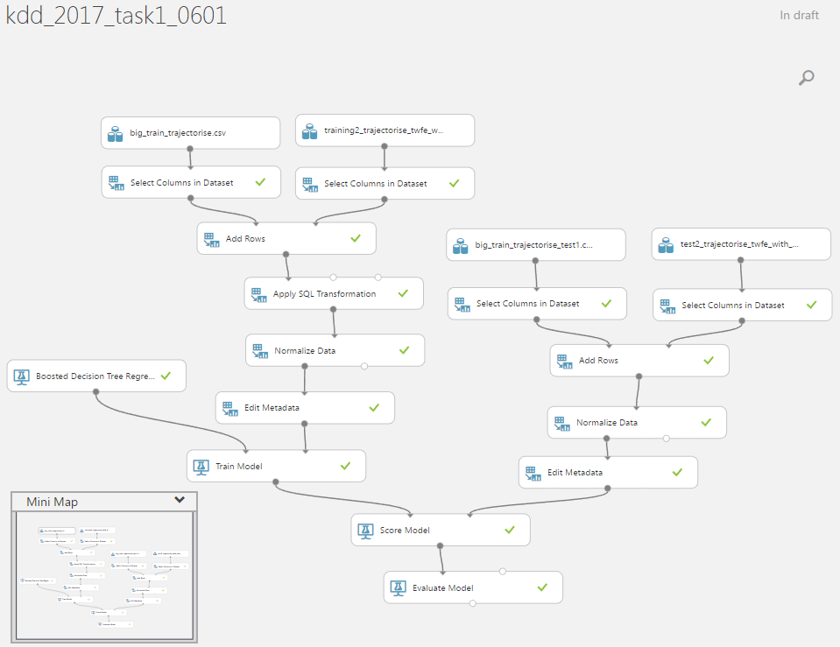
工具及平台
pandas & Azure ML

Slide 9
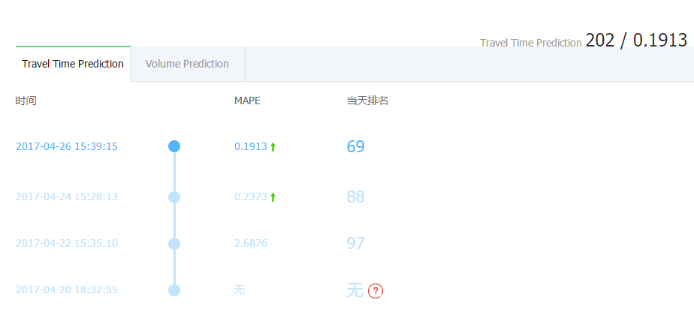
Scoring (task1, midterm)

Slide 10
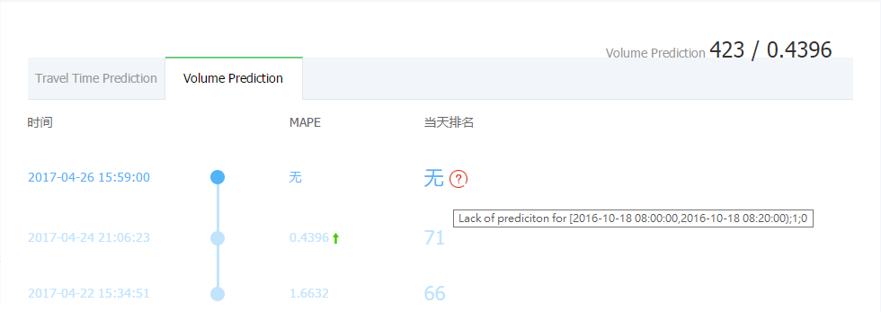

Scoring (task2, midterm)

Slide 11
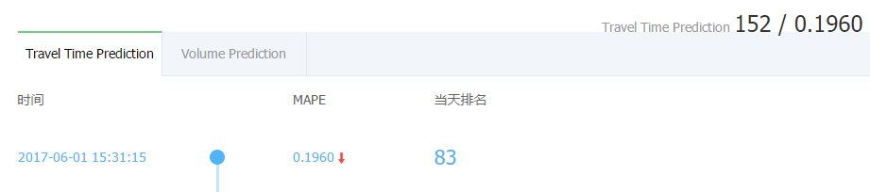
Scoring (task1, final)

Slide 12
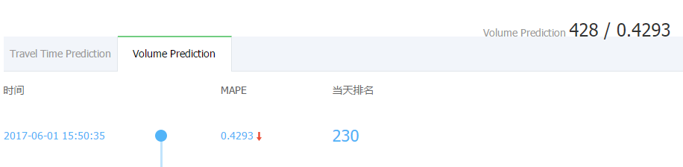
Scoring (task2, final)

Slide 13
thanks for watching!

