Slide 1

Somatic variant calling
&
Annotation
Massimo Maiolo
Institute of Tissue Medicine and Pathology – University of Bern | 8.10.2026

Slide 2
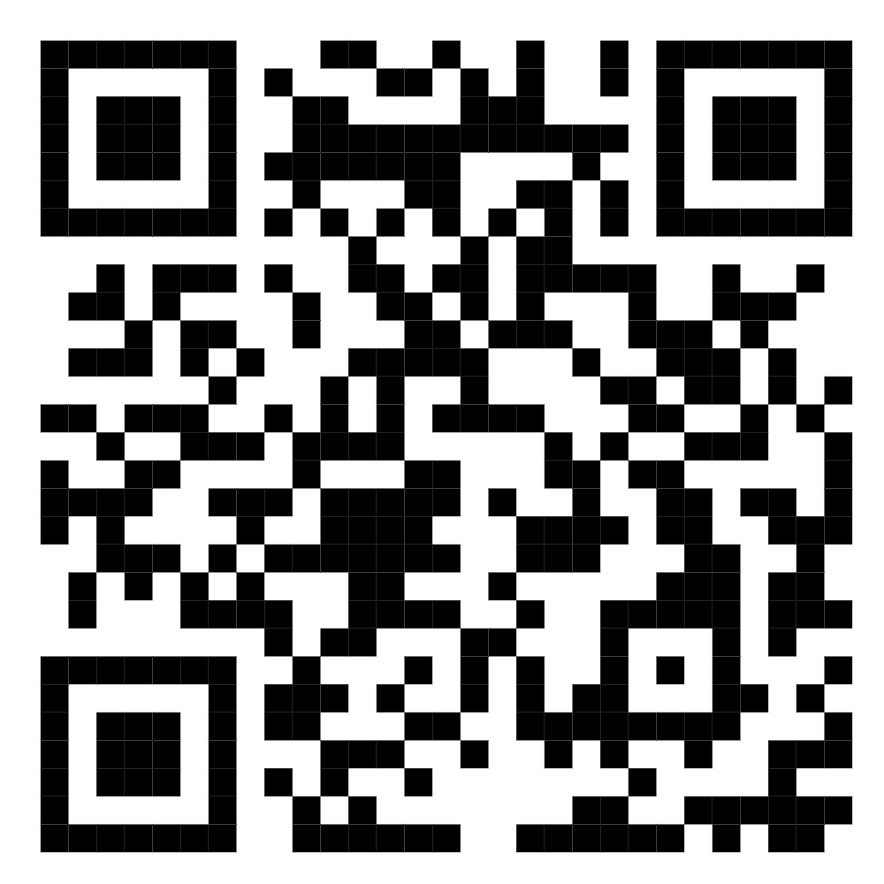
Github Cancer Genomics Course
https://github.com/supermax1234/CancerGenomicsCourse
Notes:
Intro
Pdf git
Exercises git
(VEP)
SIF

Slide 3
Lesson plan
17.09.2026 | Panos - Sofia | Introduction/Logistics + Introduction to cancer biology
24.09.2026 | Philip | Introduction to software for mutation calling, gene signatures
01.10.2026 | Sofia | Cancer Biology
08.10.2026 | Max | Somatic variant calling
15.10.2026 | Max | Somatic variant calling + variant annoation
22.10.2026 | Philip | Variant prioritization - Driver mutations
29.10.2026 | Philip | Mutational Signatures
05.11.2026 | Andrew | Mid-term exam
12.11.2026 | Panos - Andrew | Introduction to software for structural analysis
19.11.2026 | Panos - Andrew | CNV calling
26.11.2026 | Panos - Andrew | Structural variants
03.12.2026 | Panos - Andrew | Tumor clonality
10.12.2026 | Panos - Andrew | Data interpretation + summary
17.12.2026 | All | Summary - Q&As
13.01.2027 | Panos - Andrew | Final Exam

Slide 4
Course Assignment: Group Organization
Teamwork & Structure
Organize yourselves into groups of 3 students (10 groups total)
Work Together:
  Team members share the exact same grade for this assignment, so collaborate closely,
  review each other's scripts, and
  run through the pipeline as a team
Please provide the names of the group members asap

Slide 5
Course Assignment: Submission Guidelines
Submission Details
Format: Submit (email: massimo.maiolo@unibe.ch) a single compressed .zip folder containing:
  all your developed SLURM scripts, following the sequential numbering convention (e.g., 01_, 02_, etc.) covered in class
  A README.md text file containing the full names and surnames of the 3 group members. Any notes, comments, or explanations in the README if a specific step failed, threw warnings, or required alternative handling
Deadline: submit your group's work by October 25

Slide 6
Important Reminder: SLURM Script Requirements
SLURM scripts vs. Local bash
Every script you submit must be a fully functional, runnable SLURM batch script, not a local bash script
Each script must start with the required #SBATCH header (partition, memory, time, job name, and reservation) as shown in the course template
Never run heavy compute tasks directly on the master/login node; always submit your scripts via sbatch

