Slide 1
Instakart!
M Du

Slide 2
Feature Engineering (User – Products)
Frequency of Product Ordered by User | Median Cart Order by User | Mean Hour of day Ordered by User | Mean Days Since Last Order | reorder_history
4 | 5 | 14 | 3.5 | (0,1,1,0)
8 | 1 | 11 | 5 | (0,1,1,1,1,1,0,1)
2 | 2 | 10 | 31 | (0,1)

Slide 3
Feature Engineering
reorder_history
(0,1,1,1,1,1,0,1)
‘max_consec_reorders’
5
last_reorder
0

Slide 4
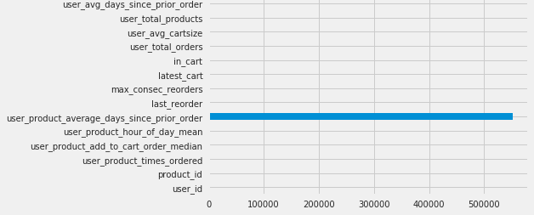
NAN Values
Notes:
‘user_product_average_days_since_prior_order’
5% NaN but NaN itself told a story, so couldn’t just remove. Hence Binning

Slide 5
NAN Values

Slide 6
Feature Engineering (User specific)
Total Orders
Average Cartsize
Total Unique Products Ordered
Average Days Between Orders

Slide 7
Feature Engineering (Aisle and Department)
Departments: 'alcohol', 'babies', 'bakery', 'beverages’, …
Aisles: 'air fresheners candles', 'asian foods', 'baby accessories’, …
Indicator Variable

Slide 8
Downsizing (Subsetting)
Original File: 32,434,489 rows
Grouped Dataframe: 8,474,661 rows
Extracted ~5% of data: 423772 rows
Downcasting
2.3gb
1gb
int64
int32
int16

Slide 9
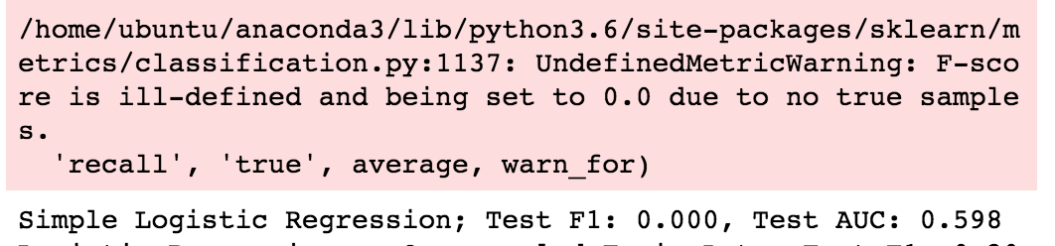
Feature Testing (Baseline)
70/30 train/test split
Logistic Regression with single feature: ‘user_total_orders’
All zeroes!

Slide 10
Label imbalance
F1 Score After Resampling: 0.201

Slide 11
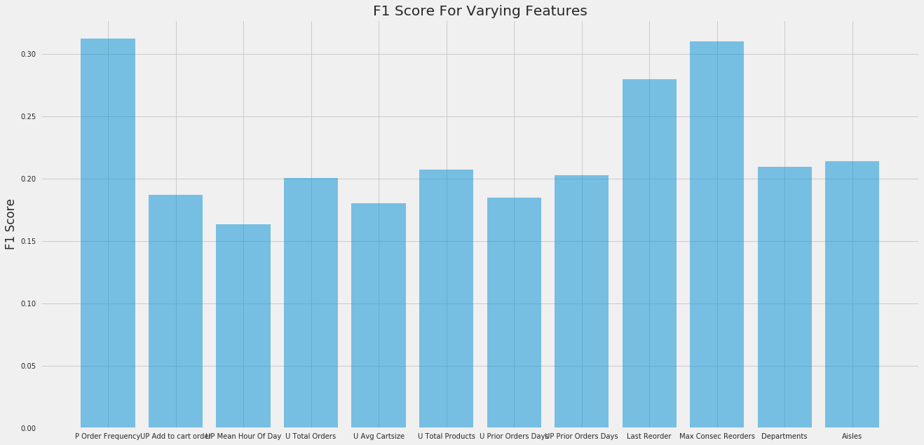
Test all features (individually)

Slide 12
Test all features (individually)
P Order Frequency | Max Consec Reorders | Last Reorder | Aisles
0.3119 | 0.3101 | 0.2798 | 0.2136

Slide 13
Logistic Regression with all features
Feature | Coefficient
Max Consecutive Reorders | 0.413161
Average Cart Size | 0.31279
Last Reorder | 0.248632
Product Order Frequency | 0.215626
Fresh Fruit Aisle | 0.081017
Produce Department | 0.072444
Water Seltzer Aisle | 0.061491
20-25 days since last order | 0.05745
Milk Aisle | 0.051247
15-20 days since last orer | 0.050933
F1 Score: 0.32624

Slide 14
Random Forest
F1 Score: 0.37117
XGBoost
F1 Score: 0.3396

Slide 15
XGBoost

Slide 16
XGBoost Gain scores
user_product_times_ordered | 68.5191
first aid | 30.4805
pantry | 30.4676
user_total_orders | 22.1683
max_consec_reorders | 19.4366

Slide 17
Compare and conquer
 | Logistic Regression | RandomForest | XGBoost
F1 | 0.3262 | 0.3734 | 0.3440
Recall | 0.2142 | 0.3145 | 0.2769

Slide 18
Conquer what?
$95 Million Revenue/Month
500000 Customers
2 Monthly Orders
$95/order
~10% reorders
31% Recall
Targetable: $3 Million

Slide 19
Conquer what?
Increase Frequency
- Infer other reorder products based on correlations with similar buyer profiles
Increase Consistency
- Providing subscription models (with free shipping)
- Email Reminders

