Slide 1

Introduction to the Pyramid Web Framework
Mark Huang (黄峥峼)
Twitter: zhenghao1
Weibo: zhenghao12
QQ: 1914406429
Tumblr: www.tumblr.com/zhenghao1
Blog: http://www.codestumps.com

Slide 2
About me
2008年从新加坡南洋理工大学毕业；本科：电脑工程。
第一份工在Lucasfilm Entertainment -- Industrial Light and Magic
2011年12月来到杭州工作。在一间小德国企业工作 -- ERP
热爱Python，也很喜欢Javascript
Love snooker
Most of all, love my wife!
Notes:
Learnt JAVA in school.
Never touched web development in my life but always curious...
Picked up python in Lucasfilm Entertainment studios. Zope, Plone and then Pylons.
Trapper Keeper.
Learnt it for the past 4 years

Slide 3
Introduction
Pyramid is a general, open-source, Python web application development framework. Its primary goal is to make it easier for a Python devleloper to create web applications.
- Chris McDonough

Slide 4
...continued
Simplicity (简单)
  “pay only for what you eat”
  It doesn’t force you to use any particular technology to produce an application
  Core set of concepts that are required to understand Pyramid is minimal
Notes:
你只需要懂一点Pyramid就能看到成果。
不逼你学某套技术

Slide 5
Minimalism
  Only solve the fundamental problems of creating a web application:
    Routing URLS
    Templating
    Security
    Serving static content
Notes:
极简主义

Slide 6
Documentation
  Because of its minimalism, it is easier to maintain complete and updated documentation
  Everything in Pyramid is documented
Notes:
保持完整的和最新的文档

Slide 7
Speed
  Templating and response generation is designed for
speed
Reliability(可靠性)
  If it’s not tested, it’s broken!
Notes:
TDD

Slide 8
Single File Applications
一整个Web App只需一个文件就能执行
有利于一次性的原型，bug reproduction，和非常小的应用程序。
Notes:
单文件程序
Good for prototyping
Pyramid is not marketed as a microframework but it allows you to do almost everything that framewords that are marketed as micro offer in very similar ways.
Sinatra, Bottle

Slide 9
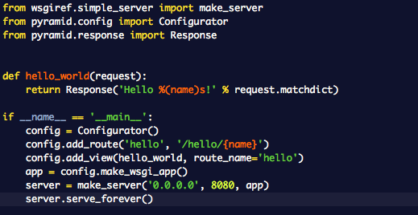
Controller (view)
Routes
Notes:
View OR View Callable

Slide 10
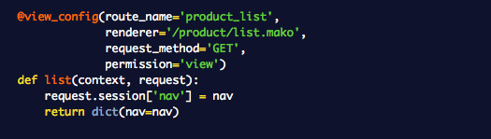
Decorator-based configuration
Notes:
装饰器 -- Decorator

Slide 11
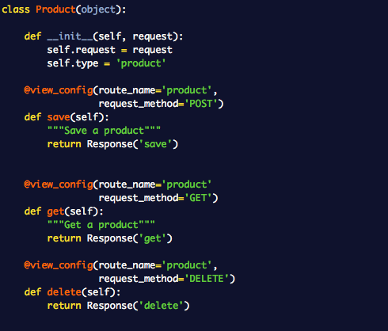
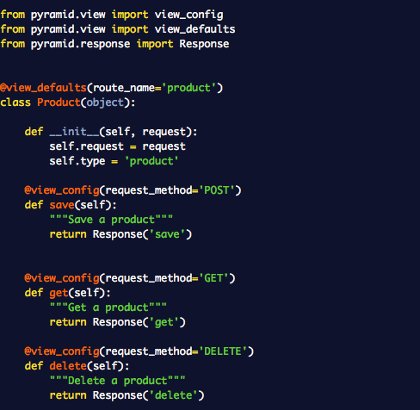
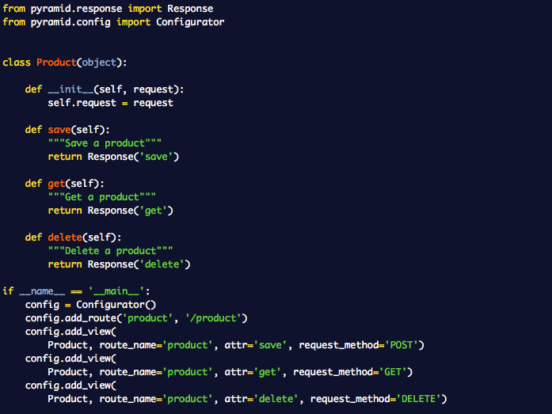
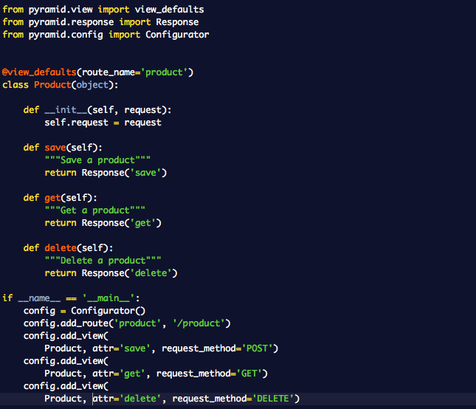
...continued
Notes:
class view-callables

Slide 12


Serving static content
Either use a directory in your project or an external file server (url)
Example usage with static_url()

Slide 13
URL Dispatch
Basic routing; similar to other frameworks like RoR or Play Framework
Order matters!
Pyramid matches the PATH_INFO present in the WSGI environment during a request

Slide 14
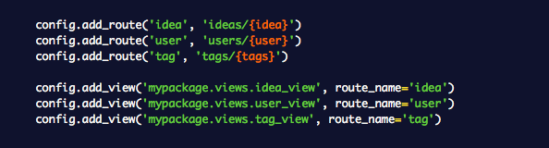
This matches:
  /ideas/123
  /users/fred
  /tags/python
1st example:
print request.matchdict.get(‘idea’)
>>> u‘123’

Slide 15


Output: http://www.example.com/1/2/3
Used for HTTP 302 Redirection

Slide 16
Advanced Pyramid
Events & Subscribers
Scripts (like Django Commands)
Traversal
Notes:
高级Pyramid的功能

Slide 17
Events
Pyramid内核运行的时候抛出的事件
ApplicationCreated
NewRequest
ContextFound
NewResponse
BeforeRender
Notes:
事件机制

Slide 18
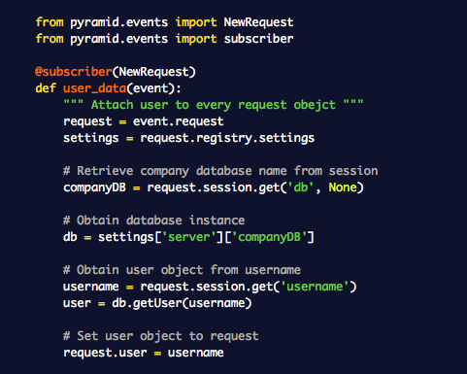
Notes:
Add user object on every request.

Slide 19
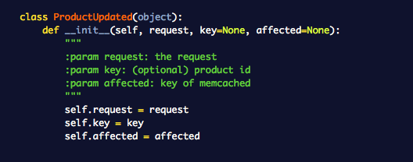
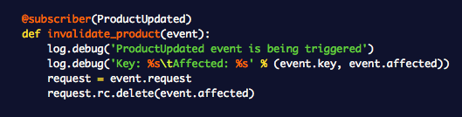
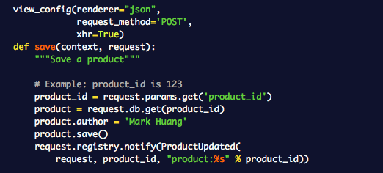
Custom events

Slide 20
Console scripts
Gets installed in bin directory of virtualenv
Used for running scripts that act on your web application
Examples:
  re-index Elastic Search
  delete a certain type of document in NoSQL
  add dummy data to database

Slide 21

...continued
Write your python command line script as usual using argparse/optparse
To use the Pyramid request object:
Add one line in setup.py under console_scripts

Slide 22
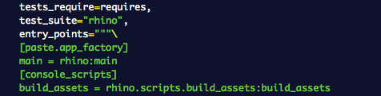
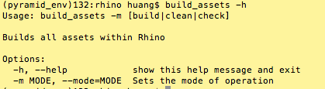
build_assets script
Run python setup.py develop

Slide 23
Traversal
无需配置Route
能够分配很细致的权限给不同的对象
  ACL & ACE
非常灵活
对身体有害...
Notes:
学的过程中，许多次想用头向墙壁撞

Slide 24

Request进来的时候
Pyramid会把当前的request当成一个WSGI Request
Pyramid建一个request的对象
通过这个request，Pyramid会去找合适的函数（view callable）

Slide 25
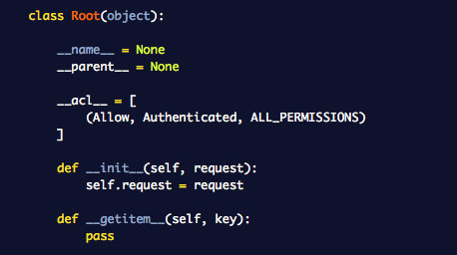

Slide 26

Example
http://example.com/foo/bar/baz/biz/buz.txt
PATH_INFO是/foo/bar/baz/biz/buz.txt
先去root(/)找foo
然后找bar
接下来找baz;资源树没有这个key, KeyError Exception
KeyError之前找到的资源就变成目前的context
View Callable就变成baz

Slide 27
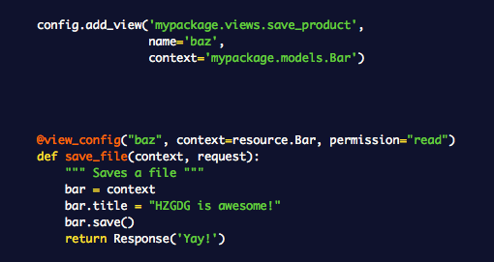
Subpath是(biz, buz.txt)
一当KeyError, Traversal就停止执行了。接着找view callable

Slide 28
Recommended Packages
Webassets
Gunicorn
Colander
Celery
Notes:
推荐的一些包

Slide 29
Pyramid资源
Pyramid Documentation
  http://docs.pylonsproject.org/projects/pyramid/en/latest/
pylons-discuss Google Groups
  https://groups.google.com/forum/?fromgroups#!forum/pylons-discuss
Stack Overflow
  http://www.stackoverflow.com

