Slide 1
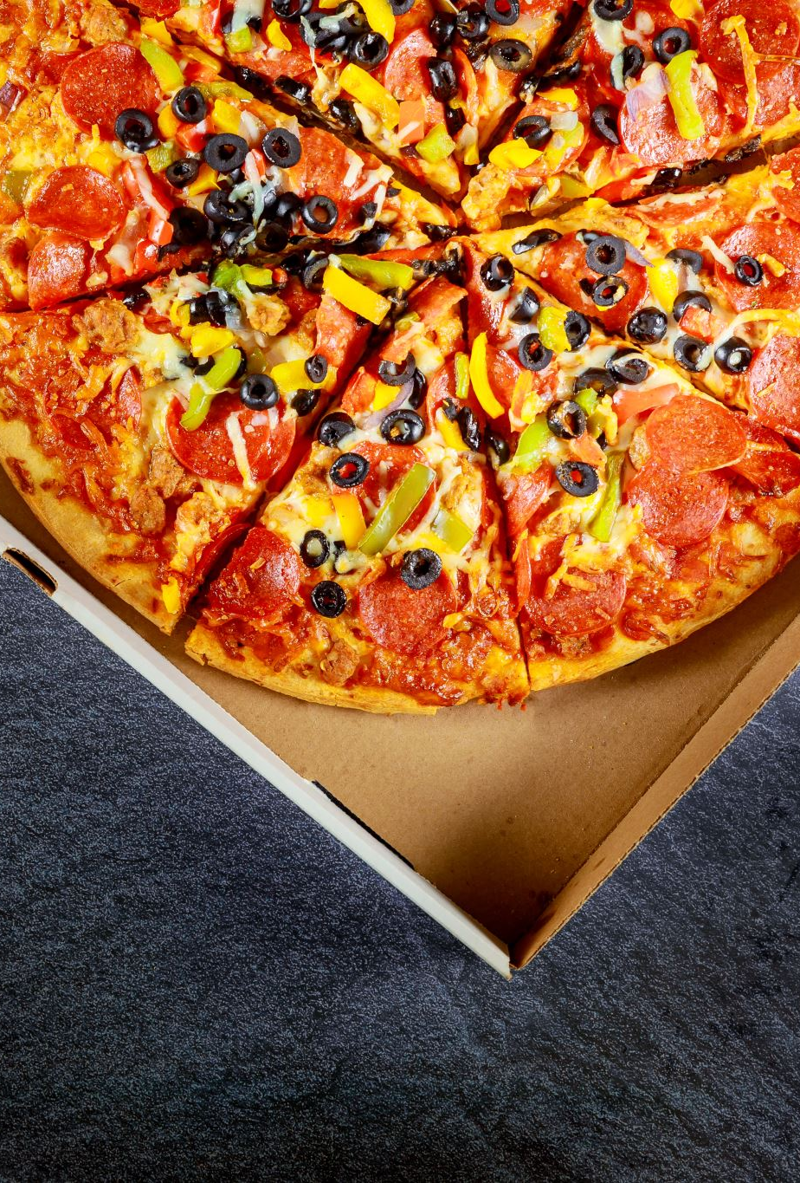
Random Acts of Pizza
Conner Brew
Maddie DiLullo Byrne
Joy Jiang
Peter Morgan
Notes:
MAddie

Slide 2

About Our Competition
Based on the subreddit “Random Acts of Pizza” where users submit request for a little bit of kindness in the form of pizza.
Our task was to assess pizza requests and see if they are likely to receive pizza from the reddit community
Notes:
Maddie

Slide 3
Conditions of the Data
Data Fields
Some fields were present in the training data but were not present in the test and live data, so we had to remove those from our models
We also needed to further split the training data into development sets so then we could assess the models performance fairly to avoid overfitting.
Dispersion of Data
Within the data, the average rate for successful pizza receipt was about 25% but the training/testing sets didn’t necessarily follow this exact ratio of successful/failed requests
Notes:
Maddie

Slide 4


The Various Baseline Models Evaluated
Random Forest Classifier
Basic Sentiment Analysis
Word Count Vectorization
Naïve Bayes Feature Engineering
Timestamp Analysis
Scaling & Transformation
Models that Improved Accuracy
Models that had no or negative impact
Notes:
Joy

Slide 5
Random Forest Classification
Random Forest was our first and primary model with an initial accuracy of 73-74%
From our initial baseline model, we saw that there was a significant feature importance in the timestamp of the request
A few other features we saw as potentially important were the net votes on the post (difference of upvotes & downvotes) and the account age when requested
Notes:
Joy

Slide 6
Assessing the timestamp feature
After seeing the feature importance from the random forest model, we decided to try and assess the performance on the model based on information from the timestamp
After splitting out the date parts from the timestamp, we were able to see that the day of the month & the hour of the day had the highest impact on the accuracy
Notes:
Joy

Slide 7

Basic Sentiment Analysis
For the sentiment analysis, we assessed the overall sentiment of the words used within the title and text of the post. With the sentiment analysis alone, it brought our accuracy to about 76-77%
Within the sentiment analysis, it was identified that there was a stronger sentiment correlation with the text of the post than the title of the post
Notes:
Conner

Slide 8
Word Count Vectorization
After cleansing the data for any formatting bias, the word count vectorization brought our accuracy to about 75%
After the initial analysis, we also transformed the data to enhance the vectorization model and we were able to improve our recall results
Notes:
Conner

Slide 9

Our models with minimal success
Scaling and Transformations
We noticed a negligible impact after applying various normalization, scaler and power transformations, we didn’t see any successful improvement of our data
Naïve bayes feature analysis
We tried to apply weights to the text displayed in the posts, but we didn’t see a tangible improvement of the data by applying these weight
Notes:
Conner

Slide 10
Our submission score
After applying the models which improved our models, within our test environment and data we saw a 77% accuracy within our data.
When we applied submitted our results to the Kaggle competition, our score was 55%
Notes:
Peter

Slide 11

Potential reasons behind our submission score
Our primary obstacle throughout our efforts was the imbalanced results in our training data. Within the training data only 25% of the requests received pizza, whereas the submission test data may have had a better distribution of positive results
Even if we applied balanced scaling for the data set distribution of results, there were too few data points (~2,000) to train the model with equal weight of positive & negative results
Notes:
Peter

Slide 12
More potential ways to improve our score
We could have incorporated more text-focused feature engineering to utilize the text & sentiments displayed in the posts to predict their receipt of pizza
We also could have used more sophisticated sampling methods to balance negative/positive observations
Experimenting with linear, isotonic, and other calibration methods to improve model recall
Notes:
Peter

Slide 13
Thank you
Any questions?

