Slide 1
Background Segmentation
Marko Mlinaric
Philipp Omenitsch

Slide 2


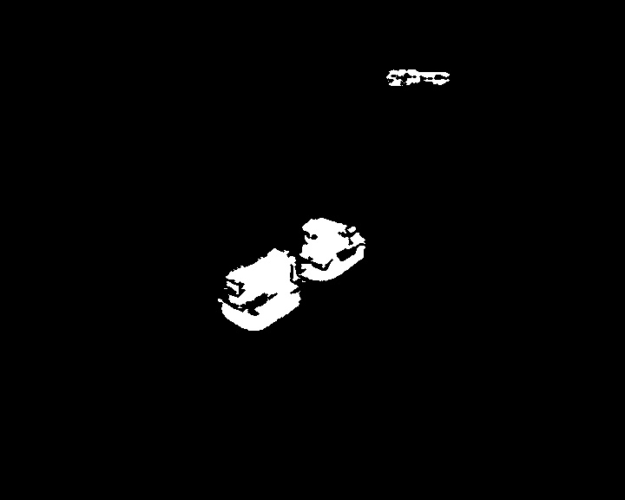
Overview
Our Implementations:
Color Mean and Variance (CMV)
ViBe [1]
Comparison
Original
CMV
ViBe
[1] Barnich, Olivier, and Marc Van Droogenbroeck. "ViBe: A universal background subtraction algorithm for video sequences.” IEEE Transactions on Image Processing, 20.6 (2011): 1709-1724.

Slide 3
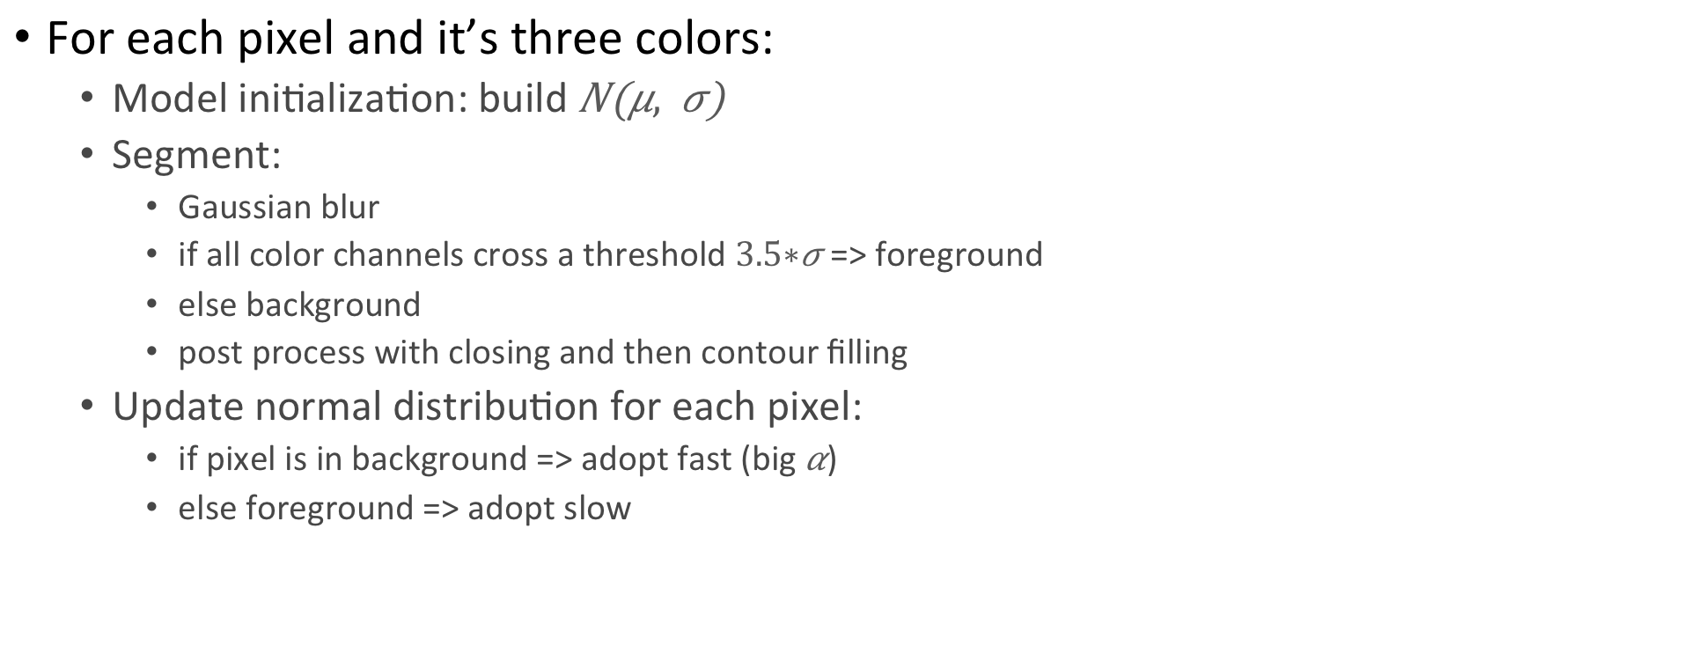
Color Mean and Variance
For each pixel and it’s three colors:
Model initialization: build
Segment:
Gaussian blur
if all color channels cross a threshold => foreground
else background
post process with closing and then contour filling
Update normal distribution for each pixel:
if pixel is in background => adopt fast (big )
else foreground => adopt slow

Slide 4
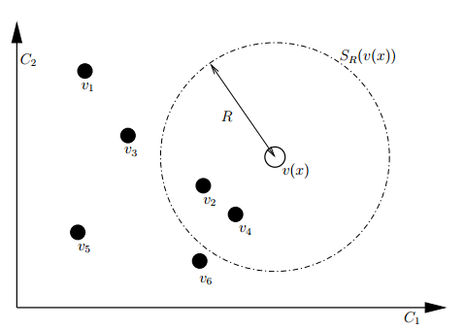
ViBe
Model initialization
Per pixel sample N values (N=20 in our implementation)
Segmentation per pixel
Count samples inside radius R
If more than q, then background (q=3)
Model update (for background pixels)
Random chance to replace random sample for pixel
Also random chance to replace random pixel in neighborhood.
[1] Barnich, Olivier, and Marc Van Droogenbroeck. "ViBe: A universal background subtraction algorithm for video sequences.” IEEE Transactions on Image Processing, 20.6 (2011): 1709-1724.

Slide 5
Comparison
Advantages
CMV in theory works good, practically not all foreground pixels are detected
Disadvantages
CMV smearing if foreground is not properly detected
CMV error propagation
[1] Barnich, Olivier, and Marc Van Droogenbroeck. "ViBe: A universal background subtraction algorithm for video sequences.” IEEE Transactions on Image Processing, 20.6 (2011): 1709-1724.

