Slide 1
Background Segmentation
Marko Mlinaric
Philipp Omenitsch

Slide 2
Overview
Our Implementations:
Color mean and variance
ViBe [1]
Comparison
[1] Barnich, Olivier, and Marc Van Droogenbroeck. "ViBe: A universal background subtraction algorithm for video sequences." Image Processing, IEEE Transactions on 20.6 (2011): 1709-1724.

Slide 3
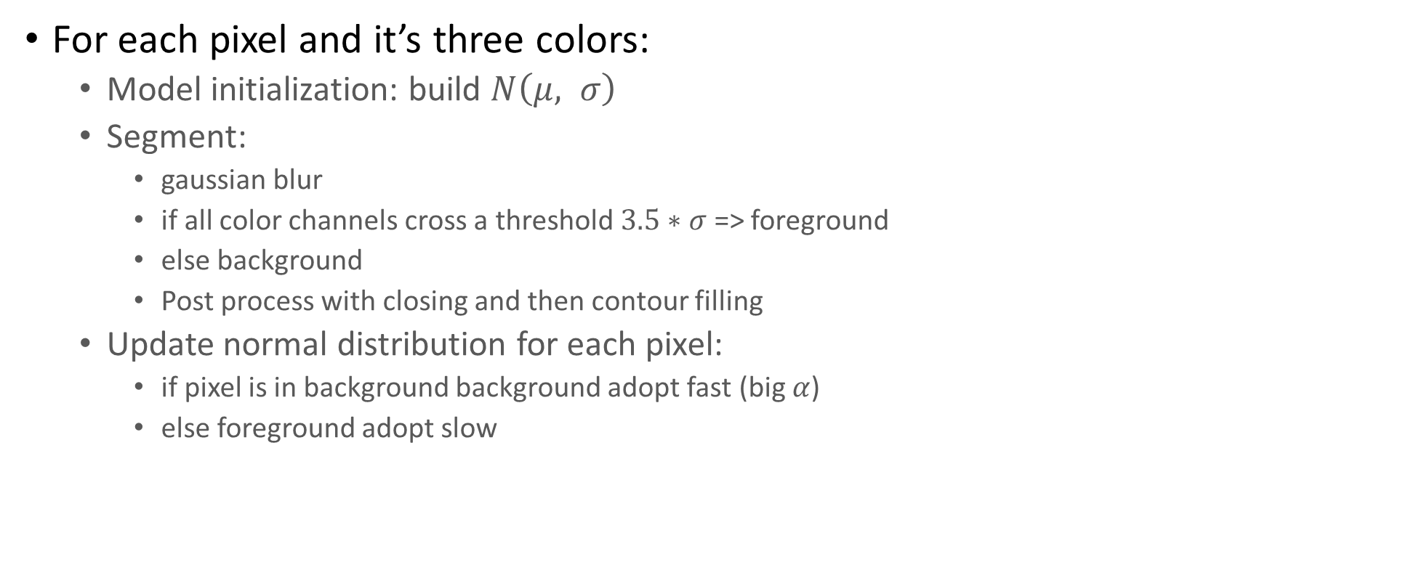
Color mean and variance
For each pixel and it’s three colors:
Model initialization: build $N\left(μ, σ\right)$
Segment:
gaussian blur
if all color channels cross a threshold $3.5∗σ$ => foreground
else background
Post process with closing and then contour filling
Update normal distribution for each pixel:
if pixel is in background background adopt fast (big $α$)
else foreground adopt slow

Slide 4
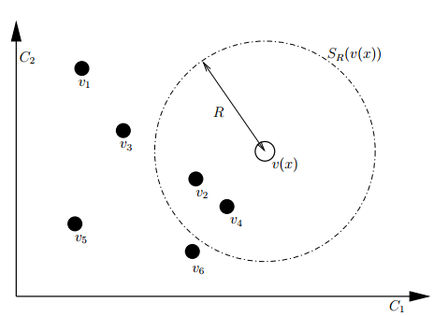
ViBe
Model initialization
Histogram of last n samples (n=20 in our case, n=1 also possible)
Segmentation per pixel
If pixel value lies in histogram => background
Else foreground (Marko ???)
Model update
If background replace one of the sample randomly
Also replace random sample in neighbourhood
Randomly replace some samples of the whole pic
[1] Barnich, Olivier, and Marc Van Droogenbroeck. "ViBe: A universal background subtraction algorithm for video sequences." Image Processing, IEEE Transactions on 20.6 (2011): 1709-1724.

Slide 5
Comparison
Advantages
CMV in theory works good, practically not all foreground pixels are detected
Disadvantages
CMV smearing if foreground is not properly detected
CMV error propagation
[1] Barnich, Olivier, and Marc Van Droogenbroeck. "ViBe: A universal background subtraction algorithm for video sequences." Image Processing, IEEE Transactions on 20.6 (2011): 1709-1724.

Slide 6
Thank you

