Slide 1

Review of PI System Manager "Must Do's"
Featuring PI SMT 3
5 MAY 05
Copyright © 2005 OSIsoft, Inc. All rights reserved.

Slide 2
Agenda
How to back up the PI server
How to monitor and create new archives
What routine PI tasks we suggest you do on a daily, weekly, and monthly basis.
plus, along the way
The new System Management Tools (SMT 3) will be taught in detail.

Slide 3

1.0 How to Backup the PI Server
Notes:
Troubleshooting the PI System
11.1 Troubleshooting Tags
11.2 Troubleshooting Interfaces
11.3 System Utilities

Slide 4
PI System Daily Backup
Daily Backup: It is highly recommended to execute a daily backup of your PI data and configuration (\pi\dat)
Use the PI Backup script:
  C:\pi\adm\pibackup.bat
The PI Backup script copies archive files, databases, and message logs to a destination directory
Try to schedule this late at night because the data will not be available for a few minutes to the users.
  This will change in PI 3.4.370 when we will truly support online backups based on Microsoft Volume Shadow Copy Services (VSS).

Slide 5
PI System Daily Backup
Remember: this backup only copies files from the \pi directory to the backup directory.
  You should then transfer the backup files to another media to have a complete backup
Create ..\pi\adm\pisitebackup.bat to move backed up files to storage media
Backup all the *.bat files used to start, stop, and manage PI and PI interfaces (including pipeschd.bat)
  Consider adding this backup to pisitebackup.bat.

Slide 6
Question
Can the PI Server be backed up by shutting it down and backing up all the directories?
Yes
Yes, but you don't have to shut down PI to back it up.
Yes, and in fact this is required until PI version 3.4.370 is released.
No, because data cached in memory may not be backed up properly.

Slide 7
Question
Can the PI Server be backed up by shutting it down and backing up all the directories?
Yes
Yes, but you don't have to shut down PI to back it up.
Yes, and in fact this is required until PI version 3.4.370 is released.
No, because data cached in memory may not be backed up properly.

Slide 8
Daily Backup Configuration
Installing daily backup
  Done via \PI\adm\pibackup.bat
  Usage: PIbackup.bat <PI root path> <backup path> <number of additional archives> [-install]
  Example: Pibackup c:\pi e:\backup\pi 3 –install
  Note: Make sure that the Task Scheduler service is running and automatically started on reboot
We suggest you change 2:00 to 5:00 a.m.
  Before installation: In the pibackup.bat script file
  If already scheduled: Use Control Panel>> Scheduled Task

Slide 9
Daily Backup Configuration
Keep the log of an interactive backup:
pibackup c:\pi e:\backup\pi 3 > e:\Backup\pi\backup.log

Slide 10
Daily Backup
Notes:
  The daily backup will be postponed 30 minutes if the system is currently shifting archives
  The backup will be interrupted if a single archives takes more than 30 minutes (configurable) to backup
  The backup will be interrupted if the whole backup takes more than 60 minutes (configurable) to complete

Slide 11
PI System Permanent Backup
Permanent Backup: Permanently backup your most recently shifted archive in 2 copies.
  Use the SMT Archive Manager Plug-in to backup the proper archive
  Wait a few weeks to allow for edits (such as Lab results)
    Coordinate this with EditDays setting in PITimeout table
  Keep one copy on-site and one off-site
  Keep a copy of files that are not backep up: pisrvsitestart, pisrvsitestop, pipeschd.bat, *.bat files, …
  Backup the archive and PI databases files together
    Keep a copy of the database files from the last daily backup

Slide 12
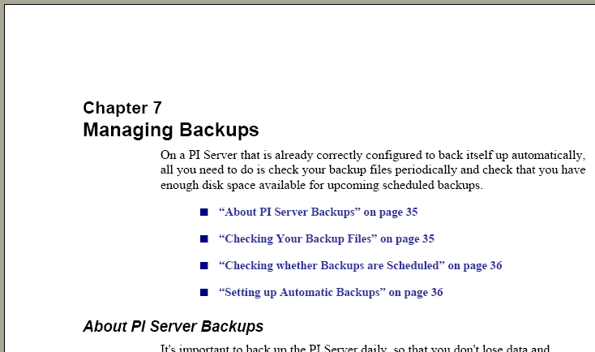
An Introduction to PI System Management is now available.
Go to techsupport.osisoft.com and choose the Download link. Search for Product = “PI 3 Enterprise Server,” Content = “User Manuals.”

Slide 13
How to Restore an Archive
To restore an archive that was backed up to removable media.
  Copy the file from the backup media to a local hard drive.
    Make sure you do not overwrite an existing archive when you copy the file.
  Register the archive in its new location with "piartool –ar“ or with the PI Archive Manager in SMT 3.
    piartool -ar c:\pi\dat\RestoredArc.dat

Slide 14
How to Restore an Archive
Remember, if there are no empty archives then the oldest archive will be the target of the next archive shift.
If you restore an archive, consider making it non-shiftable with the "piartool -ads" (archive disable shift) option or with the PI Archive Manager in SMT 3.
piartool -ads c:\pi\dat\RestoredArc.dat

Slide 15
Question
What is the name of the timeout parameter that should be coordinated with the timing of the permanent backup of an archive?
"Archive_BackupLeadTime"
"ArcMaxCollect"
"CheckUtilityLogin"
"EditDays"

Slide 16
Answer
What is the name of the timeout parameter that should be coordinated with the timing of the permanent backup of an archive?
"Archive_BackupLeadTime"
"ArcMaxCollect"
"CheckUtilityLogin"
"EditDays"

Slide 17
2.0 How to Create New Archives
Notes:
Troubleshooting the PI System
11.1 Troubleshooting Tags
11.2 Troubleshooting Interfaces
11.3 System Utilities

Slide 18
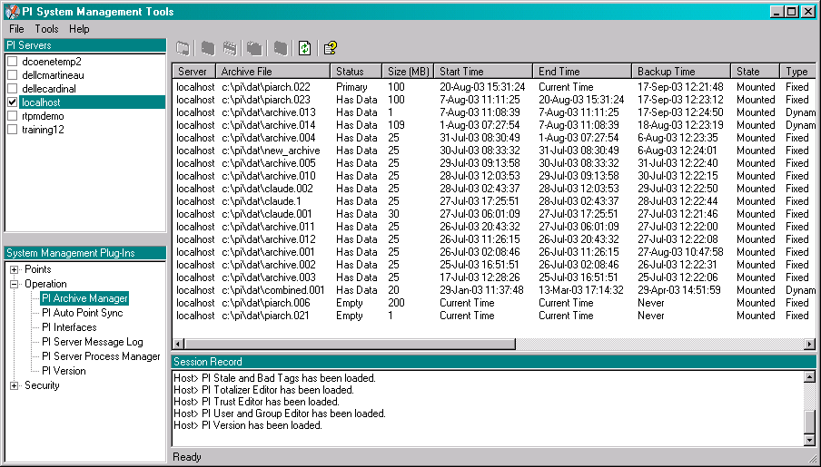
Archive Creation
Archives can be created and managed using the PI Archive Manager in SMT
Notes:
Archive Creation
To create a new archive for a particular server, select an archive from that server in the list view and click the “Create a new Archive” button on the toolbar, or right mouse click and select “Create New”. The “Create a New Archive” dialog will be shown.
Archive Path
The Archive path is the path of the archive on the selected server. For this version of the Archive Manager, the path used for the new archive to create is the same as the primary archive on a server. Future versions of the Archive Manager will allow users to select a different path for archives on a server.
Archive Name
The archive name field is populated with the next chronological archive name available based on the list of registered archives for the selected server. If this text field is yellow, then the name of the archive in the text box is already in use in the file system by another file, possibly an unregistered archive.
Options
Clone primary archive fixed size: This option uses the size of the current primary archive and creates a new empty archive just like it.
Create archive with larger size: This option allows the user to create a new empty archive of a size larger than the current primary archive. The size is specified in megabytes (MB).

Slide 19
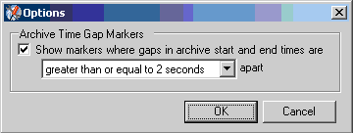

Archive Manager Plug-in
The plug-in offers the feature to mark when a gap in the time series.
  It is configured in the Options screen.
Here is what a gap looks like:

Slide 20
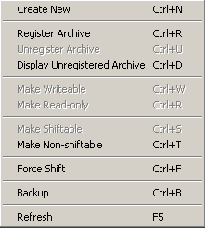
Archive Manager Plug-in
If you right click on an archive the right mouse menu appears.
  The toolbar and the right mouse menu
  each have options that are unique.
As you select each archive, items will be enabled or disabled appropriately for the selected archive.
The archive number is at the far right on the display.

Slide 21
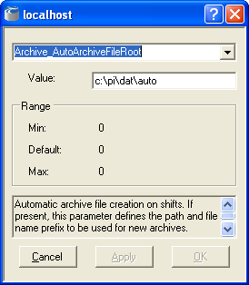
Automatic Archive Creation
Enabled by adding the Archive_AutoArchiveFileRoot parameter to the Timeout table (use SMT’s Timeout Table Editor)
  The name generated uses the following format:
  (rootname)_dd_mmm_yy_hh_mm_ss
  Example: The rootname "c:\pi\dat\auto" produces "c:\pi\dat\auto_29_Jan_04_08_12_45"
Desired path and root name

Slide 22
Automatic Archive Creation
Same size as the Primary Archive
To disable the Auto Archive Creation remove the value from the Timeout Table.
  Do not set to the default value of zero ("0"), as this will keep the function enabled.
Not enabled by default
  We recommend customers create all their archives at the same time on a disk drive with lots of free space so that the archive files will not be fragmented across the partition.
You must monitor your disk space if you use this feature. The system will cease to function if you run out of available disk space.

Slide 23
3.0 Other “Must Do” Tasks

Slide 24
Other “Must Do” Tasks
Start PI as an autostart service.
  Use SMT 3>> Operation>> Server Process Manager locally to change this.
The ExcDev and CompDev attributes of a tag determine the amount of data stored.
  Set CompDev to minimum change that is measurable by the instrument.
  Set the ExcDev to ½ of the compression deviation
Assign the user "piadmin" a password using SMT 3 or \\pi\adm\pisetpass.exe.

Slide 25
Other “Must Do” Tasks
Interfaces on the PI Server should be included in site-specific command files when the PI Server is started and stopped
\\pi\adm\pisvrsitestart.bat
and
\\pi\adm\pisrvsitestop.bat
Interfaces should be installed as automatic services
  This can be done with the Interface Configuration Utility
Buffering should be enabled on the Data Acquisition Node

Slide 26
Question
Which tag attribute has the greatest effect on how much data is stored in the archive?
CompDev
ExcDev
Location4 (i.e. scan class)
Span

Slide 27
Answer
Which tag attribute has the greatest effect on how much data is stored in the archive?
CompDev
ExcDev
Location4 (i.e. scan class)
Span

Slide 28
4.0 Routine PI tasks
Notes:
Troubleshooting the PI System
11.1 Troubleshooting Tags
11.2 Troubleshooting Interfaces
11.3 System Utilities

Slide 29
PI System Manager Tasks - Daily
Inspect the CPU and memory use of each PI subsystem
Check PI daily backup (archives and databases)
Check the PI Ping and PI PerfMon tags
Check PI System log files
Check PI System Interfaces log files
Create/delete/edit tags in the PI System
Create/delete/edit users/groups in the PI System
Use the Stale and Bad Tags plug-in in SMT to find tags in problem

Slide 30
PI System Manager Tasks - Weekly
Predict next archive shift
Do permanent backup when needed (should be every 3 to 5 weeks)
Verify OSIsoft’s Web site www.osisoft.com for engineering plan and software patches
Create new archives if required

Slide 31
PI System Manager Tasks - Annually
Completely test PI System backups by restoring PI backup on a fresh Windows installation
  The restore procedure is described in the PI System Manager II: Advanced Topics class lecture notes and in the PI Server System Management Guide.
Upgrade operating system version to the latest approved and supported version from OSIsoft
Upgrade PI Server to the latest version from OSIsoft
Upgrade PI clients to the latest versions

Slide 32
Question
Which files are not backed up as part of the standard backup script files that ship with PI?
Log files
Point Database files
Site specific batch files.
Annotation files.

Slide 33
Answer
Which files are not backed up as part of the standard backup script files that ship with PI?
Log files
Point Database files
Site specific batch files.
Annotation files.

Slide 34
5.0 Other New Plug-Ins to SMT 3
Notes:
Troubleshooting the PI System
11.1 Troubleshooting Tags
11.2 Troubleshooting Interfaces
11.3 System Utilities

Slide 35
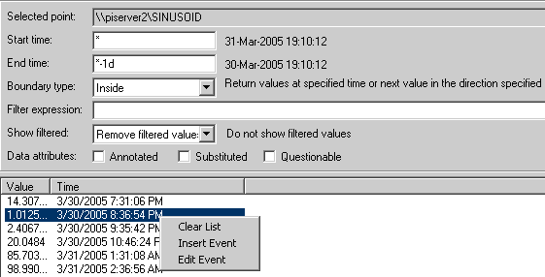
Other New Plug-Ins to SMT 3
The Recorded Values plug-in

Slide 36
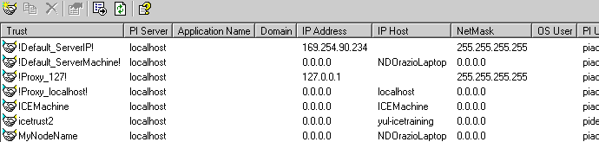
Other New Plug-Ins to SMT 3
Trust Editor

