Slide 1
Tweetalyzer
Sam Marder

Slide 2
Demo
Tweetalyzer
Notes:
Start off with a demo of the project. Make sure to show off everything including: location, custom date range, number of topics, custom topic, auto refresh, and actual tweets. Don’t get into any technical details (yet).

Slide 3
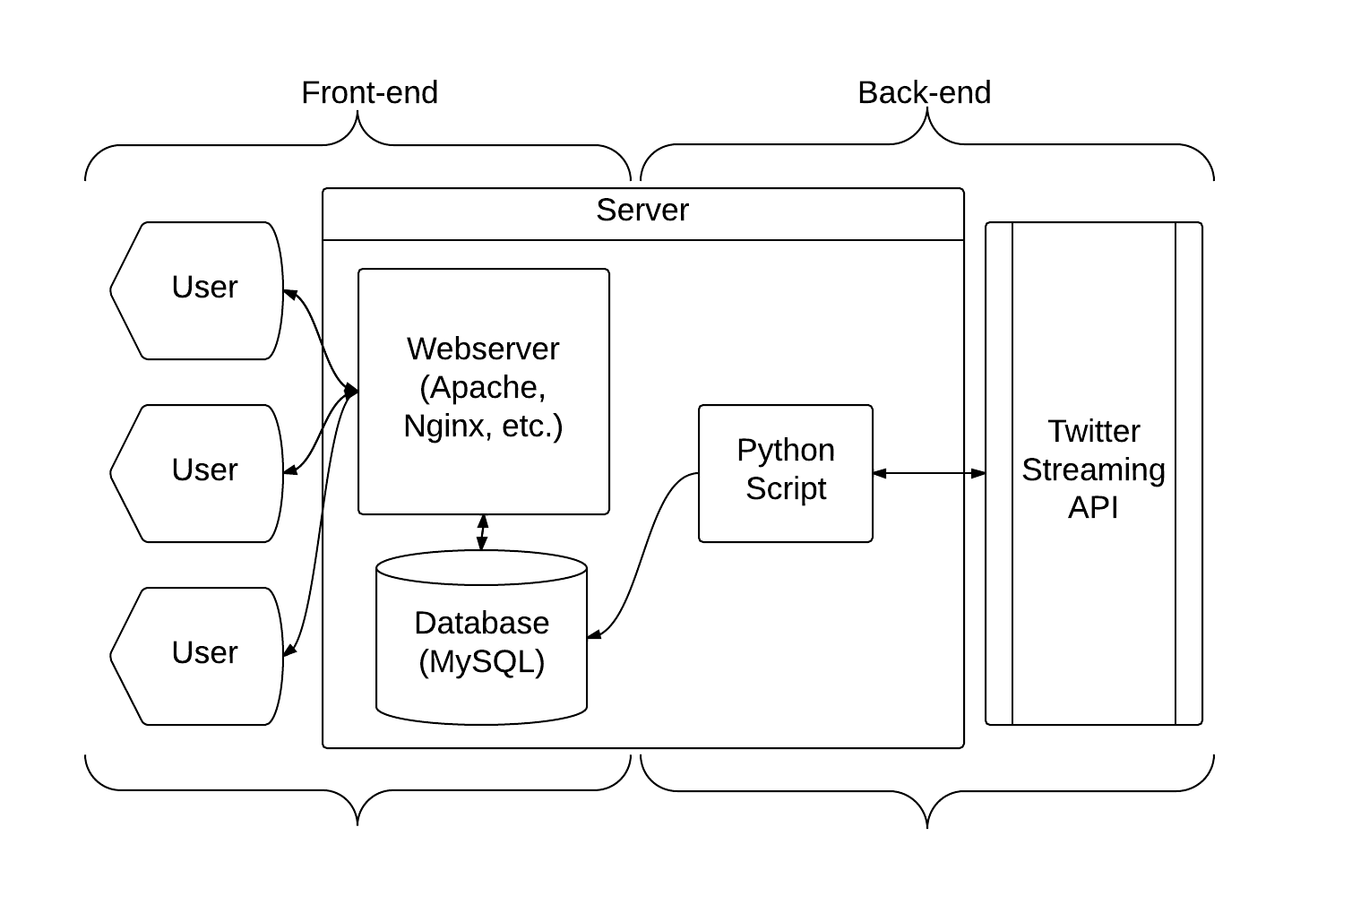
Components
Notes:
Back-end: Covers everything related to putting tweets into the database. This system is completely independent from the front-end.
Twitter Streaming API: API from Twitter that maintains a constant connection with my server. Different from a typical REST API because my server keeps one continuous connection with Twitter instead of polling Twitter every few seconds.
Python Script: Simple script that talks to Twitter through the Streaming API. Whenever it gets a tweet, it puts it into the database along with a timestamp, associated hashtags, and general location. Seeing as searching through a database based on decimal numbers is effectively worthless, I save the vague name of the city that the tweet came from. For example, tweets I pull from around New York City just have the location ‘nyc’. Note that this script exclusively adds records to the database.
Front-end: Webserver/website that users use to see analytics on past tweets.
Webserver: Framework that the website runs off of. Typical installation of Apache or Nginx that serves two PHP pages. The main index page contains a bunch of settings for which tweets to grab including location, timeframe, and number of results. All of these parameters are sent back to the server via typical http get requests. In the event that only some information or bad information is supplied, reasonable defaults are used instead (for example, if no timeframe is given, the current day is used). The main page also includes a graph with the most popular hashtags. Clicking on any of these will lead to the second page.
On this other page, all of the tweets that were tallied in mentioning all of the given hashtags. Correct parameters are also passed in through http get requests, although they are not configurable on this page. No personal information is displayed with the tweets as it is not saved.
Database: Place where tweets are stored and the bridge between the back-end and the front-end. I personally used MySQL although any relational database system would do.
Users: People who view the website and play around with the application.

Slide 4
Practical Uses
Compares the relative popularity between tweets (locally)
Shows local trends vs. national trends
Shows short-term trends vs. long-term trends
Notes:
This project has a few somewhat practical uses.
Obviously, it is pretty good at showing which tweets are most popular in a geographic area. For example, Boston-Marathon-related tweets vastly outweighed everything else on Marathon Monday.
With that said, it is also very effective at looking at local trends vs. larger trends. For example, #bostonstrong and #bostonmarathon were tweeted over 3,000 times on Marathon Day in Boston. However, neither tag made it into the top 5 (~150 tweets required) in any other location. By comparison, #job and #jobs are common tags across all locations.
In a similar way, it is also good at looking at short-term trends vs. longer ones. For example, every day, #job and #jobs show up in the chart while tags like #GoT (Game of Thrones) is only very popular on Sunday nights.

Slide 5
Room for Improvement
Lack of tweet information
User-specified locations
More fine-grained timeframes
Single-user spam
Single-tweet spam
Notes:
This was a great project but there are some shortcomings and not all of them are fixable.
There are about 300 million tweets added to Twitter every day. However, as a standard developer, I only have access to a random 1% of those. To add to this, only ~5% of tweets have geo location data attached to them and through personal observation, only about 10% of geo-tagged tweets contain a hashtag. These two factors severely limit the number of tweets I can analyze. Out of 300 million tweets, I only get between 1,000 and 3,000 tweets per day per location. While this is enough to see larger trends among tweets, smaller trends may be missed and users can be mislead when searching for a specific tag.
The project also doesn’t support user-specified locations. While it was originally supposed to, based on the way I interact with the Streaming API (which Twitter recommends), changing the location is not easy and is akin to completely recreating a connection to the API. Instead, I compromised on a few major locations. I could easily add more in the future, however a typical user can’t add them from the front-end interface.
More fine-grained timeframes would help see other trends. While watching the data in real time, I noticed that several exercise related tweets are posted during early morning hours. However, they use tons of different hashtags and get swallowed up by more unified tweets very quickly. Timeframes that can be tuned to the hour would make seeing these trends much easier.
Single-user spam is when a particular user posts a bunch of tweets. Twitters “%1” rule doesn’t discourage this, so a user who tweets a lot will have a disproportionate control over my data. I noticed this specifically with the #job and #jobs tags. Both are tweeted almost exclusively from a service called “Tweet My Job.” Counting fewer of these tweets would help multi-user trends show better than single-user spam.
Similar to single-user spam, there is also quite a bit of single-tweet spam. This is when someone puts many hashtags in a single tweet and sometimes just repeats the same tag a bunch of times. Filtering these out is difficult because many legitimate tweets overuse hashtags. However, checking for duplicate tags in a single tweet and excluding those could significantly reduce this problem.

Slide 6
Questions?

