Slide 1
SUPERSEDE enhanced ticket tracking system
How your ticketing, issues or bug tracking process can benefit thanks to adopting SUPERSEDE
matteo.pedrotti@deltainformatica.eu

Slide 2



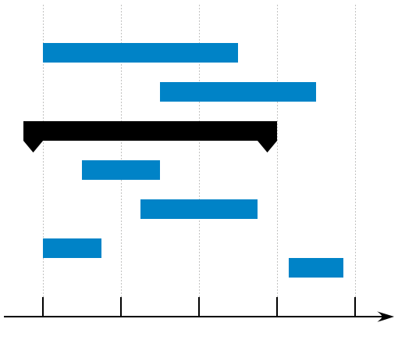











What is an Issue Tracking System?
CREATE UPDATE
CREATE UPDATE
Issue#12345
(assigned to Bob)
(unassigned)
Priority
Description
HIGH
MINOR

Slide 3
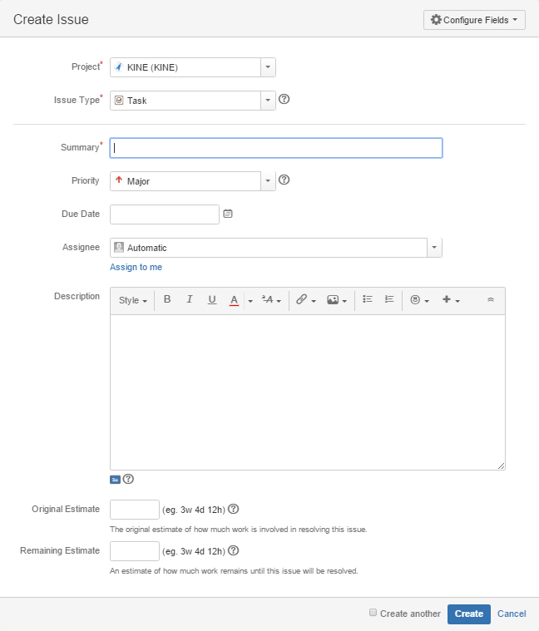
Issue Tracking System (ITS)
Open an issue (ticket) (what)
Responding to a set of requirements (needs)
Define scheduling parameters (when)
Effort estimate, priority, due date, …
Provide details (why)
Assign to someone (who)
Track issue lifecycle (how)
Progress (worklog, comments, attachments, etc.)
Close an issue (done)

Slide 4
Issue Tracking System: lifetime of a new feature request
A new feature is requested
We want to add a visitor counter for our website
An issue representing the feature is created
Visitor counter
Details to outline what’s expected are added
Count the unique visitors of the website and show a number in the footer
A priority is given
Minor
The issue is assigned to a developer and scheduled
Assigned to Bob (JS expert)
The developer works on the task
Bob writes the code and tests it
The issue is eventually marked as done
The unique visitors counter is approved and the issue is closed

Slide 5
Issue Tracking System: lifetime of a bug report
A bug is detected by users
The visitor counter prints -1
An issue representing the bug is created
Fix visitor counter
Details to outline what causing the bug are added
IE6 users see a -1 instead of the actual number of unique visitors…
A priority is given
Minor
The issue is assigned to a developer and scheduled
Assigned to Bob (the developer who implemented it)
The developer works on the task
Bob adds code to support IE6
The issue is eventually marked as done
The new counter is approved and the issue is closed

Slide 6
Typical Issue lifetime
New Feature
Bug Found
New Issue
Schedule Issue
Issue Closed

Slide 7
SUPERSEDE software evolution workflow
Collecting feedback
WP1
WP2
Requirements elicitation and prioritization
WP3
Release Planning
WP4

Slide 8
1. Collecting Feedback (WP1-2)
WP1 collects raw data from all sources
WP2 filters data and provide relevant «alerts» as a set of user requests
Feedback
Alert

Slide 9
2. Requirements elicitation (WP3)
WP3 detects what kind of action is required for the given alerts
If a Requirement emerges from an alert
A Decision Making Game is started to assign a priority
A Feature is eventually passed on
Alert
Requirement
Adaptation
Decision Making Game
Feature

Slide 10
3. Planning (WP4)
The Feature is loaded into a scheduling algorithm considering
Priority
Effort
Resource
…
The Feature is eventually considered closed (?)
Feature
Planner

Slide 11
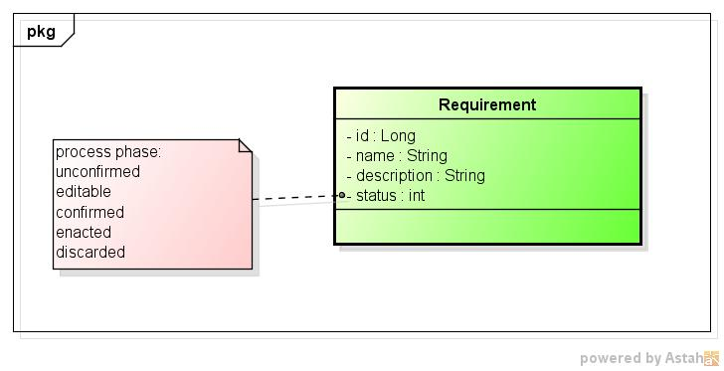
Requirement Data Model

Slide 12
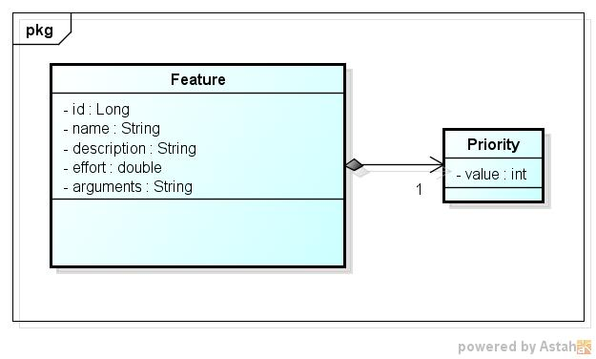
Feature Data Model

Slide 13
Issue Data Model (JIRA)
| ID | decimal(18,0) | NO | PRI | NULL | |
| pkey | varchar(255) | YES | UNI | NULL | |
| PROJECT | decimal(18,0) | YES | MUL | NULL | |
| REPORTER | varchar(255) | YES | | NULL | |
| ASSIGNEE | varchar(255) | YES | MUL | NULL | |
| issuetype | varchar(255) | YES | | NULL | |
| SUMMARY | varchar(255) | YES | | NULL | |
| DESCRIPTION | longtext | YES | | NULL | |
| ENVIRONMENT | longtext | YES | | NULL | |
| PRIORITY | varchar(255) | YES | | NULL | |
| RESOLUTION | varchar(255) | YES | | NULL | |
| issuestatus | varchar(255) | YES | | NULL | |
| CREATED | datetime | YES | | NULL | |
| UPDATED | datetime | YES | | NULL | |
| DUEDATE | datetime | YES | | NULL | |
| RESOLUTIONDATE | datetime | YES | | NULL | |
| VOTES | decimal(18,0) | YES | | NULL | |
| WATCHES | decimal(18,0) | YES | | NULL | |
| TIMEORIGINALESTIMATE | decimal(18,0) | YES | | NULL | |
| TIMEESTIMATE | decimal(18,0) | YES | | NULL | |
| TIMESPENT | decimal(18,0) | YES | | NULL | |
| WORKFLOW_ID | decimal(18,0) | YES | MUL | NULL | |
| SECURITY | decimal(18,0) | YES | | NULL | |
| FIXFOR | decimal(18,0) | YES | | NULL | |
| COMPONENT | decimal(18,0) | YES | | NULL | |
Legend
BLACK: relevant matching data RED: manual parameters PURPLE: possibly relevant
GREY: not immediately relevant

Slide 14
Enhancing ITS with SUPERSEDE
Allow ITS users to push Issues into the SUPERSEDE workflow
Mapped as SUPERSEDE Requirements
Optionally let ITS user put the Issue straight in as a Feature (?)
This would bypass the prioritization…
Allow ITS users to pull Issues (and Issue updates) from SUPERSEDE
Mapped as SUPERSEDE Requirements or Features
Issues mapped as Requirements should wait for prioritization…

Slide 15
SUPERSEDE
ITS
Collecting feedback
User Requests
New Feature Bug Found
Requirements elicitation
Requirement
Issue
Feature
Planning
Feature
Schedule
Issue Closed
Notes:
TBC

Slide 16
Enhancing ITS with SUPERSEDE: outline
One ITS Project (or equivalent ITS-specific concept) == One SUPERSEDE Tenant
From Issue to Requirement
ITS user creates an Issue
Issue is sent to SUPERSEDE as a Requirement
SUPERSEDE generates a Feature and updates Issue accordingly
From Feature to Issue
SUPERSEDE creates a new Feature
Issues is created based on the Feature
Planning
TBD…

Slide 17
ITS Actors and Use Cases
External (non-SUPERSEDE) user
Submit Issue (i.e. bug)
SUPERSEDE enabled admin
Confirm Issue to be handled by SUPERSEDE
Wait for SUPERSEDE to finish decision making (waiting for Feature)
This will set priority for example
Assign to developer
Developer
Update Issue (i.e. log work)

Slide 18
From ITS to SUPERSEDE story
External user creates Issue in ITS
Issue is imported in SUPERSEDE as a Requirement
by SUPERSEDE enabled admin
SUPERSEDE users runs a DMGame for such Requirement
The resulting Feature is mapped back to the ITS Issue
Feature is automatically forwarded to the Planner in SUPERSEDE
No need to manually do anything in ITS
ITS manager assigns the Issue to a developer
NB: potential conflict with WP4 planning?
Changes to Feature and Issue are synchronized

Slide 19
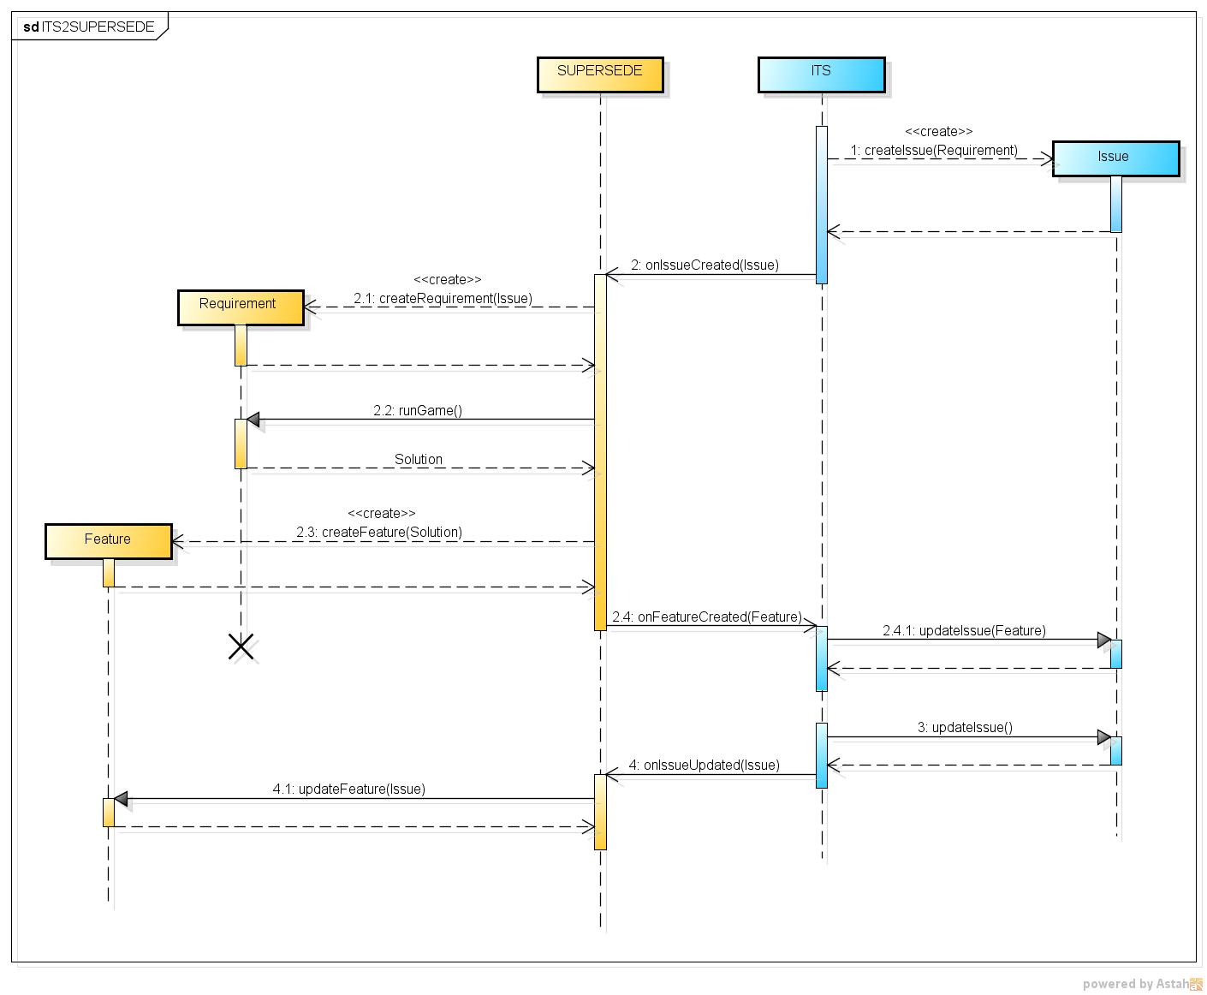

Slide 20
From SUPERSEDE to ITS story
SUPERSEDE creates Requirement from Alert (UserRequests)
This could be automatic (WP1-WP2) or manual (WP3)
Requirement is exported to the ITS as an Issue
Supervised by a SUPERSEDE enabled admin in ITS
SUPERSEDE users run a DMGame for such Requirement
The resulting Feature is mapped back to the ITS Issue
Feature is also forwarded to the Planner automatically
ITS manager assigns the Issue to a developer
Changes to Feature and Issue are synchronized

Slide 21
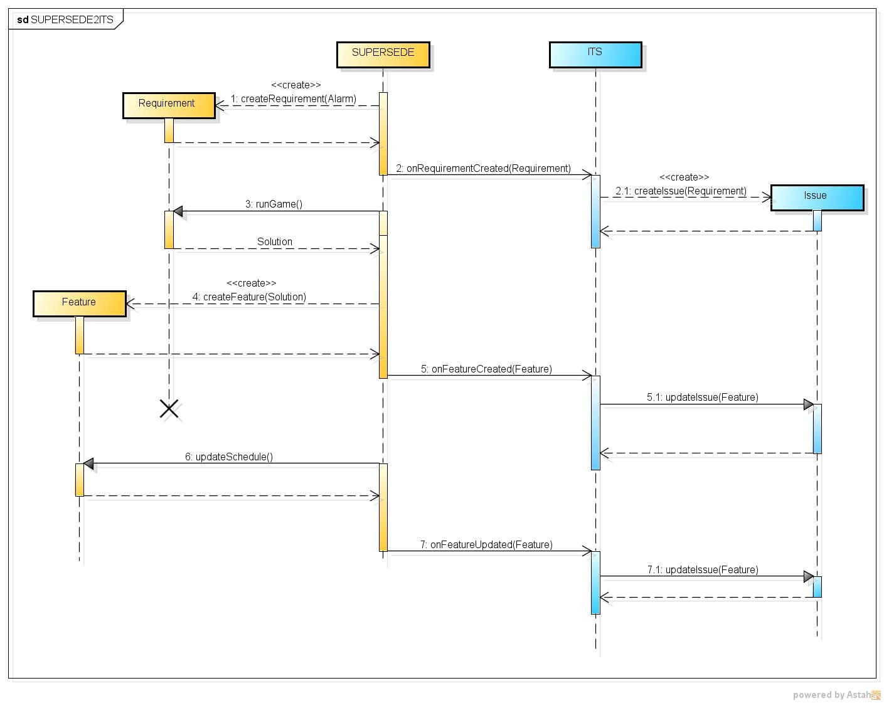

Slide 22
ITS-SUPERSEDE API
SUPERSEDE
onIssueCreated(issue: Issue): void
onIssueUpdated(issue: Issue): void
ITS
onRequirementCreated(req: Requirement): void
onFeatureCreated(feature: Feature): void
onFeatureUpdated(feature: Feature): void

Slide 23
ITS-SUPERSEDE API extended
SUPERSEDE
getRequirements(): Requirement[]
getRequirement(id: long): Requirement
getFeatures(): Feature[]
getFeature(id: long): Feature
ITS
getIssues(): Issue[]
getIssue(id: long): Issue

Slide 24
ITS-SUPERSEDE interconnections
ITS
ITS
ITS
ITS Plugin
Rationale
Let ITS users see and use SUPERSEDE integration explicitly
Require SUPERSEDE REST support
ITS Plugin
SUPERSEDE
SUPERSEDE
SUPERSEDE
SUPERSEDE Plugin
SUPERSEDE Plugin

Slide 25
ITS plugin API
onIssueCreated/Updated(issue: Issue): void When the plugin detects a suitable Issue was created or updated in ITS, it will be sent over to SUPERSEDE using a REST call
getRequirements(): Requirement[] The plugin will look for suitable SUPERSEDE requirements using a REST call (?)
onRequirementCreated/Updated(req: Requirement): void If a new requirement is identified, a new Issue will be created (user driven). If a matching Issue is available, the relevant fields will be updated.
getFeatures(): Feature[] The plugin will look for suitable SUPERSEDE features using a REST call (?)
onFeatureCreated/Updated(feature: Feature): void The plugin will look for a matching Issue for the Feature (using the Id) and internally update the relevant fields

Slide 26
Plugin UI elements
Configuration Panel:
Connection parameters (URL and authentication – tenant, username, pwd)
SUPERSEDE Issues Panel:
List of currently mapped Issues
ITS Issue ID <-> SUPERSEDE Requirement/Feature ID
List of SUPERSEDE Requirements to import
These are SUPERSEDE generated requirements not already mapped
Form to map a given Issue to SUPERSEDE
Manually type an Issue ID in a text field
ITS Issue updated by user (event driven)
If mapped, send updated data to SUPERSEDE

Slide 27
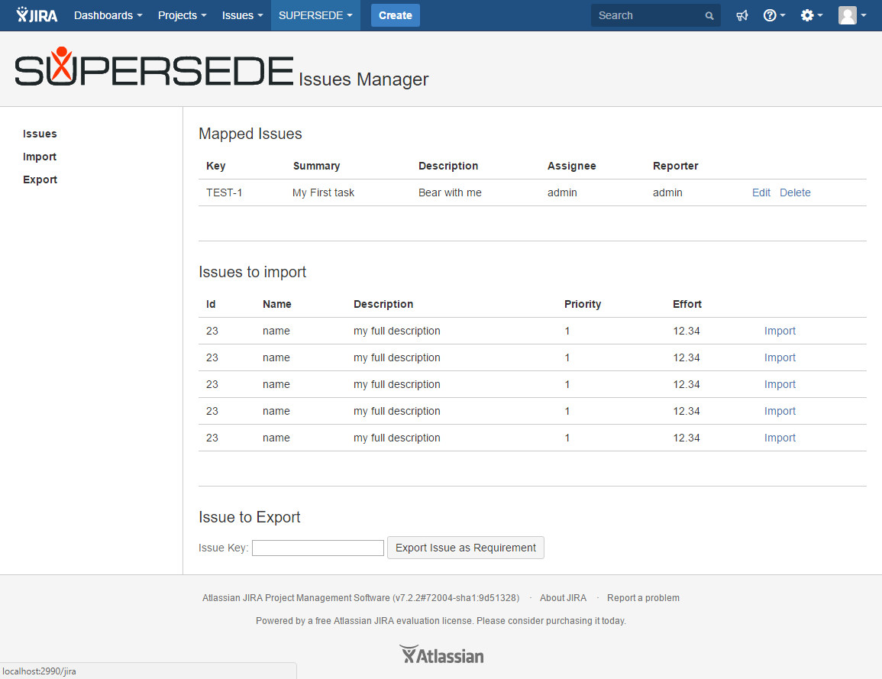
Plugin: a JIRA plugin prototype…

Slide 28
- THE END -

