Slide 1
Medicare - Health Assistant
Akshat Gupta, Abbas, Anand Raj, Aniket Tripathi, Avnish Raj, Bhawna
Group no. - 13
IIS-end sem project

Slide 2
Project Overview and Objectives
Project Overview:
This project aims to develop an intelligent healthcare chatbot that can interact with patients in a natural, conversational manner. The chatbot is designed to gather essential medical information, identify user intent, and assist in the preliminary screening process. It serves as a digital assistant for healthcare providers, streamlining patient intake and enhancing accessibility.
Objectives:
Automated Patient Interaction
Intent Recognition
Symptom Collection and Preliminary Triage
Data Storage and Retrieval
User-Friendly Interface
Scalability and Integration

Slide 3
System Architecture and Integration
Overview of Architecture:
Frontend: (Yet to be implemented)
Backend: Python-based message routing, intent recognition, and business logic.
Data Storage: MongoDB for storing patient data(demographic, medical, login), doctors data(name, medical license, speciality, etc.), admin(login data).
Speech Integration: Whisper for speech recognition, gTTS for text-to-speech, pygame for playing audio.
Multilingual Support: Using googletrans for translation, while keeping track of current language.
Integration Flow: All components run as a single local script. Speech/text input → processed by NLP modules → output generated and optionally spoken.
User inputs (speech/text) → Translate to English → Intent detection & entity extraction → Response Generation → Output (text + speech)

Slide 4
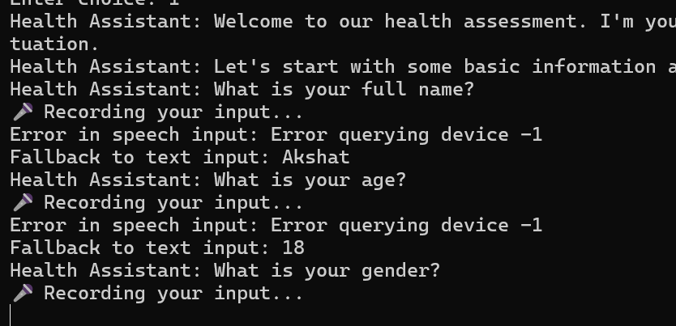
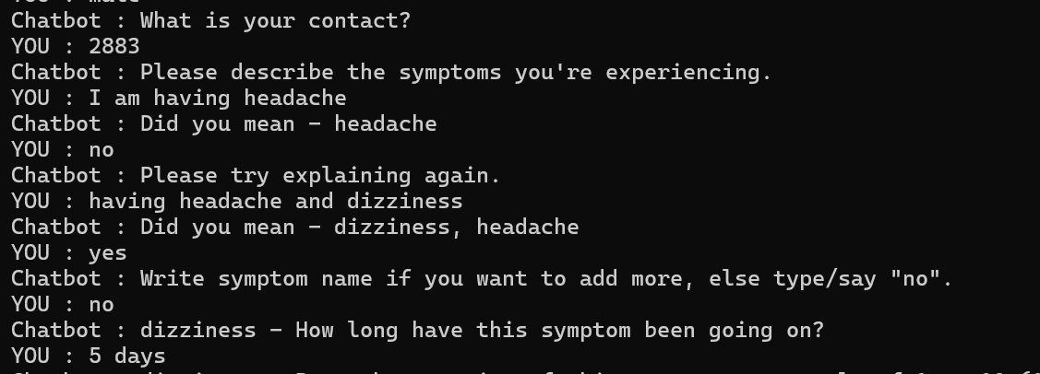
Testing and Evaluation of Features
Miscommunication Recovery:
  Politely asks users to rephrase or clarify vague queries.
  Resets conversation context if user or bot gets stuck.
Real-time Error Handling:
  Provides alternative options or clickable suggestions to reduce ambiguity.
  Uses dynamic fallbacks to handle unclear or multi-intent queries.

Slide 5

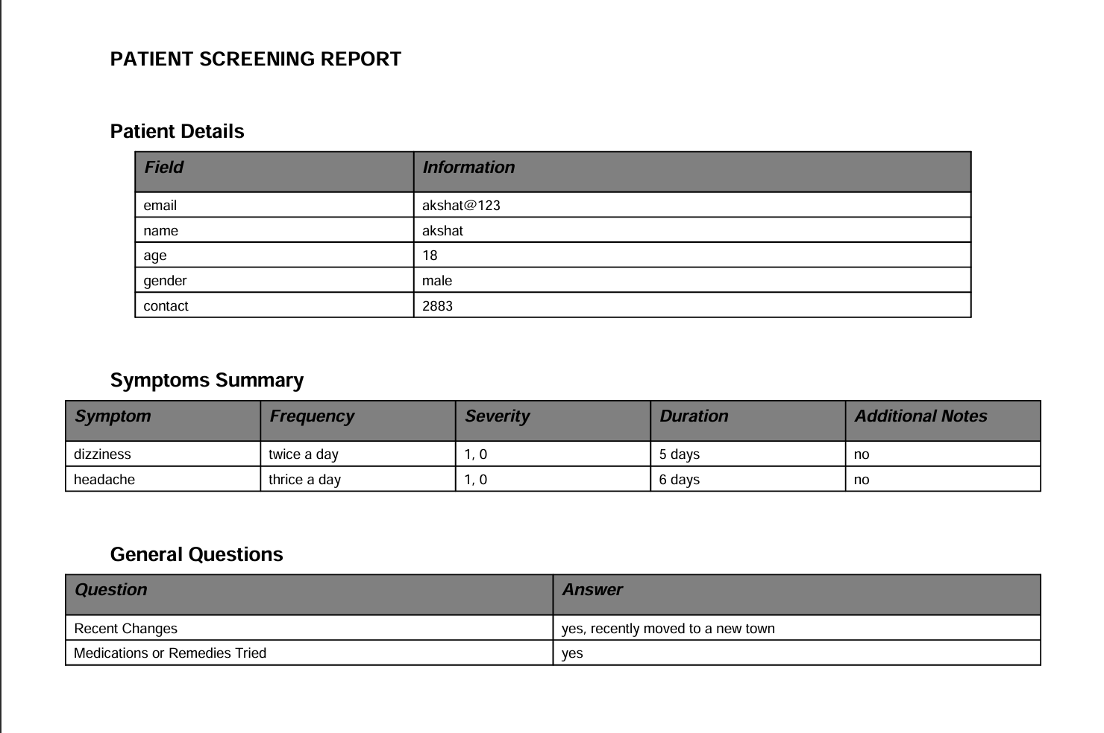
Demo Simulation of Patient Interaction
Scenario 1: A patient (use any name) interacts with the chatbot using speech/text to report symptoms. The chatbot processes the input and generates a summary report.

Slide 6
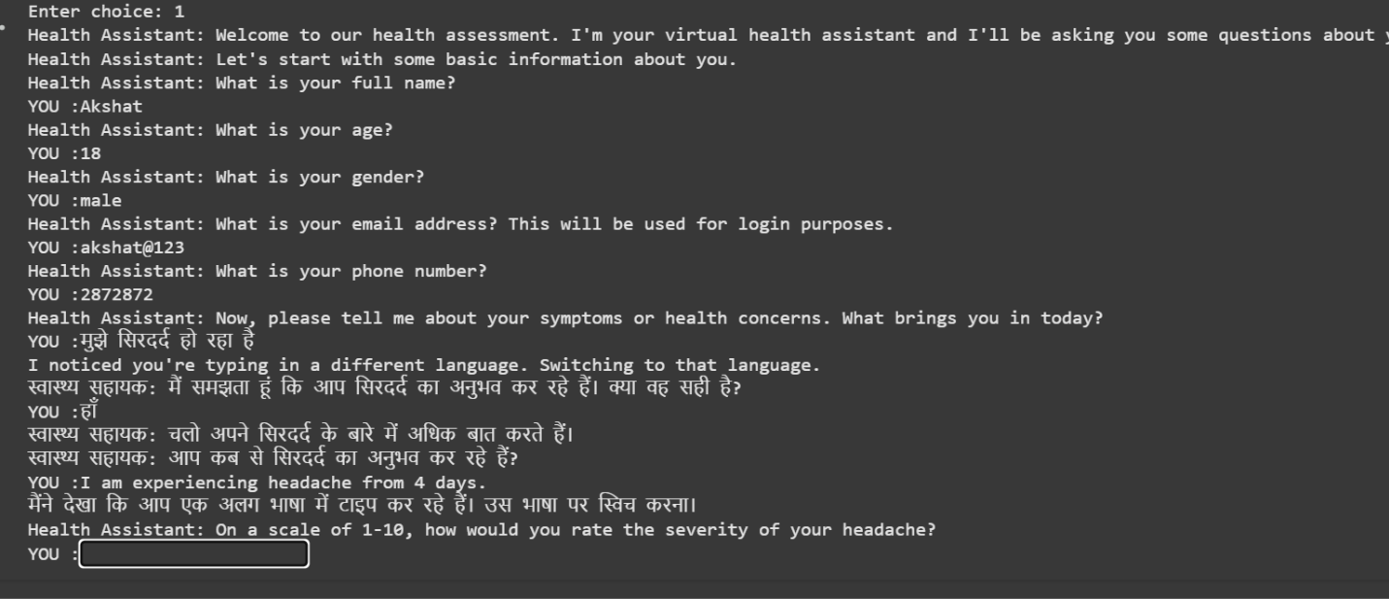
Demo Simulation of Patient Interaction
Scenario 2: The chatbot switches between English and Hindi as per the user's language preference during symptom intake.

Slide 7
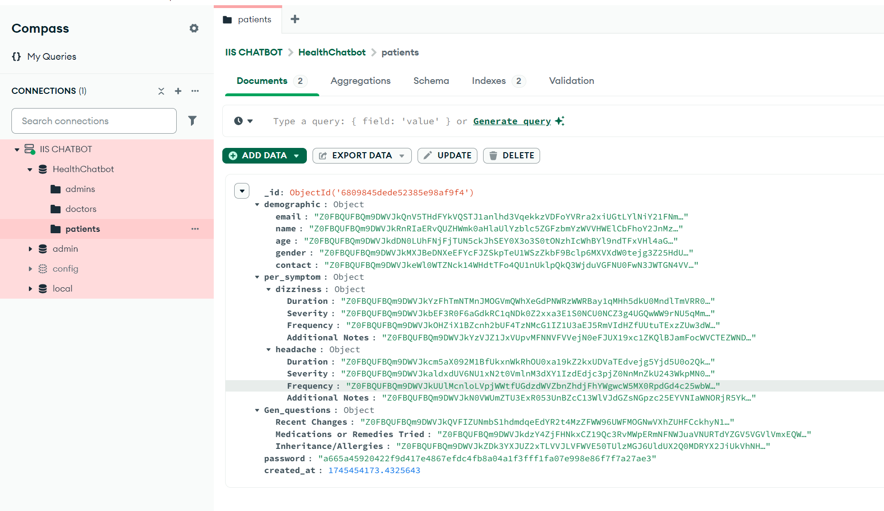
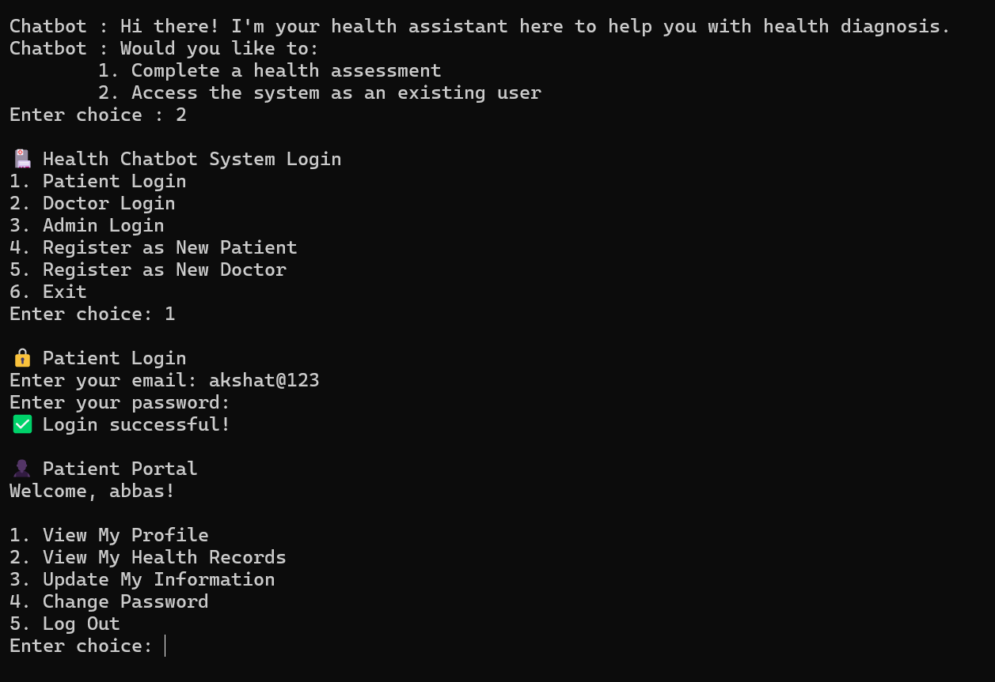
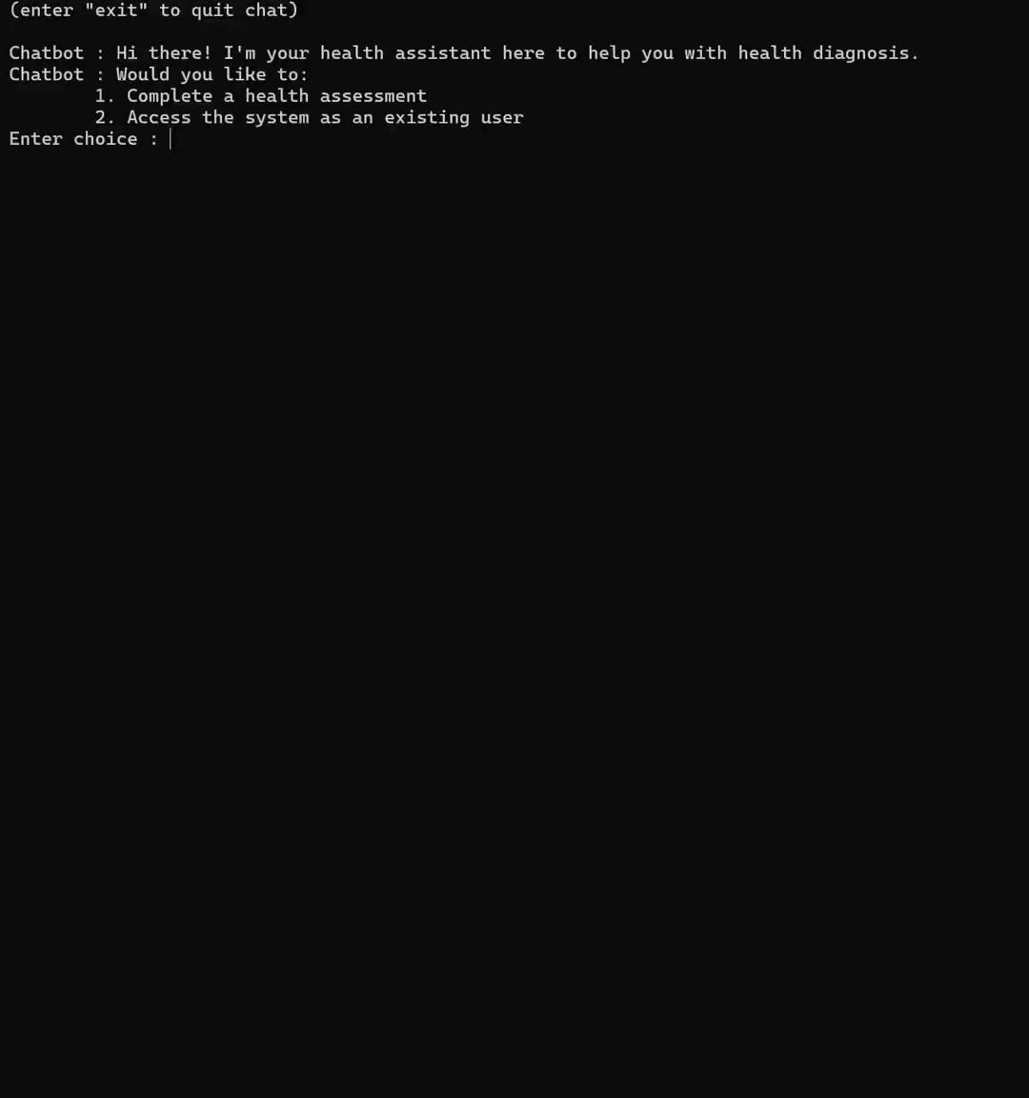
Storage and Login Systems

Slide 8
Conclusion, Results & Future Improvements
Challenges & Learnings:
  Coordination and Communication - Learned Team Collaboration Skills
  Efficiently merging Code
  Integrating the LLM model (Mistral-7B, in our case)
  Ethical and Practical Constraints in Healthcare
  Debugging\Testing and Project Planning
Future Improvements :
  Make a good Front-end interface for better user experience.
  Make the Assistant more versatile in tasks relating to the healthcare domain, like also acting like a receptionist, and more robustness & efficiency in dealing with patients.

