Slide 1
CLUSTERING THE CITY OF LONDON FOR THE OPENING OF AN AFRICAN RESTAURANT

Slide 2
Introduction
DESCRIPTION OF THE PROBLEM
The City of London is a city and county that contains the historic centre and the primary central business district (CBD) of London. The City is now only a tiny part of the metropolis of London, though it remains a notable part of central London. However, the City of London is not a London borough, a status reserved for the other 32 districts (including London's only other city, the City of Westminster).
The City is a major business and financial centre. The City has a resident population of 9,401 (ONS estimate, mid-2016) but over 300,000 people commute to and work there. About three quarters of the jobs in the City of London are in the financial, professional, and associated business services sectors.
There are many restaurants across the city of London. To name a few: Roganic , CORE by Clare Smyth, The Five Fields and Portland Restaurant. Most of these restaurants offer continental, European or American dishes.
However many of the restaurants do not offer African dishes. Approximately 922,684 Africans live in London. There are decent number of Africans namely Nigerians, South Africans, Kenyans to name a few that reside in the greater London Area. These individuals are engaged in various occupations, business or schooling.

Slide 3
INTEREST
My project seeks to find the most populous areas in London that would offer prospective investors open restaurants to cater mostly for Africans who will want to have a taste of African dishes.
The project will explore the various neighborhoods in London and segment them and recommend which area is suitable for such business.

Slide 4
Data acquisition and cleaning
The black population data was acquired from https://en.wikipedia.org/wiki/Ethnic_groups_in_London and stored onto an FTP server and read into a data frame.
For the coordinates of London, data was acquired from www.maptools.com and used in the same was as above.
After the data has been imported and read into a pandas data frame, some data cleaning will be done. I noticed after the data has been read into the data frame, some rows had some missing values and in some instances missing values were represent with not a number (NAN) values. These rows had to be dropped especially after the two data sets had been merged. This was quite necessary because when the city has been divided and clusters created, the visualization cannot be done on NAN VALUES. I also had to drop some columns in the black population data set as they were not needed in my analysis.

Slide 5
Black population data set
London Borough | Black African Population | Black Caribbean Population | Other Black Population | Total Black Population | Post Code
Lambeth | 35,187 | 28,886 | 14,469 | 78,542 | SW2, SW9, SE5
Southwark | 47,413 | 17,974 | 12,124 | 77,511 | SE1
Lewisham | 32,025 | 30,854 | 12,063 | 74,942 | SE6
Croydon | 28,981 | 31,320 | 12,955 | 73,256 | CR0
Newham | 37,811 | 15,050 | 7,395 | 60,256 | E6, E16, IG11
Brent | 24,391 | 23,723 | 10,518 | 58,632 | HA0
Hackney | 27,976 | 19,168 | 9,714 | 56,858 | E8
Enfield | 28,222 | 17,334 | 8,131 | 53,687 | N11, N14
Greenwich | 35,164 | 8,051 | 5,440 | 48,655 | SE3, SE12
Haringey | 23,037 | 18,087 | 6,706 | 47,830 | N11, N22
Waltham Forest | 18,815 | 18,841 | 7,135 | 44,791 | E11
Barking and Dagenham | 28,685 | 5,227 | 3,228 | 37,140 | IG11
Ealing | 17,299 | 13,192 | 6,369 | 36,860 | W4
Wandsworth | 14,818 | 12,297 | 5,641 | 32,756 | SW12
Barnet | 19,392 | 4,468 | 3,571 | 27,431 | EN5, NW7
Islington | 12,622 | 7,943 | 5,729 | 26,294 | EC1, N1
Redbridge | 12,357 | 9,064 | 3,424 | 24,845 | IG2
Hammersmith and Fulham | 10,552 | 7,111 | 3,842 | 21,505 | SW6
Merton | 10,442 | 8,126 | 2,243 | 20,811 | SW19
Hillingdon | 11,275 | 4,615 | 4,192 | 20,082 | UB8

Slide 6
Geographical data set
Borough | Latitude | Longitude
Barking and Dagenham | 51.5607 | 0.1557
Barnet | 51.6252 | 0.1517
Bexley | 51.4549 | 0.1505
Brent | 51.5588 | 0.2817
Bromley | 51.4039 | 0.0198
Camden | 51.5290 | 0.1255
Croydon | 51.3714 | 0.0977
Ealing | 51.5130 | 0.3089
Enfield | 51.6538 | 0.0799
Greenwich | 51.4892 | 0.0648
Hackney | 51.5450 | 0.0553
Hammersmith and Fulham | 51.4927 | 0.2339
Haringey | 51.6000 | 0.1119
Harrow | 51.5898 | 0.3346
Havering | 51.5812 | 0.1837
Hillingdon | 51.5441 | 0.4760
Hounslow | 51.4746 | 0.3680
Islington | 51.5416 | 0.1022
Kensington and Chelsea | 51.5020 | 0.1947
Kingston upon Thames | 51.4085 | 0.3064
Lambeth | 51.4607 | 0.1163
Lewisham | 51.4452 | 0.0209
Merton | 51.4014 | 0.1958

Slide 7
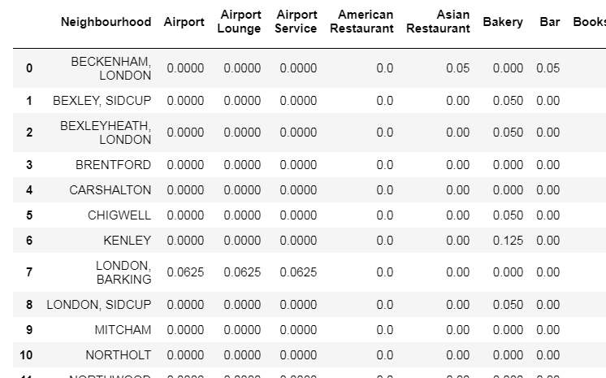
One-hot encoding

Slide 8
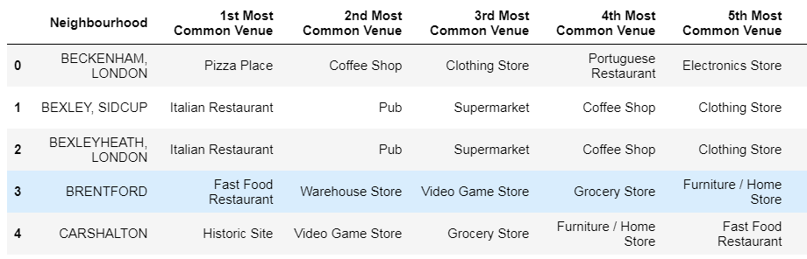
Top 5 neighborhoods

Slide 9
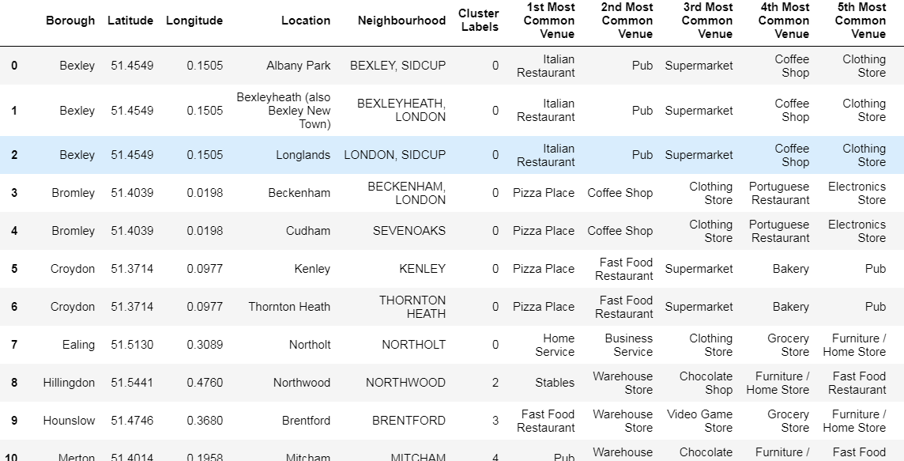
Merged data set with black neighborhood

Slide 10
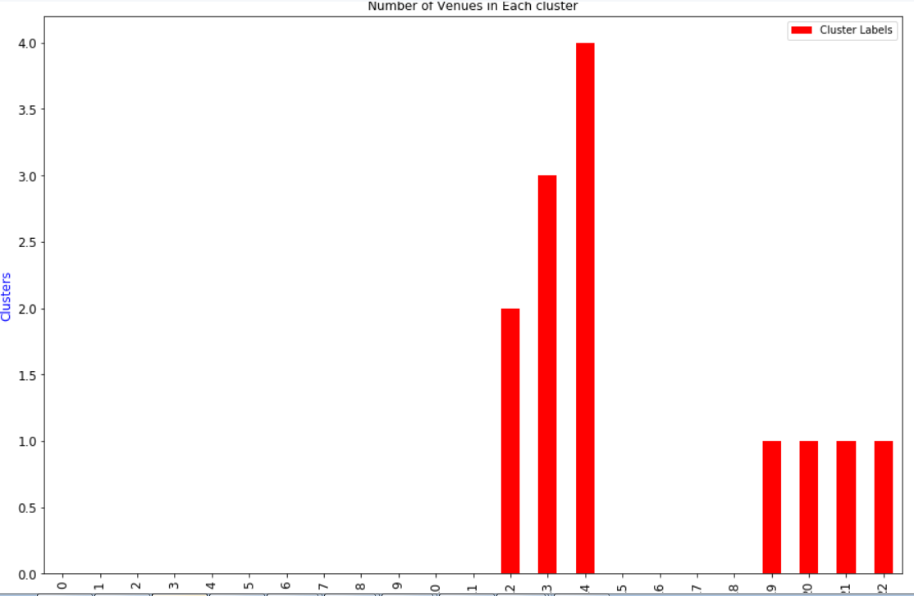
A bar chart showing the number of venues in each cluster

Slide 11
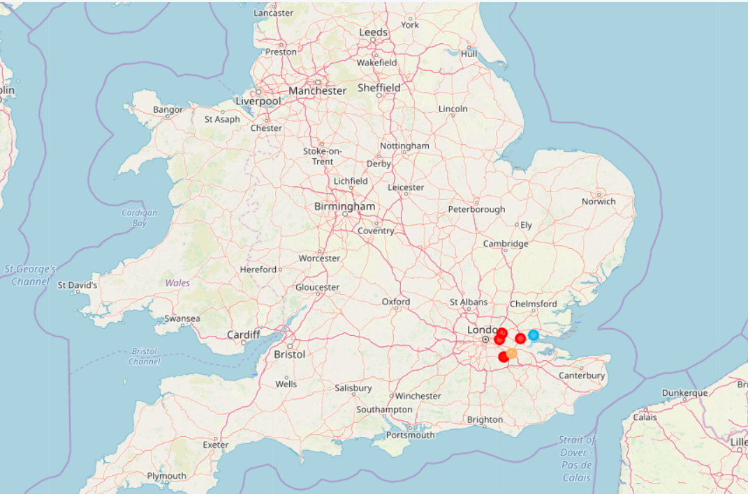
Data visualized using python

Slide 12
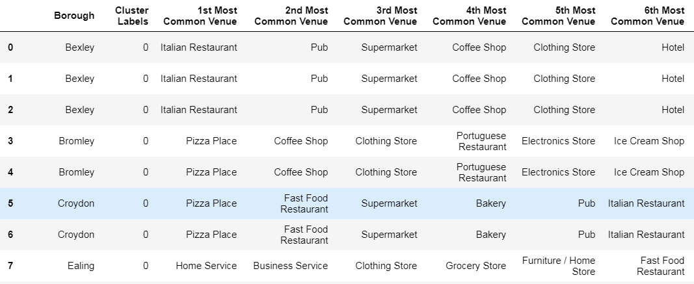
K – means clustering
K – Means clustering is grouping similar data points together and discover underlying pattern. The neighbourhoods were grouped into clusters of 5.
Cluster 1

Slide 13
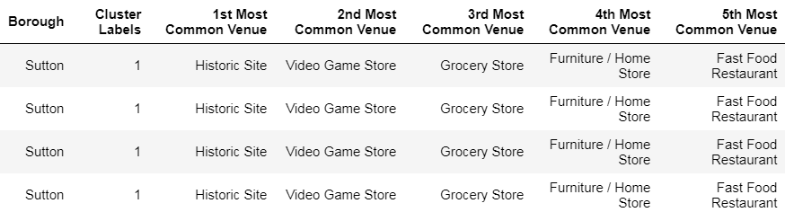
Cluster 2

Slide 14
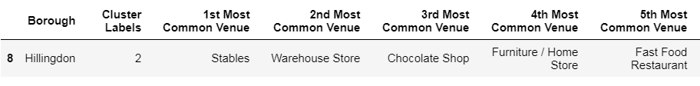
Cluster 3

Slide 15

Cluster 4

Slide 16

Cluster 5

Slide 17
RESULTS AND DISCUSSION
Results :We can see from the clusters above, there are no restaurants offering a composition of African food. Most of the restaurants above are Italian Restaurants, fast food chains or bakeries. Most of the black population in London leave in Croydon and Ealing to name a few areas.
In the clusters above for example the most popular restaurants are Pizza Restaurants and in the case of Ealing, there are not many restaurants.
Such areas for example have an estimated number of 110,116 Africans living in those areas.
Discussion: London is a big and vibrant metropolitan city and a hot spot for businesses. Different classification methods can be used to cluster the neighbourhoods.
I used the k-means algorithm in the study.

Slide 18
conclusion
The areas discussed above are a good hunting ground for prospective investors who may want to open an African restaurant for different nationals from countries such as South Africa, Kenya and Sierra Leone to name a few.
REFERENCES
www.maptools.com
https://en.wikipedia.org/wiki/List_of_London_boroughs
https://en.wikipedia.org/wiki/Ethnic_groups_in_London

