Slide 1
The Quest
for a Dictionary

Slide 2
We Need a Dictionary
The Sparse-land model assumes that our signal x can be described as emerging from the PDF:
Clearly, the dictionary D stands as a central hyper-parameter in this model.
Where will we bring D from?
Remember: a good choice of a dictionary means that it enables a description of our signals with a (very) sparse representation.
Having such a dictionary implies that all our theory becomes applicable.

Slide 3
Our Options
Choose an existing “inverse-transform” as D:
Fourier, DCT, Hadamard, Wavelet, Curvelet, Contourlet …
Pick a tunable inverse transform:
Wavelet packet, Bandelet
Learn from examples:
Dictionary Learning Algorithm

Slide 4
Little Bit of History & Background
A classical method for assessing the goodness of a given transform is the m-term approximation, which goes like this:
Apply the transform T on the signal x
Choose the leading m coefficients
Apply the inverse transform and get
Check the resulting error as a function of m
Naturally, we would like to see this function dropping to zero as fast as possible for a family of signals of interest
Observe that the above description hides the choice of using the thresholding algorithm as the effective pursuit to apply
T
=

Slide 5
Little Bit of History & Background
In the context of “images”, represented as C² surfaces with C² edges, leading researchers were able to get analytical expressions for the m-term approximation for several transforms:
Fourier:
Wavelets:
Ideal for such images
Curvelets [Candes & Donoho 2002] was proven to be near-optimal
Nevertheless, in image processing applications, the use of curvelet did not lead to satisfactory results …
T
=

Slide 6
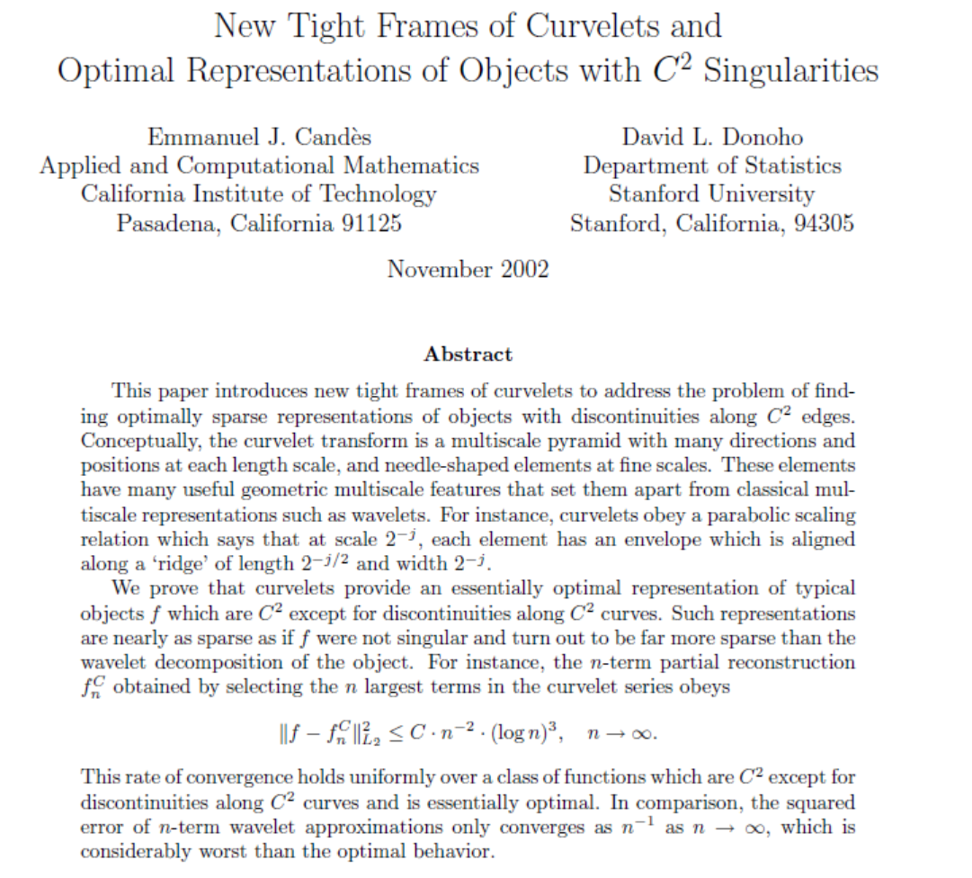


Little Bit of History & Background

Slide 7


Little Bit of History & Background
Amazingly, the first work to define the problem of dictionary learning was conceived in 1996 by two psychologists who work on brain research – David Field from Cornell, and Bruno Olshausen from UC-Davies (later moved to Berkeley.
They were the first to consider the question of dictionary learning, in the context of studying the simple cells in the visual cortex
Their message was: if we seek a “sparsifying transform”, we get atoms that resemble the measured responses by Hubel and Wiesel [1959]

Slide 8
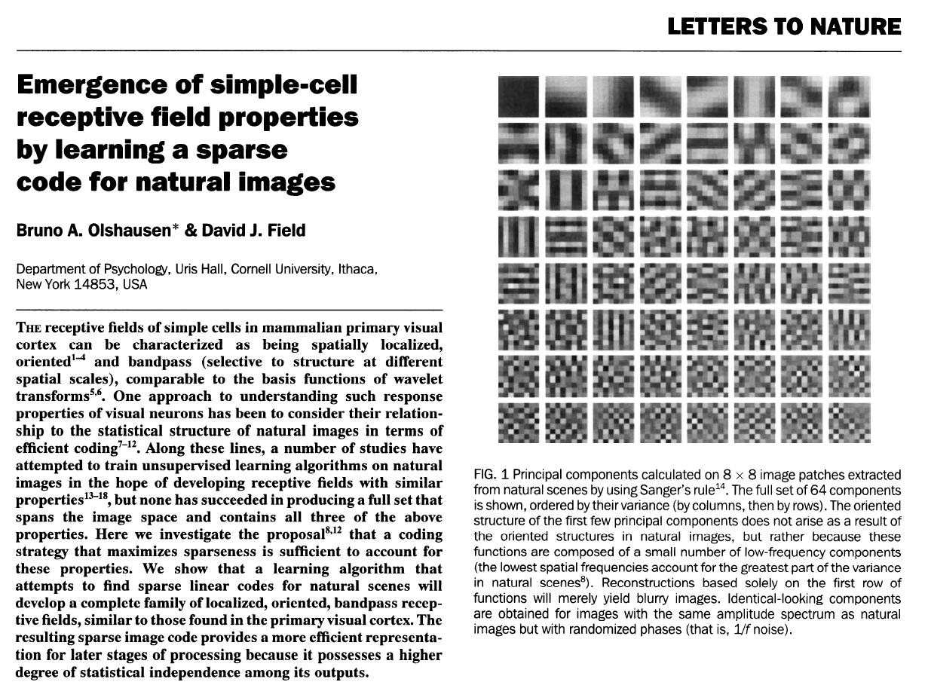
Little Bit of History & Background
Field & Olshausen were the first (1996) to consider the question of dictionary learning, in the context of studying the simple cells in the visual cortex

Slide 9
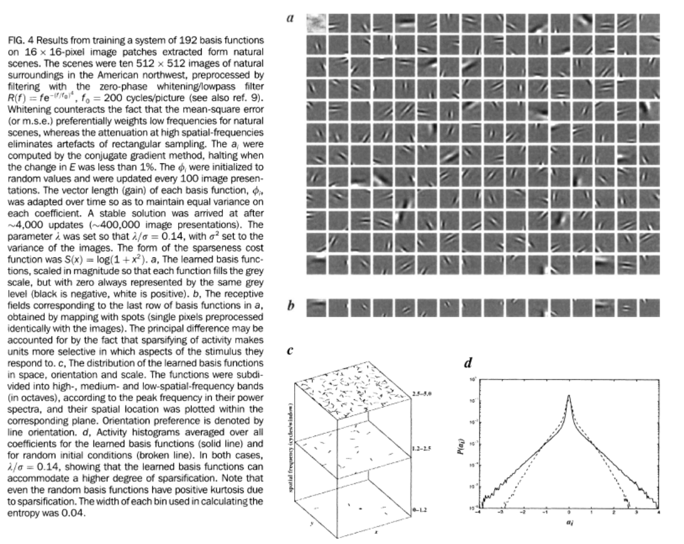
Little Bit of History & Background
Field & Olshausen were the first (1996) to consider the question of dictionary learning, in the context of studying the simple cells in the visual cortex

Slide 10
Little Bit of History & Background
Field & Olshausen were not interested in signal/image processing, and thus their learning algorithm was not considered as a practical tool
Later work by Lweicki, Engan, Rao, Gribonval, Aharon, and others took this to the realm of signal/image processing
Today, this is a hot topic, with thousands of papers that look at the problem of learning the dictionary from different aspects.
With this growth of understanding of how to get the dictionary, the field of sparse and redundant representations became far more effective and practical, as such dictionaries are now used in practically every application in data processing, ranging from simple denoising, all the way to recognition, and beyond.

Slide 11
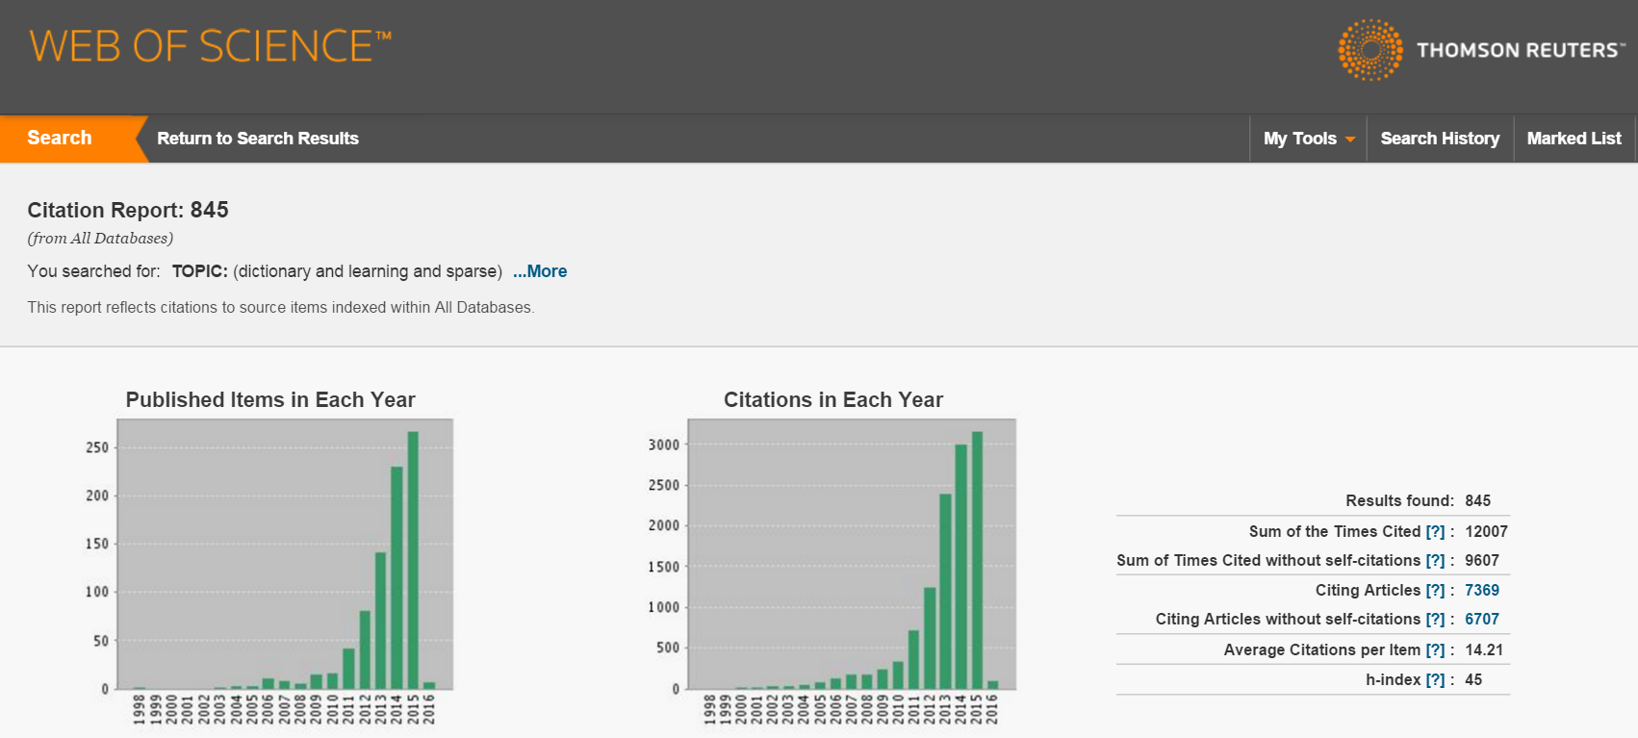
Little Bit of History & Background
Here is a search result for the words “dictionary and learning and sparse” in Thompson’s Web-of-Science

Slide 12
Dictionary Learning – Problem Definition
Assume that N signals have been generated from Sparse-Land
(with an unknown but fixed) dictionary D of known size n×m.
The learning objective: Find the dictionary and the
corresponding N representations, such that
Dictionary Learning Algorithm

Slide 13
Dictionary Learning – Problem Definition
Dictionary Learning Algorithm
The learning objective can be posed as the following optimization tasks:
or

Slide 14
Dictionary Learning (DL) – Well-Posed?
Lets work with the expression:
Is it well-posed? No!!
Permutation of atoms in D (and elements in the representations) do not affect the solution
Scale between D and the representations is undefined – this can be fixed by adding a constraint of the form (normalized atoms):

Slide 15
Uniqueness?
Question: Assume that N signals have been generated from Sparse-Land
(with an unknown but fixed) dictionary D.
Can we guarantee that D is the only outcome possible for
explaining the data?
Answer: If
N is big enough (exponential in n),
There is no noise (ε=0) in the model,
The representations are very sparse ( )
then uniqueness is guaranteed [Aharon et. al., 2005]

Slide 16
DL as Matrix Factorization
Dictionary Learning Algorithm
Training signals
Fixed size dictionary
Sparse representations
…
n
…
m
N
m
N

Slide 17
DL versus Clustering
Lets work with the expression:
Assume k₀=1 and non-zeros in α_{k} must be ‘1’
This implies that every signal x_{k} is attributed to a single column in D as its representation
This is known as the clustering problem – divide a set of n-dimensional points into m groups-clusters.
A well-known method for handling this is K-Means that iterates between:
Fix D (the cluster “centers”) and assign every training example to its closest atom in D,
Update the columns of D to give better service to their groups – this amounts to computation of the cluster mean (thus K-Means)

Slide 18
Method Of Directions (MOD) Algorithm [Engan et. Al. 2000]
Initialize D
By choosing a predefined dictionary or
Choosing m random elements of the training set
Iterate:
Update the representations, assuming a fixed D:
Update the Dictionary, assuming a fixed A:
Stop when

Slide 19
The K-SVD Algorithm [Aharon et. al. 2005]
Initialize D
By choosing a predefined dictionary or
Choosing m random elements of the training set
Iterate:
Update the representations, assuming a fixed D:
Update the Dictionary atom-by-atom, along with the elements in A multiplying it
Stop when

Slide 20
The K-SVD Algorithm – Dictionary Update
Lets assume that we are aiming to update the first atom.
The expression we handle is this:
Notice that all other atoms (and coefficients) are assumed fixed, so that E₁ is considered fixed.
Solving the above is a rank-1 approximation, easily handled by SVD, BUT the solution will result with a densely populated row a₁.
The solution – Work with a subset of the columns in E₁ that refer to signals using the first atom

Slide 21
The K-SVD Algorithm – Dictionary Update
Summary:
In the “dictionary update” stage we solve the sequence of problems
for k=1,2,3, … till m.
The operator P_{k} stands for a choosing mechanism of the relevant examples. The vector stands for a subset of the elements in a_{k} – the non-zero elements.
The actual solution of the above problem does not need SVD. Instead, use LS:

Slide 22
Speeding-up MOD & K-SVD
Both MOD and K-SVD can be regarded as special solutions to the following algorithm’ rationale:
Initialize D (somehow)
Iterate:
Update the representations, assuming a fixed D
Assume a fixed SUPPORT in A, and update both
the dictionary and the non-zeros
Stop when ….

Slide 23
Speeding-up MOD & K-SVD
Assume a fixed SUPPORT in A, and update both
the dictionary and the non-zeros
MOD
K-SVD

Slide 24
Simple Tricks that Help
After each dictionary update stage do this:
If two atoms are to similar, discard of one of them.
If an atom in the dictionary is rarely used, discard of it.
In both cases, we need a replacement for the atoms thrown – Choose the signal example that is the most ill-represented.
These two tricks are extremely valuable in getting a better quality final dictionary from the DL process.

Slide 25
Demo 1 – Synthetic Data
We generate a random dictionary D of size 30×60 entries, and normalize its columns
We generate 4000 sparse vectors α_{k} of length 60, each containing 4 non-zeros in random locations and random values
We generate 4000 signals form these representations by
with σ=0.1
We run the MOD, the K-SVD, and the speeded-up version of K-SVD (4 rounds of updates), 50 iterations, and with a fixed cardinality of 4, aiming to see if we manage to recover the original dictionary

Slide 26
Demo 1 – Synthetic Data
We compare the found dictionary to the original one, and if we detect a pair with we consider them as being the same
Assume that the pair we are considering is indeed the same, up to noise of the same level as in the input data:
On the other hand:
Thus, which means that we demand a noise decay of factor 15 for two atoms to be considrered as the same

Slide 27
Demo 1 – Synthetic Data
As we cross the level 0.1, we have a dictionary that is as good as the original because it represents every example with 4 atoms, while giving an error below the noise level

Slide 28
Demo 2 – True Data
We extract all 8×8 patches from the image ‘Barbara’, including overlapped ones – there are 250000 such patches
We choose 25000 out of these to train on
The initial dictionary is the redundant DCT, a separable dictionary of size 64×121
We train a dictionary using MOD, K-SVD, and the speeded up version, 50 iterations, fixed card. of 4
Results (1): The 3 dictionaries obtained look similar but they are in fact different
Results (2): We check the quality of the MOD/KSVD dictionaries by operating on all the patches – the representation error is very similar to the training one

Slide 29
Demo 2 – True Data
KSVD dictionary MOD dictionary

Slide 30
Dictionary Learning – Problems
D
Speed and Memory
For a general dictionary of size n×m, we need to store its nm entries
Multiplication by D ad D^{T} requires O(nm) operations
Fixed dictionaries are characterized as having a fast multiplication - O(n·logm). Furthermore, such dictionaries are never stored explicitly as matrices
Example: A separable 2D-DCT (even without the nlogn speedup of DCT) requires O(2n·√m) operations
n
m
√n
√m
√m
√n

Slide 31
Dictionary Learning – Problems
D
Restriction to Low-Dimensions
The proposed dictionary learning methodology is not relevant for high-dimensional signals – For n≥1000, the DL process will collapse because
Too many examples are needed – an order of at least 100m (thumb-rule)
Too many computations are needed for getting the dictionary
The matrix D starts to be of prohibiting size
For example – if we are to use Sparse-Land in image processing, how can we handle complete images?
n
m

Slide 32
Dictionary Learning – Problems
D
Operating on a Single Scale
Learned dictionaries as obtained by the MOD and the K-SVD operate on signals by considering only their native scale.
Past experience with the wavelet transform teaches us that it is beneficial to process signals in several scales, and operate on each scale differently.
This shortcoming is related to the above mentioned limits on the dimensionality of the signals involved
n
m

Slide 33
Dictionary Learning – Problems
D
Lack of Invariances
In some applications we desire the dictionary we compose to have specific invariance properties. The most classical example: shift-, rotation-, and scale-invariances.
These imply that when the dictionary is used on a shifted/rotated/scaled version of an image, we expect the sparse representation obtained to be tightly related to the representation of the original image.
Injecting these invariance properties to dictionary-learning is valuable, and the above methodology has not addressed this matter.
n
m

Slide 34
Dictionary Learning – Problems
D
We have some difficulties with the DL methodology:
Speed and Memory
Restriction to Low-Dimensions
Operating on a Single Scale
Lack of Invariances
The answer: Introduce
Structure into the dictionary
We will present thee such extensions, each targeting a different problem(s)
n
m

Slide 35
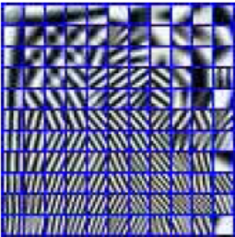
The Double Sparsity Algorithm [Rubinstein et. al. 2008]
The basic idea: Assume that the dictionary to be found can be written as
Rationale: D₀ is a fixed (and fast) dictionary and Z is a sparse matrix (k₁ non-zeros in each column). This means that we assume that each atom in D has a sparse representation w.r.t. D₀.
Motivation: Look at a dictionary found (by K-SVD) for an image – its atoms look like images themselves, and thus can be represented via 2D-DCT
D
D₀
Z
n
=
n
m₀
m₀
m
m

Slide 36
The Double Sparsity Algorithm [Rubinstein et. al. 2008]
The basic idea: Assume that the dictionary to be found can be written as
Benefits:
When multiplying by D (and its adjoint) , it will be fast, since D₀ is fast and multiplication by a sparse matrix is cheap
The overall number of DoF is small (2mk₁ instead of mn), less examples are needed for training and better convergence is obtained
We could treat this way higher-dimension signals
D
D₀
Z
n
=
n
m₀
m₀
m
m

Slide 37
The Double Sparsity Algorithm [Rubinstein et. al. 2008]
Choose D₀ and Initialize Z somehow
Iterate:
Update the representations, assuming a fixed D=D₀Z:
KSVD style: Update the matrix Z atom-by-atom,
along with the elements in A multiplying it
Stop when the representation error is below a threshold

Slide 38
The Double Sparsity Algorithm [Rubinstein et. al. 2008]
Dictionary Update Stage: the error term to minimize is
Our problem is thus:
and it will be handled by
Fixing z₁, we update by least-squares
Fixing , we update z₁ by “sparse coding”

Slide 39
The Double Sparsity Algorithm [Rubinstein et. al. 2008]
Let us concentrate on the “sparse-coding” within the “dictionary-update stage”:
A natural step to take is to exploit the algebraic relationship
and then we get a classic pursuit problem that can be treated by OMP:
The problem with this approach is the huge dimension of the obtained problem - is of size nm₀×m₀
Is there an alternative?

Slide 40
The Double Sparsity Algorithm [Rubinstein et. al. 2008]
Question: How can we manage the following sparse coding task efficiently?
Answer: One can show that
Our effective pursuit problem becomes:
and this can be easily handled.

Slide 41
Unitary Dictionary Learning [Lesage et. al. 2005]
What if D is required to be unitary?
First Implication: sparse coding becomes easy:
Second Implication: Number of DoF decreases by factor ~2, thus leading to better convergence, less examples to train on, etc..
Main Question: Ho shall we update the dictionary while forcing this constraint
?

Slide 42
Unitary Dictionary Learning [Lesage et. al. 2005]
It is time to meet “Procrustes problem”:
We are seeking the optimal rotation “D” that will take us from A to X
Solution: Our goal is
X
D
A
2
…
-
…
F

Slide 43
Unitary Dictionary Learning [Lesage et. al. 2005]
Procrustes problem:
Solution: We use the following SVD decomposition -
and get
Since and , maximum is obtained for

Slide 44
Union of Unitary Matrices as a Dictionary [Lesage et. al. 2005]
What if D₁ and D₂ is required to be unitary?
Our algorithm follows the MOD paradigm:
Update the representations given the dictionary – use the BCR (iterative shrinkage) algorithm
Update the dictionary – iterate between an update of D₁ using Procrustes to an update of D₂
The resulting dictionary is a two-ortho one, for which we have derived series of theoretical guarantees.

Slide 45
Signature Dictionary Learning [Aharon et. al. 2008]
Lets us assume that our dictionary is meant for operating on 1D overlapping patches (of length n), extracted from a “long” signal X:
Our dream: get “shift-invariance”property – if two patches are shifted version of one another, we would like their sparse representation to reflect that in a clear way.
X
Our Training Set

Slide 46
Signature Dictionary Learning [Aharon et. al. 2008]
Our training set:
Rather than building a general dictionary with nm DoF, lets construct it from a
SINGLE SUGNATURE SIGNAL
of length m, such that every patch of length n in it is an atom

Slide 47
Signature Dictionary Learning [Aharon et. al. 2008]
We shall assume cyclic shifts – thus every sample in the signature is a “pivot” for a right-patch emerging form it.
The signal’s signature is the vector , which can be considered as an “epitome” of our signal X.
In our language: the i-th atom is obtained by an “extraction” operator
=

Slide 48
Signature Dictionary Learning [Aharon et. al. 2008]
Our goal is to learn a dictionary D from the set of N examples, but D is paramterized to the “signature format”.
The training algorithm will adopt the MOD approach:
Update the representations given the dictionary
Update the dictionary given the representations
Lets discuss these two steps in more details …

Slide 49
Signature Dictionary Learning [Aharon et. al. 2008]
Sparse Coding:
Option 1:
Given d (the signature), build D (the dictionary) and apply regular sparse coding
Note: one has to normalize every atom in D and then de-normalize.

Slide 50
Signature Dictionary Learning [Aharon et. al. 2008]
Sparse Coding:
Option 2:
Given d (the signature) and the whole signal X, an inner product of the form
Implies a convolution, which has a fast version via FFT.
This means that we can do all the sparse coding stages together by merging inner products, and thus save computations

Slide 51
Signature Dictionary Learning [Aharon et. al. 2008]
Dictionary Update:
Our unknown is d and thus we should express our optimization w.r.t. it.
We will adopt an MOD rationale, where the whole dictionary is updated
Looks horrible … but it is a simple Least-Squares task

Slide 52
Signature Dictionary Learning [Aharon et. al. 2008]
Dictionary Update:

Slide 53
Signature Dictionary Learning [Aharon et. al. 2008]
We can adopt an on-Line learning approach by using the Stochastic Gradient (SG) method:
Given a function of the form to be minimized
Its gradient is given as the sum
Steepest Descent suggests iterations:
Stochastic gradient suggests sweeping through the dataset with

Slide 54
Signature Dictionary Learning [Aharon et. al. 2008]
Dictionary Update with SG:
For each signal example (patch), we update the vector d.
This update includes:
Applying pursuit to find the coefficients α_{k},
computation of the representation residual, and
back-projecting it with weights to the proper locations in d

Slide 55
Signature Dictionary Learning [Aharon et. al. 2008]
Why Use the Signature Dictionary?
Number of DoF is very low – this implies that we need less examples for the training, the learning converges faster and to a better solution (less local minimum points to fall into)
The same methodology can be used for images (2D signature)
We can leverage the shift-invariance property – given a patch that has gone through pursuit, moving to the next one, we can start by “guessing” the same decomposition with shifted atoms, and then update the pursuit – this was found to save 90% computations in handling an image
The signature dictionary is the only known structure that allows naturally for multi-scale atoms.

Slide 56
Dictionary Learning – Present & Future
There are many other DL methods competing with the above ones
All the algorithms presented here aim for (sub-)optimal representation. When handling a specific tasks, there are DL methods that target a different optimization goal, more relevant to the task. Such is the case for
Supervised DL for Classification
Supervised DL for Regression
Joint learning of two dictionaries for Super-resolution
Learning while identifying outliers and removing them
Learning jointly several dictionaries for data separation
…
Several multi-scale DL methods exist
Just like other methods in machine learning, kernelization is possible, both for the pursuit and DL – this implies a non-linear generalization of Sparse-Land
Future work will focus on new applications benefiting form DL …. and

Slide 57

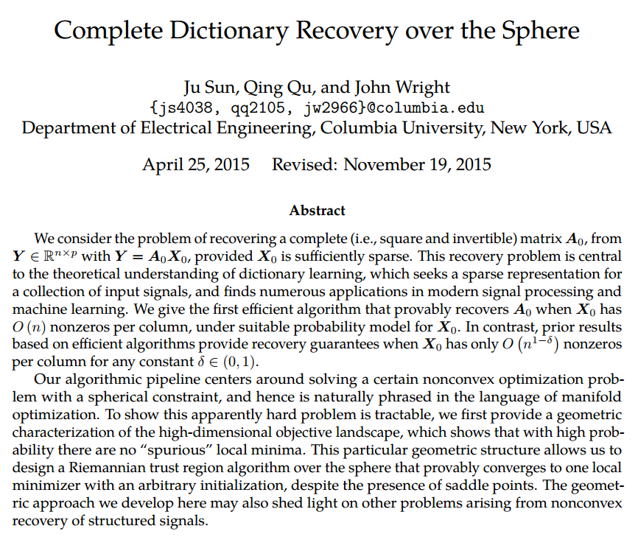
Dictionary Learning – Present & Future
In the past several years there is also an impressive progress on theoretically understanding the dictionary learning problems and its prospects of being solved.
Representative work include:
Series of papers by John Wright from Columbia, e.g.

Slide 58

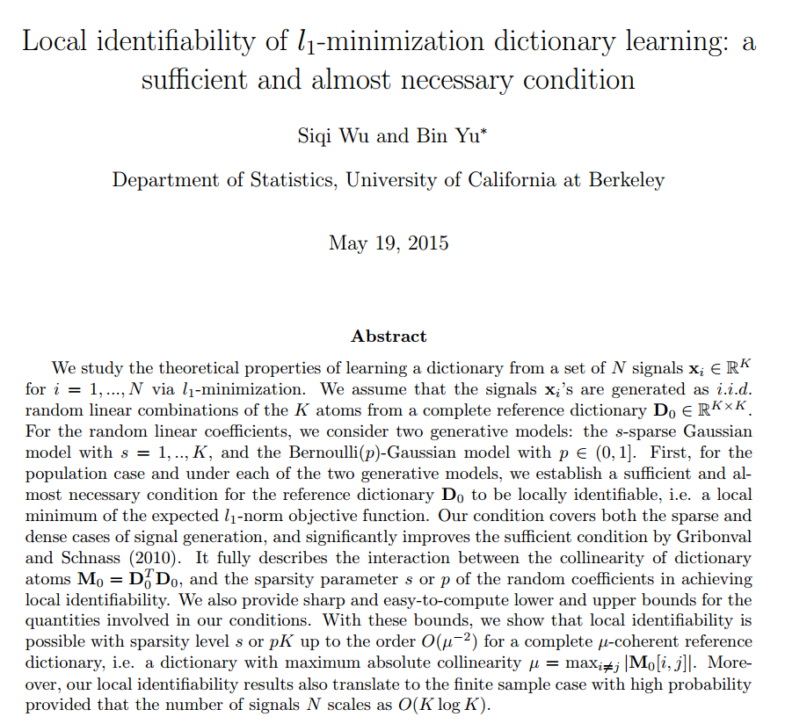
Dictionary Learning – Present & Future
In the past several years there is also an impressive progress on theoretically understanding the dictionary learning problems and its prospects of being solved.
Representative work include:
The work by Bin Yu from Berkeley

Slide 59

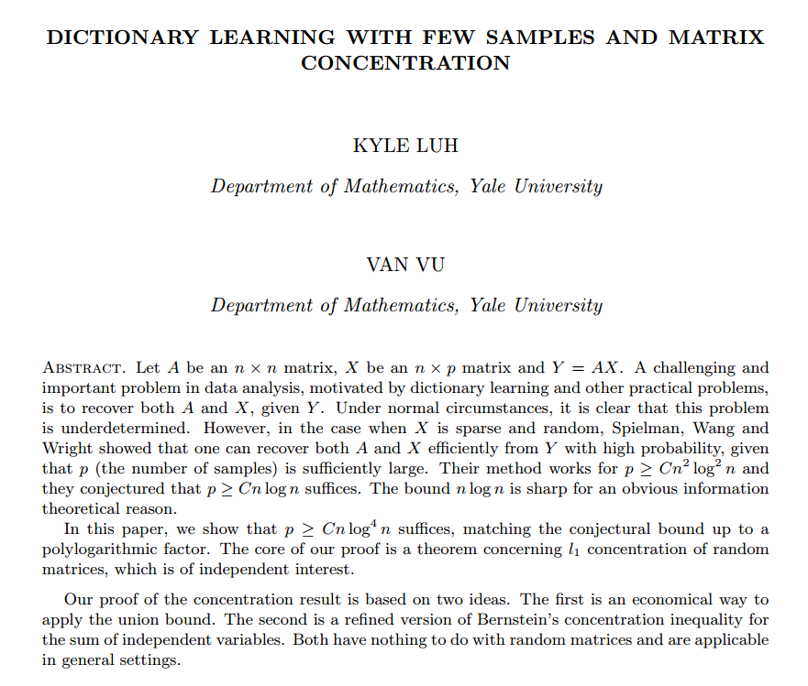
Dictionary Learning – Present & Future
In the past several years there is also an impressive progress on theoretically understanding the dictionary learning problems and its prospects of being solved.
Representative work include:
The work by Van H. Vu from Yale

Slide 60

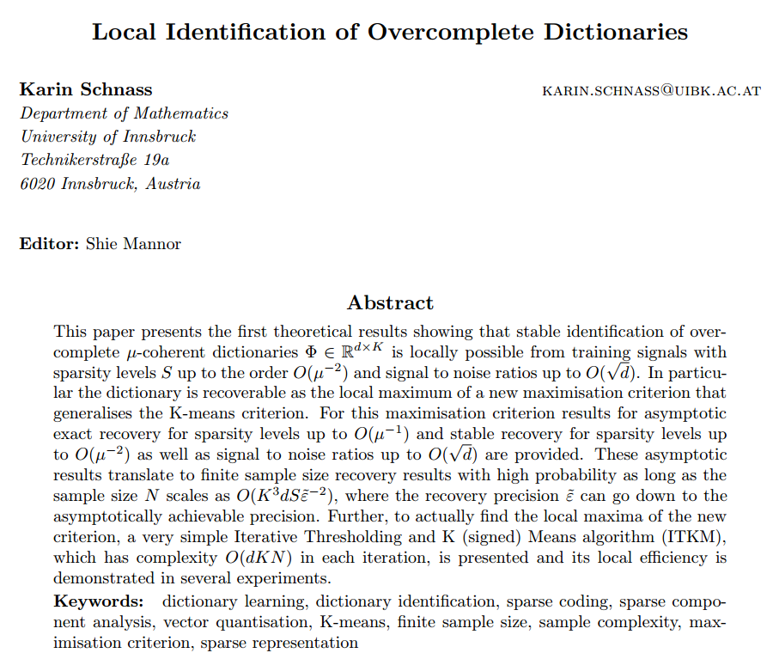
Dictionary Learning – Present & Future
In the past several years there is also an impressive progress on theoretically understanding the dictionary learning problems and its prospects of being solved.
Representative work include:
The work by Karin Schnass from Innsbruck, Austria

