Slide 1

PROPOSAL FOR PILOT REVIEW
Haki
Offline student information assistant for TUP Taguig.
A source-referenced, admin-governed campus guide proposed for supervised evaluation.
Offline-first
Source-referenced
Admin-governed
Prepared for TUPT administrative evaluation
Joshua Retrita | BSIT 2025-2026
App-matched Haki mascot artwork
Haki proposal for TUPT administrative review
01

Slide 2
THE CAMPUS SERVICE PROBLEM
The friction is not a lack of information. It is access.
Students often need simple guidance, but the answer may live across office posts, pages, documents, and informal advice.
1
Information is scattered
2
Students ask repeatedly
3
Offices absorb avoidable load
Office posts, pages, handbooks, room lists, and student hearsay are not one searchable service.
Basic questions reach front desks, classmates, group chats, or the wrong office.
Staff still become the last-mile explanation layer for routine campus guidance.
Presentation stance
Evaluate Haki as a student service layer first; treat AI as optional support.
This framing keeps the discussion practical: accuracy, ownership, privacy, maintainability, and pilot governance.
Haki proposal for TUPT administrative review
02

Slide 3
WHAT HAKI ACTUALLY IS
Haki answers from approved local sources before it ever needs AI.
TUPT-approved source package
On-device SQLite + FTS
Source answer builder
Student surfaces
Documents, procedures, office guidance, citations, and update dates selected by Administration.
Searchable local index works offline and remains the baseline even without a model.
Ranks results, checks confidence, and formats the answer with citations.
Chat, Service Desk, Library, Map, and other app screens expose the guidance.
Optional local AI lane
Compatible downloaded model -> supportive/general chat and local summarization only when safe. Official campus procedures still come from saved sources.
AI is optional
Haki proposal for TUPT administrative review
03

Slide 4
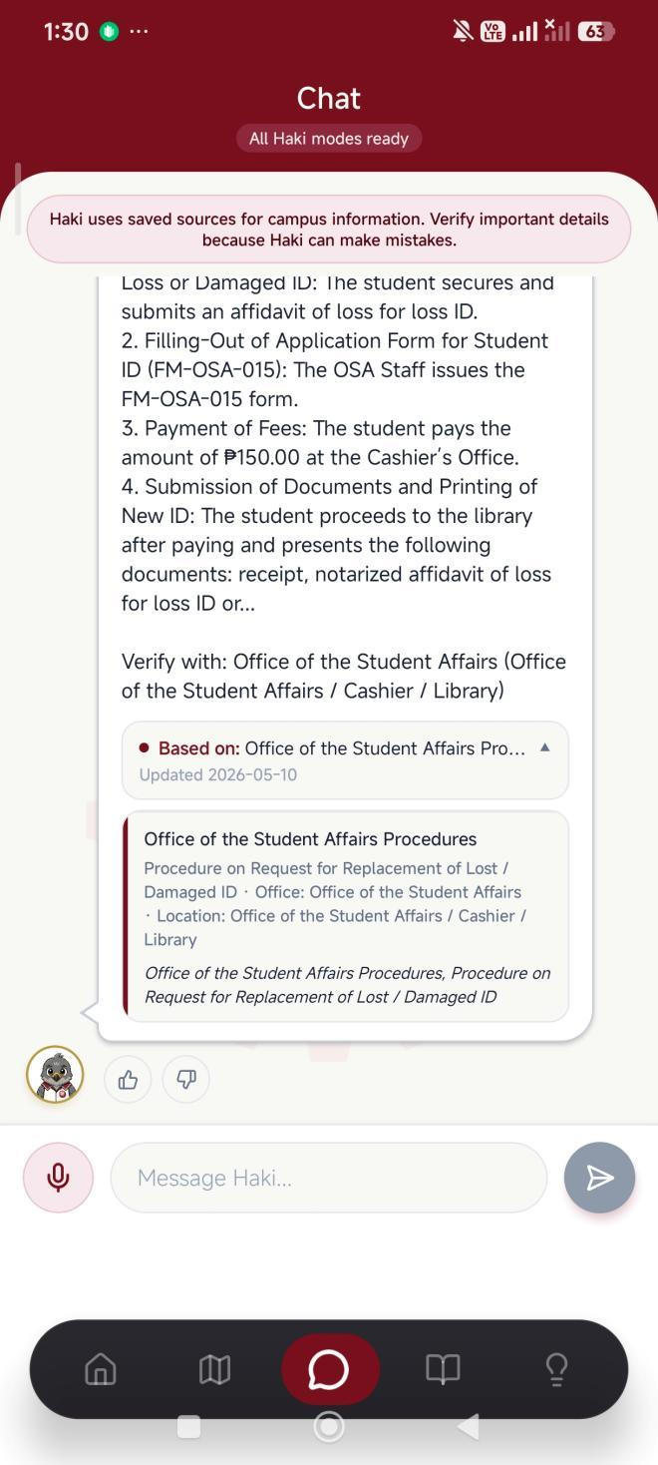
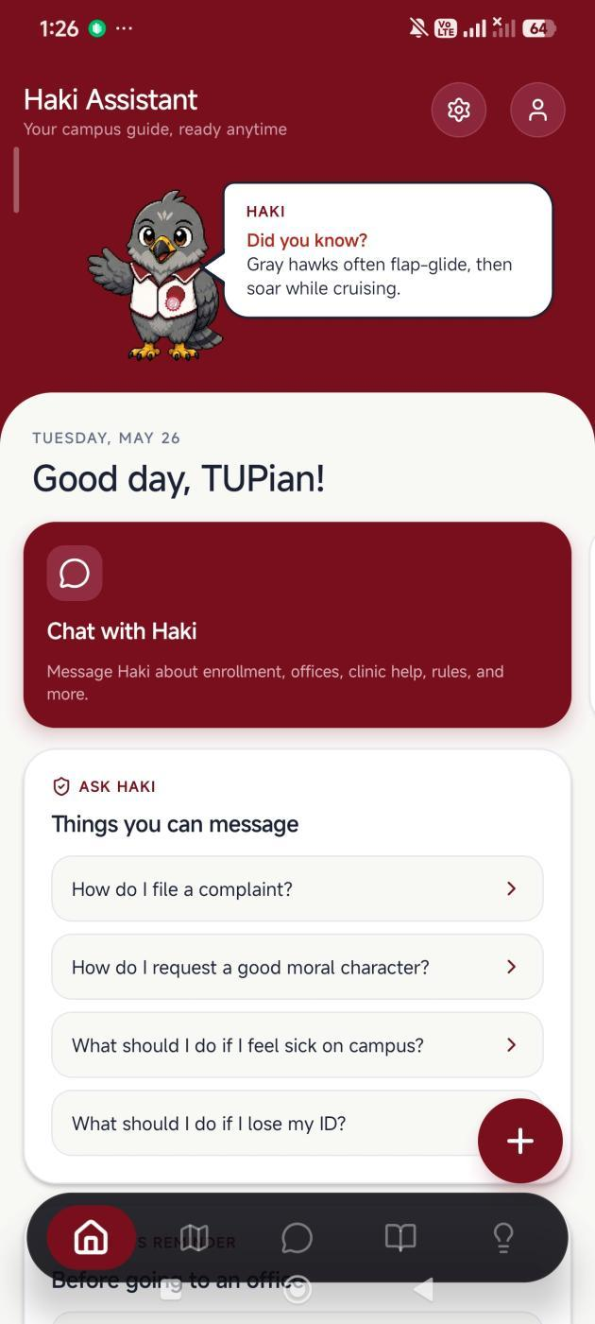
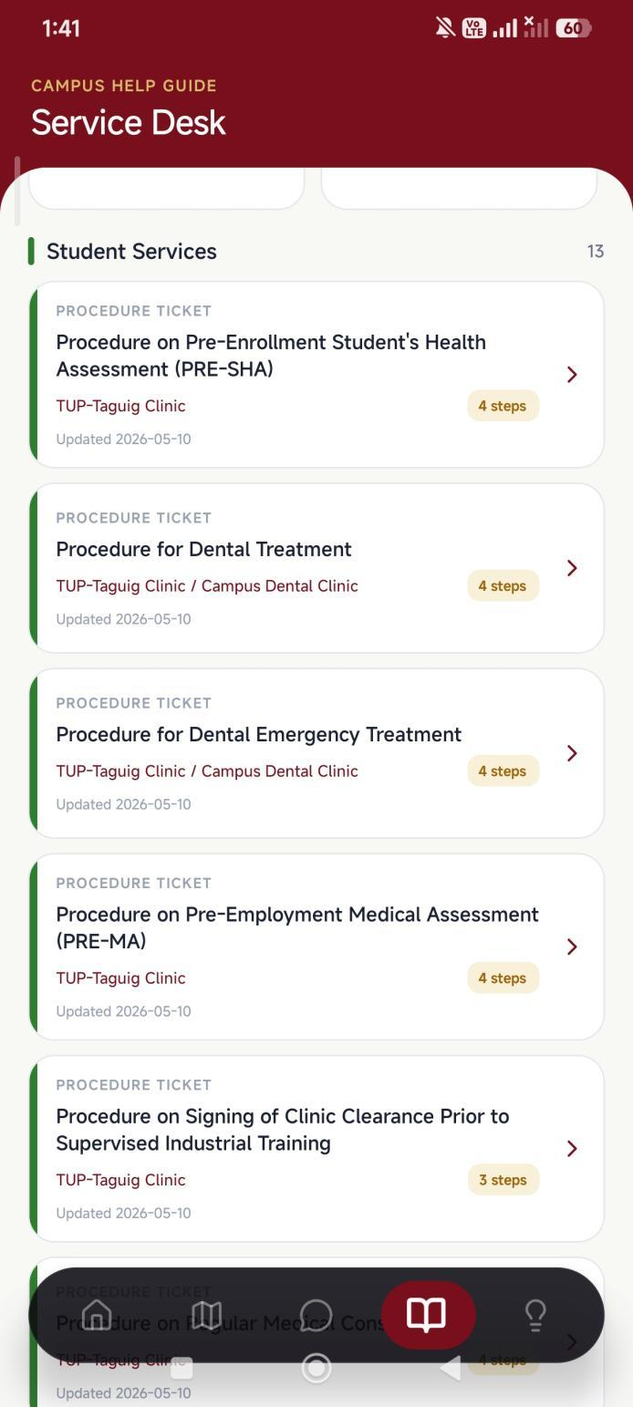
STUDENT JOURNEY
A student can move from question to source-backed next step in one flow.
1. Student home
3. Service desk topics
2. Source-backed chat
No backend required for campus source search
Haki proposal for TUPT administrative review
04

Slide 5
TRUST MODEL
Citations make Haki auditable instead of a black-box chatbot.
Student sees the answer
The response is phrased for student action, not as raw database text.
Admin can inspect evidence
The source card names the campus document, office, and citation used by the answer.
Missing source is a signal
If official content is weak or absent, the right response is review or clarification, not guessing.
The pitch point: Haki is safer when it behaves like a controlled reference system, not a model pretending to know policy.
Campus answer with source panel
Haki proposal for TUPT administrative review
05

Slide 6
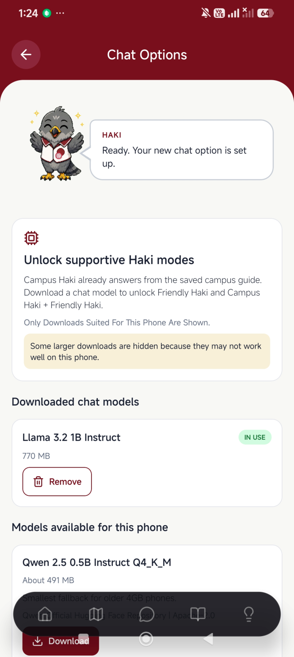
PRIVACY AND INFRASTRUCTURE
Offline-first design lowers privacy and infrastructure risk.
The proposal positions Haki as a local device app: no external chat API, no cloud database, and no server dependency for campus source search.
Inside the student's phone
Saved campus guide: Approved documents and citations
SQLite source search: Fast offline retrieval
Optional local model: Downloaded only on compatible devices
Profile/history controls: Local settings, not external server state
Official web pages remain the source for real-time announcements.
Device-aware local model screen
Haki proposal for TUPT administrative review
06

Slide 7
ADMIN GOVERNANCE
TUPT keeps ownership of the content and release decision.
Administration
Responsible office
Student or staff maintainers
Haki app
Decides whether Haki is appropriate, what content is allowed, and how distribution should be governed.
Coordinates official source review, update cadence, and policy ownership across offices.
Prepare source packages, perform updates, and preserve technical continuity under supervision.
Publishes only the approved local guide to students through chat, search, map, and library screens.
Developer role: build, hand over, guide first maintainers, and request attribution only if Haki is deployed or promoted.
Haki proposal for TUPT administrative review
07

Slide 8
COMMUNITY BENEFIT
One student app can improve service quality across the community.
Stakeholder
Current friction
What Haki improves
Students
Unsure which office to approach, what to prepare, or where to go.
Faster self-service guidance with source references and map support.
Offices
Routine questions repeat at counters and through informal channels.
Better-prepared students and fewer basic inquiries for staff.
Admin
Official guidance can be hard to keep consistent across channels.
Central content authority with local, auditable student access.
TUPT
Student-led innovation is often hard to convert into institutional value.
A visible responsible AI-era service project with controlled pilot scope.
The value is operational first: clearer guidance, less repetition, and a governable path to adoption.
Haki proposal for TUPT administrative review
08

Slide 9
LOW-RISK ADOPTION PATH
A pilot review turns adoption into a controlled administrative decision.
The ask is not a blind launch. It is permission to evaluate Haki with official content, supervision, and measured student feedback.
1
Content validation
2
Internal pilot
3
Student pilot
4
Deployment decision
Administration identifies approved offices, documents, citations, and exclusions.
Reviewing office and maintainers test answers, missing-source behavior, and update process.
Small student group tests common tasks: office concern, map, service desk, and source clarity.
Admin decides whether to publish, how to govern distribution, and who maintains it.
Decision gate after each phase: continue, revise, limit scope, or stop.
Haki proposal for TUPT administrative review
09

Slide 10

REQUESTED ADMINISTRATIVE ACTION
Approve a supervised pilot review, not a blind launch.
The proposal letter can carry the formal terms. The presentation should close on the next practical decision.
1
Assign a reviewing office or evaluation owner
2
Validate which campus information can be included
3
Approve a small, supervised student pilot
4
Decide distribution and maintenance after evidence
5
Confirm acceptable developer attribution if deployed
Haki remains a TUPT-controlled service candidate
Suggested closing line: I built Haki for the TUPT community, but the Administration should decide how it is reviewed, governed, and released.
Haki proposal for TUPT administrative review
10

Slide 11

DEMO SECTION
Haki App Exploration
A student walkthrough from question to campus action.
The next slides mimic how a TUPian could use Haki during a normal campus task: ask, verify, locate, prepare, then use student-life tools when needed.
Ask
Verify
Locate
Prepare
Haki proposal for TUPT administrative review
11

Slide 12
DEMO STEP 1
A student starts from the Haki home screen.
The first screen gives quick paths into common campus tasks instead of making the student search blindly.
One tap to Chat
The main call to action is direct: message Haki about enrollment, offices, clinic help, rules, and more.
Suggested questions
Common tasks are visible immediately, helping new students ask in the right direction.
Friendly identity
The mascot makes the app approachable while still keeping the content source-grounded.
Haki proposal for TUPT administrative review
12

Slide 13
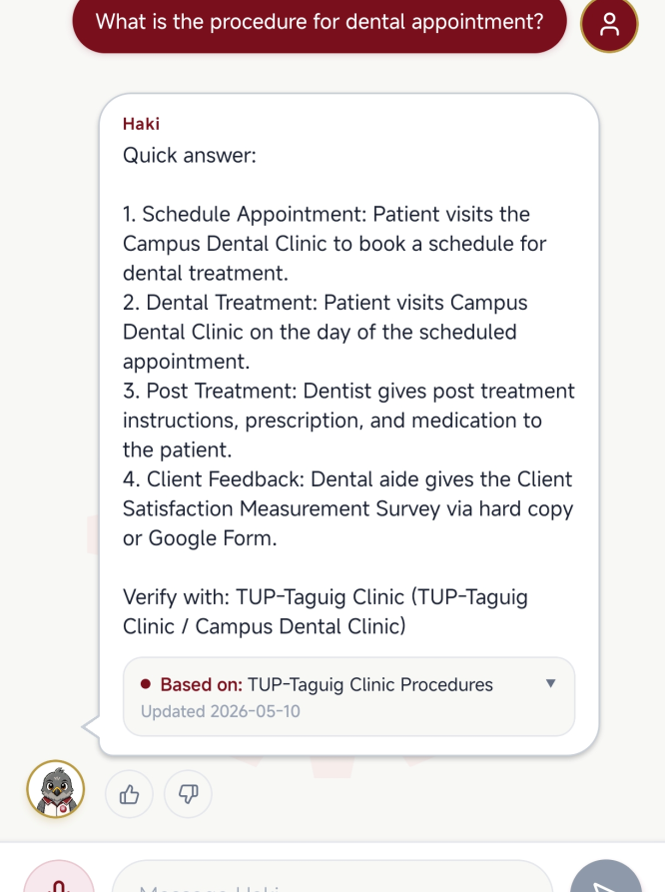
DEMO STEP 2
The student asks Haki for help.
The chat screen turns a campus question into a concise, source-backed answer with a visible verification trail.
Saved sources first
The app warns that campus information comes from saved sources and important details should be verified.
Actionable answer
The response is formatted as steps a student can follow, not just a loose paragraph.
Visible citation
The source card shows what document or office guidance supported the answer.
Haki proposal for TUPT administrative review
13

Slide 14
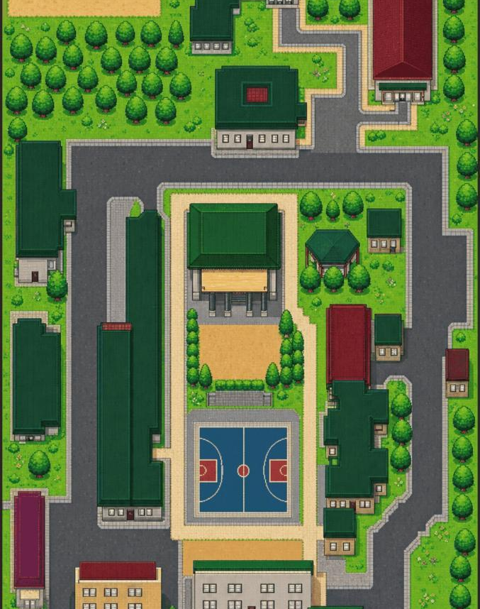
DEMO STEP 3
The student checks where to go.
After getting guidance, the student can move into the campus map to search, tap buildings, and orient themselves offline.
Map behavior
Students can walk around the campus map, search destinations, tap buildings, and use shortcuts to related screens such as Service Desk or Food.
Haki proposal for TUPT administrative review
14

Slide 15
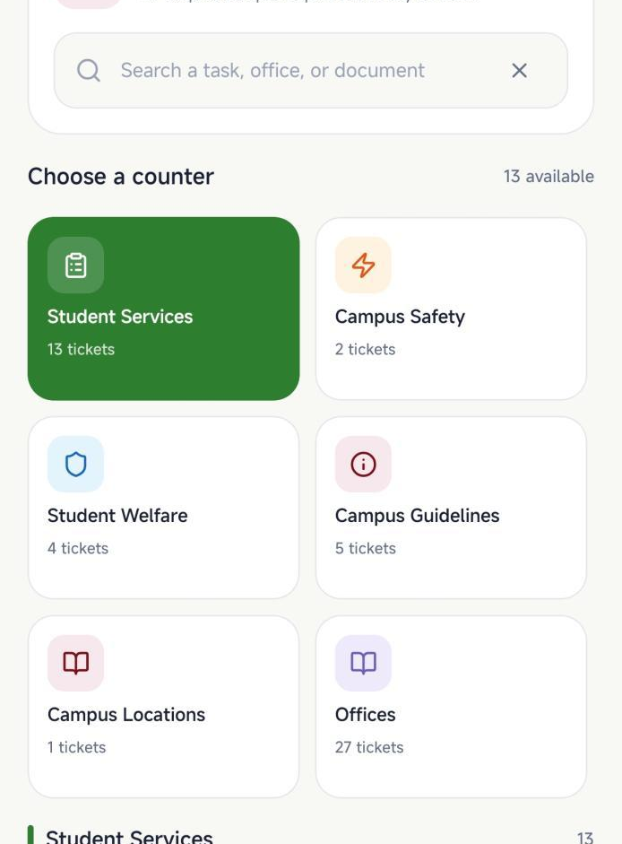
DEMO STEP 4
The student opens Service Desk when they need steps.
Service Desk organizes campus tasks into counters and procedure tickets so students can prepare before visiting an office.
Search by task or office
Students can search for a task, office, or document rather than guessing a category.
Counters group concerns
Student Services, Safety, Welfare, Guidelines, Locations, and Offices become visible paths.
Procedure tickets
Each ticket previews the topic, relevant office, update date, and number of steps.
Haki proposal for TUPT administrative review
15

Slide 16
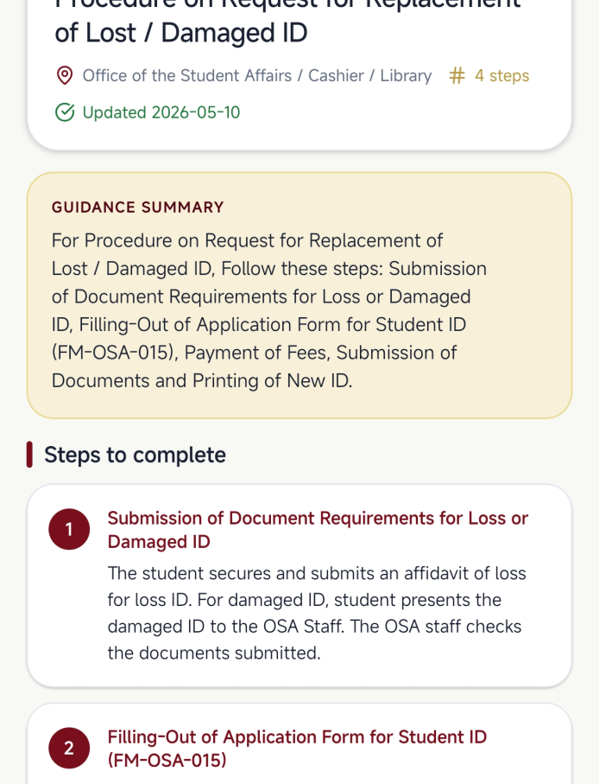
DEMO STEP 5
The student follows a procedure ticket.
The ticket detail page converts a campus concern into requirements, offices, and steps that the student can act on.
Step-by-step guide
Procedure content is broken into ordered actions, reducing confusion before the office visit.
Office context
The page names the office or offices involved, helping students route the concern.
Update visibility
The update date helps Admin and maintainers reason about freshness during review.
Haki proposal for TUPT administrative review
16

Slide 17
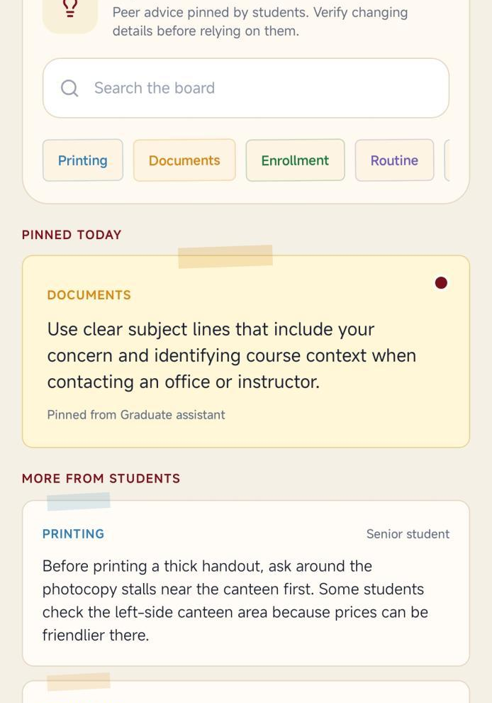
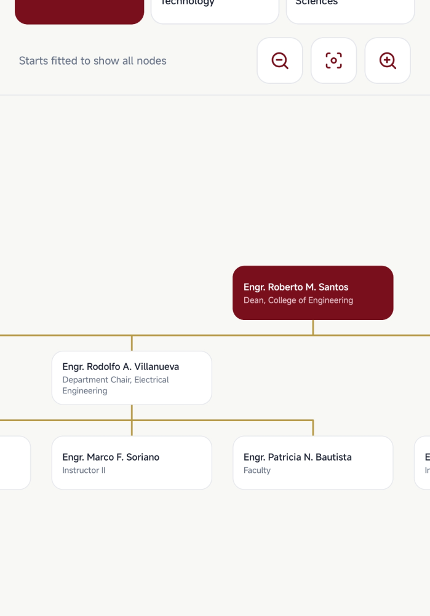
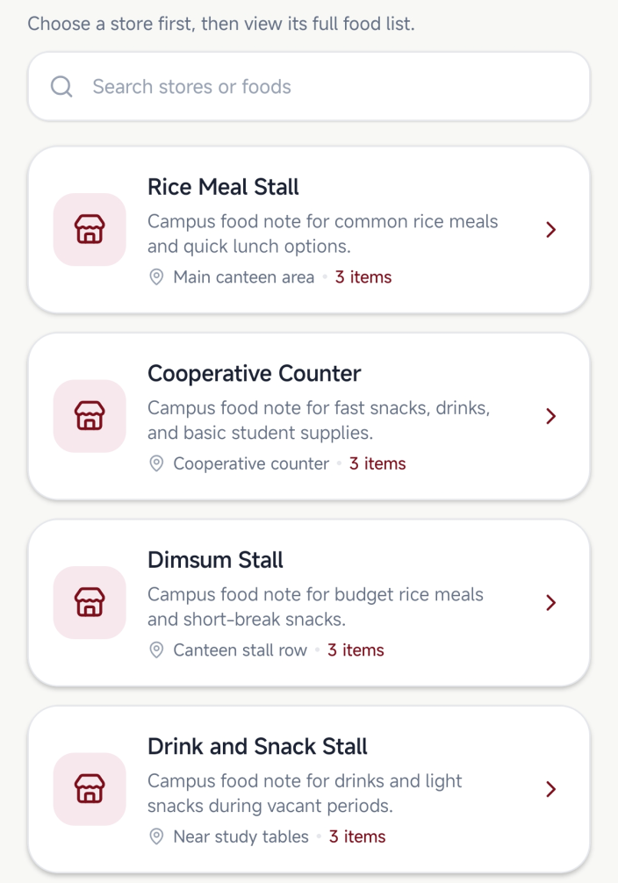
DEMO STEP 6
The student can continue into campus-life tools.
After the main task, Haki still supports everyday campus needs without making every interaction a chat conversation.
Demo takeaway
Haki behaves like a campus companion: it answers, routes, locates, and helps students prepare.
Tips
Org Chart
Food
Haki proposal for TUPT administrative review
17

