Slide 1
Today’s Objectives
Students will understand the importance of Git Version Control and of how to use it.
Students will create GitHub Repositories, push code into them, and share with class.
Students will make more HTML documents.
Students will learn to properly use basic HTML tags.
Students will implement basic CSS styling to HTML documents.

Slide 2
HTML Round 2

Slide 3
HTML Syntax (Basic)
Content
<h1>
This is Mah House
</h1>
Opening Tag
Closing Tag

Slide 4
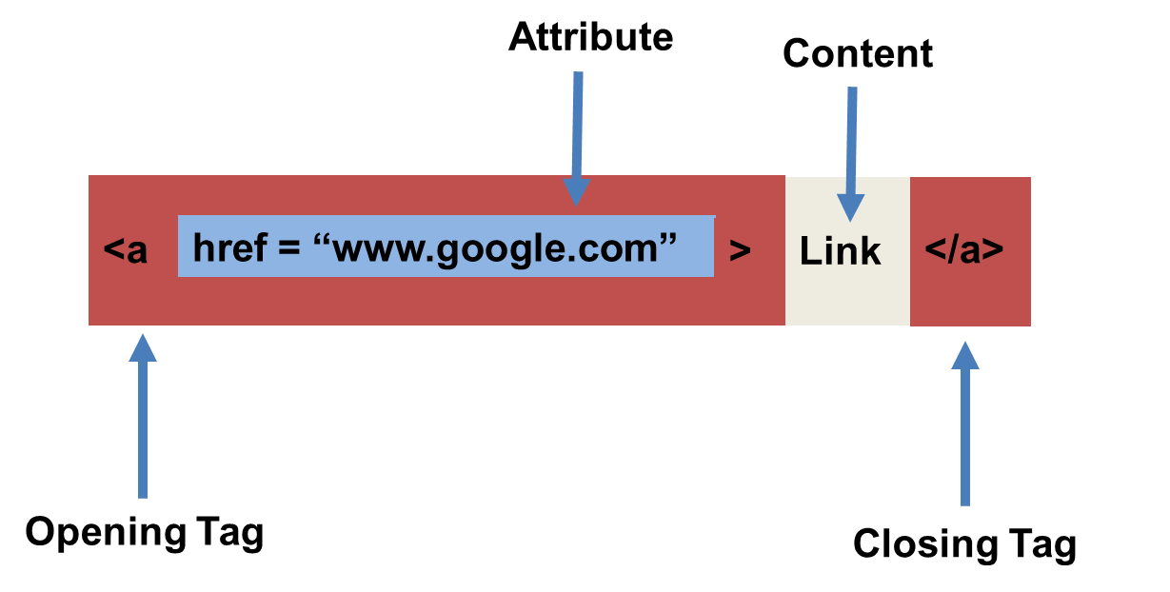
HTML Syntax (with Attribute)

Slide 5
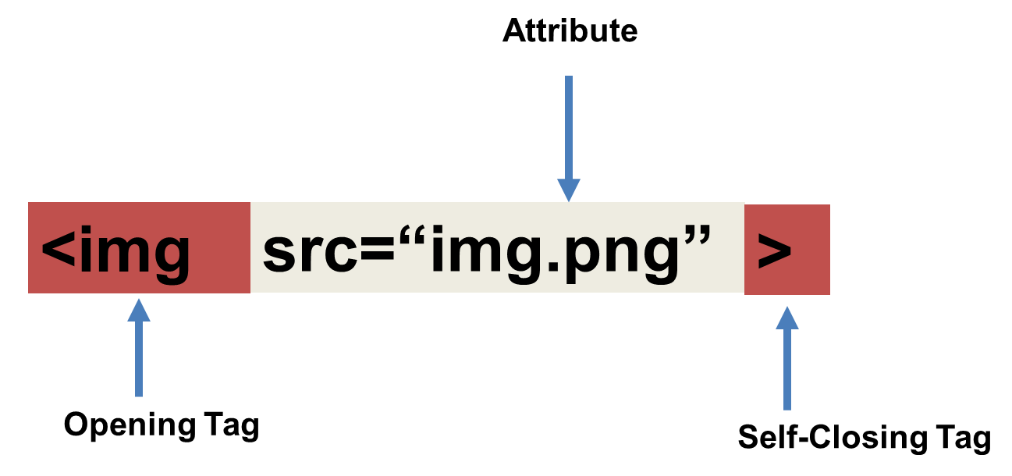
Tricky Tags (Self-Closing)

Slide 6
Important Common Tags
Headings:
<h1> </h1> - Heading 1 (Largest Heading)
<h2> </h2> - Heading 2 (Next Largest Heading)
<h3> </h3> - Heading 3
…
Containers:
<html> </html> - Wraps the entire page
<head> </head> - Wraps the header of the page
<body> </body> - Wraps the main content
<div> </div> - Logical Container ***
<p> </p> - Wraps individual Paragraphs
Others:
<strong> (bold), <em> (emphasis)
<img> (images), <a href> (links), <li> (list items) , <title> (title), <br> (line break), <table> (tables), <!-- --> (comments)

Slide 7
Less Common Tags
All HTML Tags are listed here: http://www.w3schools.com/tags/
Don’t try to memorize them! Simply refer back to documentation as needed.
Other tags:
<video> for Videos
<audio> for Audio files
<embed> for Embedded files
<code> for including computer code
<header> for headers
<nav> for navigation bars
<footer> for footers

Slide 8
HTML for Forms
Common UI (User Interface) Form Elements:
<form> - Creates a form section in HTML
<input> - Input boxes
<label> - Labels for boxes
<button> - Button
<textarea> - Large textbox

Slide 9
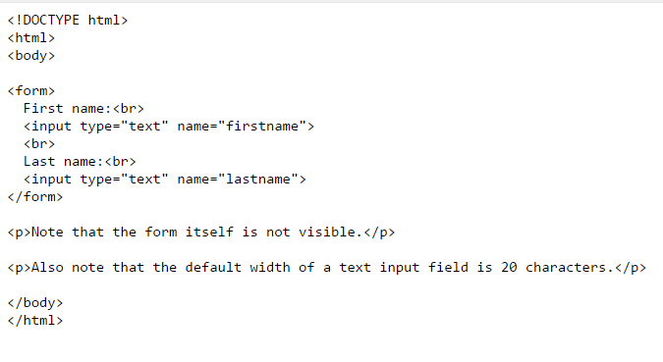
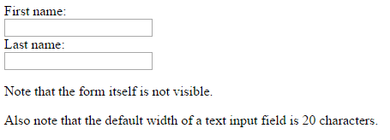
HTML for Forms

Slide 10
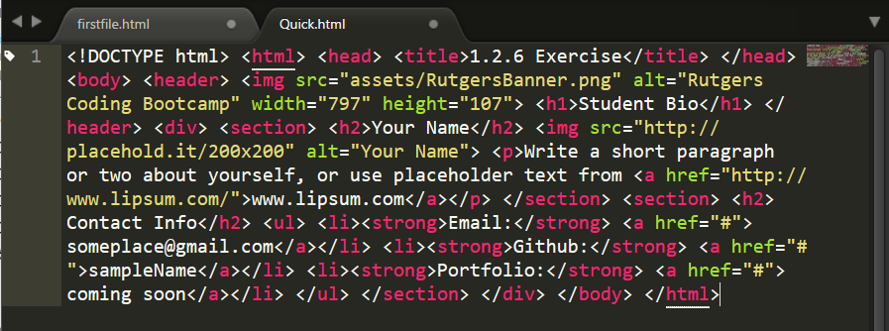
On Ugly HTML
Don’t do this… Use proper indentation and sectioning.
Readable code is easier to maintain.
Invest time to get better about this now. It will pay dividends!

Slide 11
> YOUR TURN!
Activity: 1-HTML_Git | Suggested Time: 20 min
Assignment
In this activity, you’ll create a student bio using HTML. You will then add, commit, and push your completed HTML to GitHub for the world to see.
Additional instructions, sent via Slack.

Slide 12
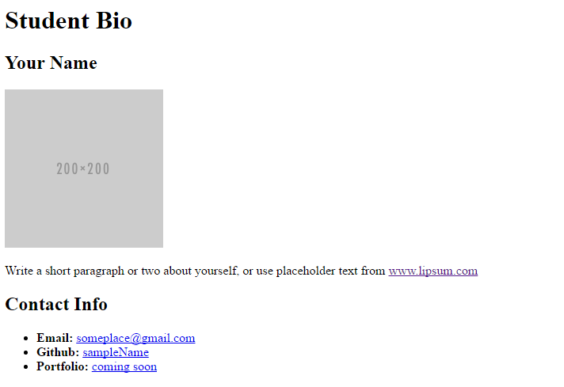
> YOUR TURN!

Slide 13
CSS Stylin’

Slide 14
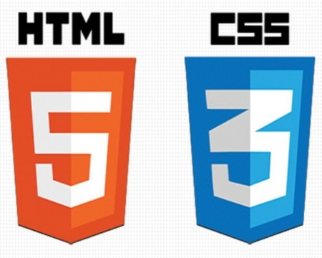

HTML / CSS Definitions (*yawn* unimportant)
HTML: Hypertext Markup Language – (Content)
CSS: Cascading Style Sheets – (Appearance)
HTML/CSS are the “languages of the web.” Together they define both the content and the aesthetics of a webpage – handling everything from the layouts, colors, fonts and content placement. (JavaScript is the third – handling logic, animation, etc.)

Slide 15


HTML / CSS Analogy
HTML Alone
Like writing papers in “Notepad.”
Can only write unformatted text.
HTML / CSS
Like writing papers in Microsoft Word.
Can format text, page settings, alignment, etc. based on “highlighting” and menu options.

Slide 16
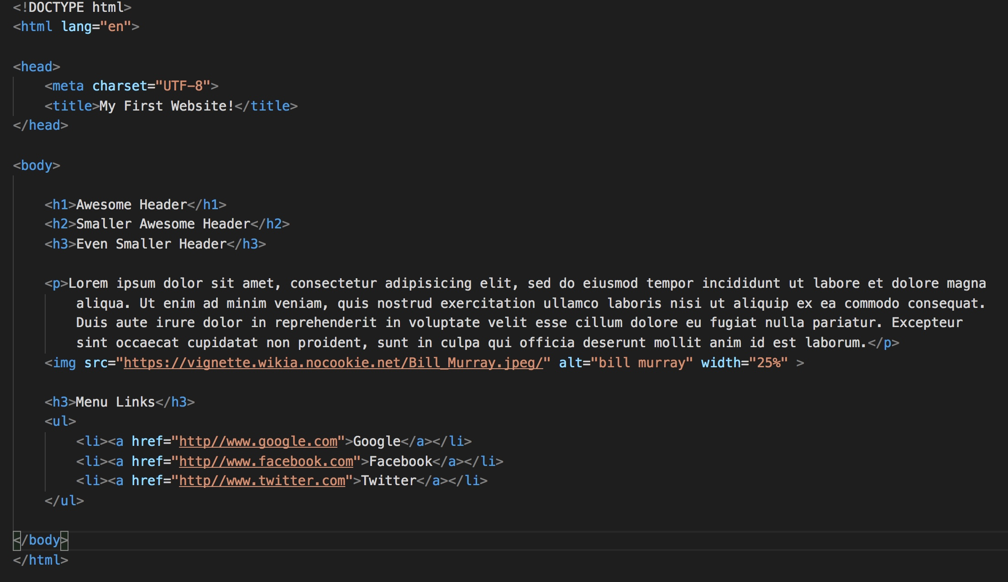
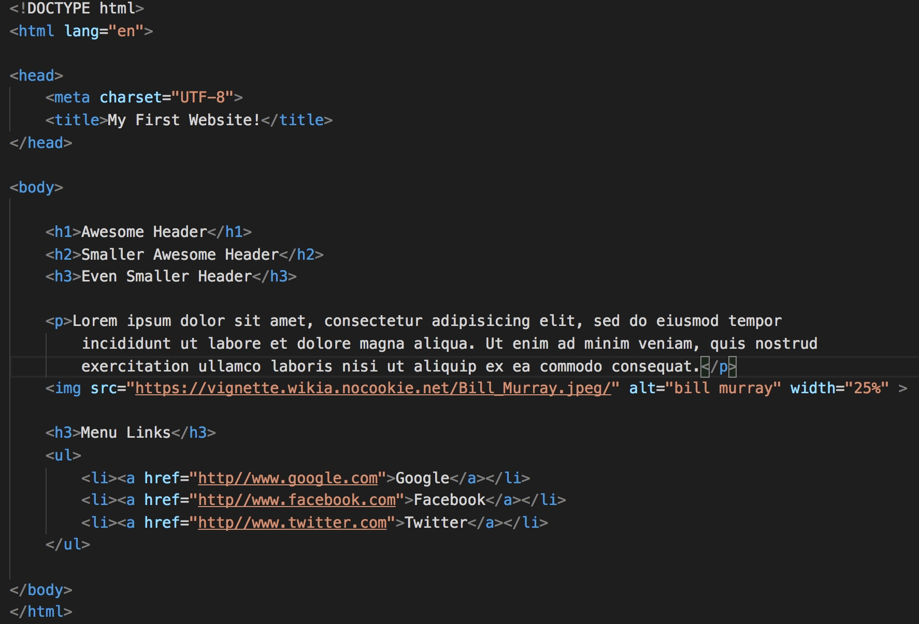
Basic HTML Page

Slide 17
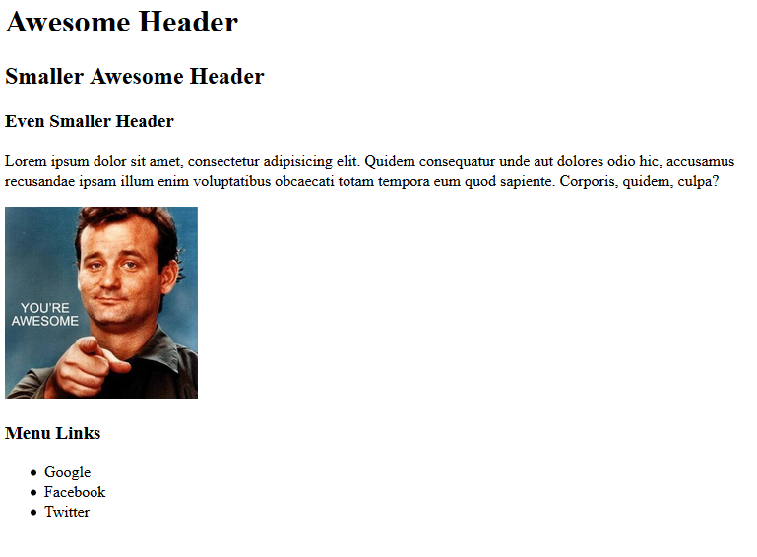
Basic HTML Page - Result

Slide 18
Basic HTML Page - Result
Hella Boring…

Slide 19
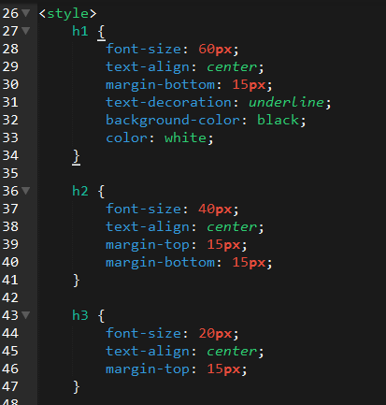
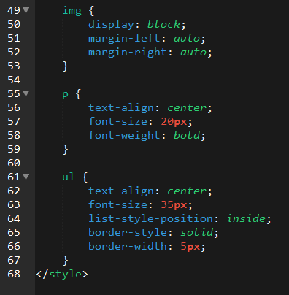
Enter CSS

Slide 20
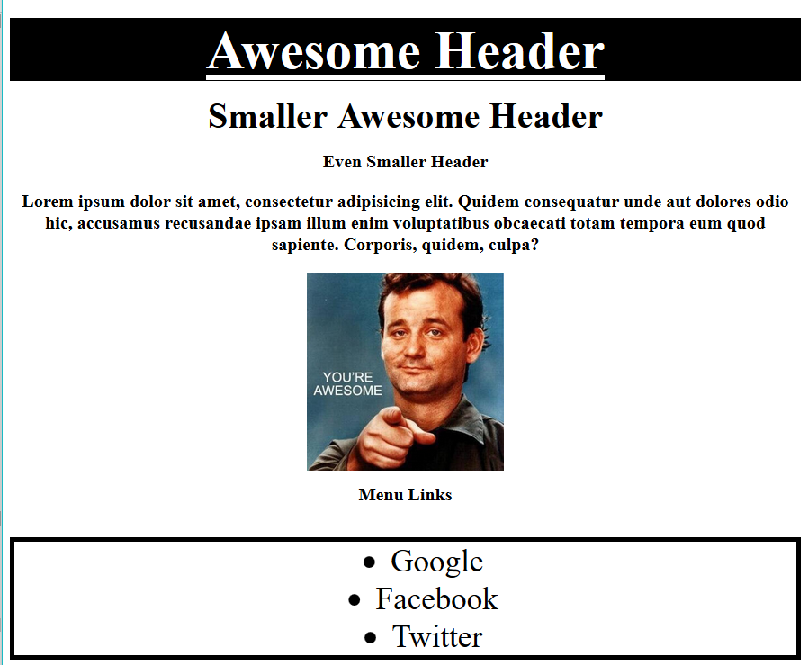
Enter CSS - Result

Slide 21
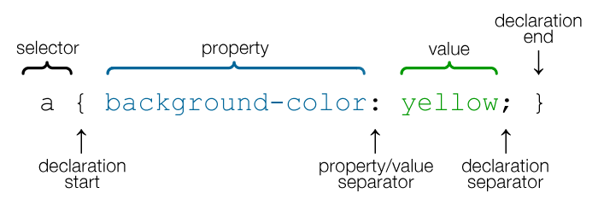
CSS Syntax
CSS works by hooking onto selectors added into HTML using classes and identifiers.
Once hooked, we apply styles to those HTML elements using CSS.

Slide 22
CSS Example
In the below example the “Header” would be turned blue and MUCH larger because of the CSS.
We can incorporate an element’s class or ID to apply a CSS style to a particular part of the document.
Just remember to include the necessary symbol before the CSS: “.” for class, “#” for ID.
Example (HTML):
<p class=“bigBlue”>Header</p>
Example (CSS):
.bigBlue
{
font-size: 100px;
color: blue;
}

Slide 23
Key CSS Attributes
Font / Color:
color: Sets color of text.
font-size: Sets size of the font.
font-style: Sets italics.
font-weight: Sets bold.
Alignment / Spacing:
padding (top/right/bottom/left): Adds space between element and its own border.
margin (top/right/bottom/left): Adds space between element and surrounding elements.
float: Forces elements to the sides, centers, or tops.
Background:
background-color: sets background color.
background-image: sets background image.

Slide 24
Powerful Duo
Believe it or not, HTML / CSS is all you need
to develop a vivid, full-blown website.

Slide 25
INSTRUCTOR DEMO
Instructor: Demo
(quickexample_internalcss.html | 2-BasicCSS)

Slide 26
> YOUR TURN!
Activity: 3-HTML_CSS_Layout | Suggested Time: 20 min
Assignment
In this activity, you’ll upgrade your previous HTML bio-page using CSS style rules. Once you’re done, commit and push up your changes to GitHub.
We’ll send you additional instructions via Slack.

Slide 27
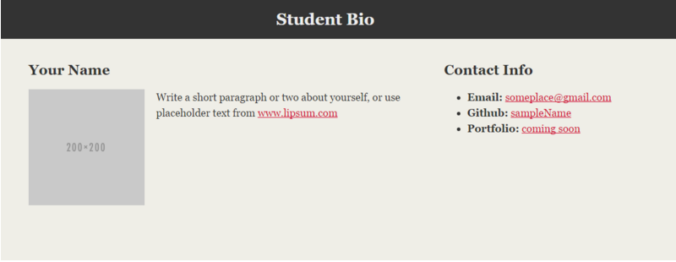
> YOUR TURN!

Slide 28
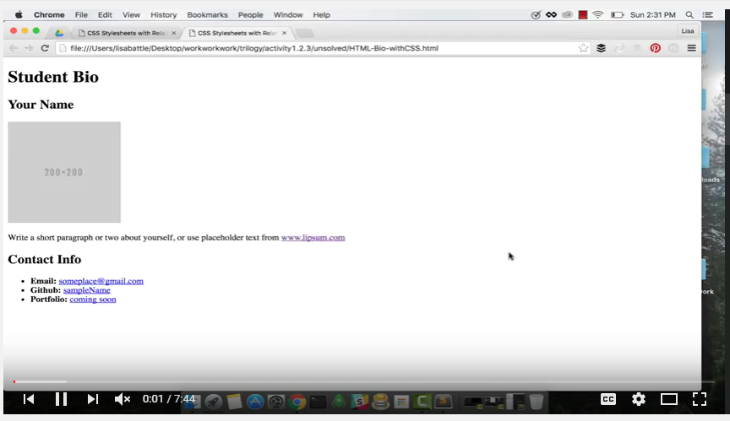
Video Walkthrough!!
https://www.youtube.com/watch?v=kMBinXTCrXI&list=PLgJ8UgkiorCnMLsUevoQRxH8t9bt7ne14&index=2

Slide 29

Still a Bit Confused?
Remember! We’ve got video guides for key activities like that last one.
If you feel like you are EVER falling behind, use those online walkthroughs to help catch back up. They are made to be easy to understand.
Still having trouble? Shoot your instructor or one of your TAs a message!
We are here to help you out in whatever way we can!

Slide 30
Recap + Questions

