Slide 1
Prezantasyon(20 segond)
Nom
Zòn
Pouki rezon ou chwazi patisipe nan kou sa?
Notes:
This class is, after all, about you – so let’s do some introductions.
(You may also want to ask “Fears about class?” – that can turn a little negative, so be ready to dissuade/make happy the students if you do ask this)

Slide 2
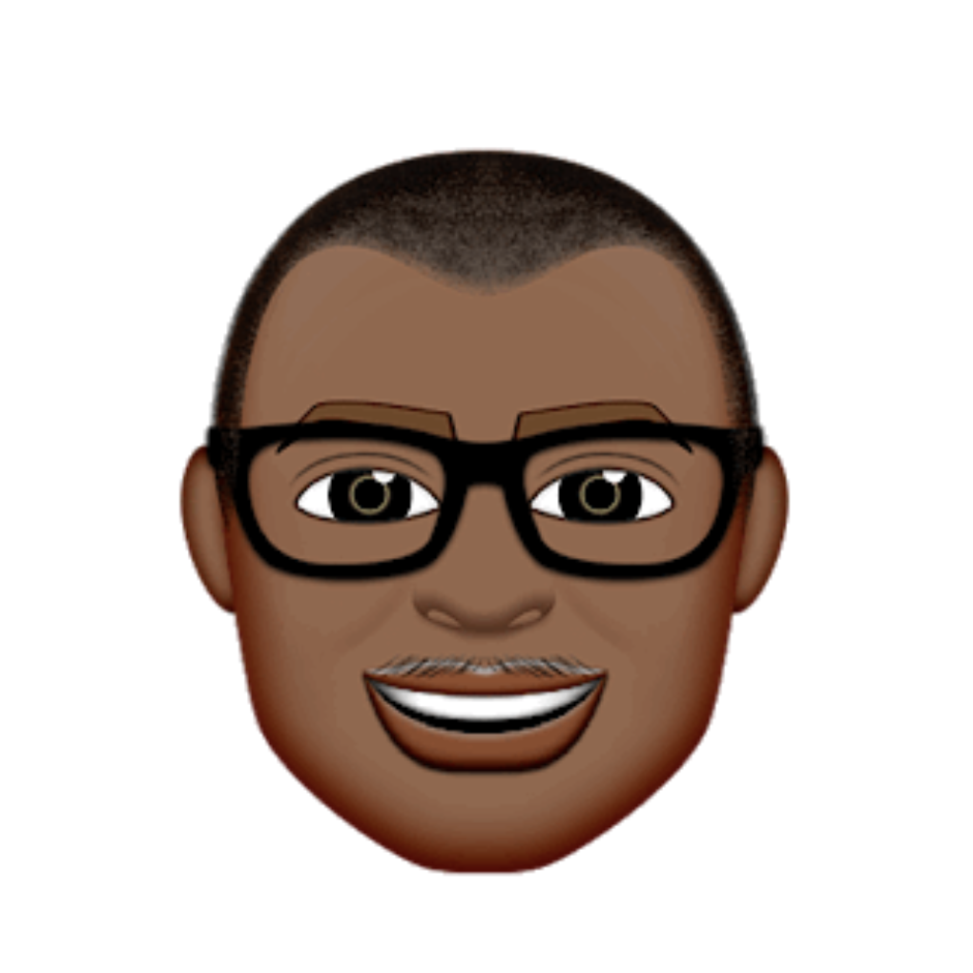
Esterling Accime
Software Engineer – Cox Automotive
Pwofesè - Georgia Tech Coding Bootcamp
4 experyans
Notes:
Enough about you, time to talk about me.

Slide 3
Pa bliye ke …
Bagay ki bon pa vini fasil
Notes:
There are a few things you can do to ensure your success

Slide 4
Kle pou reyisi…

Slide 5
Pa devni tankou misye…
Notes:
First off, don’t be this guy.
Those that have the hardest time in the program are not the ones who came in knowing no programming.
It’s not the ones who haven’t played around with HTML, CSS, or Javascript.
It’s the ones who walk in thinking they either A) Know more than they do. Or B) Are experts in a completely different field.
There is something that stops people like this from accepting the reality.

Slide 6

Ou sipoze tankou misye.
Notes:
Be this guy. Having a humble attitude is the first requirement of being successful in this program.

Slide 7
Lè’w ap aprann Web Development

Slide 8
Mwen pa konn anyen.
Notes:
Don’t be frustrated! Keep an open mind – you’re here to learn.
You mastery of other subjects, educational backgrounds, and professional successes do not guarantee that you will do well here. The only thing that will guarantee success is hard work, humility, and a relentless desire to be better.

Slide 9

Ide pou 2 jou Haiti Coding Workshop
Toujou sonje ke ou sipoze
Travay di!!

Slide 10
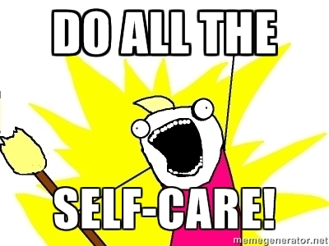
Ide pou 2 jou Haiti Coding Workshop
Toujou sonje ke ou sipoze
Travay di!!
Apresye siksè’w

Slide 11

Ide pou 2 jou Haiti Coding Workshop
Toujou sonje ke ou sipoze
Travay di!!
Apresye siksè’w
Kwè nan tèt
Notes:
Questions?

Slide 12
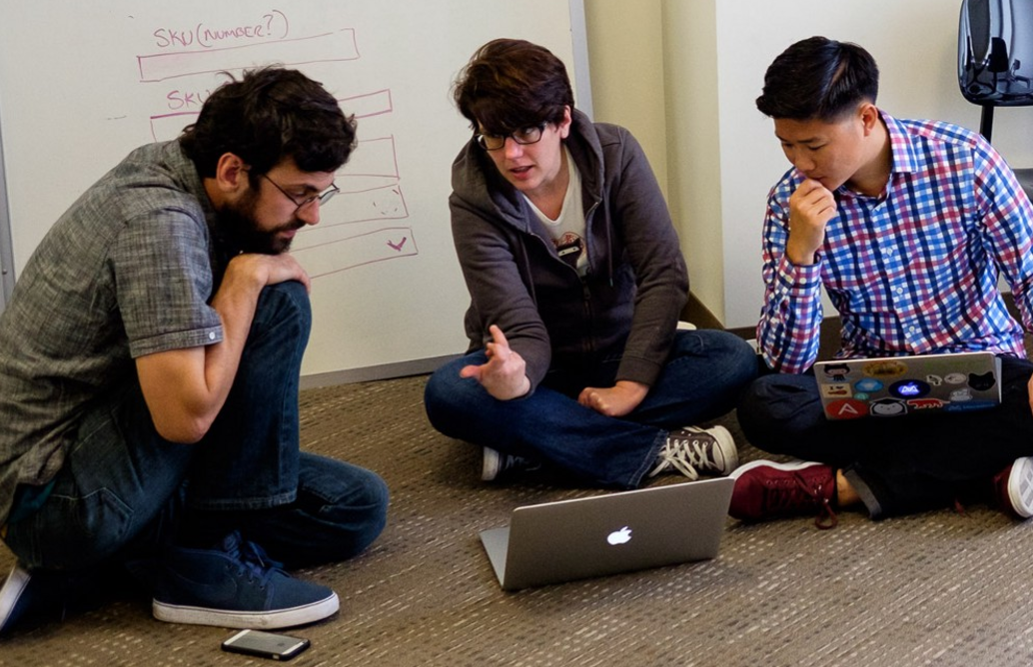
Men sonje ke…
Si’w vle ale rapid, ale pou tèt ou. Si’w vle ale lwen, ale an ekip

Slide 13

Google Fu – Pi enpòtan konpetans ke’w genyen
Kisa ki Google Fu?
Notes:
Of course, to do this, you’ll need to be great at googling!
This is arguably the best/most important skill you can use.
It’s silly, but being able to find the answers to your questions is extremely important, and people won’t always be around. Google should almost always be your first go-to (it has almost every answer, if you know how to find it).

