Slide 1
Relative File Paths

Slide 2
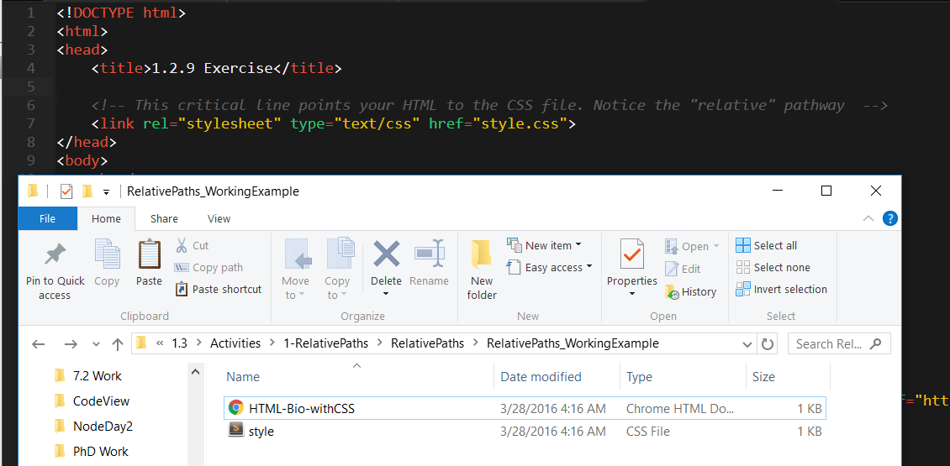
Relative File Paths
Relative file paths connect us with other files in our working directory. In this case, style.css is in the same folder as our html document.

Slide 3
Quick Demo
Instructor: Demo
(RelativePaths_DEMO | 1-RelativePaths)

Slide 4
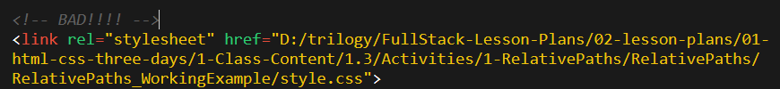

Absolutely No Absolute Paths
VERY VERY BAD
ALWAYS USE RELATIVE FILE PATHS.
If you deploy your sites without them, all of your links will fail.
The same will happen if you move your project from one folder to another.
Remember, there is no such thing as a “C:” drive on the internet.

Slide 5
> YOUR TURN!!
Activity: 1-RelativePaths| Suggested Time: 10 min
Assignment
1. Unzip the folder sent to you via Slack.
2. Edit the HTML files in all of the “RelativePaths” folders. You need to write relative paths that link the HTML documents with CSS stylesheets.
Tip: Check out the “RelativePaths_WorkingExample” folder.

Slide 6
We Be Floatin’

Slide 7
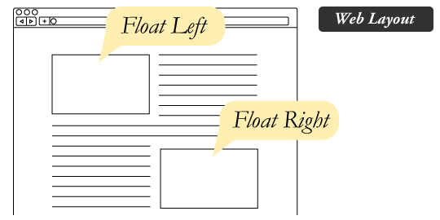
The Concept of “Flow”
By default, every HTML element displayed in the browser is governed by a concept called flow.
This means that HTML elements force their adjacent elements to flow around them.

Slide 8
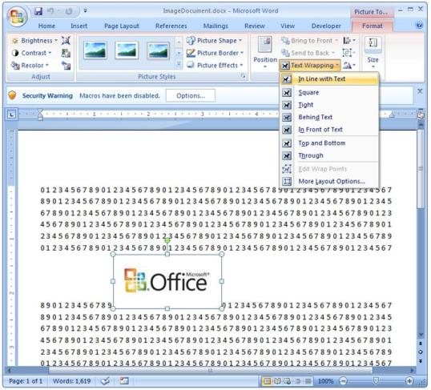
Flow Analogy to MS Word
This concept of “flow” is very similar to the wrap-text options you may be familiar with in Microsoft Word.
Just as in MS Word, you can have images in-line with text, on-top of text, etc.

Slide 9
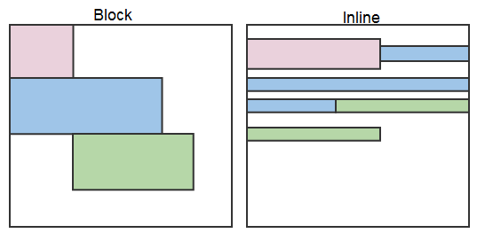
Block Elements
By default, web clients render many HTML elements as block elements. Paragraphs, headers, divs and more receive this treatment.
A block element will take up an entire line of space—unless you intervene with CSS properties.

Slide 10
Block Elements vs. Inline Elements
Now contrast the block elements with inline elements.
By using float CSS properties, we can command our website to display multiple HTML elements adjacently.

Slide 11
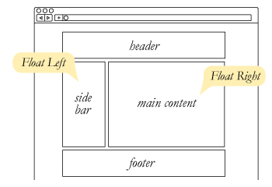
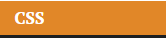
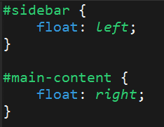
Floating
To transform these block elements into inline elements, we use a CSS property called float.
Floats are necessary for building web layouts.

Slide 12
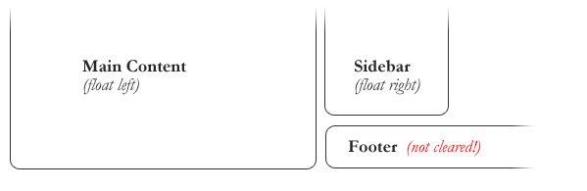
Clearing the Float
Floats often get in the way of our layouts.
Sometimes we don’t want to give each element the “inline” treatment.

Slide 13
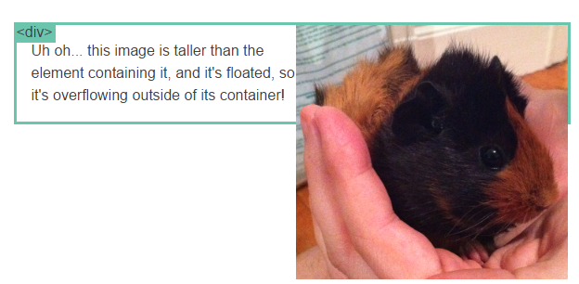
Clearfix Hack
Sometimes when elements don’t match up in size, we get situations like the above…

Slide 14
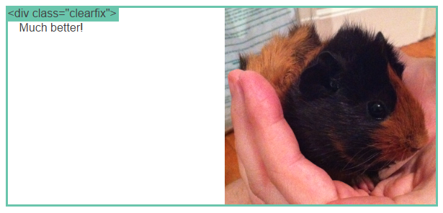
Clearfix Hack
We can get around this by using “the clearfix hack.”

Slide 15
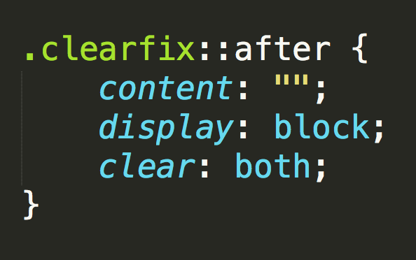
Clearfix Hack
::after is what we call a pseudo-element. We use it to style specific parts of an element.
This will add an HTML element, hidden from view, after the content of the “.clearfix” element. This clears the float.

Slide 16
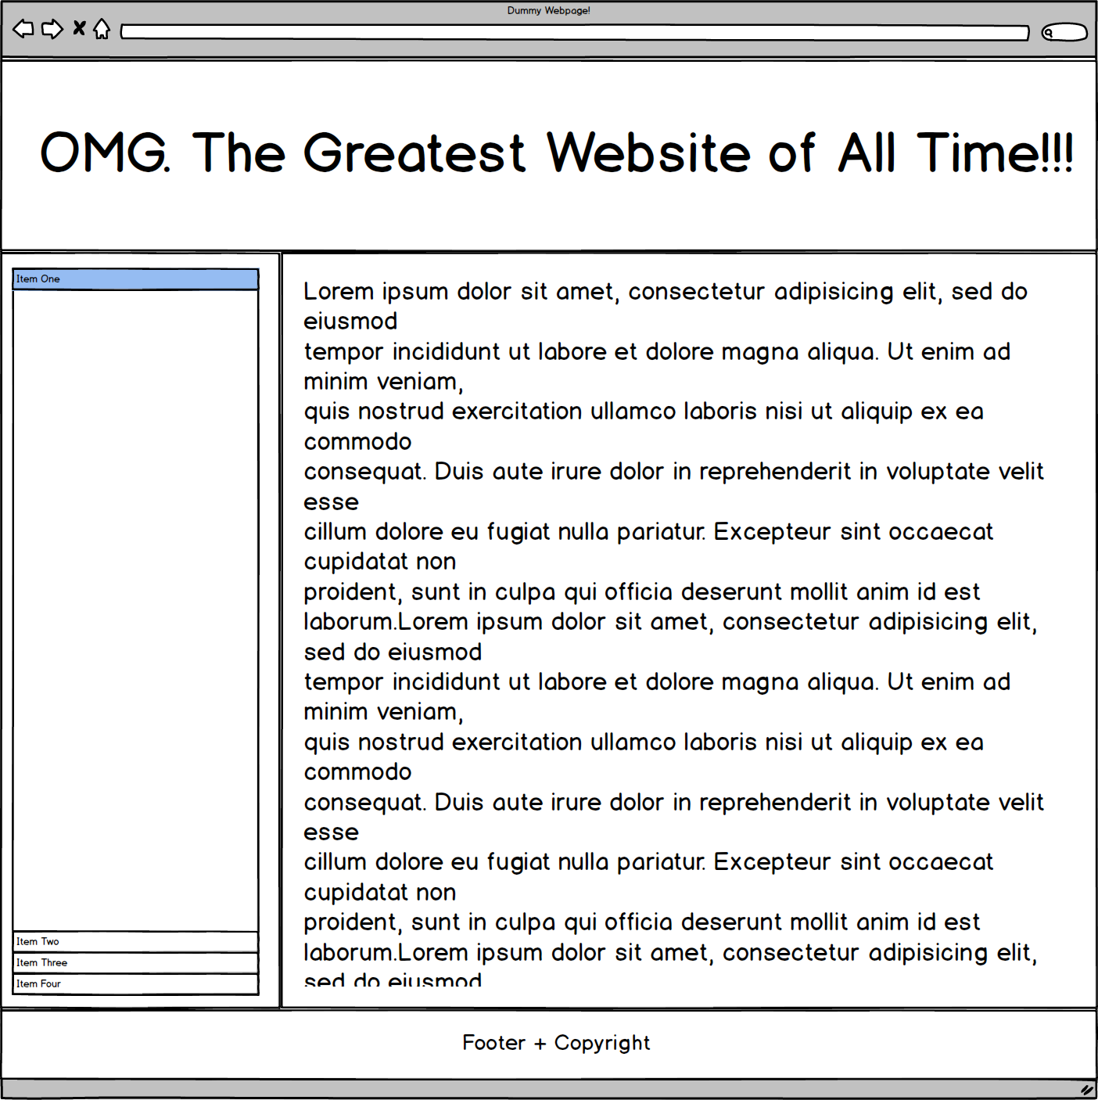
Quick Demo!

Slide 17
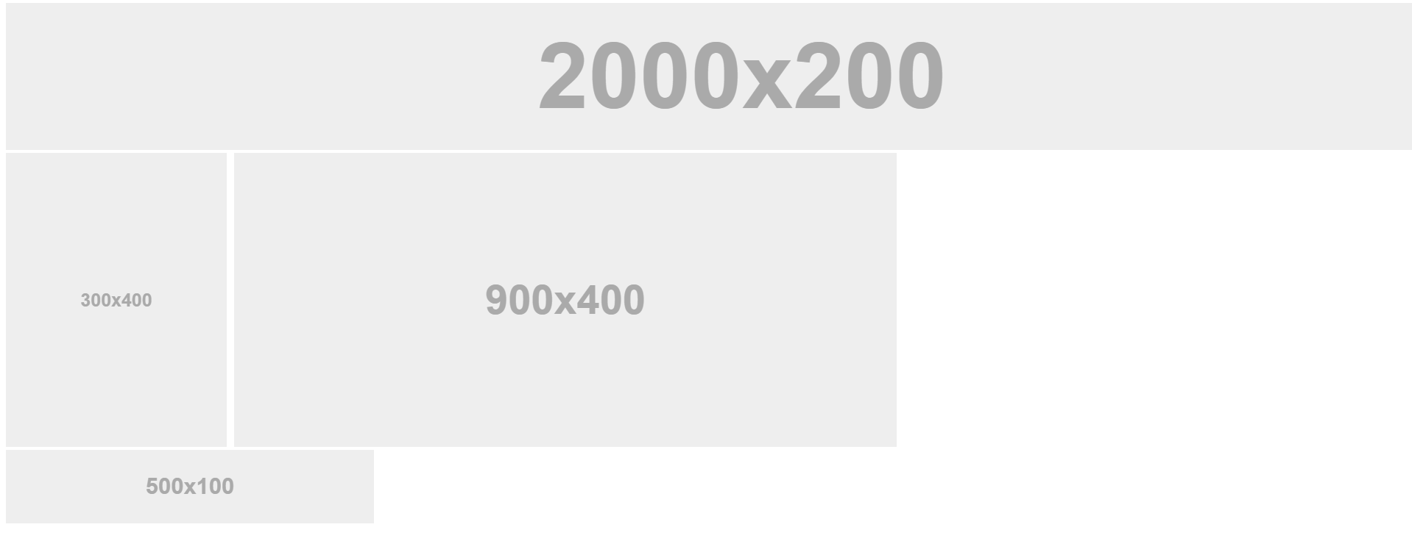
Quick Demo!

Slide 18
Quick Demo
Instructor: Demo
(2-FloatExamples)

Slide 19

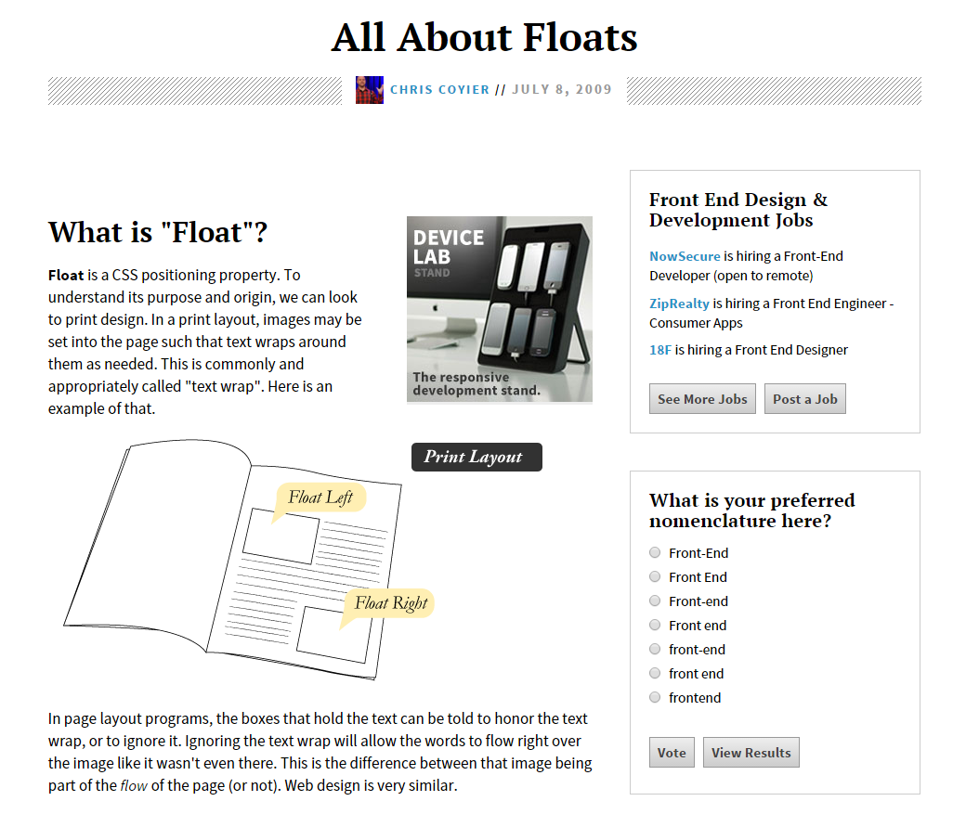
Fantastic Guide on Floats ****
To all serious front-end developers (this is a necessary read): https://css-tricks.com/all-about-floats/

Slide 20
> YOUR TURN!!
Activity: 3-FloatLayout-Activity | Suggested Time: 30 min
Assignment
In this activity, you’ll flex your newfound floating skills by creating a conceptual layout. Eyeball the design to your best ability.
Check your Slack for more instructions.

Slide 21
CSS Positioning

Slide 22
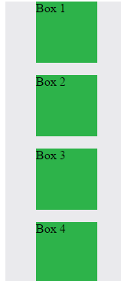
Position: Static (Default)
Four boxes placed statically (default)

Slide 23
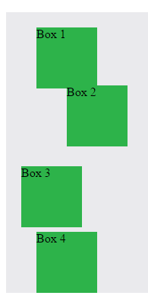
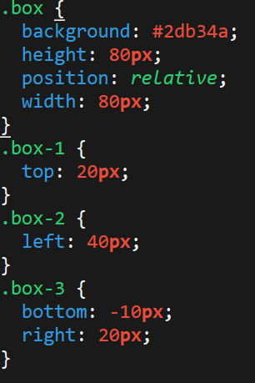
Position: Relative
Switching the boxes to relative will nudge the boxes in relation to their “original” location.

Slide 24
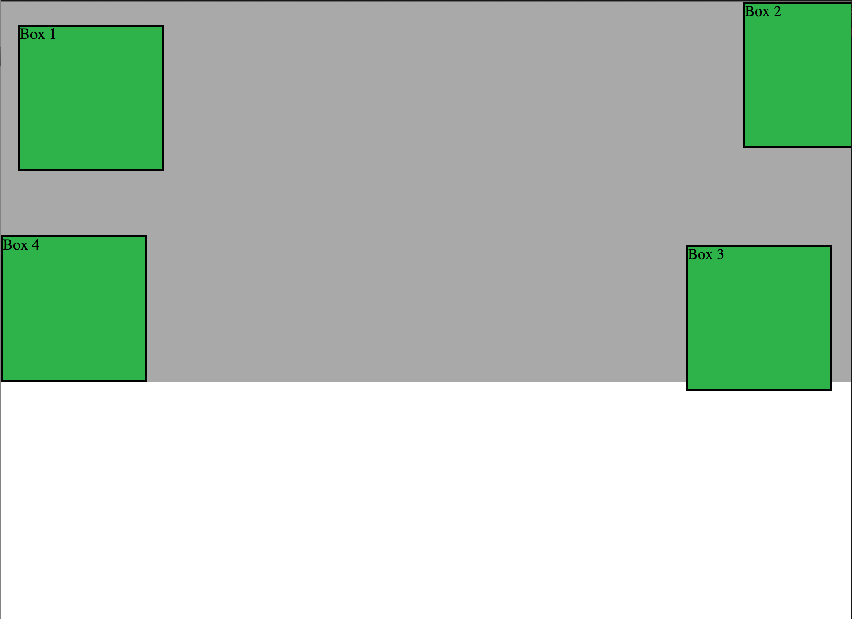
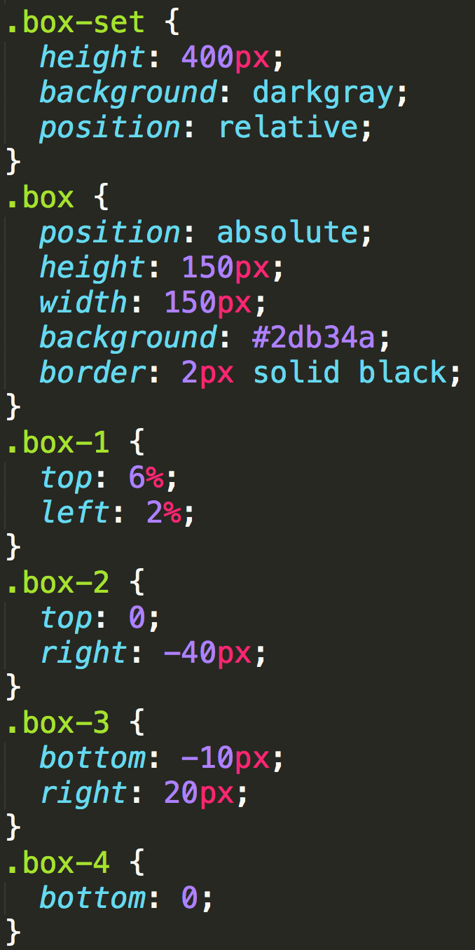
Position: Absolute
Positioned relative to nearest positioned ancestor
Notes:
An element that is positioned absolutely is taken out of the flow and thus takes up no space when placing other elements.
The absolutely positioned element is positioned relative to nearest positioned ancestor (non-static).
If a positioned ancestor doesn't exist, the initial container (body) is used.

Slide 25
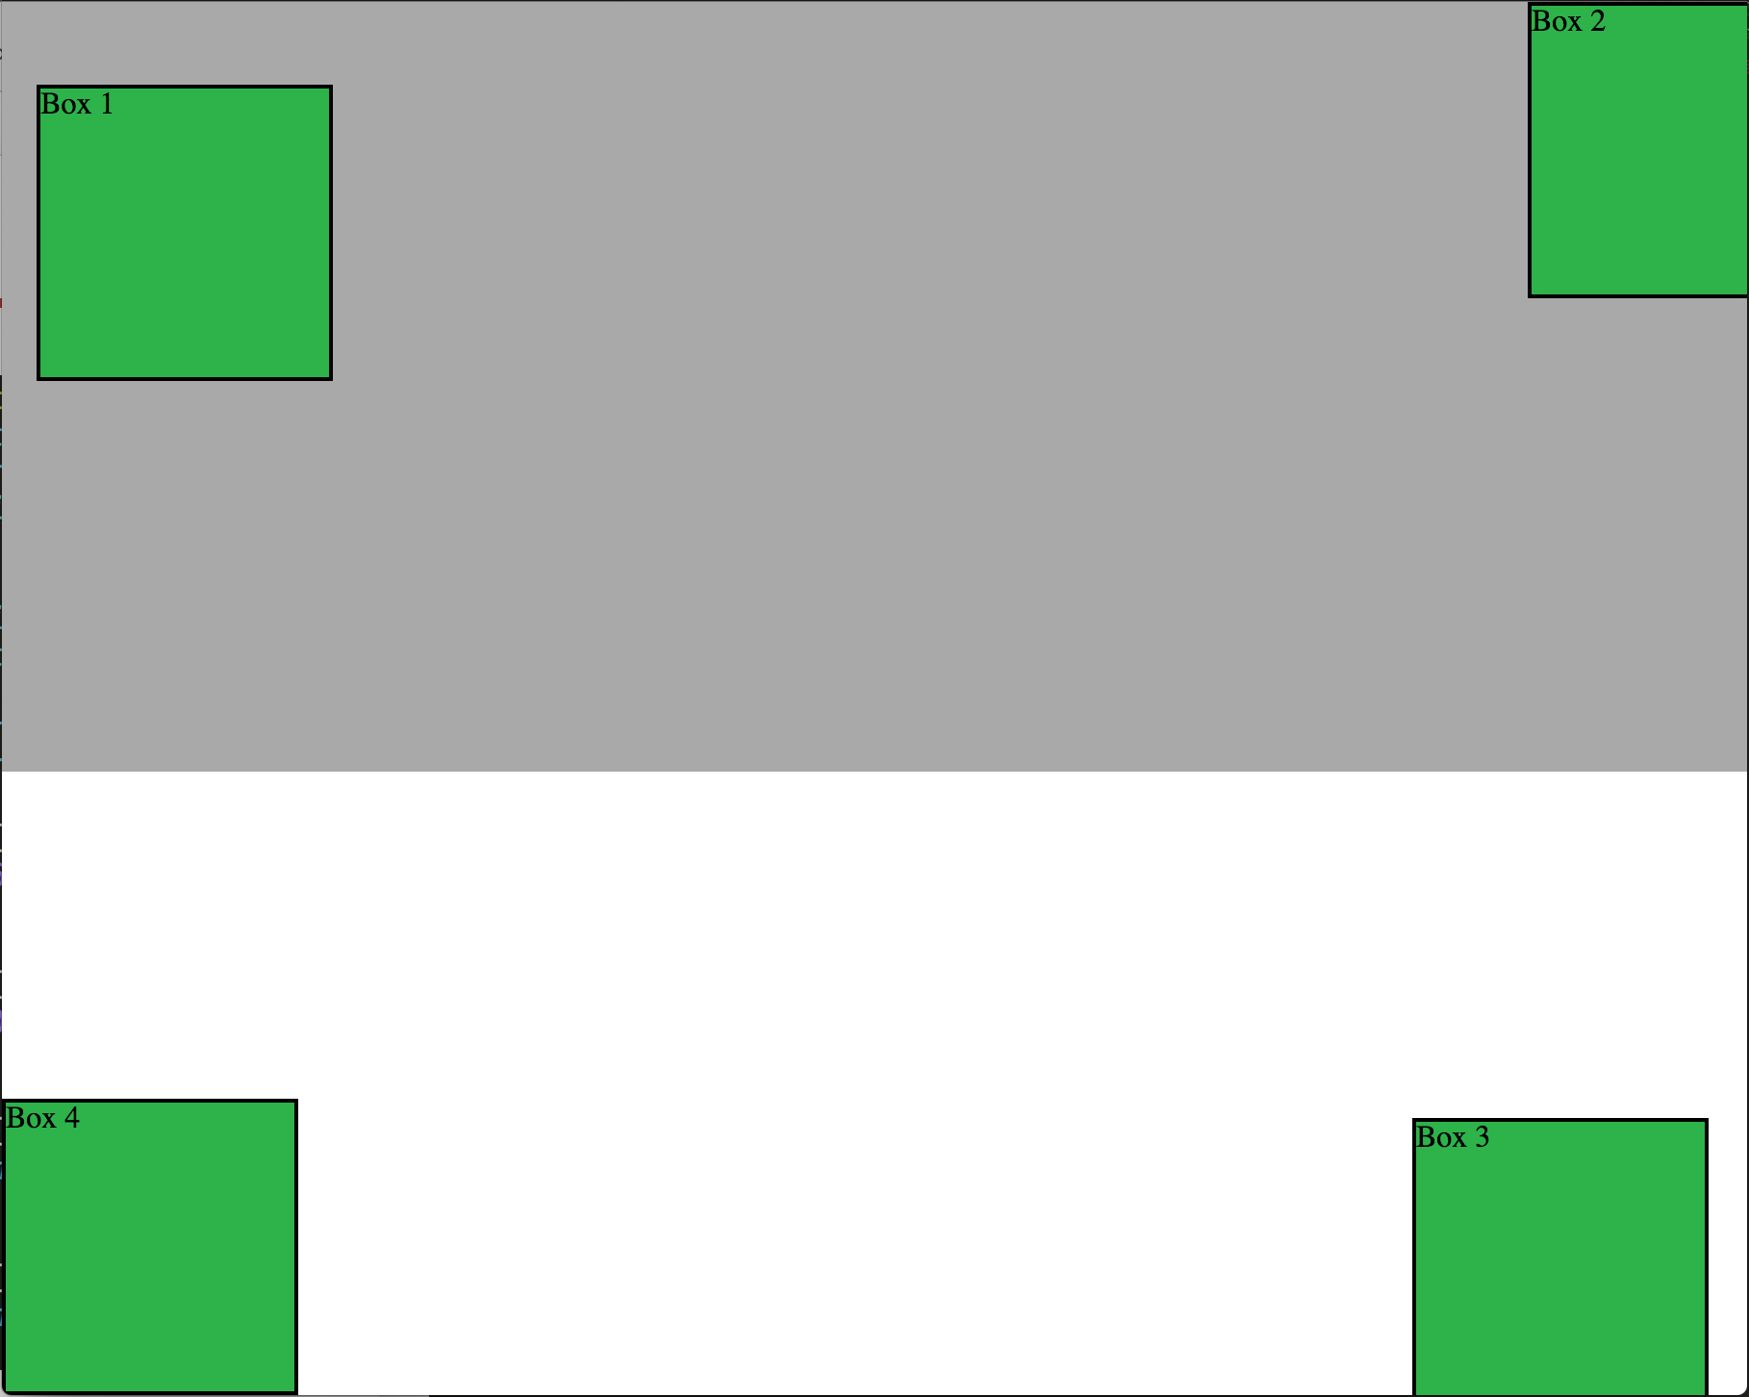
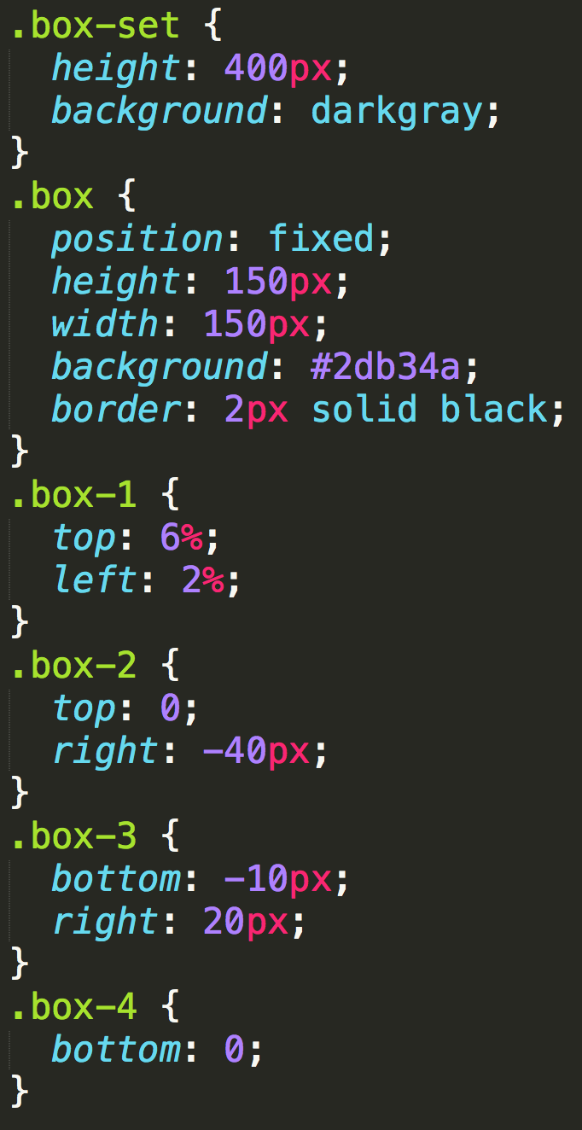
Position: Fixed
Position with exact coordinates to the browser window

Slide 26
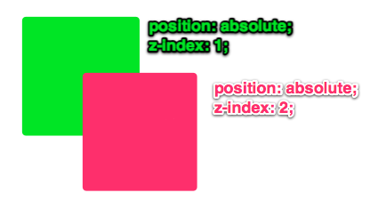
Layering with Z-Index
Z-Index allows you to layer elements on top of each other when they’re positioned.
Notes:
The elements must be positioned (any position other than static)

Slide 27
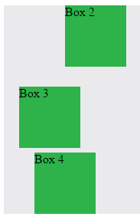
Hiding Things
“Display: none” allows us to hide elements from view.
This will become useful in later sections, when we’ll be hiding and revealing specific HTML elements of our choice.

Slide 28
Quick Demo
Instructor: Demo
(5-CSS_PositionedLayout)

Slide 29
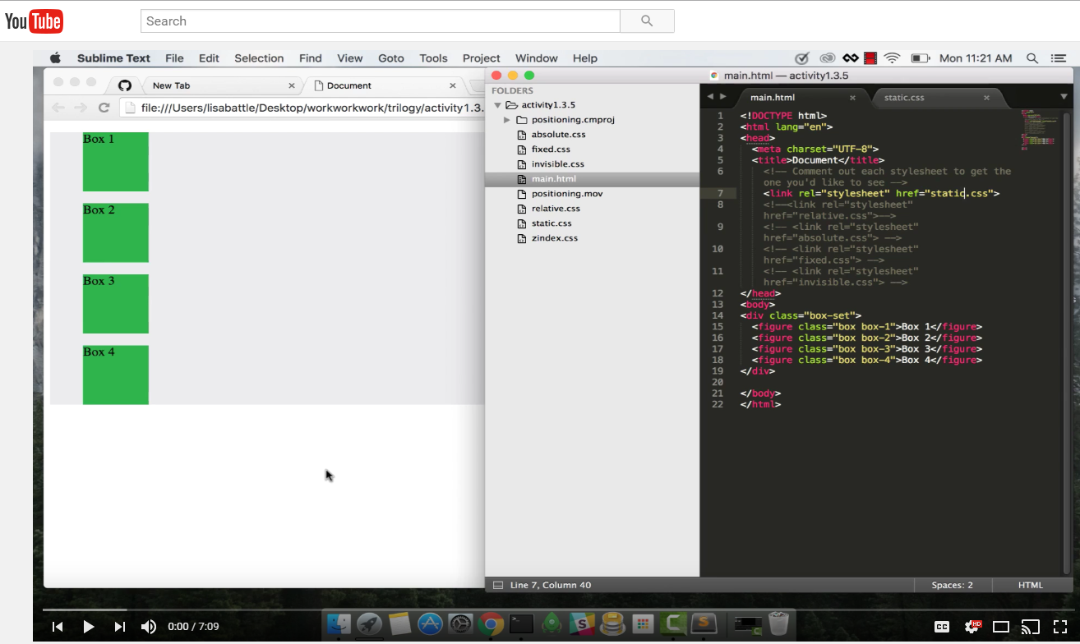
Video Walkthrough!
Video Link: https://youtu.be/sHfJn0jqBro

Slide 30
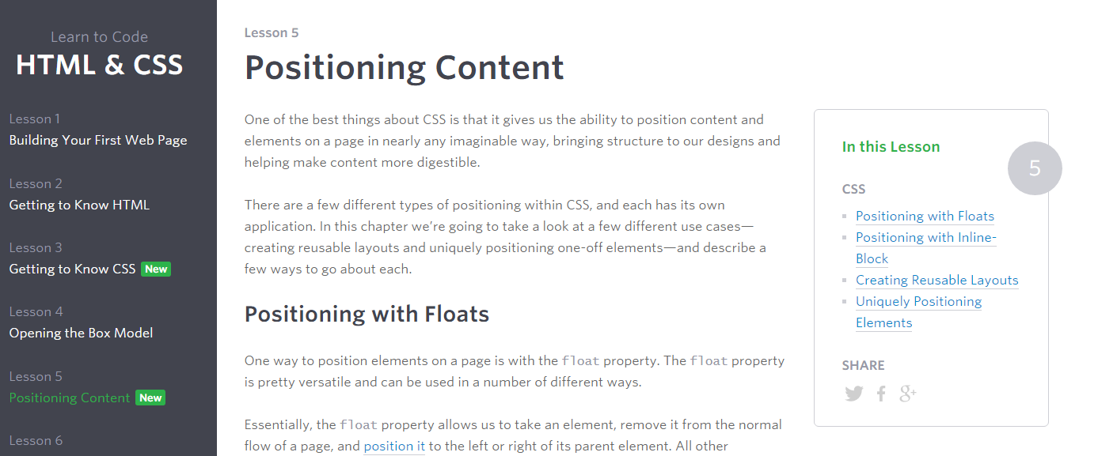
Great Resource
Another great read for front-end developers: http://learn.shayhowe.com/html-css/positioning-content/

Slide 31
> YOUR TURN!!
6-CSS_Positioned_Activity | Suggested Time: 30 min
Assignment
In this activity, you’ll flex your newfound positioning skills by creating another conceptual layout. Eyeball the design to your best ability.
Check your Slack for additional instructions.

Slide 32
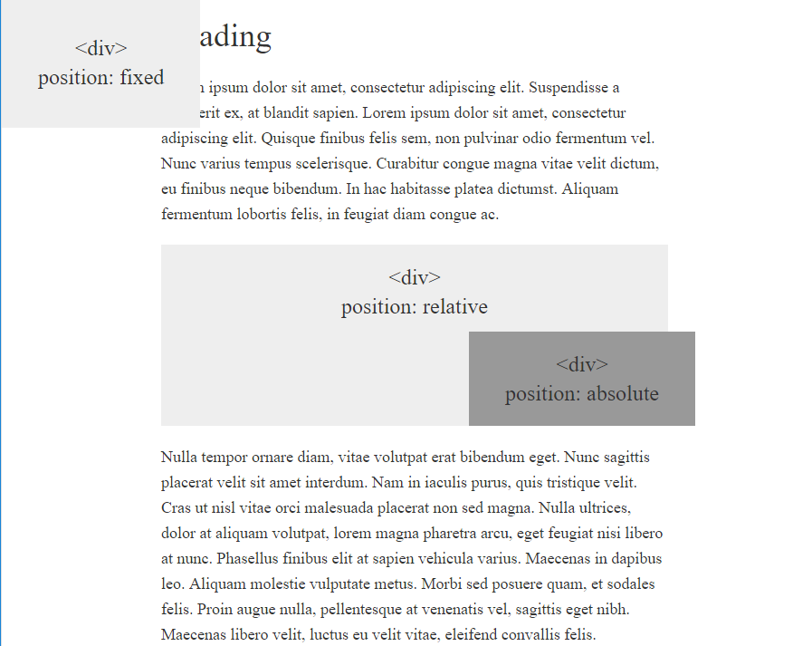
> YOUR TURN!!

Slide 33
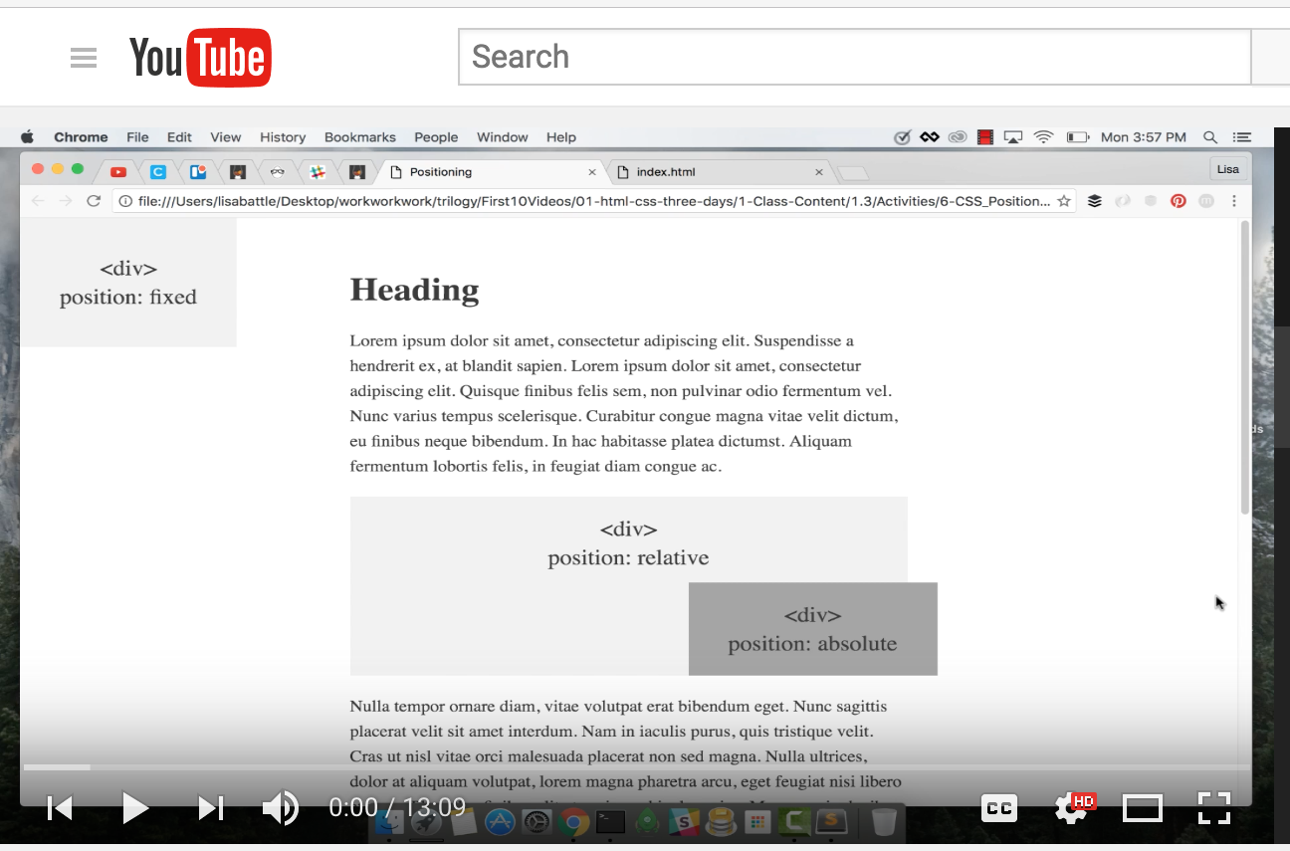
Video Walkthrough!
Video Link: https://youtu.be/yWXgnQaWSW0

Slide 34
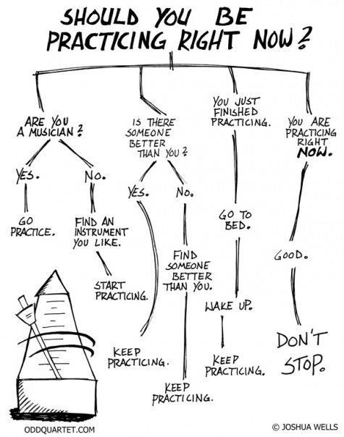
Advice
Re-do this at home. We designed this exercise
to firm up your HTML/CSS skills.
REMEMBER:
The best way to learn
web development
is to PRACTICE!

Slide 35
Chrome Inspector

Slide 36
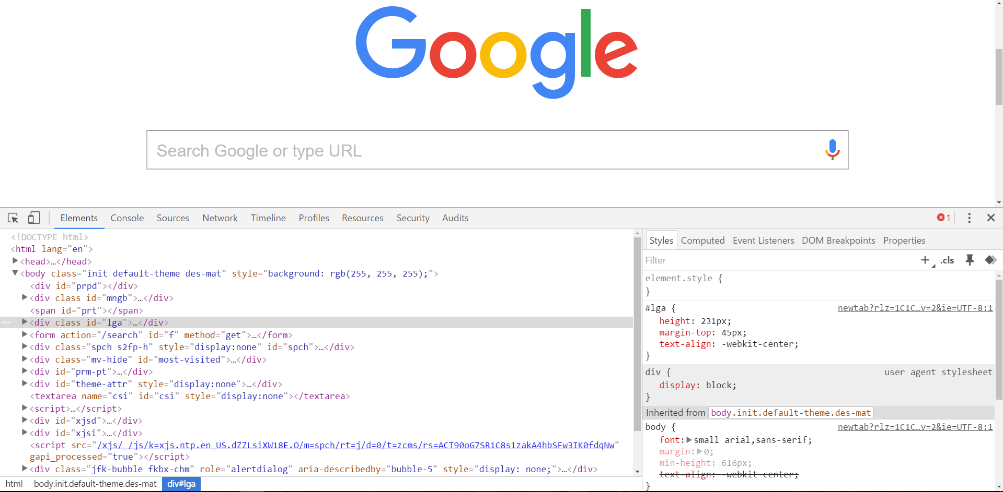
Chrome Inspector is Your Friend
To access chrome inspector, right click on a page. Then hit “Inspect.”
It will allow you to inspect the HTML, CSS and more!

Slide 37
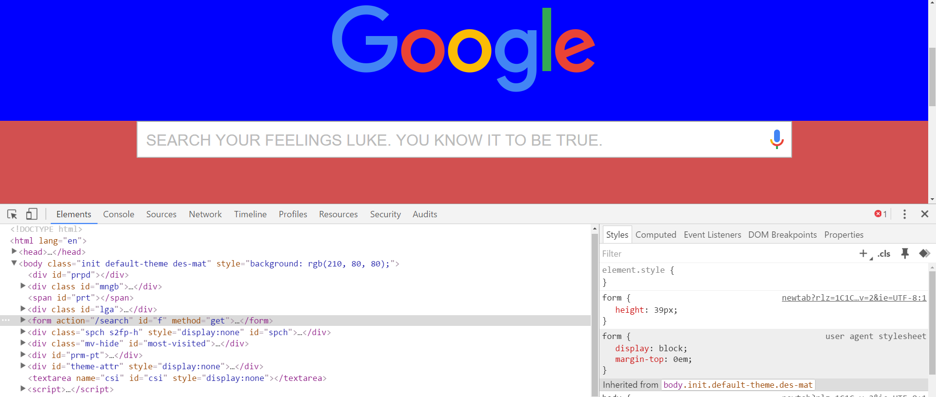
Chrome Inspector is Your Friend
You can even edit the HTML/CSS of a webpage and instantly view your changes in the browser!
This works on any website, whether yours or not.

Slide 38
Next Class!
We’ll be coming back to this
in our next class.

Slide 39
Recap + Reassurances

Slide 40


Slide 41
Questions?

Slide 42
EXTRA MATERIAL

Slide 43
> YOUR TURN!!
Assignment
Take a website you commonly visit (Amazon, Google, Huff Po, etc.) and heavily modify it with Google Developer Tools.
You have 15 minutes to test Chrome Inspector. Try modifying:
Content (change words).
Colors.
Spacing.
Any other CSS style rules.
When you’re done, send a screenshot to your class’s Slack.

Slide 44
CSS Resets

Slide 45
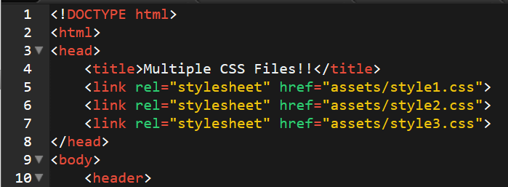
Loading Multiple CSS Files ***(Very Important!!!)***
We can link our documents to more than one stylesheet at a time—one of the most powerful features of CSS/HTML.
By tapping into different stylesheets simultaneously, we can create complex layouts with plenty of design rules.
Just remember: the loading order matters!!!

Slide 46
What Browser?
By a show of hands…
Which browser do you use?

Slide 47

Battle of the Browsers
Under the hood, web browsers often render webpages differently than their competition.
These disparities could mean HTML/CSS displaying differently in each web client.
Because of these potential divergences, web developers need to make their websites cross-browser compatible.

Slide 48
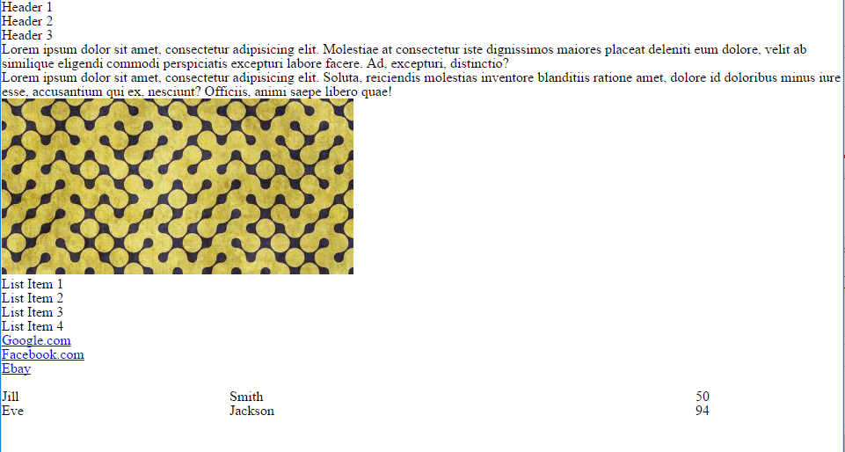
Reset.css (or Normalize.css)
Reset.css will “reset” all browser-specific CSS. This means your site will appear the same in all browsers.
However, you will have to re-style everything yourself.

Slide 49
Why CSS Resets Matter
It’s important for creating browser-compatible websites.
It’s an example of using someone else’s CSS in your website!!!
It’s a common Front-End Developer Interview question.

Slide 50
> YOUR TURN!!
Assignment
Follow the instructions given via Slack to incorporate a reset.css file in a basic HTML file.
Note the impact of the reset file makes after you include it.

