Slide 1
Objektif pou Jodi an
Etidyan dye pratike anpil HTML.
Edityan pral komanse aprann itilize senp HTML tag.
Etidyan pral aprann aplike CSS nan HTML yo

Slide 2
HTML5

Slide 3
Sentaks HTML
Kontni
<h1>
Sa se kay Matye an
</h1>
Ouvèti Tag
Fèmen Tag

Slide 4
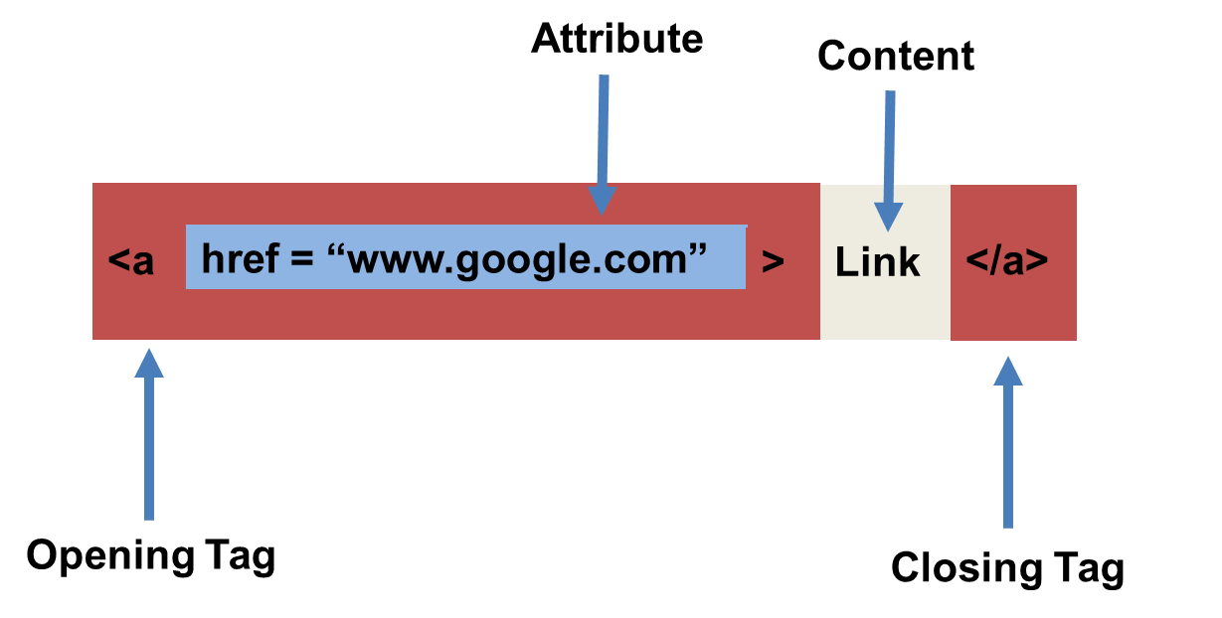
Sentaks HTML (avèk atribi)

Slide 5
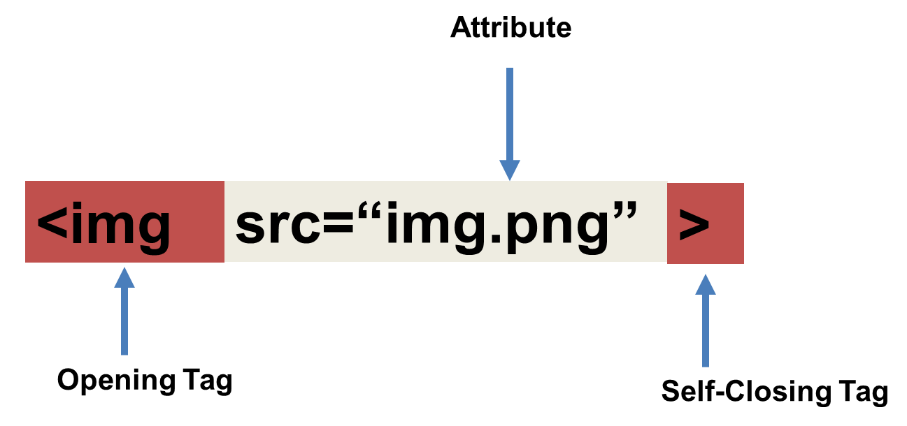
Tricky Tags (Self-Closing)

Slide 6
Tags ki enpòtan (Souvan itilize)
Headings:
<h1> </h1> - Tit 1 (Tit ki pi laj laj)
<h2> </h2> - Tit 2 (Dezyèm tit li laj)
<h3> </h3> - Tit 3
…
Containers:
<html> </html> - Vlope tout paj lan
<head> </head> - Vlope tèt paj lan
<body> </body> - Vlope Kontni prensipal lan
<div> </div> - Kontni lojik yo
<p> </p> - Vlope paragraph endividyèl
Lòt:
<strong> (fonse), <em> (anfaz)
<img> (imaj), <a href> (lyen), <li> (lis atik yo) , <title> (tit), <br> (liy kraze), <table> (tab), <!-- --> (komantè)

Slide 7
Tags ki pa two popilè
Ou kapab jwenn tout tags HTML yo sou sit sa. http://www.w3schools.com/tags/
Pa eseye memorize yo. Senpleman refere avèk yo nan dokiman an lè’w bezwen.
Lòt tags:
<video> Pou Videos
<audio> Pou fichye Audio
<embed> for fichye Embedded
<code> Pou inkli Kòd Òdinatè.
<header> Pou tèt lan
<nav> Pou navigasyon ba yo
<footer> Pou pye yo

Slide 8
Fòm HTML
<form> - Kreye yon seksyon pou fòm HTML ou.
<input> - Bwat opinyon
<label> - Etikèt bwat ou
<button> - Bouton
<textarea> - Gwo bwat tèx ou

Slide 9
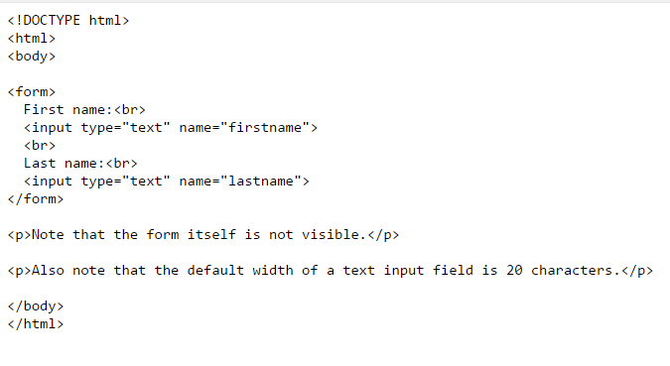
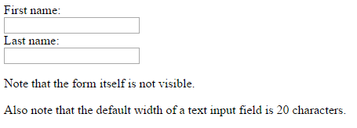
HTML for Forms

Slide 10
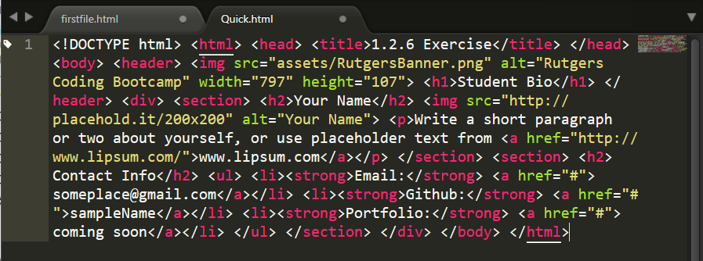
Yon HTML ki lèd
Pa fè sa. Itilize bonjan endantasyon
Fòk kòd fasil pou lòt moun lil.
Envesti tan’w pou’w evite ekri kòd ki sanble avek sa ki nan imaj lan.

Slide 11
> Tou pa’w!
Tan: 20 min
Egzèsis
Kreye yon senp paj HTML avèk enfòmasyon'w ki sanble avèk imaj sa.

Slide 12
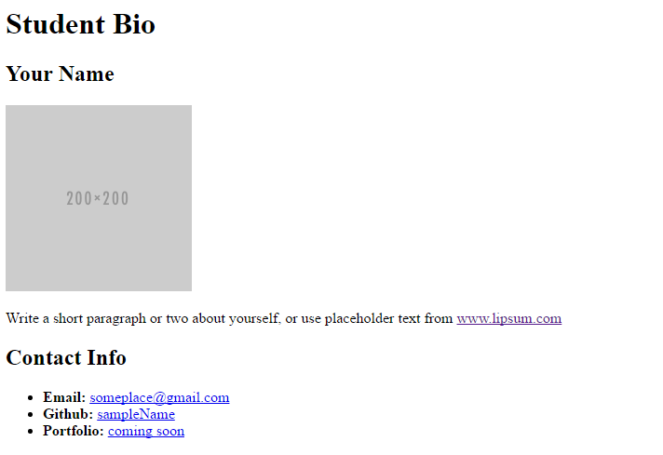
> Tou pa’w!

Slide 13
CSS Stylin’

Slide 14
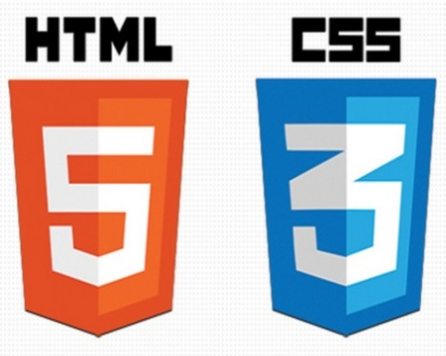

HTML / CSS Definitions (*yawn* unimportant)
HTML: Hypertext Markup Language – (Content)
CSS: Cascading Style Sheets – (Appearance)
HTML/CSS are the “languages of the web.” Together they define both the content and the aesthetics of a webpage – handling everything from the layouts, colors, fonts and content placement. (JavaScript is the third – handling logic, animation, etc.)

Slide 15


HTML / CSS Analogy
HTML Alone
Like writing papers in “Notepad.”
Can only write unformatted text.
HTML / CSS
Like writing papers in Microsoft Word.
Can format text, page settings, alignment, etc. based on “highlighting” and menu options.

Slide 16
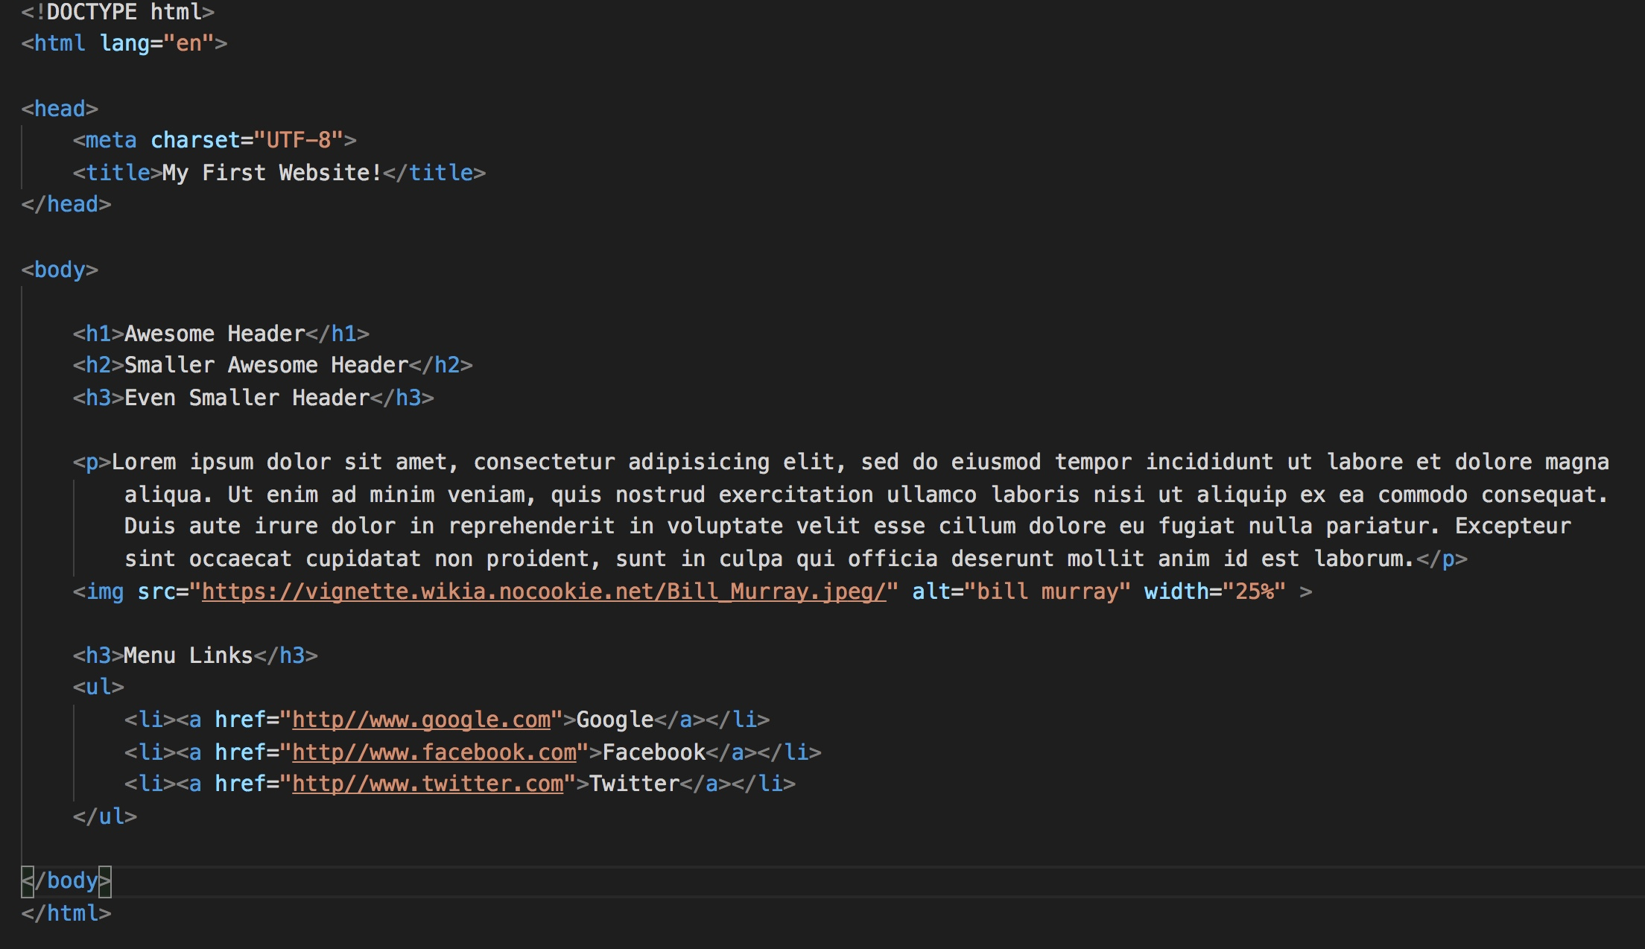
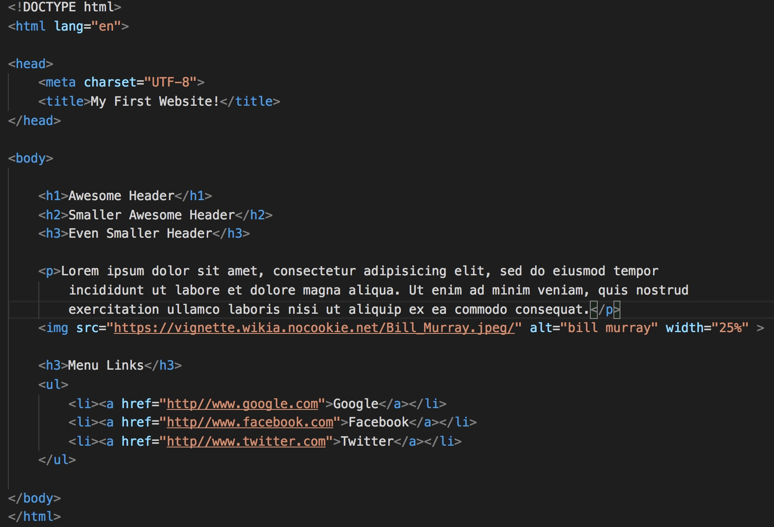
Basic HTML Page

Slide 17
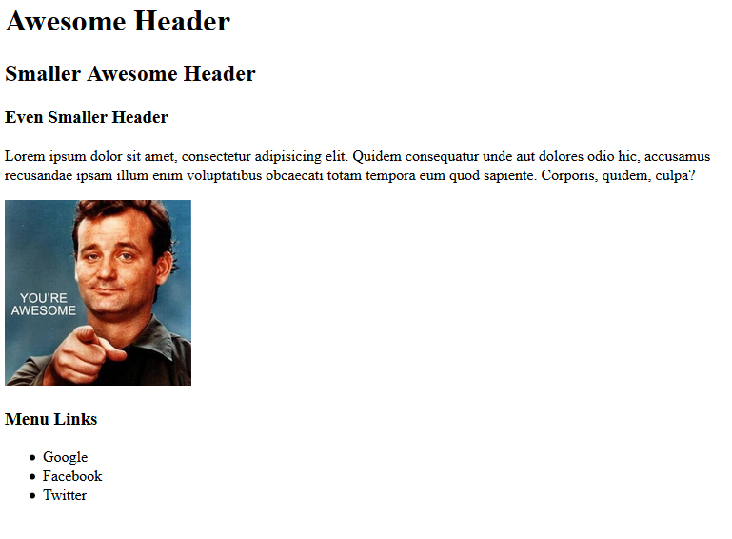
Basic HTML Page - Result

Slide 18
Basic HTML Page - Result
Hella Boring…

Slide 19
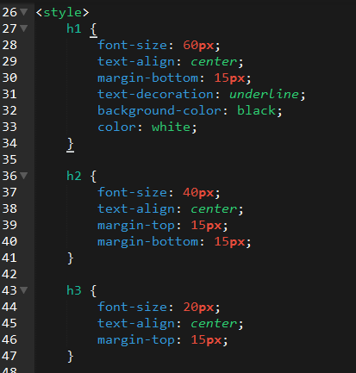
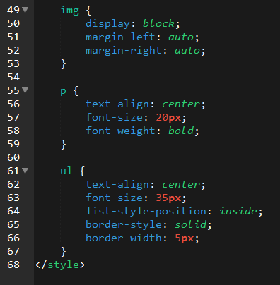
Enter CSS

Slide 20
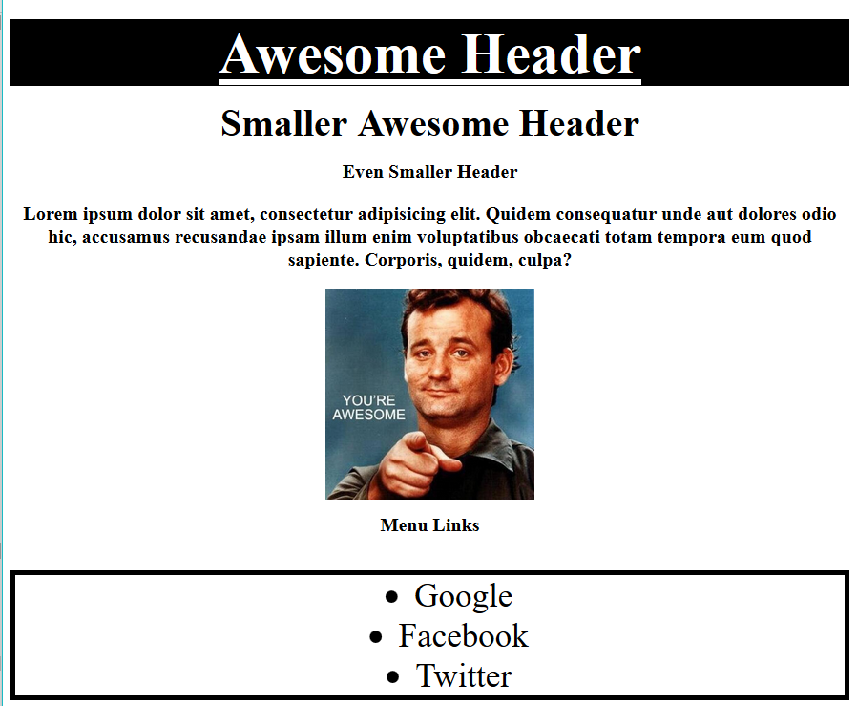
Enter CSS - Result

Slide 21
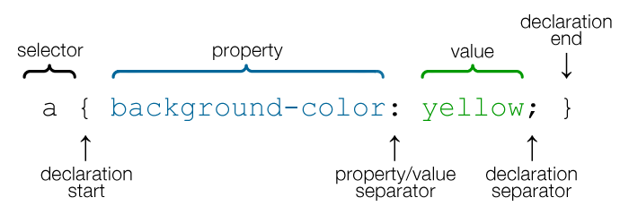
CSS Syntax
CSS works by hooking onto selectors added into HTML using classes and identifiers.
Once hooked, we apply styles to those HTML elements using CSS.

Slide 22
CSS Example
In the below example the “Header” would be turned blue and MUCH larger because of the CSS.
We can incorporate an element’s class or ID to apply a CSS style to a particular part of the document.
Just remember to include the necessary symbol before the CSS: “.” for class, “#” for ID.
Example (HTML):
<p class=“bigBlue”>Header</p>
Example (CSS):
.bigBlue
{
font-size: 100px;
color: blue;
}

Slide 23
Key CSS Attributes
Font / Color:
color: Sets color of text.
font-size: Sets size of the font.
font-style: Sets italics.
font-weight: Sets bold.
Alignment / Spacing:
padding (top/right/bottom/left): Adds space between element and its own border.
margin (top/right/bottom/left): Adds space between element and surrounding elements.
float: Forces elements to the sides, centers, or tops.
Background:
background-color: sets background color.
background-image: sets background image.

Slide 24
Powerful Duo
Believe it or not, HTML / CSS is all you need
to develop a vivid, full-blown website.

Slide 25
INSTRUCTOR DEMO
Instructor: Demo
(quickexample_internalcss.html | 2-BasicCSS)

Slide 26
> YOUR TURN!
Activity: 3-HTML_CSS_Layout | Suggested Time: 20 min
Assignment
In this activity, you’ll upgrade your previous HTML bio-page using CSS style rules. Once you’re done, commit and push up your changes to GitHub.
We’ll send you additional instructions via Slack.

Slide 27
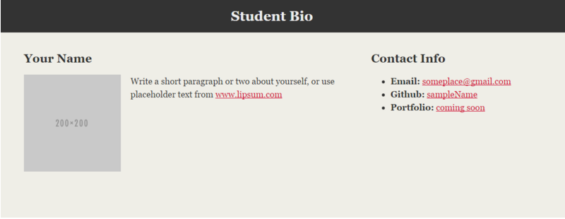
> YOUR TURN!

Slide 28
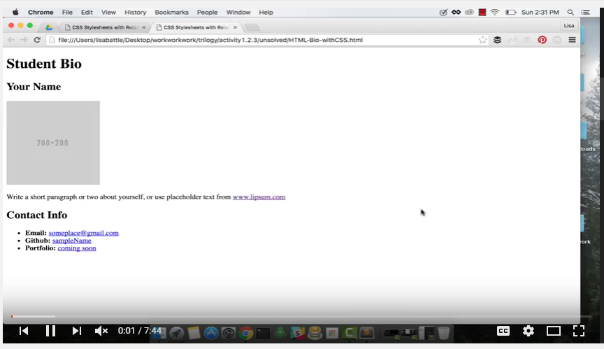
Video Walkthrough!!
https://www.youtube.com/watch?v=kMBinXTCrXI&list=PLgJ8UgkiorCnMLsUevoQRxH8t9bt7ne14&index=2

Slide 29

Still a Bit Confused?
Remember! We’ve got video guides for key activities like that last one.
If you feel like you are EVER falling behind, use those online walkthroughs to help catch back up. They are made to be easy to understand.
Still having trouble? Shoot your instructor or one of your TAs a message!
We are here to help you out in whatever way we can!

Slide 30
Recap + Questions

