Slide 1
secure multi-layered network
By William A. Skinner
Notes:
William A Skinner
Secure Multi-Layered Network

Slide 2
What is my project
Network Segmentation
Access Control & Identity Management
Secure System Architecture
Basics of penetration testing

Slide 3

Why did I choose this project
I wanted to learn more about cybersecurity
I wanted to design my own network
I wanted to understand the shortcomings of the configuration
Most of all, I wanted to learn what I would miss
So that I can improve

Slide 4







Technologies Used

Slide 5
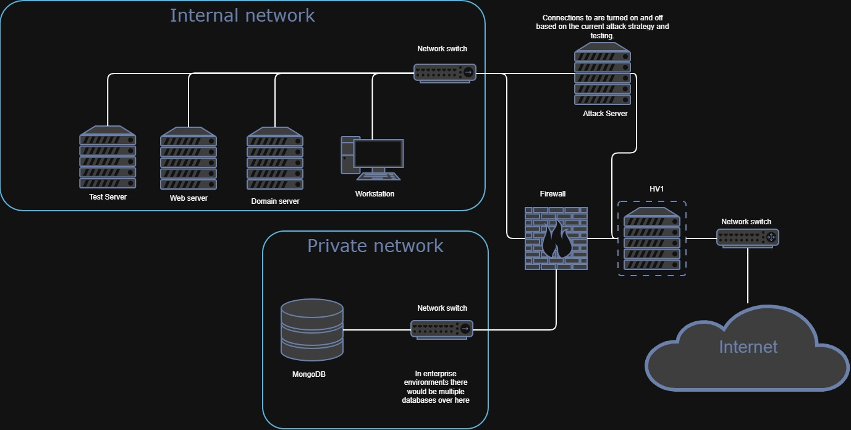
Demo

Slide 6
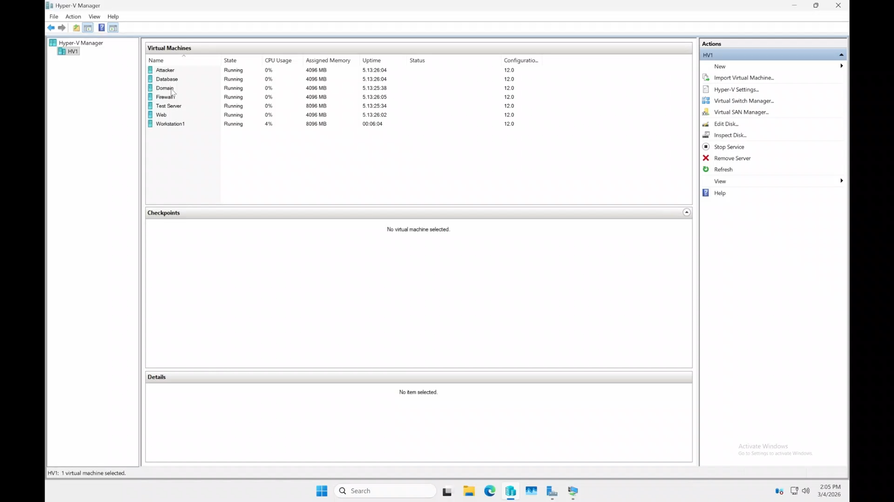
Notes:
DNS – show baseline
Domain – show connection
Firewall – show main rule
Website – show functions
Nmap scan – Show testing

Slide 7
What went wrong and How I fixed it
Blade connection issue
I compacted down the one blade to remove the extra network
Network Firewall routing issues
I removed the other firewall that was causing the routing and built up better protections
Database authentication issue
I changed the password to a form that was allowed
Server room connection issue
I went to the server room physically and connected directly
I rebuilt all VMs and configurations at minimal specs
Synology failure

Slide 8
What Went Right
DNS setup
Domain Services configuration
System-wide updates
Installation of all softwares
Website creation
Attack server execution

Slide 9
penetration testing results
All 65,535 ports filtered on firewall WAN interface
Internal VLANs not accessible from external network
SMB (445) and RDP (3389) blocked between hosts
Web server only exposes HTTP (port 80) internally
MongoDB (27017) accessible from user VLAN

Slide 10
Conclusion
I designed and deployed a segmented enterprise network
I solved infrastructure problems, including routing, authentication, and connectivity
I tested the environments using penetration testing techniques
I gained practical experience in cybersecurity architecture and defense strategies

Slide 11
Q & A
Notes:
How did issues affect your time?
The issues that I brought up caused existential time losses as I had to rebuild most systems when they happened.
What did you learn from this project?
I learned a lot about how system architecture is built and maintained, and you can break one.
Did your project succeed or fail?
I would say overall my projects succeed, but I never got to my extended tasks.

Slide 12
The End
Notes:
Overall, Ref for the most part my first trial on running this slide show ran to issues of time loss due to very long demonstrations and over-explanation. Most of these issues were fixed when I removed excess material compressed the demo to make it more understandable. After timing myself and recording it for prosperity sake I determined that my current slideshow stands around 12 minutes in time.

