Slide 1

Unit-11: Genetic Algorithms
Artificial Intelligence (AI)
3170716
Dr. Gopi Sanghani
Computer Engineering Department
gopi.sanghani@darshan.ac.in
9825621471

Slide 2

Outline
Peek into the Biological World
Genetic Algorithms (GAs)
Significance of the Genetic Operators
Termination Parameters
Looping

Slide 3
Introduction
Let’s start with the famous quote by Charles Darwin:
It is not the strongest of the species that survives, nor the most intelligent, but the one most responsive to change.
Genetic Algorithms are inspired by Charles Darwin’s theory: “Natural selection is survival of the fittest”.
Genetic algorithms (GA) are inspired by the natural selection of species and belong to a broader class of algorithms referred to as Evolutionary Algorithms (EA).
The concept of biological evolution is used to solve all different kinds of problems and has become well-known for its reliable global search capabilities.
Thus, genetic algorithms have been used to solve real-world optimization problems and are an essential subject of research in optimization and related fields.
Genetic algorithms have been commonly employed to address well-known optimization problems in Data Science, Machine Learning, and Artificial Intelligence.

Slide 4
Peek into the Biological World
Genetic algorithms (GAs) are search methods based on principles of natural selection and genetics developed by John Holland and his collaborators in the 1960s and 1970s.
GAs encode the decision variables of a search problem into finite-length strings of alphabets of certain cardinality.
The strings which are candidate solutions to the search problem are referred to as chromosomes, the alphabets are referred to as genes and the values of genes are called alleles.
For example, in a problem such as the traveling salesman problem, a chromosome represents a route, and a gene may represent a city.
In contrast to traditional optimization techniques, GAs work with coding of parameters, rather than the parameters themselves.
To evolve good solutions and to implement natural selection, we need a measure for distinguishing good solutions from bad solutions.

Slide 5
Peek into the Biological World
The measure could be an objective function that is a mathematical model or a computer simulation, or it can be a subjective function where humans choose better solutions over worse ones.
In essence, the fitness measure must determine a candidate solution’s relative fitness, which will subsequently be used by the GA to guide the evolution of good solutions.
Another important concept of GAs is the notion of population.
Unlike traditional search methods, genetic algorithms rely on a population of candidate solutions.
The population size, which is usually a user-specified parameter, is one of the important factors affecting the scalability and performance of genetic algorithms.
For example, small population sizes might lead to premature convergence and yield substandard solutions. On the other hand, large population sizes lead to unnecessary expenditure of valuable computational time.

Slide 6
START
Genetic Algorithm Flow chart
Initialize
Evaluate solution
Is solution optimum ? Or I = N?
I = I + 1
N
Selection
Population Replacement
Y
Crossover
STOP
Fitness Evaluation
Mutation

Slide 7
GA Operators and Parameters
Initialization:
The initial population of candidate solutions is usually generated randomly across the search space. However, domain-specific knowledge or other information can be easily incorporated.
Evaluation:
Once the population is initialized or an offspring population is created, the fitness values of the candidate solutions are evaluated.
Selection:
The process that determines which solutions are to be preserved and allowed to reproduce and which ones deserve to die out.
The primary objective of the selection operator is to emphasize the good solutions and eliminate the bad solutions in a population while keeping the population size constant. Selects the best, discards the rest.
To identify the good solutions, Fitness value / objective function value can be assigned to evaluate the solutions.

Slide 8
GA Operators and Parameters
A fitness function value quantifies the optimality of a solution.
The value is used to rank a particular solution against all the other solutions.
A fitness value is assigned to each solution depending on how close it is actually to the optimal solution of the problem.
Selection allocates more copies of those solutions with higher fitness values and thus imposes the survival-of-the-fittest mechanism on the candidate solutions.
The main idea of selection is to prefer better solutions to worse ones, and many selection procedures have been proposed to accomplish this idea are
Tournament selection
Roulette wheel selection
Proportionate selection
Rank selection
Steady state selection, etc.

Slide 9
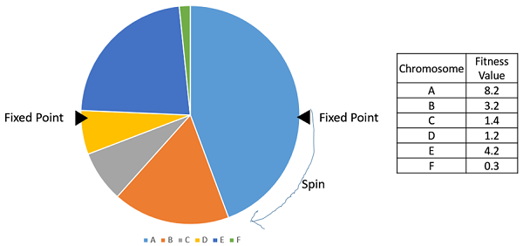
Selection Operator
Tournament Selection (2 Players)
Roulette Wheel Selection
Chromosome | Fitness
A | 80
B | 70
C | 90
D | 60
E | -30
F | 40
G | 50
B | 70
?
F | 40
?

Slide 10
GA Operators and Parameters
Recombination or Crossover
The crossover operator is used to create new solutions from the existing solutions available in the mating pool after applying selection operator.
Encoding of solution is necessary so that our solutions look like a chromosome. Its the process of representing a solution in the form of a string that conveys the necessary information.
Just as in a chromosome, each gene controls a particular characteristic of the individual, similarly, each bit in the string represents a characteristic of the solution.
Most common method of encoding is binary coded. Chromosomes are strings of 1 and 0 and each position in the chromosome represents a particular characteristic of the problem.
0 | 1 | 0 | 0 | 1 | 0 | 1 | 1 | 1 | 0

Slide 11

GA Operators and Parameters
Recombination or Crossover
This operator exchanges the gene information between the solutions in the mating pool.
Recombination combines parts of two or more parental solutions to create new, possibly better solutions.
Crossover is usually applied in a GA with a high probability $p_{c}$.
There are many ways of accomplishing this, and competent performance depends on a properly designed recombination mechanism.
The offspring under recombination will not be identical to any particular parent and will instead combine parental traits in a novel manner.
Parent Chromosomes
Offspring
1 | 5 | 4 | 3 | 2 | 1 | 6 | 7 | 3 | 5
1 | 5 | 4 | 3 | 2 | 1 | 8 | 2 | 1 | 6
2 | 7 | 1 | 4 | 5 | 5 | 8 | 2 | 1 | 6
2 | 7 | 1 | 4 | 5 | 5 | 6 | 7 | 3 | 5
Single Point Crossover

Slide 12
GA Operators and Parameters
Recombination or Crossover
1 | 5 | 4 | 3 | 2 | 1 | 6 | 7 | 3 | 5
1 | 5 | 4 | 4 | 5 | 5 | 8 | 7 | 3 | 5
2 | 7 | 1 | 4 | 5 | 5 | 8 | 2 | 1 | 6
2 | 7 | 1 | 3 | 2 | 1 | 6 | 2 | 1 | 6
Two Point Crossover
1 | 5 | 4 | 3 | 2 | 1 | 6 | 7 | 3 | 5
1 | 5 | 1 | 3 | 5 | 1 | 6 | 2 | 1 | 5
2 | 7 | 1 | 4 | 5 | 5 | 8 | 2 | 1 | 6
2 | 7 | 4 | 4 | 2 | 5 | 8 | 7 | 3 | 6
Uniform Crossover

Slide 13
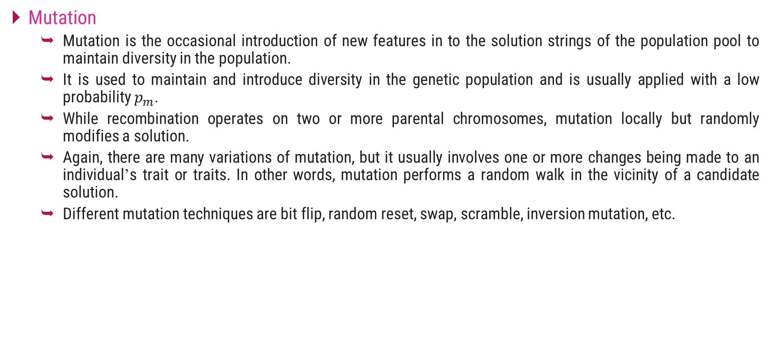
GA Operators and Parameters
Mutation
Mutation is the occasional introduction of new features in to the solution strings of the population pool to maintain diversity in the population.
It is used to maintain and introduce diversity in the genetic population and is usually applied with a low probability $p_{m}$.
While recombination operates on two or more parental chromosomes, mutation locally but randomly modifies a solution.
Again, there are many variations of mutation, but it usually involves one or more changes being made to an individual’s trait or traits. In other words, mutation performs a random walk in the vicinity of a candidate solution.
Different mutation techniques are bit flip, random reset, swap, scramble, inversion mutation, etc.
1 | 0 | 0 | 1 | 0 | 1 | 0 | 1 | 0 | 1
1 | 0 | 0 | 0 | 0 | 1 | 0 | 1 | 0 | 1
Bit Flip
1 | 5 | 4 | 3 | 2 | 1 | 6 | 7 | 3 | 5
1 | 5 | 4 | 6 | 2 | 1 | 6 | 4 | 3 | 5
Random Reset

Slide 14
GA Operators and Parameters
Replacement
The offspring population created by selection, recombination, and mutation replaces the original parental population.
Many replacement techniques such as elitist replacement, generation-wise replacement and steady-state replacement methods are used in GAs.

Slide 15
Significance of the Genetic Operators
A genetic operator is an operator used in genetic algorithms to guide the algorithm towards a solution to a given problem.
There are three main types of operators (mutation, crossover and selection), which must work in conjunction with one another in order for the algorithm to be successful.
Genetic operators are used to create and maintain genetic diversity (mutation operator), combine existing solutions (also known as chromosomes) into new solutions (crossover) and select between solutions (selection).
Selection:
Selection operators give preference to better solutions (chromosomes), allowing them to pass on their 'genes' to the next generation of the algorithm.
The best solutions are determined using some form of objective function also known as a fitness function, before being passed to the crossover operator.
Different methods for choosing the best solutions exist, for example, fitness proportionate selection and tournament selection; different methods may choose different solutions as being 'best'.

Slide 16
Significance of the Genetic Operators
The selection operator may also simply pass the best solutions from the current generation directly to the next generation without being mutated; this is known as elitism or elitist selection.
Crossover:
If no crossover is performed then the offspring would be exact copies of the parents with no improvements or variations.
Crossover ensures that the search progresses by making new chromosomes that possess characteristics similar to both the parents.
Thus, crossover is an attempt to create better or fitter chromosomes (solutions) from the existing good ones.
Selection operator identifies an area of high fitness and crossover enables the movement of search in that area and thereby directing search towards an optimum.
Mutation:
Like all random searches, there is ample probability that search process conducted using selection and crossover operators would invariable hit a local optima.
It is therefore necessary, though occasionally, to divert search from such areas.
Mutation facilitates a sudden change in a gene within a chromosome, generating a solution that is dimensionally far away from or dissimilar to those in the current pool.

Slide 17
Significance of the Genetic Operators
If the mutated chromosome has better fitness then it may tend to dominate and guide GA to migrate to an area of search space to which it belongs to.
This serves to overcome a local optimum trap and a genetic algorithm can reach to an improved solution.
If the mutant has a lesser fitness value then it will gradually fade out as selection operator will ensure that it will not be taken up for offspring generation.
Thus, the mutation operator encourages genetic diversity amongst solutions and attempts to prevent the genetic algorithm converging to a local minimum by stopping the solutions becoming too close to one another.

Slide 18
Termination Parameters
GA represents an iterative process. Each iteration is called a generation. The entire set of generations is called a run.
A common practice is to terminate a GA after a specified number of generations and then examine the best chromosomes in the population. If no satisfactory solution is found, the GA is restarted.
The termination condition of a Genetic Algorithm is important in determining when a GA run will end.
It has been observed that initially, the GA progresses very fast with better solutions coming in every few iterations, but this tends to saturate in the later stages where the improvements are very small.
We usually want a termination condition such that our solution is close to the optimal, at the end of the run.

Slide 19
Termination Parameters
Usually, we keep one of the following termination conditions:
When there has been no improvement in the population for N iterations.
After a pre-specified number of generations.
When the objective function value has reached a certain pre-defined value.
For example, in a genetic algorithm we keep a counter which keeps track of the generations for which there has been no improvement in the population.
Initially, we set this counter to zero. Each time we don’t generate off-springs which are better than the individuals in the population, we increment the counter.
However, if the fitness any of the off-springs is better, then we reset the counter to zero. The algorithm terminates when the counter reaches a predetermined value.
Like other parameters of a GA, the termination condition is also highly problem specific and the GA designer should try out various options to see what suits their particular problem the best.

Slide 20
Thank You!

