Slide 1

Unit-3: Knowledge Representation
Artificial Intelligence (AI)
3170716
Dr. Gopi Sanghani
Computer Engineering Department
gopi.sanghani@darshan.ac.in
9825621471

Slide 2

Outline
Representations And Mappings
Approaches To Knowledge Representation
Representation of Simple Facts In Logic
Representing Instance And Isa Relationships
Computable Functions and Predicates
Resolution
Procedural versus Declarative Knowledge
Logic Programming
Forward versus Backward Reasoning
Looping

Slide 3
Representations And Mappings
In order to solve complex problems encountered in artificial intelligence, one needs both a large amount of knowledge and some mechanism for manipulating that knowledge to create solutions.
Knowledge and Representation are two distinct entities.
They play central but distinguishable roles in the intelligent system.
Knowledge is a description of the world. It determines a system’s competence by what it knows.
Moreover, Representation is the way knowledge is encoded. It defines a system’s performance in doing something.
Different types of knowledge require different kinds of representation.
The Knowledge Representation models/mechanisms are often based on: Logic, Rules, Frames, Semantic Net, etc.

Slide 4
Types of Knowledge
Informal or Implicit Formal or Explicit
Exists within a human being
It is embodied.
Difficult to articulate formally.
Difficult to communicate or share.
Hard to steal or copy.
Drawn from experience, action, subjective insight
Exists outside a human being;
It is embedded.
Can be articulated formally.
Can be shared, copied, processed and stored.
Easy to steal or copy
Drawn from artifact of some type as principle, procedure, process, concepts.

Slide 5
Mapping between Facts and Representation
Initial Facts
Desired Real Reasoning
Final Facts
Forward Representation Mapping
Backward Representation Mapping
Internal Representation of Initial Facts
Internal Representation of final Facts
Operated by Program

Slide 6
Approaches To Knowledge Representation
A knowledge representation system should have following properties.
Representational Adequacy : The ability to represent all kinds of knowledge that are needed in that domain.
Inferential Adequacy : The ability to manipulate the representational structures to derive new structures corresponding to new knowledge inferred from old.
Inferential Efficiency : The ability to incorporate additional information into the knowledge structure that can be used to focus the attention of the inference mechanisms in the most promising direction.
Acquisitional Efficiency : The ability to acquire new knowledge using automatic methods wherever possible rather than reliance on human intervention.

Slide 7
Knowledge Representation Schemes
Relational Knowledge : The simplest way to represent declarative facts is as a set of relations of the same sort used in the database system.
Player | Height | Weight | Bats - Throws
Aaron | 6-0 | 180 | Right - Right
Mays | 5-10 | 170 | Right - Right
Ruth | 6-2 | 215 | Left - Left
Williams | 6-3 | 205 | Left - Right

Slide 8
Knowledge Representation Schemes
Inheritable Knowledge : Here the knowledge elements inherit attributes from their parents.
Adult-male
Isa
Player
Isa
Isa
Cricket
Football
Instance
Instance
Peter
Ankit

Slide 9
Knowledge Representation Schemes
Inferential Knowledge : This knowledge generates new information from the given information. This new information does not require further data gathering form source, but does require analysis of the given information to generate new knowledge.
Example:
given a set of relations and values, one may infer other values or relations.
A predicate logic (a mathematical deduction) is used to infer from a set of attributes.
Inference through predicate logic uses a set of logical operations to relate individual data.
Represent knowledge as formal logic:
All dogs have tails :: ∀x: dog(x) → hastail(x)

Slide 10
Knowledge Representation Schemes
Procedural Knowledge : A representation in which the control information, to use the knowledge, is embedded in the knowledge itself.
For example, computer programs, directions, and recipes.
Knowledge is encoded in some procedures, small programs that know how to do specific things, how to proceed.

Slide 11
Representation of Simple Facts In Logic

Slide 12
Introduction
Logic
The logical formalism of a language is useful because it immediately suggests a powerful way of deriving new knowledge from old using mathematical deduction.
In this formalism, we can conclude that a new statement is true by proving that it follows from the statements that are already known.
Proposition
A proposition is a statement, or a simple declarative sentence.
For example, “the book is expensive” is a proposition.
A proposition can be either true or false

Slide 13
Propositional logic
Logical constants: true, false
Propositional symbols: P, Q, S,... (atomic sentences)
Propositions are combined by connectives:
∧ | and [conjunction]
∨ | or [disjunction]
⇒ | implies [implication]
¬ | not [negation]
∀ | For all
∃ | There exists

Slide 14
Propositional Logic
Representing simple facts using propositional logic:
It is raining
RAINING
It is sunny
SUNNY
It is windy
WINDY
If it is raining, then it is not sunny
RAINING → ¬ SUNNY

Slide 15
Predicate Logic
First-order Predicate logic (FOPL) is a formal language in which propositions are expressed in terms of predicates, variables and quantifiers.
It is different from propositional logic which lacks quantifiers.
It should be viewed as an extension to propositional logic, in which the notions of truth values, logical connectives, etc. still apply but propositional letters will be replaced by a newer notion of proposition involving predicates and quantifiers.
A predicate is an expression of one or more variables defined on some specific domain.
A predicate with variables can be made up of a proposition by either assigning a value to the variable or by quantifying the variable.

Slide 16
Well Formed Formula
Well Formed Formula (wff) is a predicate holding any of the following −
All propositional constants and propositional variables are wffs
If x is a variable and Y is a wff, ∀Y and ∃x are also wff
Truth value and false values are wffs
Each atomic formula is a wff
All connectives connecting wffs are wffs

Slide 17
Facts Represented as Well Formed Formula in FOPL
Marcus was a man.
man(Marcus)
Marcus was a Pompeian.
Pompeian(Marcus)
All Pompeians were Romans.
∀ x: Pompeian(x) → Roman(x)
Caesar was a ruler.
ruler(Caesar)
All Pompeians were either loyal to Caesar or hated him.
∀x: Roman(x) → loyalto(x, Caesar) ∨ hate(x, Caesar)

Slide 18
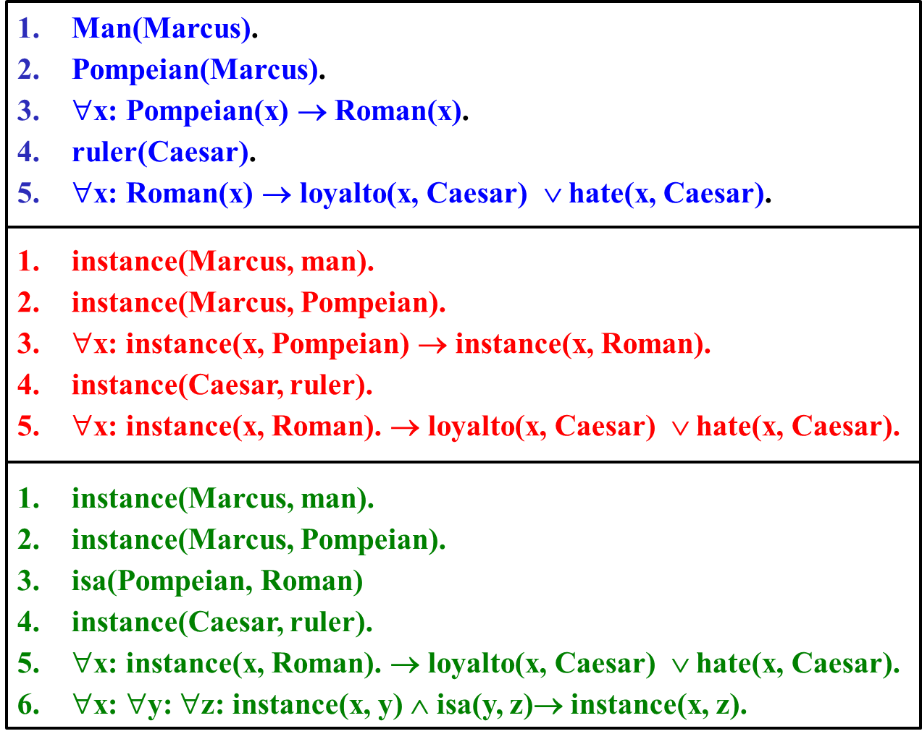
Specific attributes instance and isa play important role particularly in a useful form of reasoning called property inheritance.
The predicates instance and isa explicitly captured the relationships they are used to express, namely class membership and class inclusion.
The predicate instance is a binary one, whose first argument is an object and whose second argument is a class to which the object belongs.
The use of the isa predicate simplifies the representation of sentence 3, but it requires that one additional axiom (shown here as number 6) be provided.
Representing INSTANCE and ISA Relationships

Slide 19
Resolution

Slide 20
Introduction
Resolution is a procedure, which gains its efficiency from the fact that it operates on statements that have been converted to a very convenient standard form.
Resolution produces proofs by refutation.
In other words, to prove a statement (i.e., to show that it is valid), resolution attempts to show that the negation of the statement produces a contradiction with the known statements (that it is un-satisfiable).
The resolution procedure is a simple iterative process: at each step, two clauses, called the parent clauses, are compared (resolved), resulting into a new clause that has been inferred from them.
The new clause represents ways that the two parent clauses interact with each other.

Slide 21
Facts Represented as Well Formed Formula in FOPL
Marcus was a man.
man(Marcus)
Marcus was a Pompeian.
Pompeian(Marcus)
All Pompeians were Romans.
∀x: Pompeian(x) → Roman(x)
Caesar was a ruler.
ruler(Caesar)
All Pompeians were either loyal to Caesar or hated him.
∀x: Roman(x) → loyalto(x, Caesar) ∨ hate(x, Caesar)

Slide 22
Facts Represented as Well Formed Formula in FOPL
Every one is loyal to someone.
∀x: ∃y: loyalto(x, y)
People only try to assassinate rulers they are not loyal to.
∀x: ∀y: person(x) ∧ ruler(y) ∧ tryassassinate(x, y) → ¬loyalto(x, y)
Marcus tried to assassinate Caesar.
tryassassinate(Marcus, Caesar)

Slide 23
Axioms in clause form
man(Marcus).
Pompeian(Marcus).
∀x: Pompeian(x) → Roman(x).
ruler(Caesar).
∀x: Roman(x) → loyalto(x, Caesar) ∨ hate(x, Caesar).
∀x: ∃y: loyalto(x, y).
∀x: ∀y: person(x) ∧ ruler(y) ∧ tryassassinate(x, y) → ¬loyalto(x, y).
8. tryassassinate(Marcus, Caesar).
man(Marcus)
Pompeian(Marcus)
¬Pompeian(x1) ∨ Roman(x1)
ruler(Caesar)
¬Roman(x2) ∨ loyalto(x2, Caesar) ∨ hate(x2, Caesar)
loyalto(x3,fl(x3))
¬man(x4) ∨ ¬ruler(y1) ∨ ¬tryassassinate(x4,y1) ∨ ¬ loyalto(x4,y1)
trayassassinate(Marcus,Caesar)
a → b is equivalent to ¬ a ∨ b
Prove: hate(Marcus, Caesar)

Slide 24
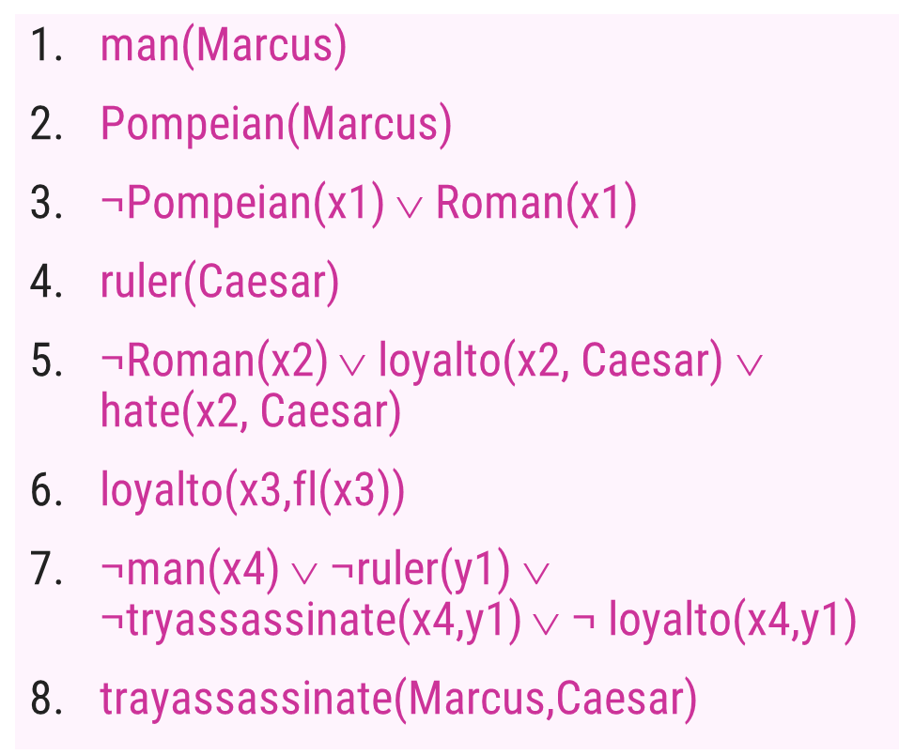
Prove: hate(Marcus, Caesar)
¬hate (Marcus, Caesar)
5 (Marcus l x2)
Sunny ∨ Rain
Windy ∨ ¬ Rain
3 (Marcus l x1)
¬Roman(Marcus) ∨ loyalto(Marcus, Caesar)
Sunny ∨ Windy
2
¬Pompeian(Marcus) ∨ loyalto(Marcus, Caesar)
7 (Marcus l x4, Caesar l y1)
loyalto(Marcus, Caesar)
Resolution by Refutation
¬man(Marcus) ∨ ¬ruler(Caesar) ∨ ¬tryassassinate(Marcus, Caesar)
1
Final resolvent is an empty clause means that a contradiction is found in the initial assumption. So it is proved that
hate (Marcus, Caesar).
4
¬ruler(Caesar) ∨ ¬tryassassinate(Marcus, Caesar)
¬tryassassinate(Marcus, Caesar)
8

Slide 25
Resolution by Refutation – Example
John likes all kinds of food.
Apples are food.
Chicken is food.
Anything anyone eats and isn’t killed by is food.
Bill eats peanuts and is still alive.
John eats everything Bill eats.

Slide 26
Resolution by Refutation – Example
Step 1 : Translate these sentences into formulas in FOPL
John likes all kinds of food.
∀x Food(x) → Likes(John, x)
Apples are food.
Food(Apples)
Chicken is food.
Food(Chicken)
Anything anyone eats and isn’t killed by is food.
∀x ∃y : Eats(y, x) ∧ ¬KilledBy(y, x) → Food(x)
Bill eats peanuts and is still alive.
Eats(Bill, Peanuts) ∧ ¬KilledBy(Bill, Peanuts)
John eats everything Bill eats.
∀x : Eats(Bill, x) → Eats(John, x)

Slide 27
Axioms in clause form
Step 2 : Convert the formulas of step 1 into clause form.
∀x Food(x) → Likes(John, x)
Food(Apples)
Food(Chicken)
∀x ∃y : Eats(y, x) ∧ ¬KilledBy(y, x) → Food(x)
Eats(Bill, Peanuts) ∧ ¬KilledBy(Bill, Peanuts)
∀x : Eats(Bill, x) → Eats(John, x)
¬Food(x) ∨ Likes(John, x)
Food(Apples)
Food(Chicken)
¬Eats(y, x) ∨ KilledBy(y, x) ∨ Food(x)
Eats(Bill, Peanuts)
¬KilledBy(Bill, Peanuts)
¬Eats(Bill, x) ∨ Eats(John, x)
Use resolution to prove that John likes peanuts.

Slide 28
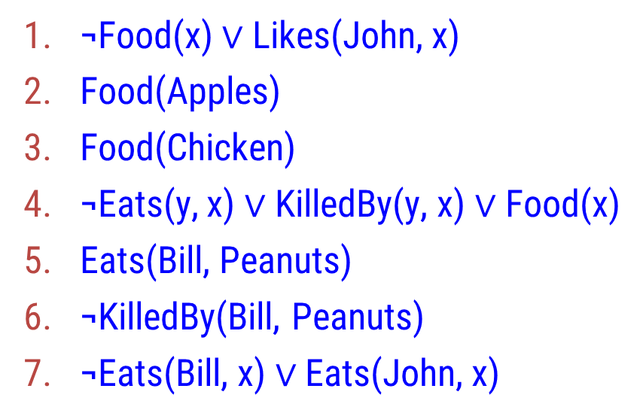
Prove: Likes(John, Peanuts)
¬Likes(John, Peanuts)
1 (Peanuts l x)
4 (Peanuts l x)
¬Food(Peanuts)
¬Eats(y, Peanuts) ∨ KilledBy(y, Peanuts) (Bill l y)
5
Resolution by Refutation
6
KilledBy(Bill, Peanuts)
Final resolvent is an empty clause means that a contradiction is found in the initial assumption. So it is proved that
Likes(John, Peanuts)

Slide 29
Representing Knowledge Using Rules

Slide 30
Procedural and Declarative Knowledge
Procedural Knowledge :
Procedural Knowledge is the type of knowledge which clarifies how a particular thing can be accomplished.
It emphasize how to do something to solve a given problem.
A representation in which the control information that is necessary to use the knowledge is embedded in the knowledge itself for e.g. computer programs, directions, and recipes; these indicate specific use or implementation;
Declarative Knowledge :
Declarative Knowledge is the type of knowledge which tells the basic knowledge about something and it is more popular than Procedural Knowledge.
It emphasize what to do something to solve a given problem.
A statement in which knowledge is specified, but the use to which that knowledge is to be put is not given. For example, laws, these are the facts which can stand alone, not dependent on other knowledge.

Slide 31
Differences Between Declarative knowledge and Procedural Knowledge
Procedural knowledge Declarative knowledge
It is also known as Interpretive knowledge.
Procedural Knowledge means how a particular thing can be accomplished.
High efficiency and Low modifiability
Low perceptive adequacy (better for knowledge engineers)
Produces creative, reflective thought and promoters critical thinking and independent decision making
It is also known as Descriptive knowledge.
While Declarative Knowledge means basic knowledge about something.
Good modifiability and good readability
Suitable for independent facts
Good cognitive matching (better for domain experts and end-users) and low computational efficiency.

Slide 32
Forward versus Backward Reasoning
A search procedure must find a path between initial and goal states. There are two directions in which a search process could proceed.
Forward Reasoning Backward Reasoning
Reason forward from the initial state
It begins building a tree of moves by starting with the initial configuration at the root of the tree.
Generates the next level of tree by finding all rules whose left hand side matches against the root node. The right hand side is used to create new configurations.
Forward Chaining searches for any conclusion. Suitable for planning, monitoring, control, and interpretation applications.
Reasoning backward from the goal states
It begins building a tree of moves by starting with the goal node configuration at the root of the tree.
Generate the next level of tree by finding all rules whose right hand side matches against the root node. The left hand side is used to create new configurations.
Backward chaining searches for only the required data. Suitable for diagnostic and debugging applications.

Slide 33
Thank You!

