Slide 1

Unit-6: Game Playing
Artificial Intelligence (AI)
3170716
Dr. Gopi Sanghani
Computer Engineering Department
gopi.sanghani@darshan.ac.in
9825621471

Slide 2

Outline
Overview
MiniMax Search Procedure
Alpha-Beta Cut-offs
Refinements Theory
Looping

Slide 3
Introduction
Game Playing is an important domain of Artificial Intelligence.
There are two reasons that games appeared to be a good domain.
They provide a structured task in which it is very easy to measure success or failure.
They are easily solvable by a straightforward search from the starting state to a winning position.
Games require only the domain knowledge such as the rules, legal moves and the conditions of winning or losing the game.
In a two-player game, both the players try to win the game. So, both of them try to make the best move possible at each turn.
To improve the effectiveness of a search based problem solving program two things can be done.
Improve generate procedure so that only good moves are generated.
Improve test procedure so that the best move will be recognized and explored first.

Slide 4
Introduction
If we use legal-move generator then the test procedure will have to look at each of them, because the test procedure must look at so many possibilities and it must be fast.
The depth of the resulting tree or graph and its branching factor will be too large.
Instead of legal-move generator we can use plausible-move generator in which only some small numbers of promising moves are generated.
As the number of legal available moves increases it becomes increasingly important in applying heuristics to select only those moves that seem more promising.
The performance of overall system can be improved by adding heuristic knowledge into both the generator and the tester.
It is possible to search tree only ten or twenty moves deep then in order to choose the best move, the resulting board positions must be compared to discover which is most advantageous.

Slide 5
Introduction
This is done using static evaluation function, which uses whatever information it has to evaluate individual board position by estimating how likely they are to lead eventually to a win.
The most common search technique in game playing is Minimax search procedure.
17
MAX (player)
14
17
5
MIN (opponent)
14
27
17
21
14
5
MAX (player)
3
14
12
27
17
2
6
21
14
3
5
1
MIN (opponent)

Slide 6
The MINIMAX Search Procedure
The Minimax search is a depth first and depth limited procedure.
The idea is to start at the current position and use the plausible-move generator to generate the set of possible successor positions.
Now we can apply the static evaluation function to those positions and simply choose the best one.
After doing so, we can back that value up to the starting position.
Here, we assume that static evaluation function returns larger values to indicate good situations for us.
So our goal is to maximize the value of the static evaluation function of the next board position.
The opponents’ goal is to minimize the value of the static evaluation function.

Slide 7
The MINIMAX Search Procedure
The alternation of maximizing and minimizing at alternate ply when evaluations are to be pushed back up corresponds to the opposing strategies of the two players is called MINIMAX.
It is recursive procedure that depends on two procedures :
MOVEGEN(position, player)— The plausible-move generator, which returns a list of nodes representing the moves that can be made by Player in Position.
STATIC(position, player) -- static evaluation function, which returns a number representing the goodness of Position from the standpoint of Player.
To decide when recursive procedure should stop, variety of factors may influence the decision such as,
Has one side won?
How many ply have we already explored? Or how much time is left?
How stable is the configuration?

Slide 8
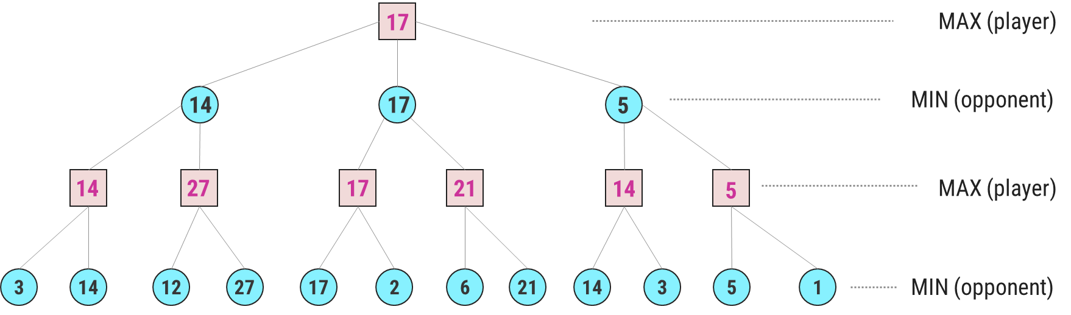
Minimax – Algorithm
Given a game tree, the optimal strategy can be determined from the minimax value of each node, which we write as MINIMAX(n).
The minimax algorithm computes the minimax decision from the current state.
It uses a simple recursive computation of the minimax values of each successor state, directly implementing the defining equations.
The recursion proceeds all the way down to the leaves of the tree, and then the minimax values are backed up through the tree as the recursion unwinds.

Slide 9
Minimax – Algorithm
The minimax value of a node is the utility (for MAX) of being in the corresponding state, assuming that both players play optimally from there to the end of the game.
The algorithm first recuses down to the three bottom left nodes and uses the UTILITY function on them to discover that their values are 3 and 14 respectively.
Then it takes the maximum of these values, 14, and returns it as the backed up value of parent node.
A similar process gives the backed-up values of 27, 17, 21, 14 and 5 respectively.

Slide 10
Minimax – Algorithm
Then it takes the minimum of these values 14, 17 and 5 respectively.
Finally, we take the maximum of 14, 17, and 5 to get the backed-up value of 17 for the root node.
The minimax algorithm performs a complete depth-first exploration of the game tree.
During every ply MAX prefers to move to a state of maximum value, whereas MIN prefers a state of minimum value.

Slide 11
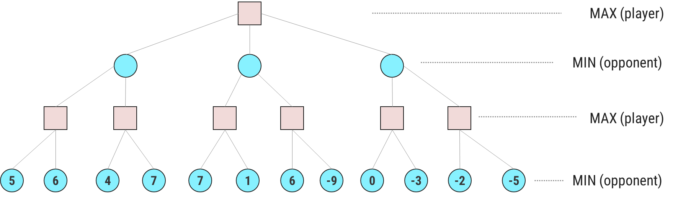
Minimax Example -1
6

Slide 12
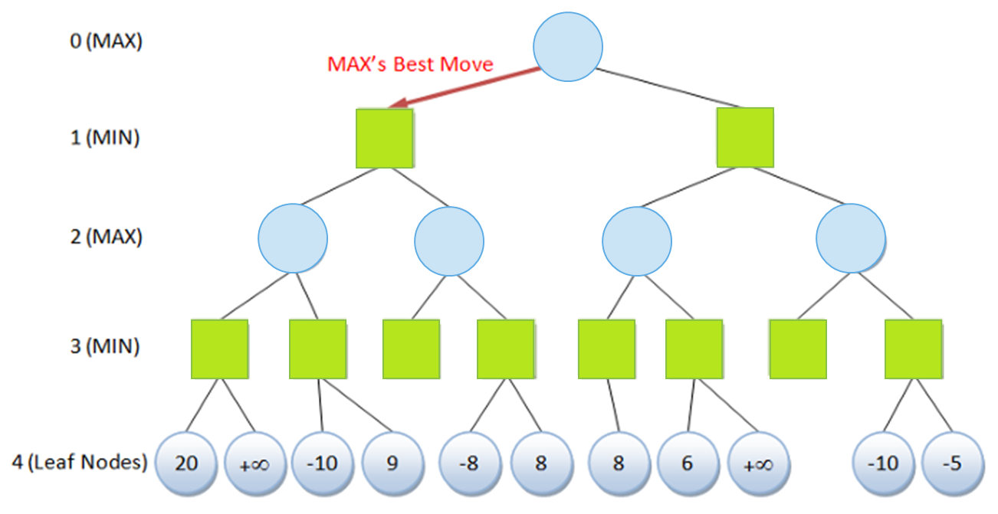
Minimax Example -2
-8
-∞
-∞

Slide 13
Alpha-Beta Pruning
Alpha-beta pruning is a modified version of the Minimax algorithm. It is an optimization technique for the Minimax algorithm.
In the Minimax search algorithm, the number of game states to be examined can be exponential in the depth of a tree.
Hence there is a technique by which without checking each node of the game tree we can compute the correct Minimax decision, and this technique is called pruning.
This involves two threshold parameter Alpha and beta for future expansion, so it is called alpha-beta pruning. It is also called as Alpha-Beta Algorithm.
Alpha-beta pruning can be applied at any depth of a tree, and sometimes not only it prunes the tree leaves but also entire sub-tree.

Slide 14
Alpha-Beta Pruning
Alpha-beta pruning technique maintains two bounds:
Alpha (𝜶): The best (highest-value) choice we have found so far at any point along the path of Maximizer. The initial value of alpha is -∞. A lower bound on best, i.e., Max
Beta (𝜷): The best (lowest-value) choice we have found so far at any point along the path of Minimizer. The initial value of beta is +∞. An upper bound on what the opponent can achieve
The Search proceeds maintaining 𝜶 and 𝜷
Whenever 𝜶 ≥ 𝜷_𝒉𝒊𝒈𝒉𝒆𝒓, or 𝜷 ≤ 𝜶_𝒉𝒊𝒈𝒉𝒆𝒓, searching further at this node is irrelevant.
In conclusion, Minimax with alpha beta pruning is a faster algorithm than the Minimax algorithm.

Slide 15







Minimax with Alpha-beta Pruning – Example 1
Max
A
$$≥4$$
$$≤4$$
$$≤3$$
Min
B
$$≤6$$
C
D
$$≤4$$
Max
$$≥3$$
J
K
E
F
G
$$4$$
H
I
3
8
4
5
6
L
M
N
O
3
4
7
9

Slide 16









Minimax with Alpha-beta Pruning – Example 2
Max
$$≥3$$
A
Min
$$≤3$$
B
$$≤1$$
C
$$≤2$$
D
Max
$$≥2$$
E
$$≥5$$
F
$$≥1$$
G
H
$$≥2$$
I
J
$$3$$
2
3
5
9
1
0
7
4
2
1
5
6

Slide 17
Minimax with Alpha-beta Pruning – Example 3
6
MAX (player)
3
6
5
MIN (opponent)
5
3
6
7
5
8
MAX (player)
5
4
3
6
6
7
5
8
6
MIN (opponent)
5
6
7
4
5
3
6
6
9
7
5
9
8
6
MAX (player)

Slide 18
Game Refinement Theory
Game theory is a discipline which stands from the game player’s point of view with a focus on how to win a game.
However, game designers would consider another important aspect: how to make a game more attractive.
With such motivation, a new game theory from the game designer’s point of view, called game refinement theory was proposed in the early 2000s.
Von Neumann was a pioneer who formed the foundation for the modern game theory, which has widely been applied in various fields.
One direction with game theory was to find the best move in a game or to ensure the possibility of winning the game based on the understanding of current positions.
Another direction with game refinement theory was to assess the attractiveness or sophistication of a game.

Slide 19
Game Refinement Theory
In particular, game refinement theory gives a measure to quantify the sophistication of a game.
This enables to obtain the deep insight into the current game and improve the quality of the game.
The measure of game refinement can also be used to obtain the deep insight into the history of games.
It also gives a reasonable look on the evolution of specific game variants.
Game refinement theory has been widely applied to many different types of games with the promising results.
We can extend the idea of game refinement into the other domains in human life such as sports games, video games, education or business.
In many activities of human, the engagement is used as one of the important standards to evaluate the effectiveness of those activities.

Slide 20
Thank You!

