Slide 1




A N S I B L E
IT AUTOMATION

Slide 2
What is Ansible (?)
Ansible is a free software platform for configuring and managing computers. It combines multi-node software deployment, ad hoc task execution, and configuration management.
It manages nodes over SSH or PowerShell and requires Python (2.4 or later)
-----------------------
Server Configuration Management, Orchestration & Deployment Tool

Slide 3
Ansible vs. Other Config-Management Tools
Overhead caused by agents: Ansible is almost unique among CM tools in using an agentless architecture. Instead it only relies on the tried and tested SSH
Difficult to learn: Puppet and Chef use Ruby-derived languages to create commands and modules using their CLI’s. On the other hand Ansible modules and packages, called playbooks, are relatively easy to learn; they use a simpler YAML-derived syntax.
Dependence on Ruby: Since it’s more common to have Python libraries installed as default on Linux distros, Ansible’s creators decided to develop it in Python. But they took it even further – Ansible modules work over JSON and can therefore be written in any programming language. So no requirement to learn Ruby at all.

Slide 4
What is Ansible (?)
Ansible is a free software platform for configuring and managing computers. It combines multi-node software deployment, ad hoc task execution, and configuration management.
It manages nodes over SSH or PowerShell and requires Python (2.4 or later)
-----------------------
Server Configuration Management, Orchestration & Deployment Tool

Slide 5
Licensing
Open Source
License:
GNU General Public License
Ansible Tower
Basic Tower
Enterprise Tower
Premium Tower
Ansible Open Source vs. Ansible Tower
Tower Dashboard
Enterprise Features & Support

Slide 6
Ansible Tower
PROS
  Has a proper web GUI
  Easy for new users
  Playbook Creation
  Real-time System Monitoring
  Enterprise Features
    LDAP/AD integration
    Jobs scheduler
    Portal mode (simplified view)
    Dashboard Summary
    Cloud Integration
  SUPPORT
CONS
CLI & GUI could give two different results

Slide 7
Architecture Principles (i)
MINIMAL NATURE
(agentless)
SECURE
(ssh)
RELIABLE
(prevent re-run scripts)
LOW-LERANING CURVE
(Playbooks - YAML)

Slide 8
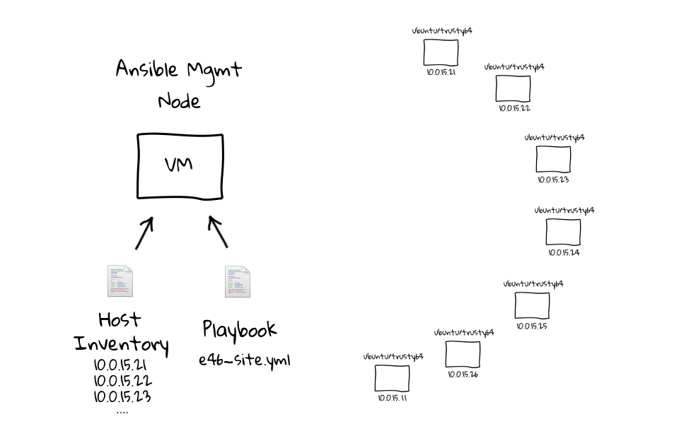
Architecture (ii)

Slide 9
What is Ansible for?
Provisioning
Configuration Management
App Deployment
Continuous Delivery
Security and Compliance
Orchestration

Slide 10
Installing Ansible
Ubuntu
# apt-get install python-pip python-dev
# pip install ansible
Path
/etc/ansible
/etc/ansible/hosts

Slide 11
Concepts
Host Inventory
Playbooks
Plays
Task & Modules
Handlers
Variables, Templates & Facts
Roles

Slide 12
Host Invetory
Your list of hosts that you want manage with Ansible
Can be organised into groups
Can set ports or override other connections settings
Can use flat config-files or plugins to communicate with Cloud providers

Slide 13
Host Invetory (sample)
The format for /etc/ansible/hosts is an INI-like format and looks like this:
[webservers]
foo.example.com
bar.example.com
[dbservers]
one.example.com
two.example.com
three.example.com

Slide 14
Intro to Playbooks
Basically a script of tasks to run against a set of hosts. In a playbook you define what actions Ansible should take to get the server in the state you want
      Playbooks contain Plays
          Plays contain Taks
              Tasks call Modules
Playbooks are expressed in YAML format and have a minimum of syntax, which intentionally tries to not be a programming language or script, but rather a model of a configuration or a process.

Slide 15
Plays
Plays are a set of tasks
They reside in Playbooks and are applied against a subset o hosts
The ansible-playbook command is used to run playbooks, and the simplest usage is: ansible-playbook your-playbook.yml.
# ansible-playbook apache.yml

Slide 16
Writting your first Playbook
We’re going to write a playbook that does the following:
Install apache2
Make sure index.html is present in /var/www/ and is owned by www-data
Restart apache

Slide 17
[Code]
– hosts: all
user: root
sudo: no
tasks:
– name: install apache2
action: apt pkg=apache2 state=latest
notify:
– start apache2
– name: Make sure index.html is present for the default virtual host
action: copy src=files/index.html dest=/var/www/index.html
– name: Make sure index.html is owned by www-data
action: file path=/var/www/index.html owner=www-data group=www-data
handlers:
– name: start apache2
action: service name=apache2 state=started

Slide 18
Tasks & Modules
Tasks call modules to alter some configuration on a server
Changes are made in all hosts or groups
Ansible ships with a number of modules (called the ‘module library’)
You can write your own modules
Modules do everything: install a package, run commands, manage services, copy template files, mount drives, etc...
  Core Modules (maintained by Ansible)
  Extra Repos (maintained by the Community)

Slide 19
Handlers
Handlers are tasks that get run after certain triggers
They are only run at the end of a Play and they are only run once
Example:
  After configuring Nginx you can setup a handler to restart or reload the service

Slide 20
Variables, Templates & Facts
Variables allow you to easily change your configuration for different environments
Templates allow you to copy configuration files and update certain sections using variables
Templates use Jinja2, a full featured template engine for Python
Facts are information collected about each server in your inventory (ip address, memory, disk space, etc...)

Slide 21
Roles (i)
Allow better organisation and reuse of your tasks
Roles are a further level of abstraction that can be useful for organizing playbooks.
Defined by a file estructure
Chose level of granularity

Slide 22
Roles (ii)
files: This directory contains regular files that need to be transferred to the hosts you are configuring for this role. This may also include script files to run.
handlers: All handlers that were in your playbook previously can now be added into this directory.
meta: This directory can contain files that establish role dependencies. You can list roles that must be applied before the current role can work correctly.
templates: You can place all files that use variables to substitute information during creation in this directory.
tasks: This directory contains all of the tasks that would normally be in a playbook. These can reference files and templates contained in their respective directories without using a path.
vars: Variables for the roles can be specified in this directory and used in your configuration files.

Slide 23
Resources · Go further
Apart from the official documentation [http://docs.ansible.com]
      https://en.wikipedia.org/wiki/Ansible_%28software%29
      http://www.ansible.com/tower-features
      https://www.scriptrock.com/articles/ansible-vs.-ansible-tower
      https://www.youtube.com/watch?v=2jXHxkLBOHg
      https://es.wikipedia.org/wiki/YAML
      http://devops.com/2014/04/10/automation-versus-orchestration/
      http://lowendbox.com/blog/getting-started-with-ansible/
      http://cloudacademy.com/blog/building-ansible-playbooks-step-by-step/
      http://jinja.pocoo.org/
      https://www.digitalocean.com/community/tutorials/how-to-use-ansible-roles-to-abstract-your-infrastructure-environment

Slide 24
Gracias ;-)
@colomer_io

