Slide 1

A3-PS003-TC196
Federated Traffic-Flow Predication with Communication-Cost Evaluation
Banoth Varshith
banothvarshith12@gmail.com
AIORI Hackathon 3

Slide 2
AIORI 3
Abstract
Problem Description
Traffic-flow prediction plays a role in smart transportation systems.. Traditional models collect raw traffic data from many intersections and send it to one server. This causes problems with privacy. Uses a lot of communication resources. In traffic-flow prediction each intersection or client trains a model using its own data. Only the model updates are sent to a server for combining. However traffic data at intersections is often not the same. This means each place has traffic patterns. This can make predictions less accurate. Make the process take longer to get good results. Also sending model parameters back and forth uses a lot of network resources. The challenge is to create a traffic-flow prediction model that gives good results even when data is spread out and different. It also needs to check how much communication is used. The solution should compare federated methods. It should look at accuracy measures, like MAE and RMSE. It should also check how many bytes are sent each round and how quickly the model gets better.
A3-PS003-TC196

Slide 3
AIORI 3
Background
Background
Traffic-flow prediction plays a role in Intelligent Transportation Systems. It uses data from sensors and road intersections to forecast how traffic will move. This helps reduce traffic jams improve route choices and make traffic signals work better. In methods data from many places is sent to a central server for training. This approach needs a lot of storage and communication. Can risk privacy because raw data is shared. Federated Learning solves this by letting each location train a model on its data. The central server then combines updated models without seeing the original data. This is done using a method called Federated Averaging or FedAvg.
Traffic data is not the same everywhere. Different intersections have traffic volumes, road sizes and peak times. This leads to data that's not independent and identically distributed or non-IID. Such data can hurt the accuracy of predictions. Make it harder for the model to learn. Also sending updates often increases communication costs. So this project looks at how Federated Learning works for traffic-flow prediction. It measures accuracy using Mean Absolute Error and Root Mean Squared Error. It also tracks how much communication is needed. The goal is to find a balance, between accurate predictions and low communication overhead.
A3-PS003-TC196

Slide 4
AIORI 3
Literature & RFC Review
Literature & RFC Review
McMahan and colleagues introduced Federated Averaging (FedAvg) in 2017. This method allows multiple clients to train a shared model without sharing data. It is designed to be communication-efficient. Al-Huthaifi and colleagues proposed Fed AGAT in 2024. This approach combines learning with graph attention networks. The goal is to improve traffic-flow prediction. It does this by taking into account the relationships between road locations. Other studies look into model pruning and personalized aggregation. These techniques aim to reduce communication costs. They also aim to improve prediction performance. REFOL was introduced in 2025. It focuses on resource- federated online learning for traffic forecasting. It handles changing traffic conditions. These studies show that there are challenges. Non-IID data is one of them. Communication delays are another. Changing traffic patterns make things harder too. The NIST Privacy Framework gives guidance. It helps. Manage privacy risks. These risks come from data processing.
Research Gap: Existing methods struggle to balance prediction accuracy, communication and training efficiency. This project evaluates FedAvg. It uses Mean Absolute Error (MAE) and Root Mean Squared Error (RMSE) to measure prediction performance. It also tracks data transmitted and communication rounds. The goal is to find a balance. This balance is, between prediction performance and communication efficiency.
A3-PS003-TC196

Slide 5
AIORI 3
Proposed Solution
Proposed Solution
The proposed system uses Federated Learning to predict traffic flow while reducing privacy risks and communication costs. Historical traffic data collected from road intersections or sensors is distributed among different clients, where each client trains a local machine‑learning model without sharing raw data. A central server coordinates the training process using Federated Averaging, which combines model updates received from clients to create a model. The updated global model is then shared with clients for training over multiple communication rounds. The system evaluates prediction accuracy using Mean Absolute Error and Root Mean Squared Error. Communication efficiency is measured by calculating the data transmitted the number of communication rounds and overall training time. Finally the proposed federated approach is compared with local learning methods to understand the trade‑off between prediction accuracy, data privacy and communication overhead aiming to achieve efficient and reliable traffic‑flow prediction, for intelligent transportation systems.
A3-PS003-TC196

Slide 6
AIORI 3
Solution Optimization
Optimization Proposed
Optimization | Before | After
Data Privacy | Raw data shared with a central server. | Data remains locally stored using Federated Learning.
Model Training | Independent or centralized training. | Collaborative training using FedAvg.
Communication Cost | Frequent model updates increase network usage. | Reduce communication rounds and explore model compression.
Prediction Accuracy | Traffic variations may reduce accuracy. | Tune model parameters and evaluate using MAE and RMSE.
Non-IID Data | Different traffic patterns affect model performance. | Evaluate improved aggregation strategies.
Training Efficiency | Repeated communication increases training time. | Optimize local training epochs and communication frequency.
A3-PS003-TC196

Slide 7
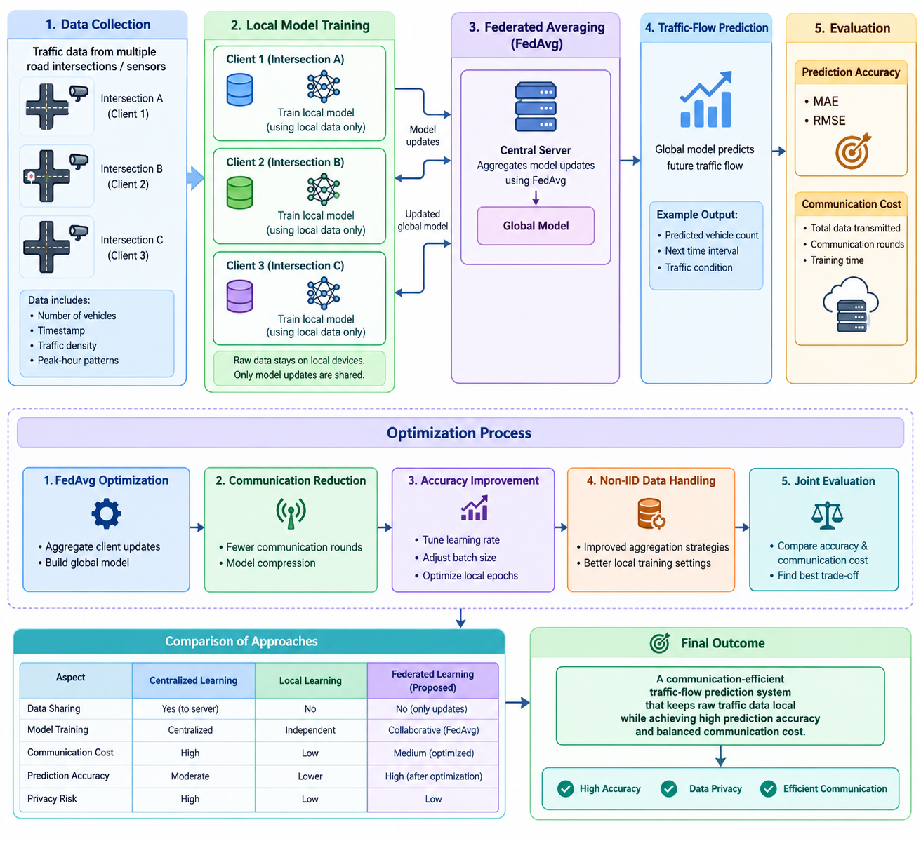
Solution Architecture & Design
AIORI 3 Architecture Design (UML Diagram)
Image
Figure: System Architecture UML Diagram
A3-PS003-TC196

Slide 8
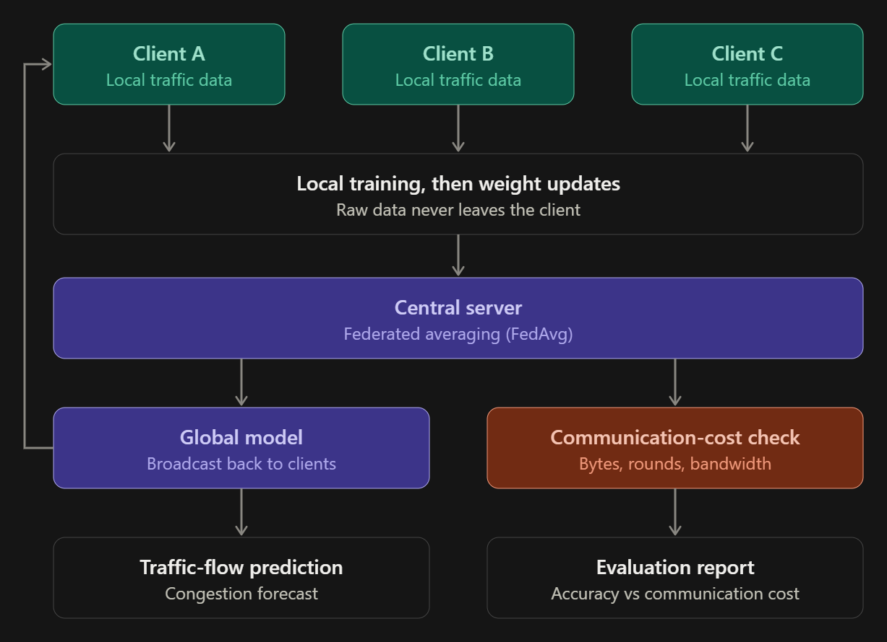
Data Flow Diagram
AIORI 3 Data Flow Diagram
Image
Figure: Data Flow Diagram (DFD)
A3-PS003-TC196

Slide 9
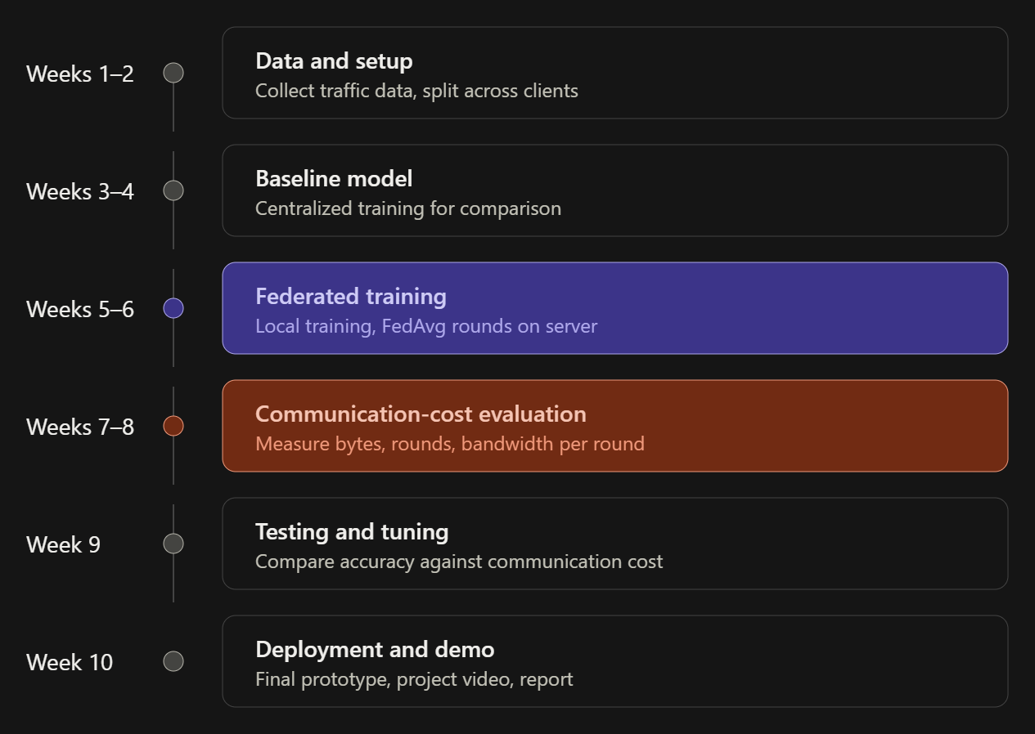
AIORI 3
Deployment Timeline
Deployment Timeline
A3-PS003-TC196

Slide 10
Bibliography I
Bibliography
B. McMahan, E. Moore, D. Ramage, S. Hampson, and B. Agüera y Arcas, “Communication-efficient learning of deep networks from decentralized data,” in Proc. 20th Int. Conf. Artificial Intelligence and Statistics (AISTATS), PMLR vol. 54, 2017, pp. 1273–1282.
Y. Liu, J. J. Q. Yu, J. Kang, D. Niyato, and S. Zhang, “Privacy-preserving traffic flow prediction: A federated learning approach,” IEEE Internet of Things Journal, vol. 7, no. 8, pp. 7751–7763, 2020.
A3-PS003-TC196

Slide 11
Thank You for Your Attention!

