Slide 1

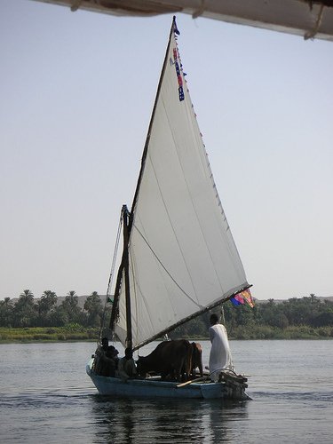



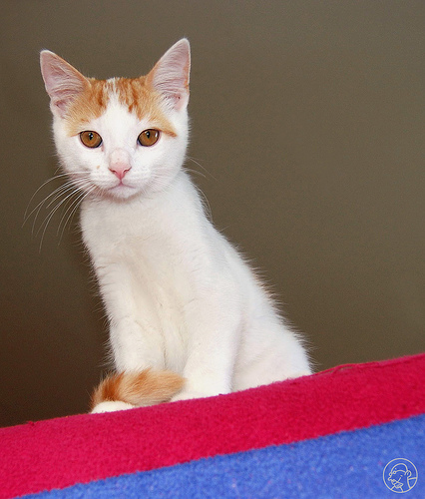

EXPORT TO PASCAL VOC
JPEGImage
CLASS
OBJECT

