Slide 1
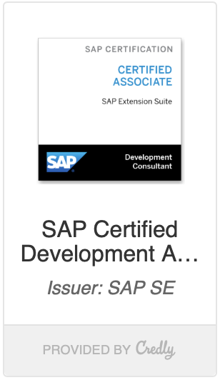
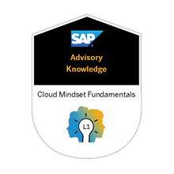

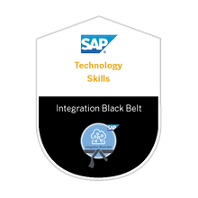
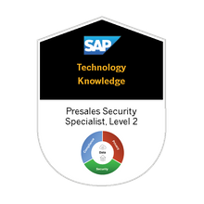
Cloud Mindset
Advisory Knowledge
SAP SE
Extension Suite 2021
Innovation & Advisory Knowledge
SAP SE
Integration Blackbelt L3
Technology Skill
SAP SE
Security L2
Technology Knowledge
SAP SE

Slide 2


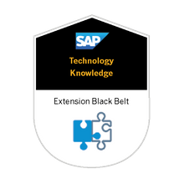
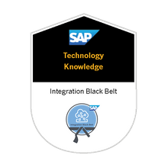
Database Ninja
Technology Knowledge
SAP SE
Security L1
Technology Knowledge
SAP SE
Extension Blackbelt
Technology Knowledge
SAP SE
Integration Blackbelt L2
Technology Knowledge
SAP SE

Slide 3
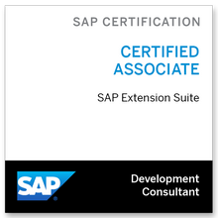
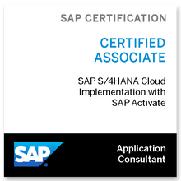
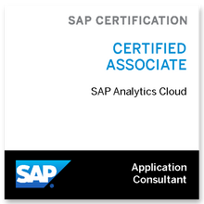
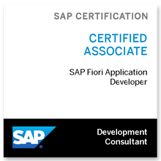
Extension Suite
SAP Certificated
SAP SE
S/4HANA Cloud Implementation with SAP Activate
SAP Certificated
SAP SE
Sap Analytics Cloud
SAP Certificated
SAP SE
Sap Fiori Application Development
SAP Certificated
SAP SE

Slide 4
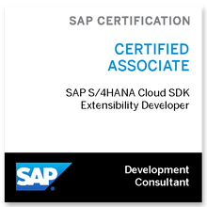

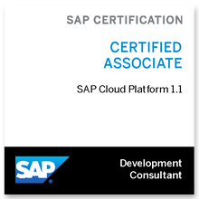

S/4HANA Cloud SDK Extensibility Developer
SAP Certificated
SAP SE
SAP Cloud Platform Integration
SAP Certificated
SAP SE
SAP Cloud Platform 1.1
SAP Certificated
SAP SE
TOGAF® 9 Certified
The Open Group Certified

Slide 5
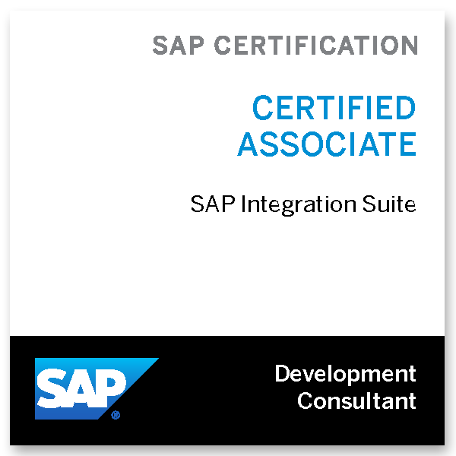

SAP Integration Suite 2021
SAP Certificated
SAP SE
SAP
SAP
TOGAF® Standard, Version 9.2
The Open Group Certified

Slide 6
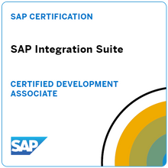

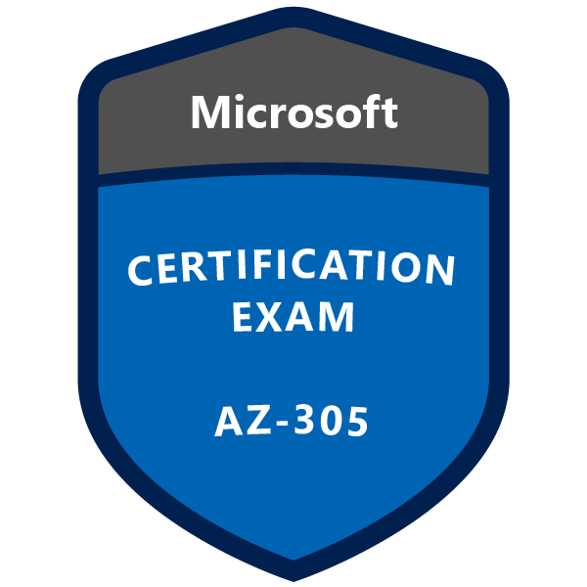

SAP Certified Development Associate - SAP Integration Suite
Microsoft Certified: Azure Administrator Associate
AZ-305: Designing Microsoft Azure Infrastructure Solutions
Microsoft Certified: Azure Solutions Architect Expert

Slide 7
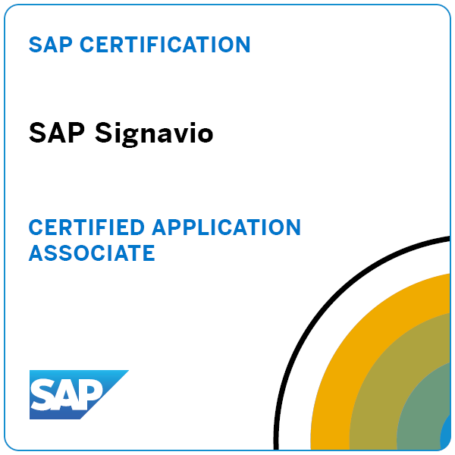

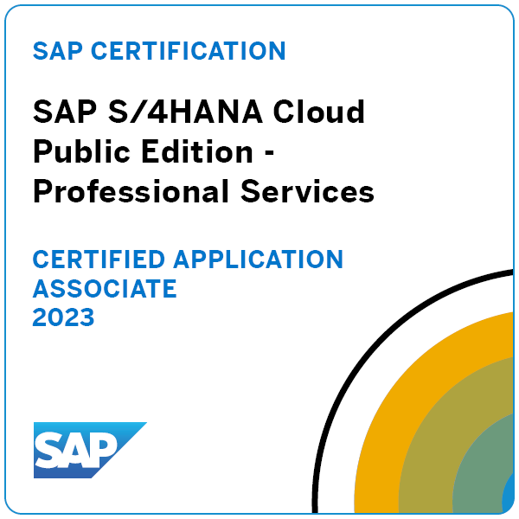
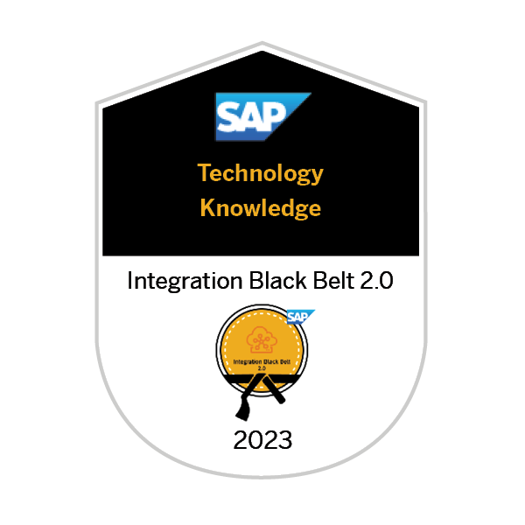
SAP Signavio
Compose and Automate with SAP Build the No-Code Way
SAP S/4HANA Cloud - Public Edition - Professional Services 2023
Integration Black Belt 2.0

Slide 8
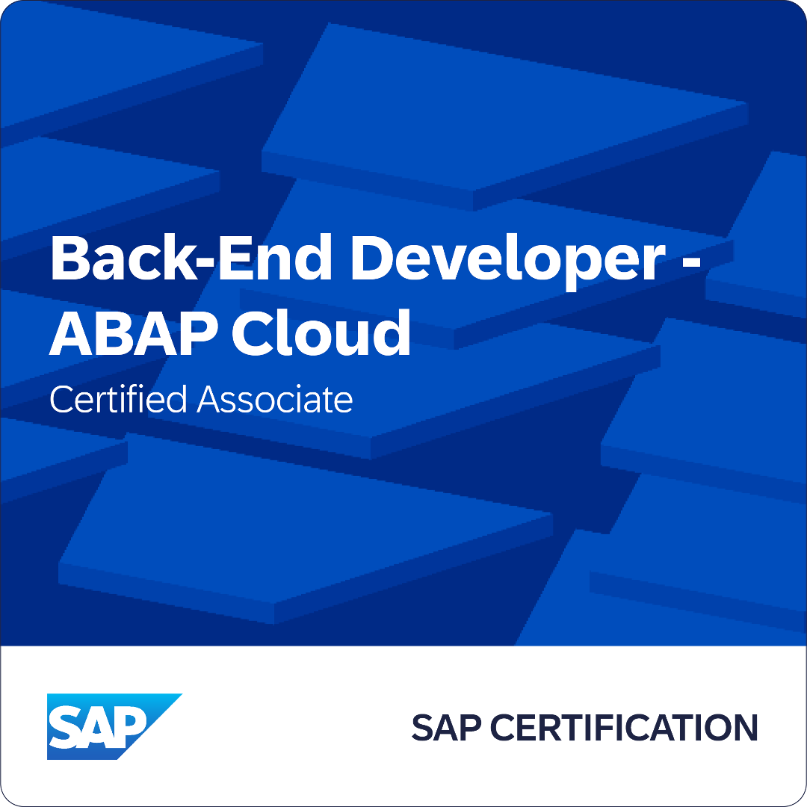
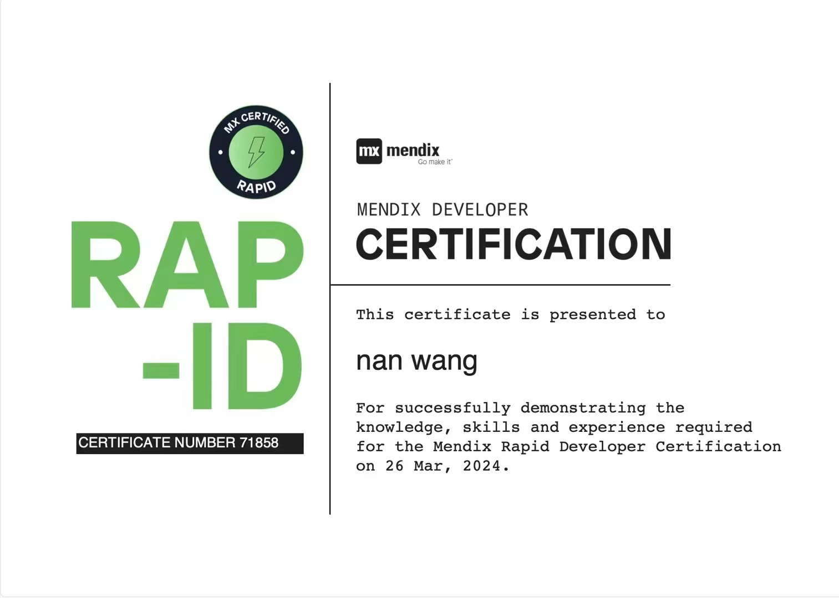
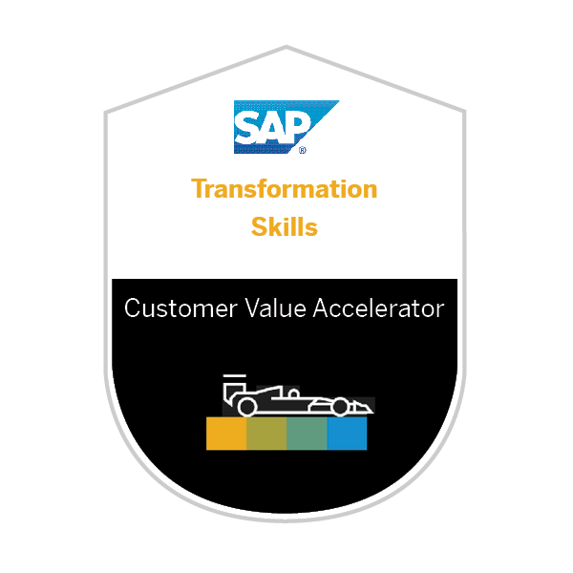
Back-End Developer - ABAP Cloud
Mendix Developer Certification
Customer Value Accelerator
Integration Black Belt 2.0

Slide 9
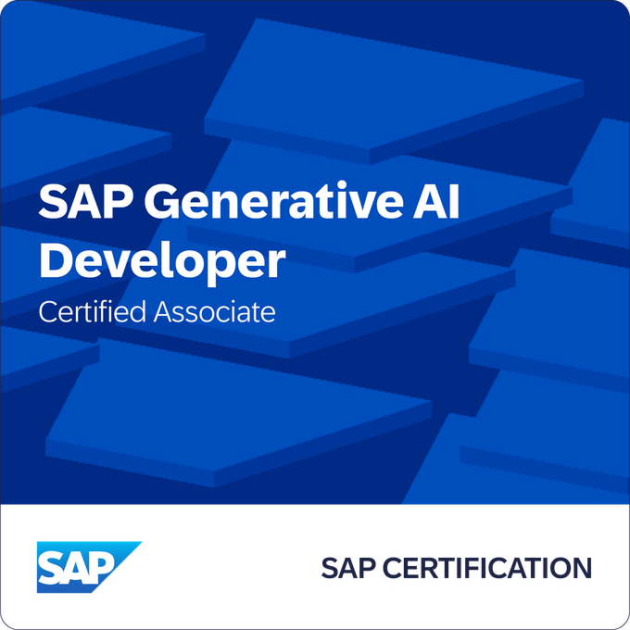
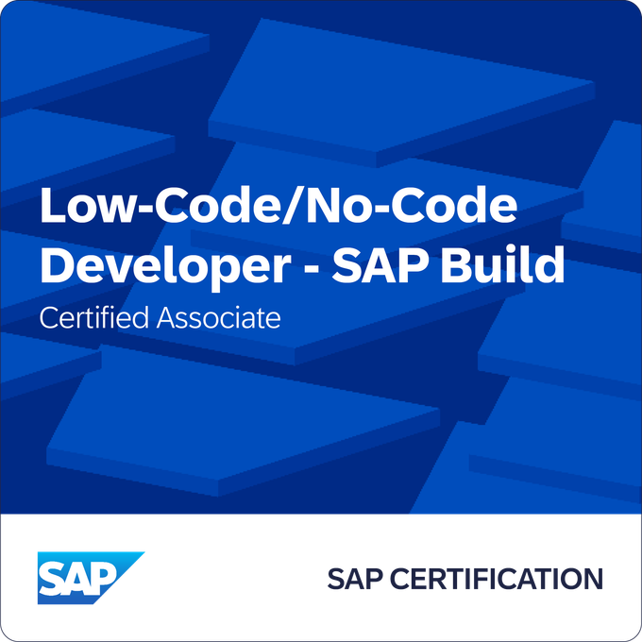
Business AI - SAP Generative AI Developer
Low-Code/No-Code Developer - SAP Build
Customer Value Accelerator
Integration Black Belt 2.0
link
link

