Slide 1

Top
Dollar
Deals
King Phinyathanabat
(Implementor)
Phillip Wernersbach
(Configuration Manager)
Hadi Almotairi
(Tester)
Rachel Wilson
(Team Leader)

Slide 2
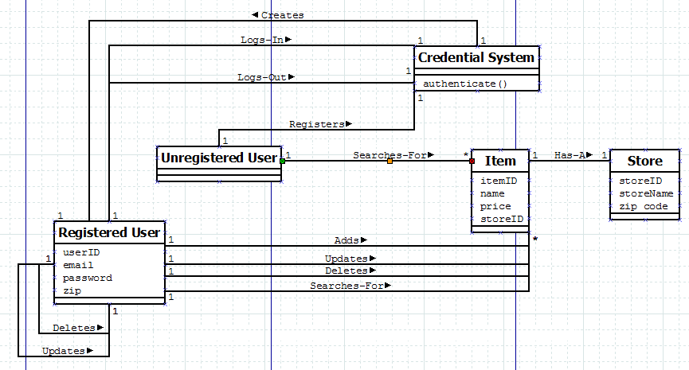
Domain Model

Slide 3
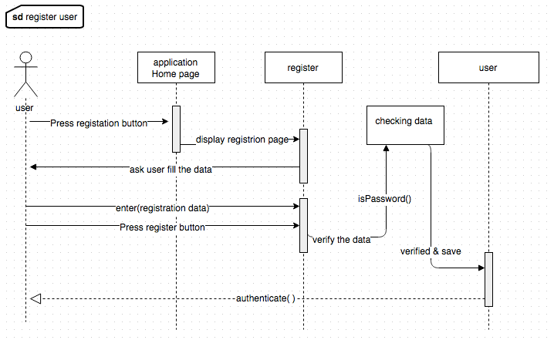
Sequence Diagrams

Slide 4
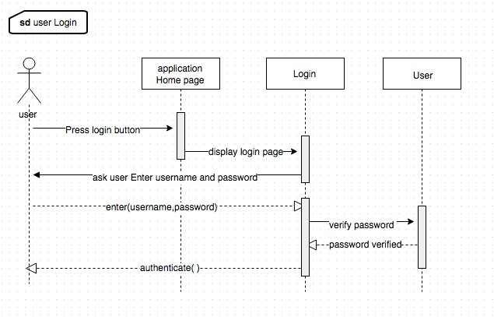
Sequence Diagrams

Slide 5
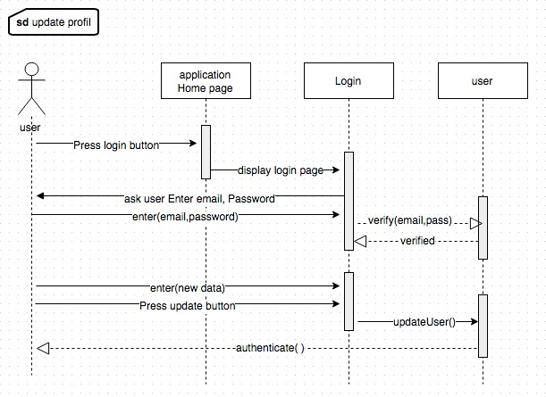
Sequence Diagrams

Slide 6
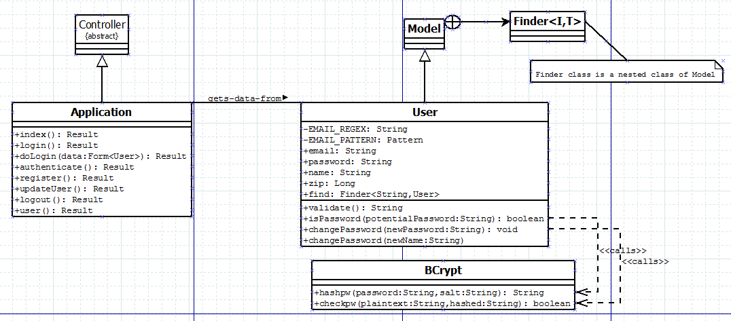
Class Diagram

Slide 7
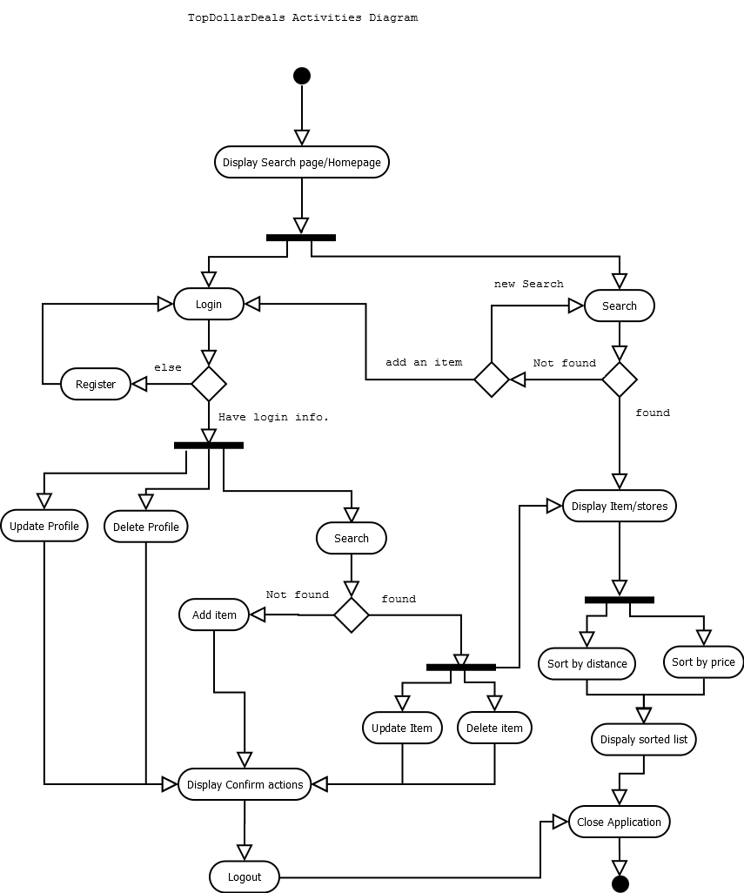
Activity Diagram

Slide 8
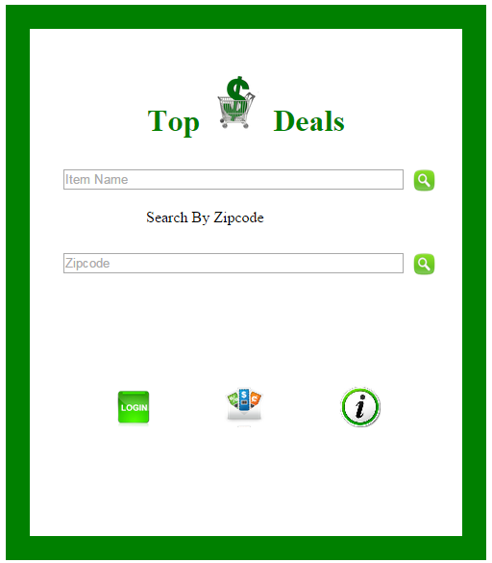
Live Demo

