Slide 1

Top
Dollar
Deals
King Phinyathanabat
(Implementor)
Phillip Wernersbach
(Configuration Manager)
Hadi Almotairi
(Tester)
Rachel Wilson
(Team Leader)

Slide 2
Project Aim and Goal
Grocery pricing currently varies wildly based on variables such as supply, demand, and the availability of substitute items. We envision a web application that will allow an end user to compare the price of a grocery item based on geographic location. Other features include the ability to crowdsource grocery prices, and add and remove grocery items from a geographic region based on availability.

Slide 3
Project Aim and Goal
There is currently no way for a grocery consumer to compare prices within a geographic region. This application will fill that void with a reliable geographically-based comparison engine and crowdsourcing features.

Slide 4
Requirement Analysis
Grocery items categorized by geographical area
Ability for users to add/remove/modify grocery items within geographical area
Ability for users to easily query grocery item data
Account system and administration system for community management

Slide 5
Summary of Use Cases
1. Search for an item
2. Sort Items by distance or price
3. Login/ Register (option to use Gmail/Facebook login)
4. Add an item (name, price, and picture)
5. Update item (price, name or image)
6. Delete item
7. Update profile (By user or admin)
8. Delete profile (By user or admin)

Slide 6
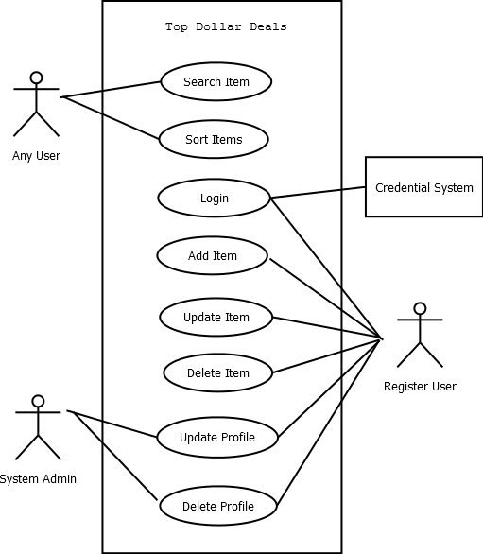
Use Case Diagrams

Slide 7
Future Working Plan
 High Level: Formulate design for UI and database
 Web based user interface – implementation details?
 Database type and schema design
 Detailed Level: Draft demo for fully dressed use cases
 Search for grocery item
 Add grocery item
 Manage grocery items
 Issues to complete vs to deferred to the next iteration
 Searching with predictive text?
 Will we need to create authentication piece for the ‘add grocery item’ use case?
 Do we start with anything populated in our database?

