Slide 1
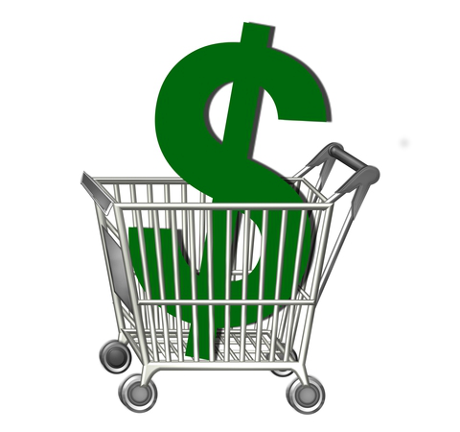
Top
Dollar
Deals
King Phinyathanabat
(Implementor)
Phillip Wernersbach
(Configuration Manager)
Hadi Almotairi
(Tester)
Rachel Wilson
(Team Leader)

Slide 2
Project Aim and Goal
Users are able to compare/check price of any items within their Area.
Users are able to login with their Gmail/Facebook account
Users have option to register with a new login
Users are able to update price on any items within their Area.
Users are able to add/delete any items within their Area.
Users are able to update/Delete their profile

Slide 3
Requirement Analysis
Grocery items categorized by geographical area
Ability for users to add/remove/modify grocery items within geographical area
Ability for users to easily query grocery item data
Account system and administration system for community management

Slide 4
Summary of Use Cases
1. Search for an item
2. Sort Items by distance or price
3. Login/ Register (option to use Gmail/Facebook login)
4. Add an item (name, price, and picture)
5. Update item (price, name or image)
6. Delete item
7. Update profile (By user or admin)
8. Delete profile (By user or admin)

Slide 5
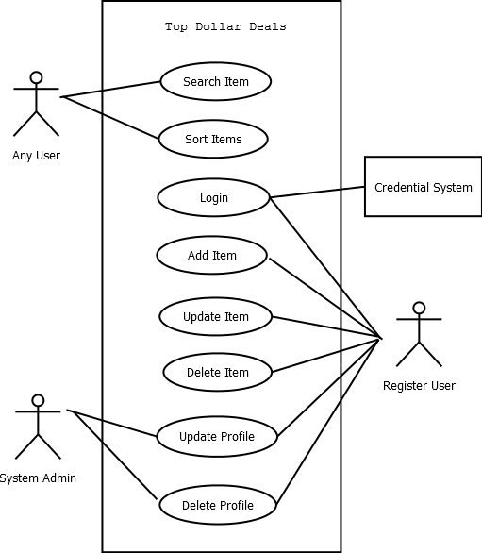
Use Case Diagrams

Slide 6
Future Working Plan
High Level: Formulate design for UI and database
Web based user interface – implementation details?
Database type and schema design
Detailed Level: Draft demo for fully dressed use cases
Search for grocery item
Add grocery item
Manage grocery items
Issues to complete vs to deferred to the next iteration
Searching with predictive text?
Will we need to create authentication piece for the ‘add grocery item’ use case?
Do we start with anything populated in our database?

