Slide 1
VII Technologies
Innovate For Future

Slide 2
SUSTAINABLE LAND MANAGEMENT & RESTORATION IN THE SAHEL
A DATA-DRIVEN APPROACH FOR
RISK ASSESSMENT & DECISION SUPPORT
VII Technologies
Innovate For Future

Slide 3
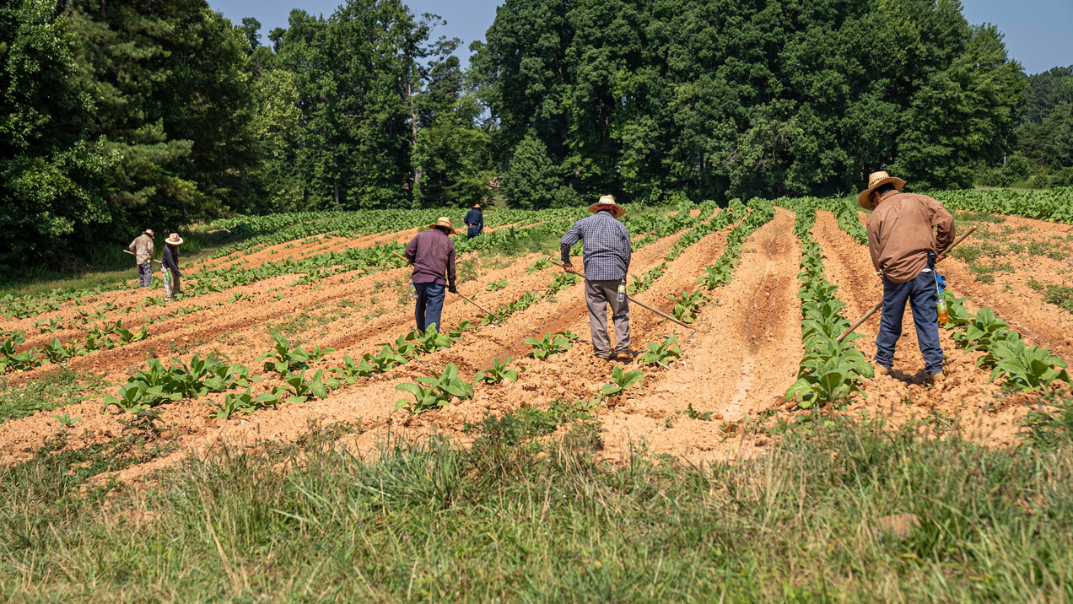

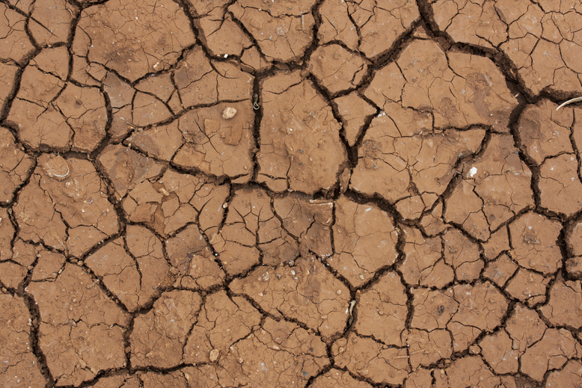
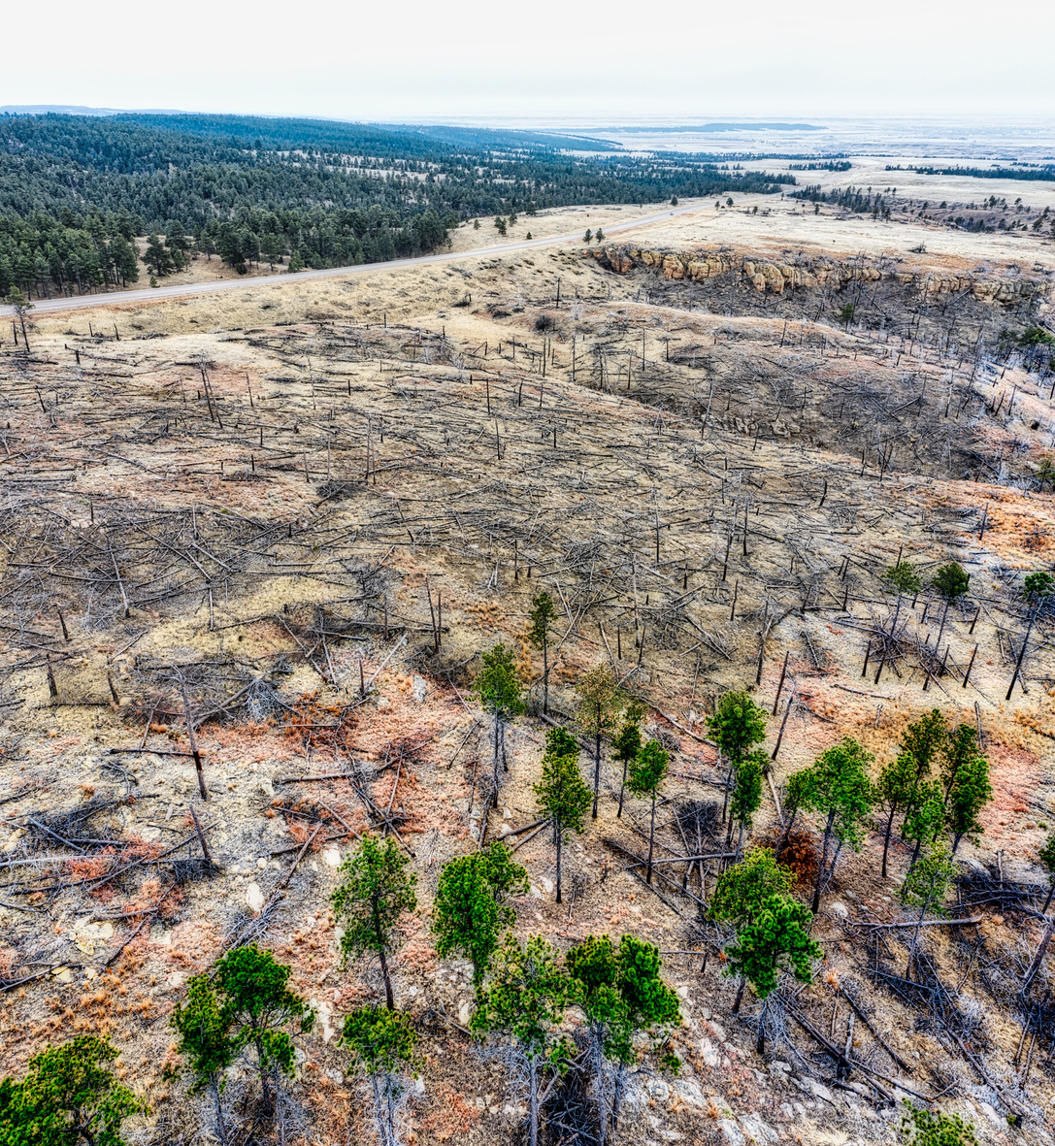
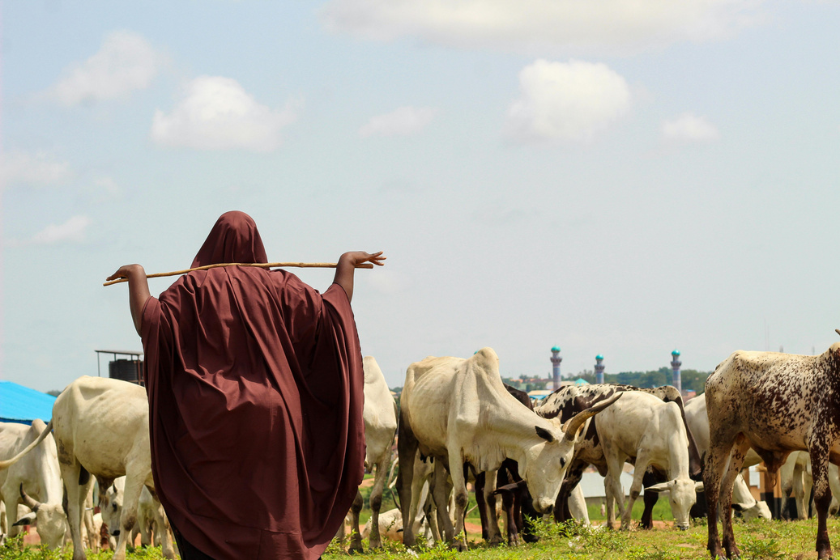
The Problems
❌ Land degradation & drought are accelerating in the Sahel
❌ Farmers, herders, and insurers struggle with risk assessment
❌ Lack of real-time, data-driven decision-making tools

Slide 4



Our Solutions
💡 LAND DEGRADATION RISK DASHBOARD
A user-friendly tool designed for reliability & impact
✅ Interactive Risk Assessment Dashboard – Visual insights for easy decision-making
✅ Data-Driven Insurance Support – Helps insurers price policies accurately
✅ Climate & Land Analysis – Identifies high-risk areas using satellite data

Slide 5
How it works ?

Slide 6
How it works ?
Step 1: Upload .tif files containing degradation risk data.
Step 2: The app processes and visualizes the data.
Step 3: View interactive heatmap and risk profile tables to identify high-risk zones.
Animation: Multiple years of data can animate changes over time.

Slide 7
How it works ?
Step 1: Upload .tif files containing degradation risk data.
Step 2: The app processes and visualizes the data.
Step 3: View interactive heatmap and risk profile tables to identify high-risk zones.
Animation: Multiple years of data can animate changes over time.

Slide 8
Key Insights & Impact
Insights: Identifies high-risk regions for intervention.
Applications:
Policy Making: Guide sustainable land management strategies.
Insurance: Adjust risk assessments for insurance pricing.
Future Improvements
More Data Formats: Support for GeoTIFF and shapefiles.
Advanced Analytics: Incorporating machine learning models for risk prediction.
User Customization: Allowing users to define regions and focus on specific timeframes.

Slide 9


VII Technologies
Innovate For Future
GERHARDT LUTTERODT
SUPHAWADEE BUNTHOT
Data Analytics (M.Sc.)
Medical Biochemistry & Molecular Biology (M.Sc.) | Data Analytics

