Slide 1
Atliq Hardware Consumer Goods Ad-hoc Insights Presented by Supin Hooda

Slide 2
AGENDA
1
Company Overview/ Problem statement
2
Atliq’s business their markets and products
3
Data inputs
4
Ad-hoc request along with the result, visualization and insights

Slide 3
About company
Atliq Hardware (imaginary company) is one of the leading computer hardware producers in India and well expanded in other countries too.
Problem Statement
The management noticed that they do not get enough insights to make quick and smart data-informed decisions. They want to expand their data analytics team by adding several junior data analysts.
Tony Sharma, their data analytics director wanted to hire someone who is good at both tech and soft skills.
Task
There are 10 ad hoc requests to run a SQL query to answer these requests.
The target audience of this Project is top-level management – and create a presentation to show the insights.
1
Company Overview/ Problem statement

Slide 4
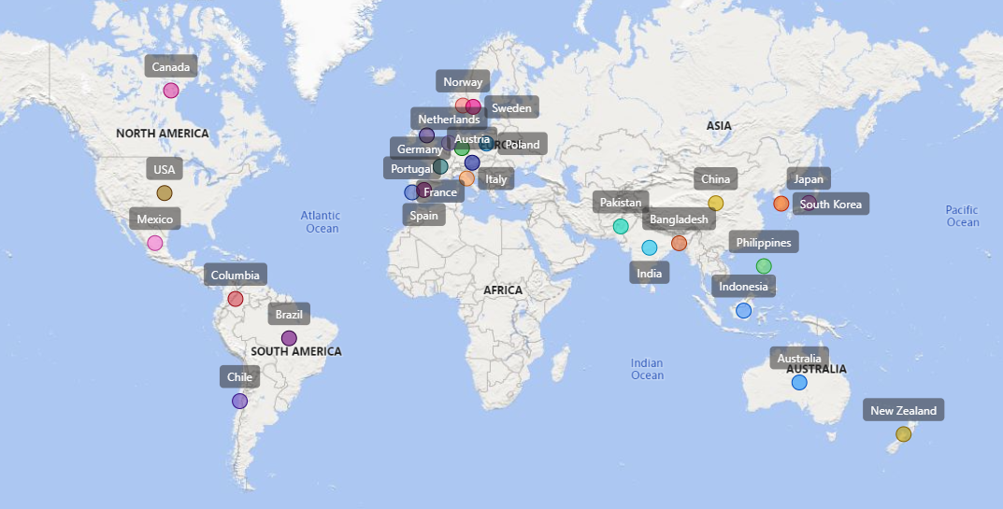
2
Atliq’s business their markets and product lines
Atilq Markets

Slide 5
Atliq’s Products
P&A
P&C
N&S
Peripherals
Accessories
Notebook
Desktop
Storage
Networking
Mouse
Personal Laptop
Business Laptop
Internal HDD
External Solid state Drives
WIFI Extender
Graphic card
Business Laptop
Keyboard
Personal Laptop
USB Flash Drives
Processors
Batteries
Gaming Laptop
Mother Board

Slide 6
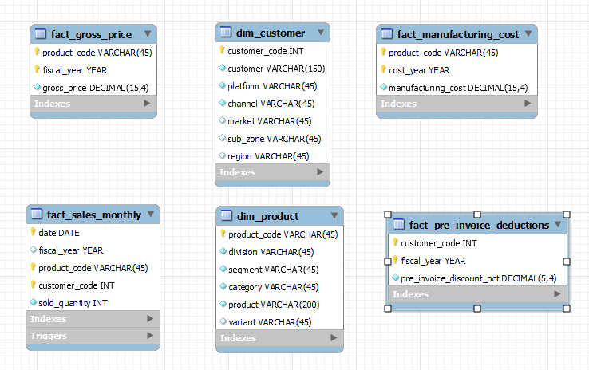
3
Data inputs
It’s Contains 2020 – 2021 Fiscal year data available
dim_customer
dim_product
fact_gross_price
fact_manufacturing_cost
fact_pre_invoice_deductions
fact_sales_monthly

Slide 7
4
Ad-hoc request along with the result, visualization and insights

Slide 8
Provide the list of markets in which customer "Atliq Exclusive" operates its business in the APAC region.
Request: 1
Output:-
Markets
India
Indonesia
Japan
Philiphines
South Korea
Australia
New Zealand
Bangladesh

Slide 9
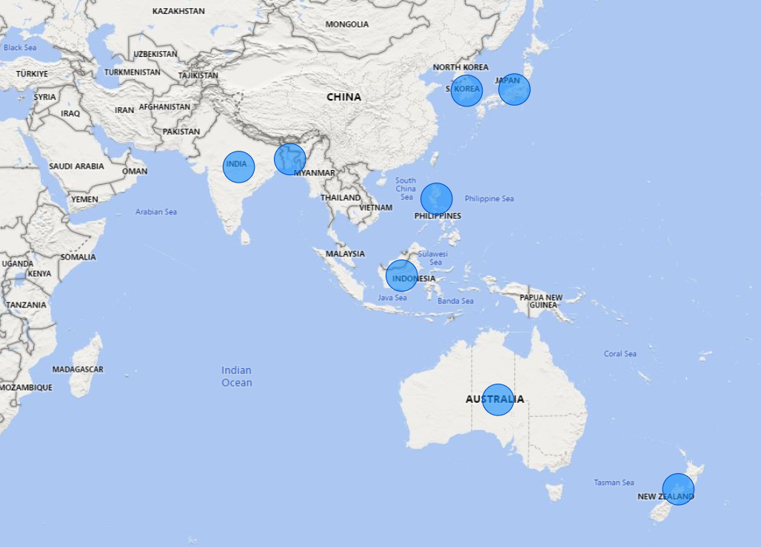
Insights:-
It appears that "Atliq Exclusive" operates in 8 markets in the APAC region

Slide 10
Request: 2
What is the percentage of unique product increase in 2021 vs. 2020? The final output contains these fields
unique_products_2020
unique_products_2021
Percentage_chg
Output:-
Unique_products_2020 | Unique_products_2021 | Percentage_chg
245 | 334 | 36.33

Slide 11
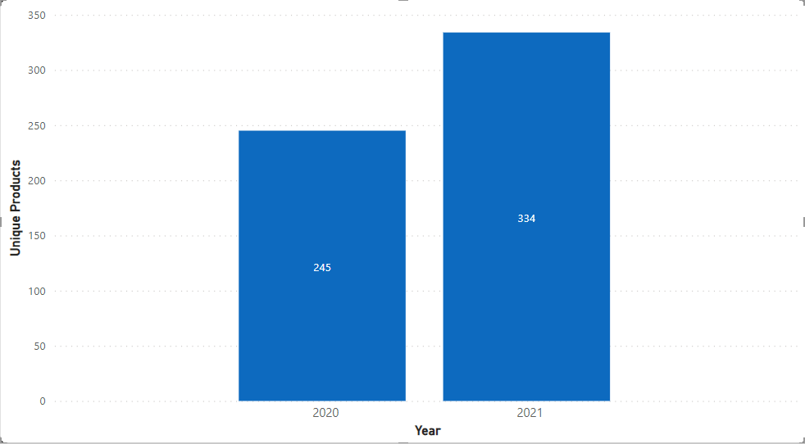
Insights:-
The company added a significant number of new products in 2021 compared to 2020, with a 36.33% increase in the number of products. This could indicate that the company is expanding its product offerings or introducing new products to the market.
Unique products in FY2020 & 2021

Slide 12
Request: 3
Provide a report with all the unique product counts for each segment and sort them in descending order of product counts. The final output contains 2 fields,
Segment
Product count
Output:-
Segment | Product count
Notebook | 129
Accessories | 116
Peripherals | 84
Desktop | 32
Storage | 27
Networking | 9

Slide 13
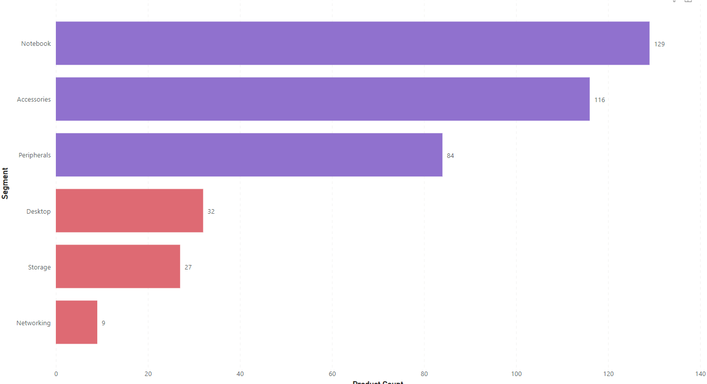
Insights:-
Notebook and Accessories are the highest selling categories with 129 and 116 , followed by Peripherals with 84 .
Desktop and Storage are the least sold categories with 32 and 27, and Networking has the lowest sales with only 9 units sold.
This information can be used to make decisions related to inventory management and marketing strategies.

Slide 14
Request: 4
Follow-up: Which segment had the most increase in unique products in 2021 vs 2020? The final output contains these fields
segment
product_count_2020
product_count_2021
difference
Output:-
Segment | Product_count_2020 | Product_count_2021 | Difference
Accessories | 69 | 103 | 34
Notebook | 92 | 108 | 16
Peripherals | 59 | 75 | 16
Desktop | 7 | 22 | 15
Storage | 12 | 17 | 5
Networking | 6 | 9 | 3

Slide 15
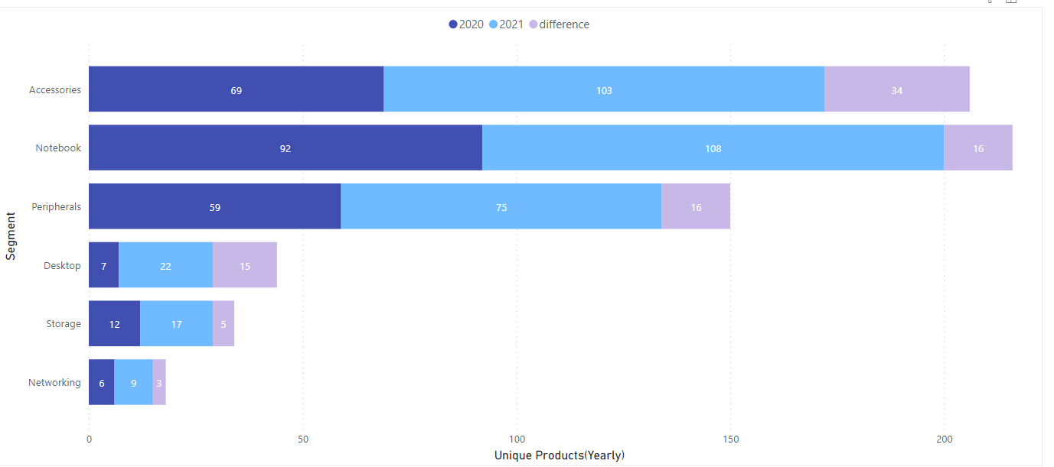
Insights:-
We can see that the Accessories segment had the highest increase in products between 2020 and 2021, with an increase of 34 products.
The Notebook had the second-highest increase, with the 16 products. The Peripherals, Desktop, Storage, and
Networking also experienced increases it’s products, with ranging from 3 to 16.

Slide 16
Request: 5
Get the products that have the highest and lowest manufacturing costs. The final output should contain these fields
product_code
Product
Manufacturing_cost
Output:-
Product_code | Product | Manufacturing_cost
A6121110208 | AQ HOME Allin1 Gen 2 | $263.42
A2118150101 | AQ Master wired x1 MS | $0.87

Slide 17


Insights:-
AQ HOME Allin1 Gen 2
Desktop
AQ Master wired x1 MS
Mouse
Knowing the manufacturing costs of products is important for businesses to determine the profitability of each product. By comparing the manufacturing cost to the selling price, businesses can determine the profit margin of each product and make informed decisions about pricing and production.
Higher Manufacturing costs
Lower Manufacturing costs
$263.42
$0.87

Slide 18
Request: 6
Generate a report which contains the top 5 customers who received an average high Pre_invoice_discount_pct for the fiscal year 2021 and in the Indian market. The final output contains these fields
customer_code
Customer
average_discount_percentage
Output:-
customer_code | Customer | average_discount_percentage
90002009 | Flipkart | 30.83%
90002006 | Viveks | 30.38%
90002003 | Ezone | 30.28%
90002002 | Croma | 30.25%
90002016 | Amazon | 29.33%

Slide 19
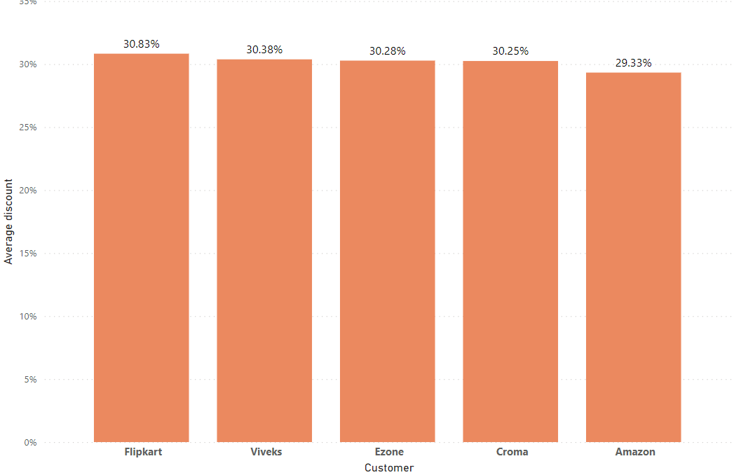
Top 5 customers in the Indian market receiving the highest pre-invoice discounts
Insights:-
This report can be useful for understanding which customers in the Indian market are receiving the highest pre-invoice discounts and for identifying potential areas for cost-saving measures.

Slide 20
Output:-
YEAR | MONTH | GROSS SALES AMOUNT
2019 | September | $4.50M
2019 | October | $5.14M
2019 | November | $7.52M
2019 | December | $4.83M
2020 | January | $4.74M
2020 | February | $4.00M
2020 | March | $0.38M
2020 | April | $0.40M
2020 | May | $0.78M
2020 | June | $1.70M
2020 | July | $2.55M
2020 | August | $2.79M
2020 | September | $12.35M
2020 | October | $13.22M
2020 | November | $20.46M
2020 | December | $12.94M
2021 | January | $12.40M
2021 | February | $10.13M
2021 | March | $12.14M
2021 | April | $7.31M
2021 | May | $12.15M
2021 | June | $9.82M
2021 | July | $12.09M
2021 | August | $7.18M
Request: 7
Get the complete report of the Gross sales amount for the customer “Atliq Exclusive” for each month. This analysis helps to get an idea of low and high-performing months and take strategic decisions.
The final report contains these columns
Month
Year
Gross sales Amount

Slide 21
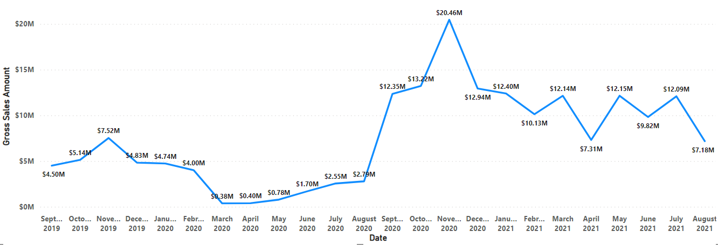
Insights:-
Atliq Exclusive Gross sales in millions
Atliq Exclusive's best-performing months in terms of gross sales are October, November and December of 2020, with sales of $13.22M $20.46M and $12.94M respectively.
The lower-performing month is in March, April, May 2020, due to the COVID-19 pandemic
There seems to be a seasonal trend in Atliq Exclusive's sales, with higher sales during the months of September to December, and lower sales during the months of January to April.
These insights can help Atliq Exclusive make strategic decisions, such as focusing on marketing and promotions during the months of September to December, and planning for inventory and staffing needs based on the seasonal trends.

Slide 22
Request: 8
In which quarter of 2020, got the maximum total_sold_quantity?
The final output contains these fields sorted by the total_sold_quantity
Quarter
total_sold_quantity
Output:-
Quarters | Total_sold_quantity
Q1 | 7.01M
Q2 | 6.65M
Q4 | 5.04M
Q3 | 2.08M

Slide 23
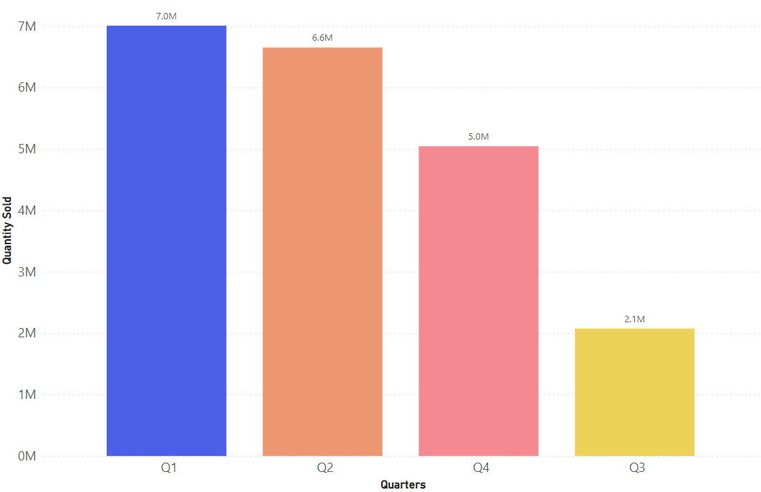
Insights:-
Quarters wise sales volume
Q1 had the highest sales volume of 7.01M, and Q2 had second-highest sales volume of 6.65M, suggesting that the company's sales and marketing strategies were successful during the beginning of the fiscal year.
The lowest sales volume in Q3 2020 is 2.8M, indicating that is the effect of COVID_19 on our sales. In Q4 there is recovery because of high demand on computer accessories.

Slide 24
Request: 9
Which channel helped to bring more gross sales in the fiscal year 2021 and the percentage of contribution?
The final output contains these fields
Channel
Gross sales millions
Percentage
Output:-
Channel | Gross_sales_mln | Percentage%
Retailer | 1219.08 | 73.23%
Direct | 257.53 | 15.47%
Distributor | 188.03 | 11.30%

Slide 25
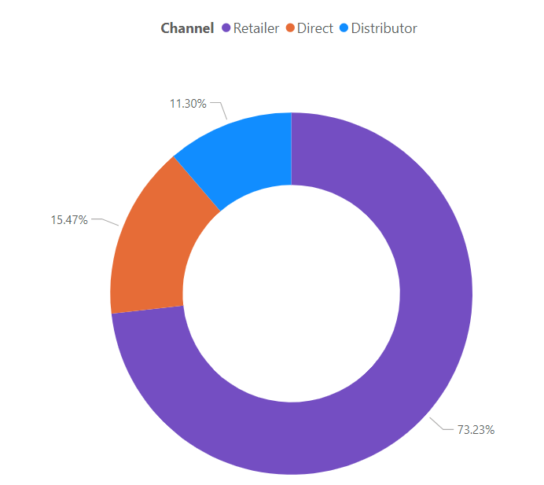
Insights:-
The Retailer channel was the top-performing sales channel for the company in fiscal year 2021. this channel performed so well compared to the Direct and Distributor channels.

Slide 26
Output:-
Request: 10
Division | Product_code | Product | Total_sold_quantity | Rank_order
N & S | A6720160103 | AQ Pen Drive 2 IN 1 | 701,373 | 1
N & S | A6818160202 | AQ Pen Drive DRC | 688,003 | 2
N & S | A6819160203 | AQ Pen Drive DRC | 676,245 | 3
P & A | A2319150302 | AQ Gamers Ms | 428,498 | 1
P & A | A2520150501 | AQ Maxima Ms | 419,865 | 2
P & A | A2520150504 | AQ Maxima Ms | 419,471 | 3
PC | A4218110202 | AQ Digit | 17,434 | 1
PC | A4319110306 | AQ Velocity | 17,280 | 2
PC | A4218110208 | AQ Digit | 17,275 | 3
Get the Top 3 products in each division that have a high total_sold_quantity in the fiscal_year 2021?
The final output contains these fields
Division
product_code
Product
total_sold_quantity
rank_order

Slide 27
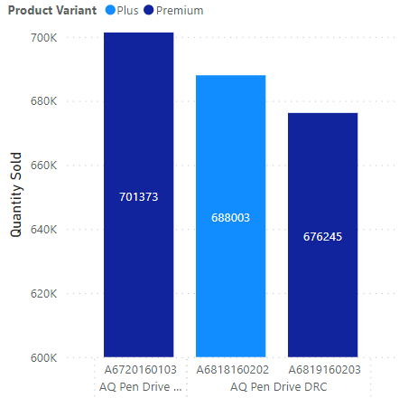
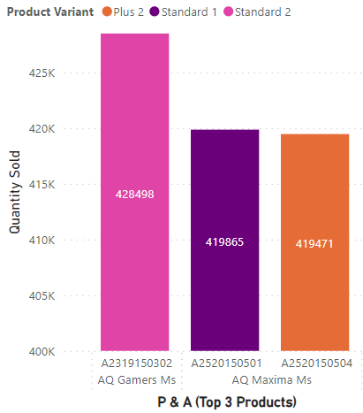
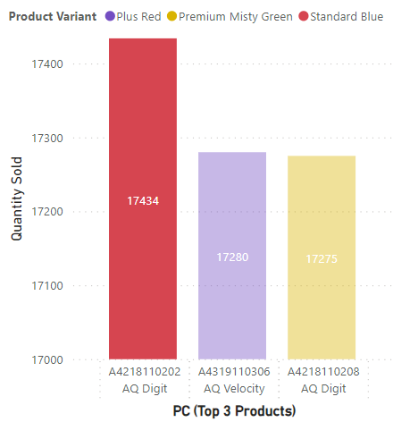
Insights
N&S
P&A
P&C
The top-selling product in the N & S division is the AQ Pen Drive 2 IN 1, with a total quantity sold of 701,373 units. This is significantly higher than the second and third top-selling products in the same division.
In the P & A division, the difference in the quantity sold between the top-selling product (AQ Gamers MS) and the second and third top-selling products (AQ Maxima MS) is relatively small, with a difference of only a few hundred units sold.
The AQ Digit is the top-selling product in the PC division, with a total quantity sold of 17,434 units. However, the difference in quantity sold between the top-selling and second and third top-selling products in this division is relatively small.

Slide 28
THANK YOU

