Slide 1

Python Web Scraping
Using BeautifulSoup and Selenium
Estela Alvarez
Software Developer
supita@gmail.com
https://github.com/supita/Pyladies-Python-Web-Scraping

Slide 2
What is web scraping?
Web scraping is a computer software technique of extracting information from websites.
  Load a web page and extract the interesting bits.

Slide 3
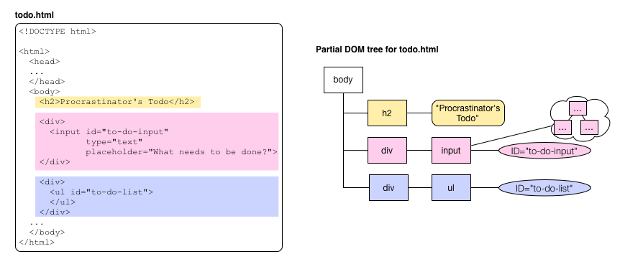
The HTML DOM (Document Object Model)
When a web page is loaded, the browser creates a Document Object Model of the page. The HTML DOM model is constructed as a tree of Objects

Slide 4
Before start scraping
Check if an api exist.
Check site terms and conditions.
Space your requests.
Sites change all the time!!!

Slide 5
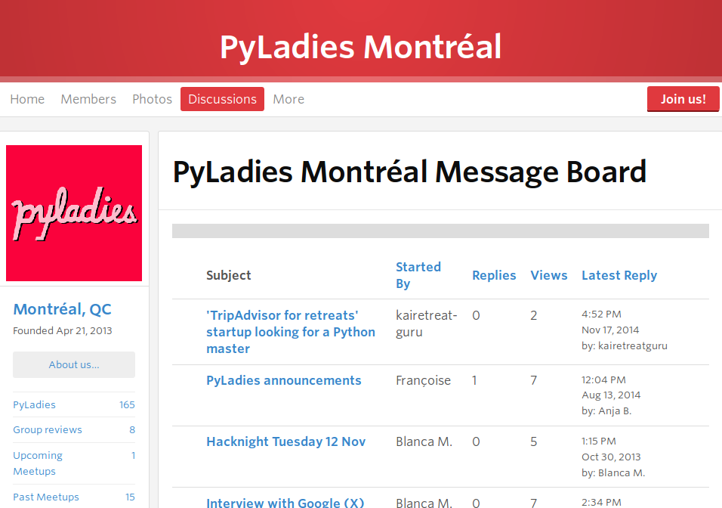
Let's do some scraping!
1
2
3
4
5

Slide 6
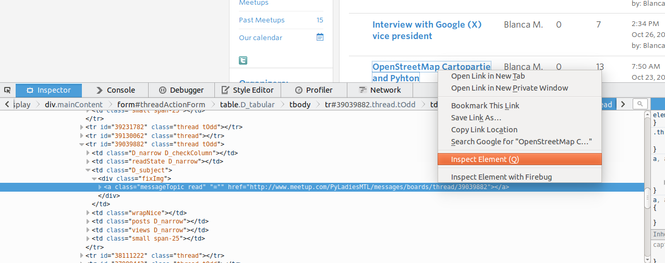
Let's do some scraping!

Slide 7
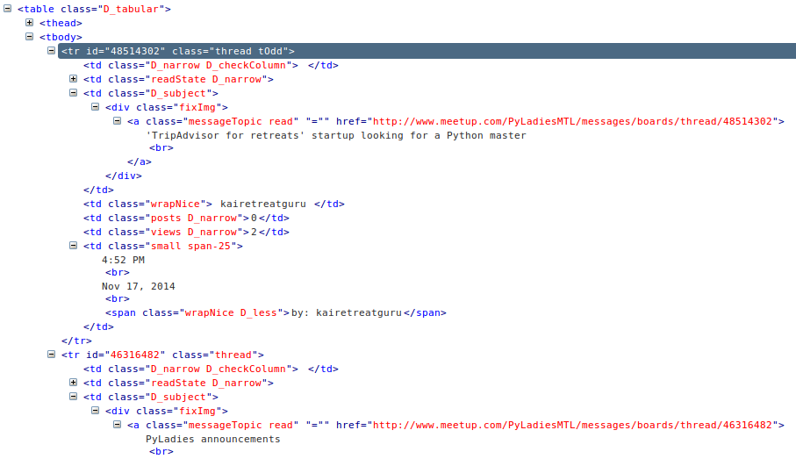
First inspect the page to scrape to determine how the data can be located.

Slide 8
Using request and BeautifulSoup
  Load a web page and extract the interesting bits.
import requests
response = requests.get('http://www.meetup.com/PyLadiesMTL/messages/boards/')
page_content = response.text
page_content is a string that contains the web page source, for parsing it, let's use BeautifulSoup.

Slide 9
Using request and BeautifulSoup
from bs4 import BeautifulSoup
soup = BeautifulSoup(page_content, "html.parser")
print(soup.prettify())
BeautifulSoup parses the document using the best available parser and transforms a complex HTML document into a complex tree of Python objects (Tag, NavigableString, BeautifulSoup, and Comment)

Slide 10
Navigating through the tree
Using name of the tag you want
anchor = soup.a # anchor.name
anchor = soup.find("a")
anchor = soup.find(re.compile("^a$"))
soup.find_all("a")
form = soup.find("form",id="threadActionForm")
print(form[“id“]) # form.attrs[“id”]
form.find_all("a")

Slide 11
Navigating through the tree
<a class="messageTopic read" href="http://www.meetup.com/PyLadiesMTL/messages/boards/thread/48514302">
form.select("a.messageTopic")
form.find_all("a", {"class":"messageTopic"})
form.find_all("a",href=re.compile("http://www.meetup.com/PyLadiesMTL/messages/boards/thread/"))

Slide 12
Navigating through the tree
anchor = form.find("a",
  href=re.compile("http://www.meetup.com/PyLadiesMTL/messages/boards/thread/"))
anchor.parent
tr = anchor.find_parent("tr")
tr.find_next_siblings()

Slide 13
Extracting data
soup = BeautifulSoup('<a href="http://example.com/">I linked to <i>example.com</i></a>')
soup.a.contents
  [u'I linked to ', <i>example.com</i>]
soup.a.text
  u'I linked to example.com'
soup.a.i.string
  u'example.com'

Slide 14
Let's see the actual action!

Slide 15
Using selenium webdriver
Selenium webdriver was created for browser automation and can easily be used for scraping.
It takes control of your browser, and drives it as a user would either locally or on a remote machine.
Selenium Python bindings provide a convenient API to access Selenium WebDrivers like Firefox, IE, Chrome, Remote etc, sometimes as a separate executable
Webdriver can scrape complicated web pages with dynamic content.

Slide 16
Using selenium webdriver (cons)
A browser application needs to be started
The program becomes quite large
The browser generates a bigger network traffic
The scraping process is slower
The scraping can be detected
It can be “fragile”

Slide 17
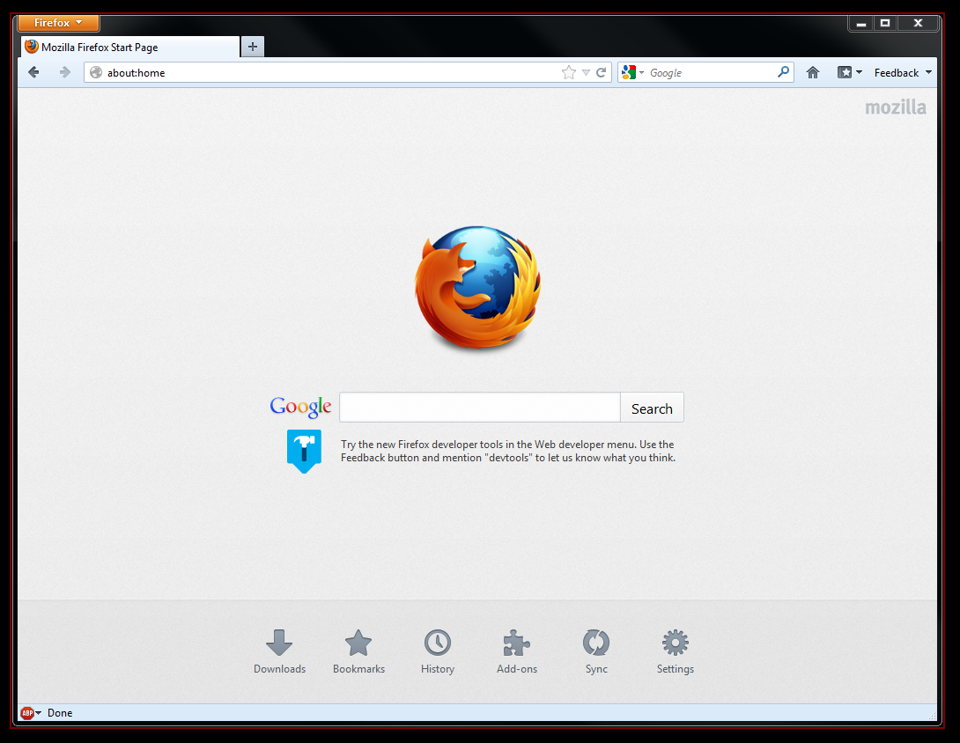
Navigating!
from selenium import webdriver
browser = webdriver.Firefox()
profile = webdriver.FirefoxProfile()
profile.set_preference("general.useragent.override", "some UA string")
browser = webdriver.Firefox(profile)
browser.close()

Slide 18
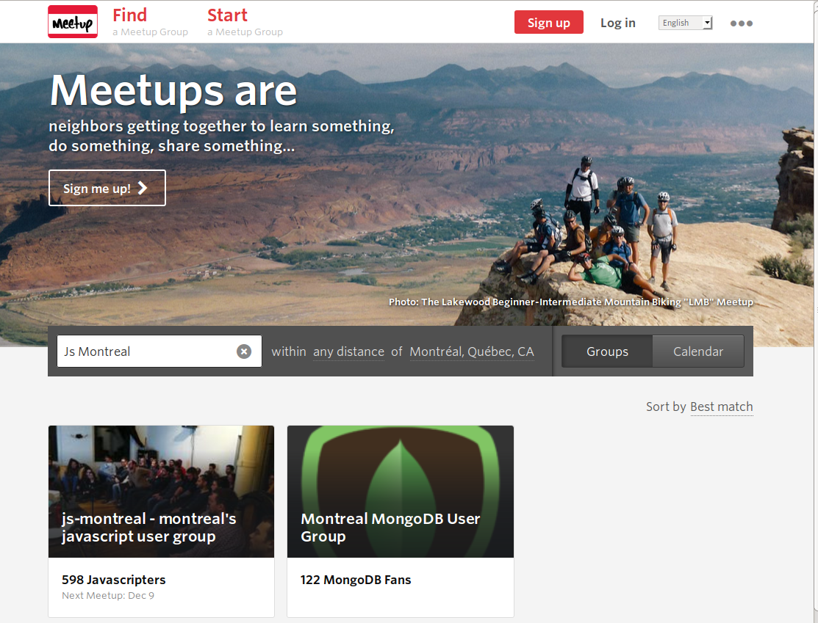
Get discussions info from some groups
Submit your query and get results
Get the name of the groups
Go to each group board and get their discussions info

Slide 19
Navigating!
browser.get("http://www.meetup.com/find/?radius=25")
search_box = browser.find_element_by_id("mainKeywords")
WebElement: Represents a DOM element
This search can be done completing the url with your search parameters (GET request), but let's do the full workout with Selenium... for science ;)

Slide 20
WebElement
find_element(by='id', value=None)
find_element_by_class_name(name)
find_element_by_name(name)
find_element_by_css_selector(css_selector)
find_element_by_id(id_)
find_element_by_link_text(link_text)
find_element_by_partial_link_text(link_text)
find_element_by_tag_name(name)
find_element_by_xpath(xpath)
XPath is used to navigate through elements and attributes in an XML document.

Slide 21
WebElement
id
parent
tag_name
text
submit()
click()
clear()
send_keys(*value)
get_attribute(name)
value_of_css_property(property_name)

Slide 22
Submiting a search
search_box = browser.find_element_by_id("mainKeywords")
search_box.send_keys("js montreal")
search_box.send_keys(Keys.RETURN)
New page is loaded after the form is submitted with the results of “js montreal” query.

Slide 23
Getting search results
link = browser.find_element_by_xpath('
//ul[contains(@class, "search-result")]
//a[contains(@class, "display-none") and contains(@href,"http://www.meetup.com/")]')
link.get_attribute("href")
http://www.meetup.com/js-montreal/
http://www.meetup.com/js-montreal/messages/boards/

Slide 24
Load discussions page for given group
browser.get("http://www.meetup.com/js-montreal/messages/boards/")
try:
ui.WebDriverWait(browser, #wait to load! 10).until(EC.presence_of_element_located((By.ID, "threadActionForm")))
except:
browser.close()

Slide 25
Extracting data
row = browser.find_element_by_xpath(
'.//form[@id="threadActionForm"]//tbody//tr')
tds = row.find_elements_by_tag_name("td")
thread["url"] = tds[2]
.find_element_by_tag_name("a")
.get_attribute("href")
thread["subject"] = tds[2].text

Slide 26
And more scraping!

Slide 27
Thank you :)

