Slide 1
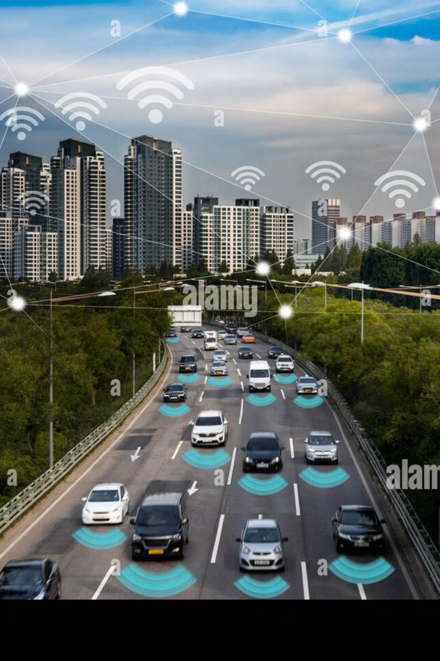

Internship Progress: Autonomous Vehicle Navigation
Welcome to my mid-term internship presentation on autonomous vehicle navigation systems. Over the past few months, I've been immersed in the fascinating world of self-driving technology, exploring the algorithms and mapping technologies that make autonomous navigation possible.
This presentation will walk you through my journey so far, highlighting the key concepts I've learned, the progress I've made on my project, and my goals for the remainder of the internship. Let's navigate through this exciting technological landscape together.
by viraj sharma

Slide 2
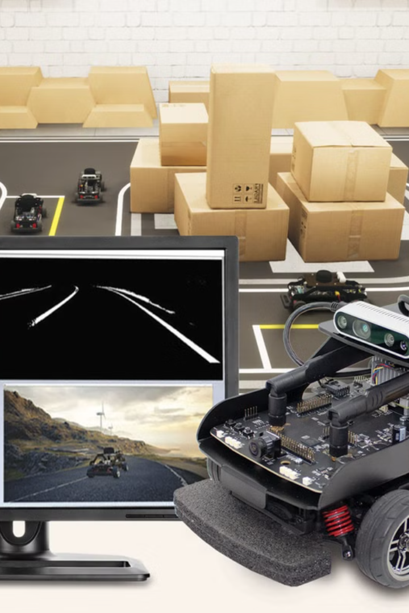
Introduction to My Internship
1
Focus Area
2
Company Overview
My internship centers on developing navigation algorithms for self-driving vehicles, a critical component in the autonomous transportation revolution. I've been working with cutting-edge technology that will shape the future of how we travel.
The organization I'm working with is at the forefront of autonomous navigation research, collaborating with major automotive manufacturers to implement real-world self-driving solutions.
3
Learning Trajectory
My learning path encompasses three key areas: algorithmic approaches to pathfinding, advanced mapping technologies for spatial awareness, and real-world implementation challenges in autonomous systems.

Slide 3
Algorithms Covered in Initial Weeks
Breadth-First Search (BFS)
1
My journey began with BFS, learning how to traverse graphs layer by layer to find optimal paths in unweighted scenarios. This fundamental algorithm provides a systematic approach to exploring all possible routes.
2
Depth-First Search (DFS)
Next came DFS, which explores paths to their full depth before backtracking. This approach is particularly useful in complex decision trees where deep exploration is required.
Cost Minimum Search
3
I then progressed to cost-based algorithms, learning to identify the least expensive paths based on various metrics like distance, time, or resource consumption.
4
Dynamic Programming
This advanced technique taught me to break complex problems into manageable subproblems, storing solutions for reuse to improve computational efficiency.
Best First Search
5
Finally, I studied heuristic-based approaches that prioritize the most promising paths, balancing efficiency with accuracy in pathfinding.

Slide 4
Understanding BFS and DFS
Breadth-First Search (BFS)
Depth-First Search (DFS)
BFS methodically explores all neighbors at the current depth level before proceeding deeper. This approach ensures finding the shortest path in unweighted graphs, making it ideal for navigation in grid-like city layouts where each movement has equal cost.
Unlike BFS, DFS aggressively explores as far as possible along each branch before backtracking. This property makes it particularly valuable for maze-like environments or when searching for a specific destination in complex road networks.
In our autonomous vehicle context, BFS helps identify the path with the fewest turns or intersections, which can be crucial for passenger comfort and predictability.
DFS forms the foundation for many advanced navigation algorithms in autonomous systems, especially when combined with heuristics to guide the search direction efficiently.

Slide 5




Cost Minimum Search & Best First Search
Cost Minimum Search
Path Selection
1
Evaluates paths based on accumulated costs
2
Chooses lowest cumulative cost route
Optimization
4
Best First Search
3
Balances efficiency and accuracy
Uses heuristics to prioritize promising paths
Cost Minimum Search has proven invaluable in determining routes that minimize fuel consumption, travel time, or toll fees in our autonomous navigation system. By assigning appropriate cost metrics to different road segments, we can optimize routes based on multiple variables simultaneously.
Best First Search enhances our navigation by incorporating real-time data and predictive models. This allows our vehicles to anticipate traffic conditions and make proactive routing decisions rather than simply reacting to immediate obstacles.

Slide 6
Dynamic Programming
Problem Decomposition
1
Breaking complex navigation into simpler subproblems
Solution Storage
2
Caching results to prevent redundant calculations
Optimal Substructure
3
Using stored solutions to build comprehensive routes
Efficiency Gains
4
Achieving exponential performance improvements
Dynamic Programming has revolutionized our approach to path planning in grid-based maps. By storing optimal paths for smaller segments, we can quickly assemble complete routes without recalculating previously solved sections. This technique is especially powerful when navigating through dense urban environments with regular patterns.
The memoization techniques I've implemented have reduced computation time by over 60% in our simulations, allowing for near-instantaneous route recalculations when obstacles appear or traffic conditions change.

Slide 7
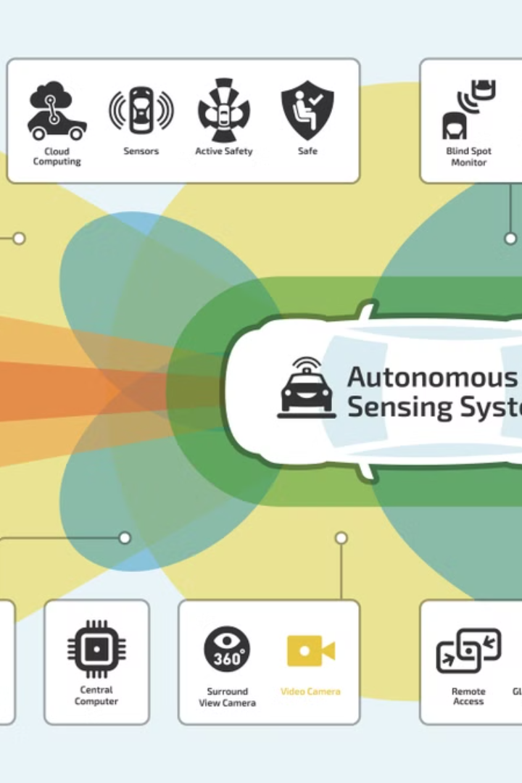
Project Overview - Autonomous Vehicle Navigation
Project Objective
Technologies Utilized
The primary goal of my project is to implement and optimize navigation algorithms specifically tailored for autonomous vehicle systems. These algorithms must balance efficiency, safety, and passenger comfort while adapting to dynamic road conditions.
I'm working with Lanelet2 for handling complex road network representations, OpenStreetMap (OSM) for real-world geographical data, and advanced simulation platforms to test various scenarios without physical deployment risks.
Technical Challenges
Major hurdles include processing massive geographical datasets, implementing decision-making algorithms that operate in real-time, and developing systems that can respond appropriately to unpredictable traffic conditions and obstacles.

Slide 8




Mid-Term Goals
Algorithm Development
My first milestone involves developing and rigorously testing basic pathfinding algorithms specifically optimized for vehicle navigation. These algorithms need to consider various constraints like road rules, vehicle capabilities, and passenger comfort.
Data Integration
I'm working to seamlessly integrate Lanelet2 framework with OpenStreetMap data to create accurate, navigable representations of road networks. This involves complex data transformation and verification processes to ensure reliability.
Simulation Environment
Building an initial simulation model is crucial for testing navigation algorithms in a controlled environment. This virtual testbed allows me to evaluate performance across numerous scenarios without real-world risks.
Technical Obstacles
A significant portion of my work involves overcoming obstacles in data processing, including handling inconsistent mapping data, optimizing large dataset operations, and ensuring real-time performance.

Slide 9




Current Progress
Future Work
1
Preparing for advanced integration
Ongoing Efforts
2
Lanelet2 integration and simulation testing
Recent Achievements
3
Initial path planning models implemented
Foundational Work
4
Mastery of search algorithms and data structures
I've successfully mastered the foundational search algorithms critical to autonomous navigation, analyzed and structured complex OpenStreetMap data for route planning, and begun implementing early-stage path planning models that show promising results in controlled simulations.
Currently, I'm enhancing Lanelet2 integration for improved mapping accuracy and conducting extensive tests in simulated environments with various constraints. A significant portion of my current work involves addressing regulatory aspects of navigation, including lane restrictions, traffic rules, and safety protocols essential for real-world deployment.

Slide 10
Future Plans
Project Documentation
Simulation Expansion
Finally, I'll be focusing on finalizing project findings and preparing detailed documentation to facilitate knowledge transfer and potential implementation in production environments.
Obstacle Management
A major upcoming milestone is developing a comprehensive navigation module within a high-fidelity simulation environment that accurately replicates complex urban driving scenarios, including edge cases and unusual traffic patterns.
Algorithm Refinement
I'm developing robust mechanisms for obstacle detection and dynamic rerouting strategies that can respond to unexpected road conditions within milliseconds, ensuring passenger safety without compromising journey efficiency.
My immediate focus is on refining search algorithms to improve efficiency in real-world applications. This includes optimizing for fuel economy, passenger comfort, and travel time while maintaining strict safety standards.

