Slide 1
Why are all the members of baseball paid the amount they are?

Slide 2
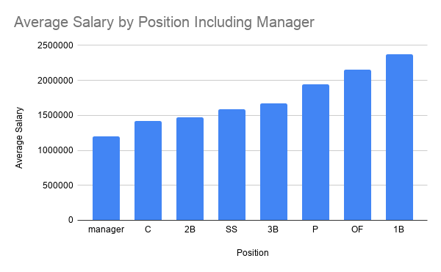
Notes:
We can see from this that the first basemen makes the most and the manager the least.

Slide 3
First basemen make the most
Let’s find out why by checking some batting statistics

Slide 4
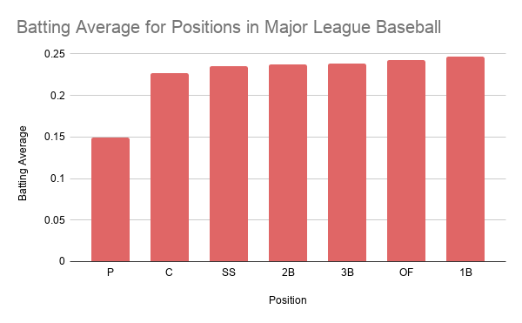

Slide 5
First basemen appear to have the highest salary because they have the best batting statistics
Why do shortshops make more than second basemen if they have worse batting statistics?

Slide 6
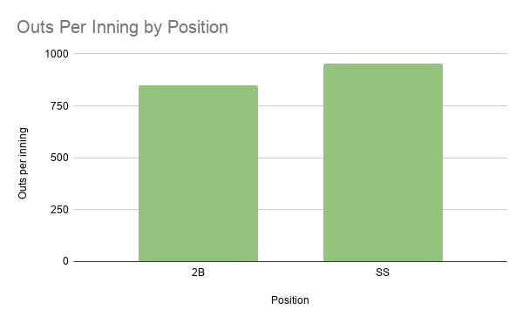

Slide 7
Shortstops have better fielding statistics than second basemen
By having more outs per inning, shortstops show why they have a higher salary.

Slide 8
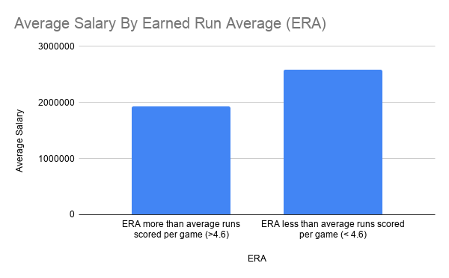

Slide 9
Pitchers earned more based on a better ERA
If they have an ERA below the average runs scored in a game then they get paid more on average.

Slide 10
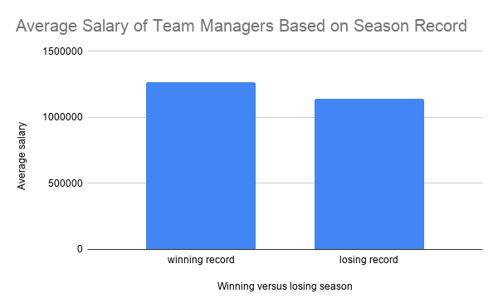

Slide 11
Managers make more money on average when they have a winning season
Let’s review all our findings now

Slide 12
Salary findings
First basemen have the highest salary of any position player because they have the best batting statistics
Shortstops have a higher salary than second basemen because they have better fielding statistics
Pitchers make have a higher salary when their ERA is less than the average runs scored in a baseball game
Managers have a higher salary based on having a winning record

