Slide 1

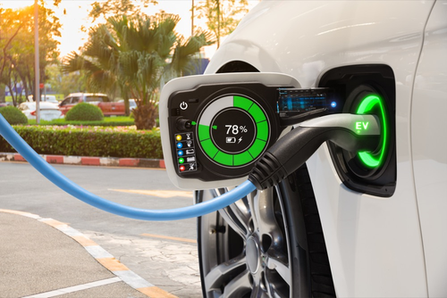
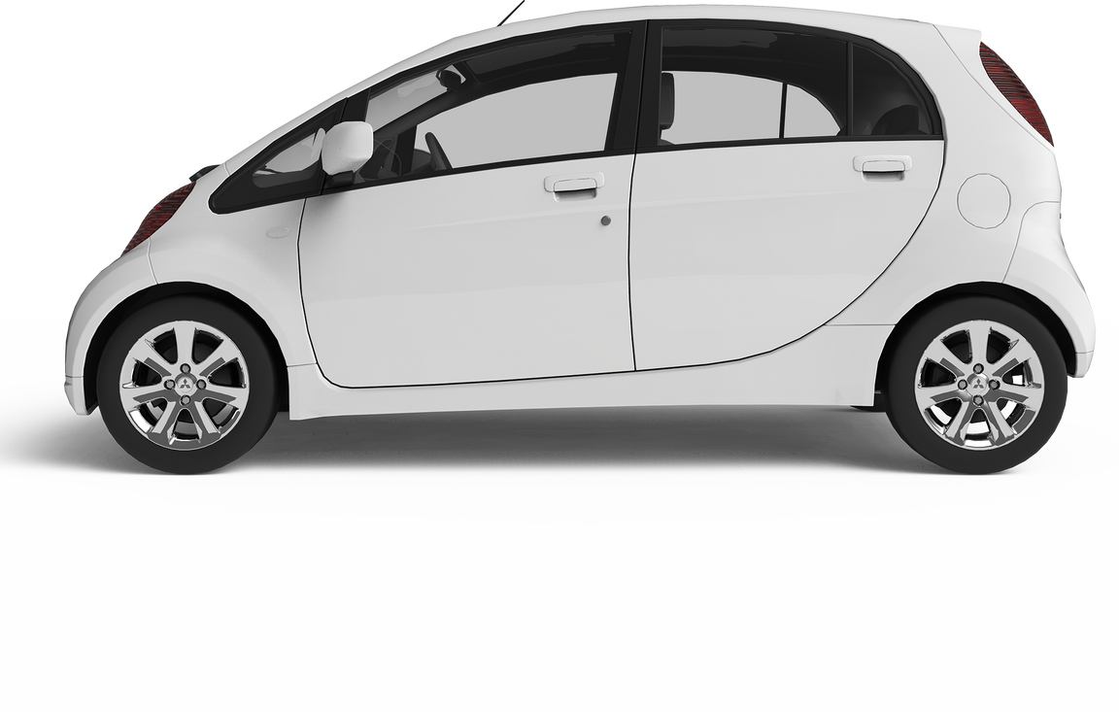

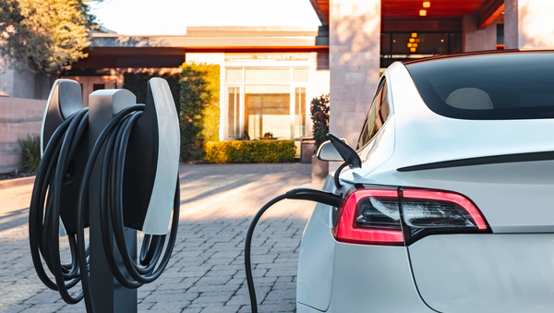

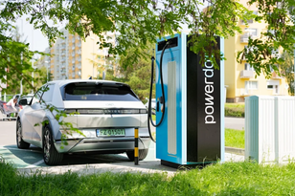
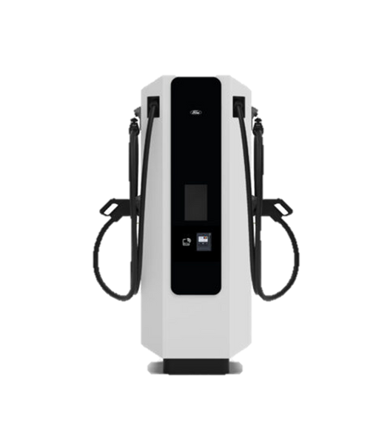

ELECTRIC AND HYBRID VEHICLE
Electric and Hybrid Vehicle
Fast
GROUP 1 (B.E.A.N.N.S TEAM)
Modern
Efficient
Analysis & Visualization of Electric and Hybrid Vehicle
GROUP 1
Adoption in Washington State, USA
ITCS495 Special Topics in Databases and Intelligent Systems
Faculty of Information and Communication Technology
Mahidol University

Slide 2

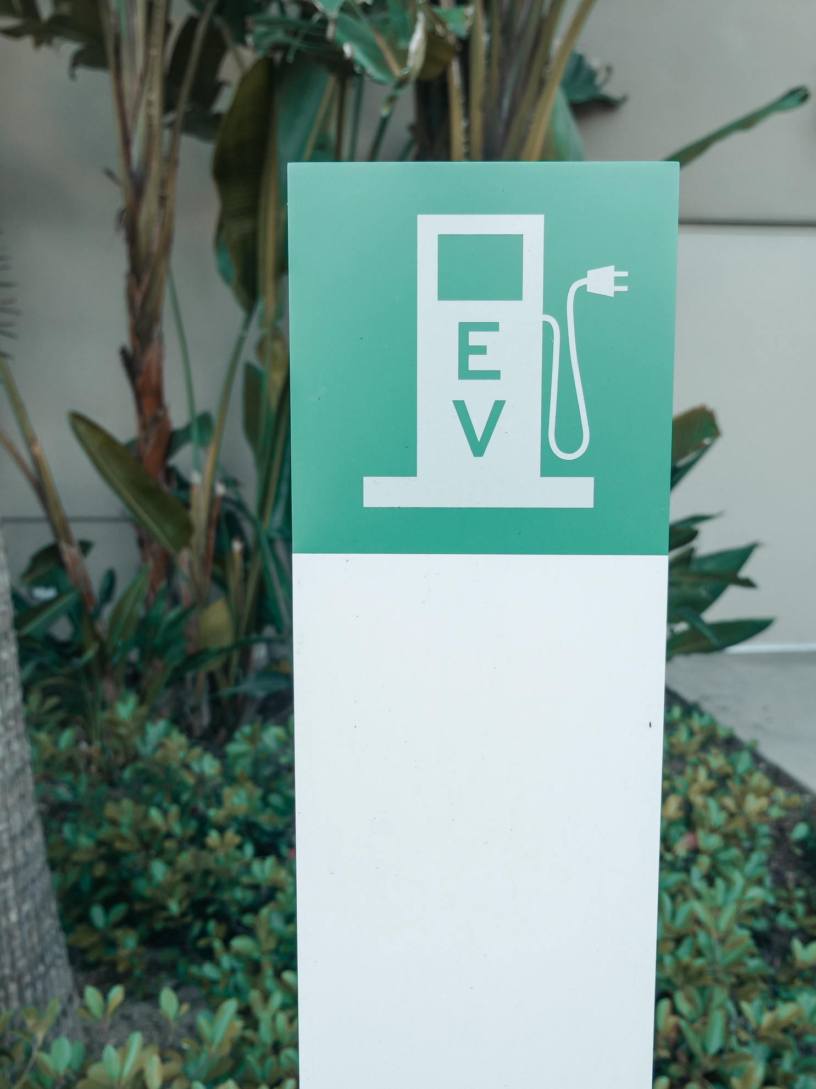


GROUP 1 (B.E.A.N.N.S team)
BUSINESS DOMAIN
Project domain lies at the intersection of
01
Automotive
03
Public policy
02
Energy & utilities
EV adoption is reshaping transportation, reducing dependence on fossil fuels.
Washington State is a strong case due to CAFV incentives, climate goals, and consumer demand.
Utilities face challenges of grid stability and charging infrastructure planning.
OEMs & dealerships must track market share and consumer shifts.
1

Slide 3




GROUP 1 (B.E.A.N.N.S team)
TARGET USER GROUPS
Policy Makers
& Regulators
Electric Utilities & Charging Operators
OEMs &
Dealerships
2

Slide 4
TARGET USER GROUPS
01
Background
Policy Makers
& Regulators
Need to monitor EV and PHEV adoption to guide environmental policy and programs like CAFV.
Plan charging infrastructure and track emission reduction goals.
02
Example Scenarios
03
Objective & Scope
Identify counties or cities with the highest and lowest EV adoption.
Assess if CAFV eligibility correlates with higher registration numbers.
Track the long-term shift from PHEVs to BEVs.
Refine EV incentive policies.
Allocate funding for charging stations and grid expansion.
Measure progress toward clean energy targets.
3

Slide 5
GROUP 1 (B.E.A.N.N.S team)
TARGET USER GROUPS
Policy Makers
& Regulators
Electric Utilities & Charging Operators
OEMs &
Dealerships
4

Slide 6
TARGET USER GROUPS
01
Background
Electric Utilities & Charging Operators
Need to prepare for rising EV penetration, which impacts electricity demand and grid stability.
Geographic EV density informs investment planning.
02
Example Scenarios
03
Objective & Scope
Estimate EVs connected to each utility (e.g., Seattle City Light vs Puget Sound Energy).
Predict peak charging demand in urban vs rural areas.
Decide where to install additional fast-charging stations.
Support load forecasting and ensure grid reliability.
Guide charging infrastructure investment.
Align energy planning with state clean energy policies.
5

Slide 7
GROUP 1 (B.E.A.N.N.S team)
TARGET USER GROUPS
Policy Makers
& Regulators
Electric Utilities & Charging Operators
OEMs &
Dealerships
6

Slide 8
TARGET USER GROUPS
01
Background
OEMs &
Dealerships
Want to understand adoption of brands and models to benchmark against competitors.
Use insights to refine product strategies and align with consumer demand.
02
Example Scenarios
03
Objective & Scope
Compare Tesla’s market share with Nissan, Chevrolet, and Ford.
Identify most popular models across price segments.
Monitor consumer shift from PHEVs toward BEVs.
Map Washington’s competitive EV landscape.
Guide marketing and dealership positioning.
Adjust product roadmaps to meet local demand.
7

Slide 9
GROUP 1 (B.E.A.N.N.S team)
TARGET USER GROUPS
Policy Makers
& Regulators
Electric Utilities & Charging Operators
OEMs &
Dealerships
8

Slide 10



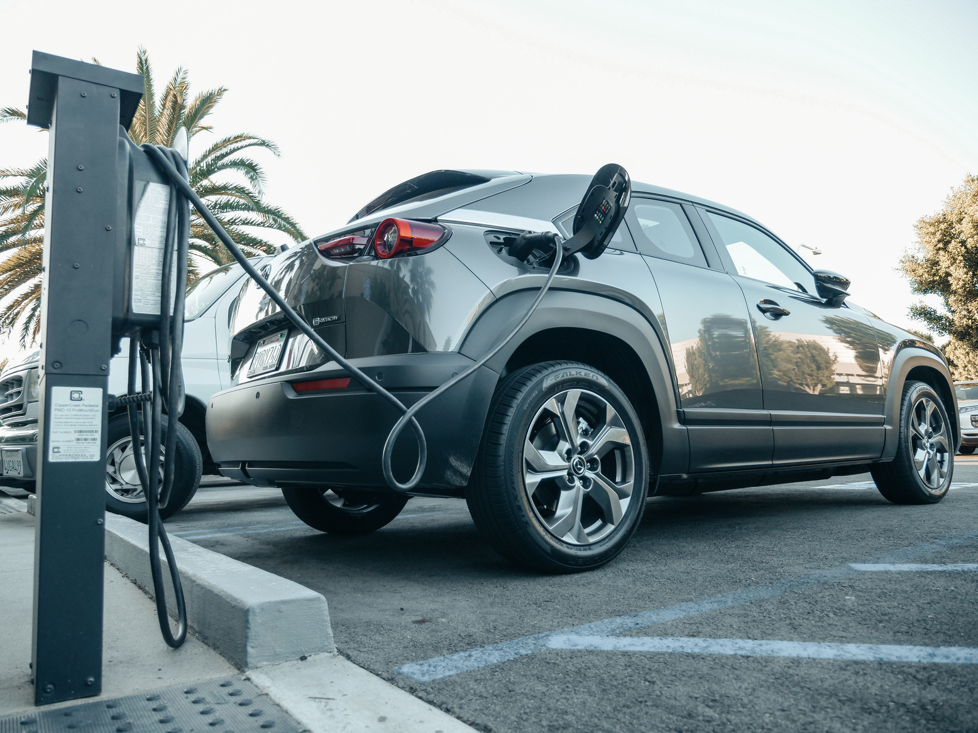
B.E.A.N.N.S GROUP
PROJECT OBJECTIVE
GOALS
To analyze EV adoption patterns in Washington State using
Alteryx (data preparation)
Power BI (dashboards).
1
Monitor Adoption Trends:
Track growth over time and identify acceleration points.
2
Evaluate BEV vs PHEV Share:
Assess consumer preference shifts toward full EV adoption.
3
Identify Market Leaders:
Benchmark brands and models dominating the market.
4
Map Hotspots:
Analyze adoption by City, County, and ZIP to inform infrastructure planning.
5
Assess CAFV Effectiveness:
Compare eligible vs non-eligible vehicles to measure policy impact.
6
Analyze Utility Demand:
Estimate charging demand by utility providers.
7
Explore Pricing and Range Relationships
Analyze the relationship between Base MSRP and Electric Range..
Research Questions: For example, which counties or cities adopt the most EVs?
9

Slide 11


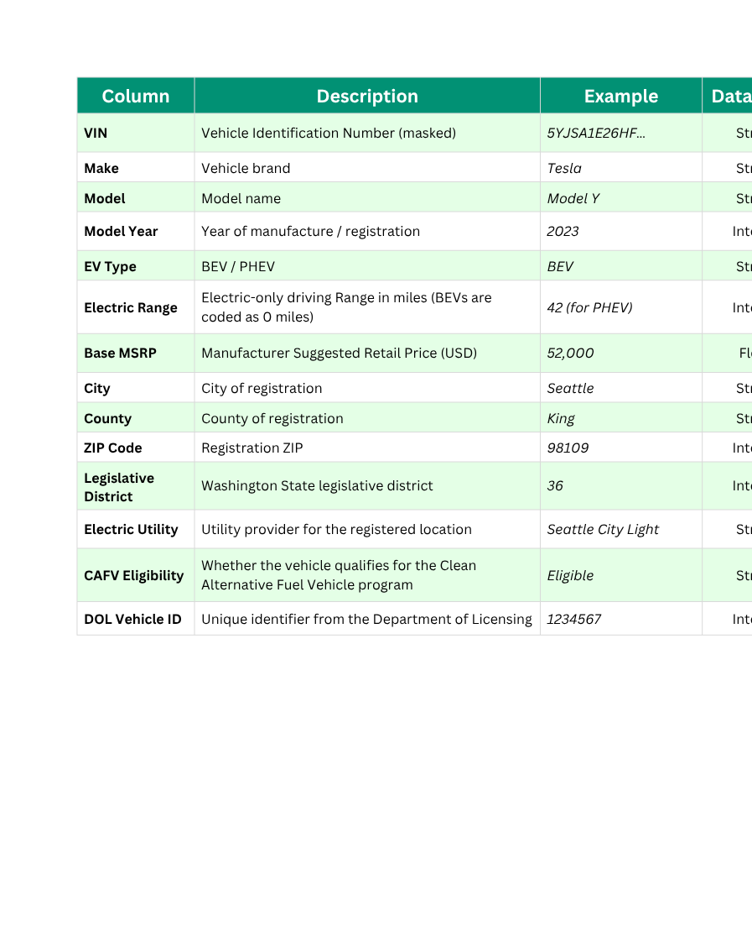

DATA DESCRIPTION
“
”
Dataset Overview
2025 Electric and Hybrid Cars in Washington, USA
Contains detailed registration records of battery electric vehicles (BEVs) and plug-in hybrid electric vehicles (PHEVs) currently registered in Washington State.
by the Washington State Department of Licensing (DOL)
Size:
Over 200,000 records, each representing one registered EV or PHEV.
Columns:
17 attributes describing vehicle characteristics, location, and eligibility
Data Characteristics
Coverage:
Vehicle registrations across all cities and counties in Washington State.
Scope:
Covers BEV and PHEV registrations from early models up to 2025
Indicates whether a vehicle qualifies for the Clean Alternative Fuel Vehicle program,
useful for evaluating policy effectiveness.
Policy Field:
Utility Field:
Connects each registration with its electricity provider, supporting analysis of EV use relative to grid infrastructure.
Geographic
Field:
Contains City, County and ZIP Code allowing spatial visualization and regional comparisons.
Source Link: 2025 Electric and Hybrid Cars in Washington, USA
10
B.E.A.N.N.S GROUP

Slide 12

Data Quality Notes
Electric range for BEVs recorded as “0”
For BEVs, the field is recorded as 0 (not actual range), so it requires special handling in analysis.
Inconsistent naming in categorical fields
(e.g., utilities, cities)
City and Utility names may have spelling variations (e.g., “Seattle City Light” vs “City of Seattle – SCL”), so requiring standardization.
Duplicated Records
VIN duplicates may exist and must be removed during cleansing.
11

Slide 13

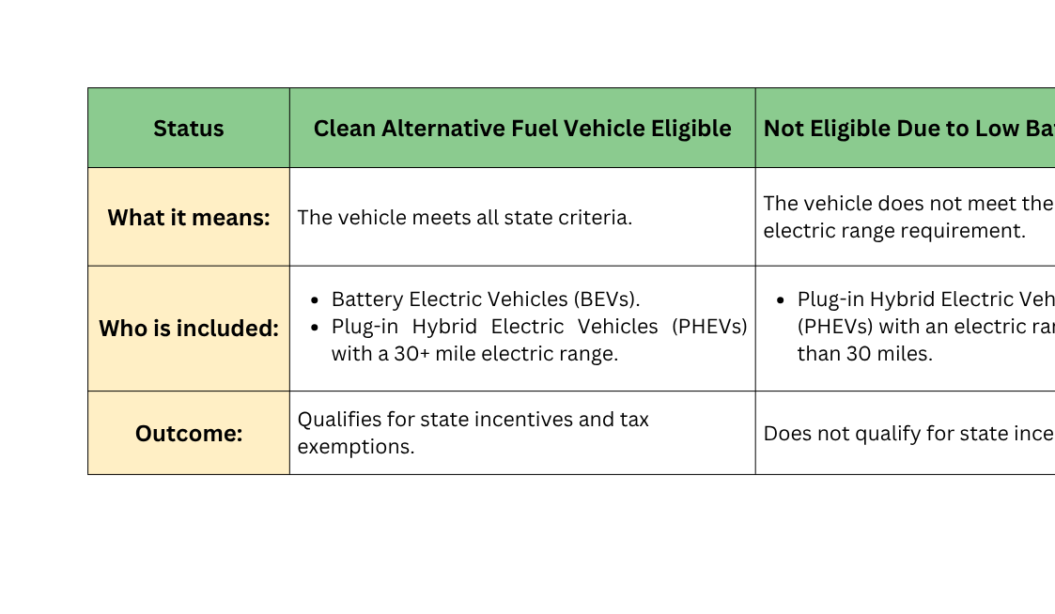
GROUP 1 (B.E.A.N.N.S team)
Washington
?
CAFV POLICY
Washington's Clean Alternative Fuel Vehicle
A Clean Alternative Fuel Vehicle (CAFV) runs on clean energy like electricity or hydrogen.
To qualify for state tax incentives, Plug-in Hybrid Electric Vehicles (PHEVs) must have an all-electric range of at least 30 miles (48 km).
Eligibility Status Categories
Purpose: To transparently administer tax incentives and promote vehicles that significantly contribute to Washington's environmental goals.
12

Slide 14
ALTERYX
DATA PREPARATION
13

Slide 15

B.E.A.N.N.S GROUP
DATA PREPARATION
WORKFLOW OVERVIEW
E
T
L
THE OBJECTIVE OF DATA PREPARATION
Initial Data Ingestion and Profiling
This stage is to transform the raw Washington State EV dataset from Kaggle into a clean, consistent, and analysis-ready format for use in Power BI. The process involves data cleansing, deduplication, handling missing values, feature engineering, and the addition of geographic coordinates.
Tool: Input Data
Loaded Electric_Vehicle_Population_Data.csv into Alteryx
Initial data review showed missing values, inconsistent formatting, and unnecessary fields
Formed the basis for subsequent cleaning and transformation steps
Tool: Auto Field
Automatically optimized data types for all columns
Converted fields to the most efficient types (e.g., string → integer)
Ensured data integrity and improved workflow performance for later calculations
14

Slide 16
B.E.A.N.N.S GROUP
Data Cleansing and Standardization
Tool: Select
Removed Irrelevant Columns:
- VIN: Anonymized, not useful for unique identification
- 2020 Census Tract: Outside the scope of analysis
Tool: Text to Columns
Input the vehicle Location field in the format "POINT (Longitude Latitude)". Then, Split the string using a space delimiter to separate Longitude and Latitude
Tool: Formula
Categorical Simplification: Extracted short form (BEV/PHEV) from EV_Type using Regex → EV_Type_short
Data Quality Fix: Replaced invalid BEV Range_Miles = 0 → Null() to prevent skewed averages
New Feature – Vehicle Age: Created Vehicle_Age = 2025 – ModelYear for time-based analysis
Binary Flags: Added BEV_Flag, PHEV_Flag, CAFV_Flag for efficient filtering and aggregation
MSRP Imputation: Assigned estimated Base_MSRP by vehicle model using verified price sources
Coordinate Cleanup: Removed parentheses in Latitude & Longitude → ensured numeric values
Utility Name Standardization: Grouped variants under unified company names for accurate aggregation
DATA PREPARATION
WORKFLOW OVERVIEW
E
T
L
Data Cleansing and Standardization
Tool: Data Cleansing
Handled Null Values:
- Replaced string nulls with empty strings ""
- Replaced numeric nulls with 0 as a baseline
Removed extra spaces: Trimmed leading/trailing whitespaces to ensure consistent joins, filters, and logic (e.g., "TESLA " → "TESLA")
15

Slide 17
B.E.A.N.N.S GROUP
Final Scoping and Output
- Geographic Focus: Limited dataset to Washington State (WA) for
consistent regional analysis
Tool: Unique
- Removed duplicate records using DOL_ID as the unique key
Tool: Output Data
- The workflow concludes by saving the fully processed data
stream. The Altryx return the final CSV file Named “ EV_clean.csv”
DATA PREPARATION
WORKFLOW OVERVIEW
DATA QUALITY RESULTS
E
T
L
Row Count: ~200,000 valid and relevant records retained
Column Count: 20 key attributes (2 removed, 6 new engineered features added)
Duplicate Removal: All duplicates eliminated using DOL_ID as a unique key
Standardization:
- Unified City/County formatting
- Standardized Electric Utility names into Company_Name
Missing Value Treatment:
- Imputed Base_MSRP intelligently
- Corrected invalid BEV Range (0 → Null)
Final Scoping and Output
Tool: Filter
- Model Year Range: Included vehicles from
2008–2024 (excluded 2025 due to incomplete
data)
- Vehicle Type: Kept only Battery Electric (BEV)
and Plug-in Hybrid (PHEV) vehicles
16

Slide 18
MS POWER BI
DATA VISUALIZATION & ANALYSIS
17

Slide 19
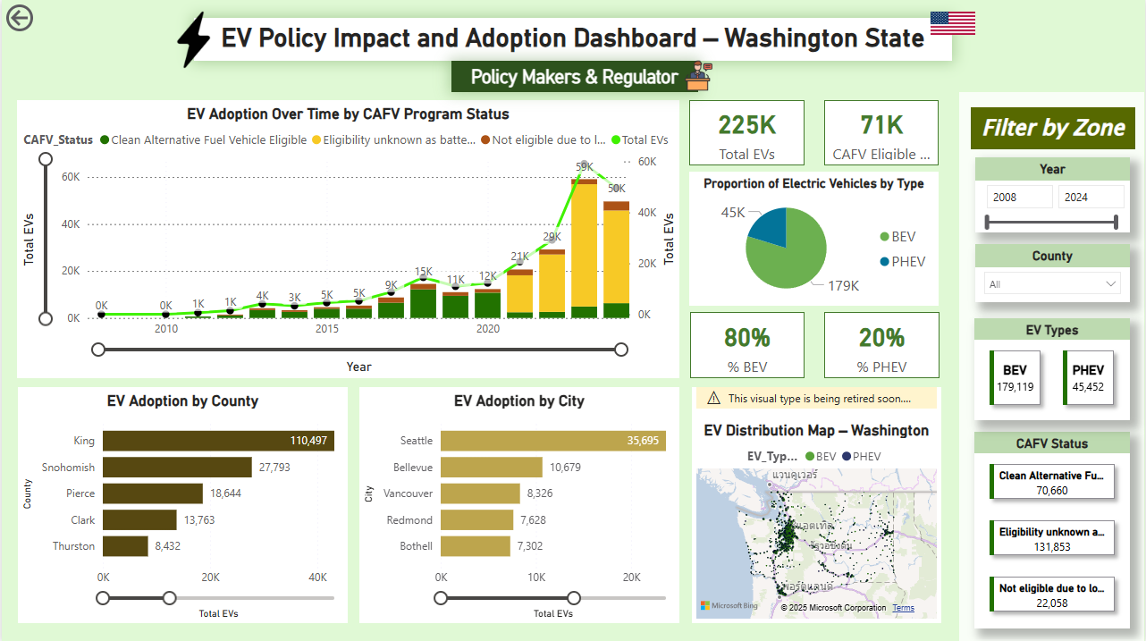
B.E.A.N.N.S GROUP
DASHBOARD 1
18

Slide 20
B.E.A.N.N.S GROUP
DASHBOARD 1
INSIGHT/ANALYSIS
Policy Makers
& Regulators
Dashboard 1 - EV Policy Impact & Adoption in Washington State
Key Insights:
Growth was gradual in the early 2010s, but began to accelerate significantly after 2018, reaching a total of over 225,000 registered vehicles by 2024. This shows sustained growth momentum across the state.
Approximately 71,000 of these vehicles, which are about 31% of the total, are Clean Alternative Fuel Vehicle (CAFV) eligible. This strong representation suggests that financial incentives and state programs have played a crucial role in influencing consumer decisions and promoting cleaner transportation.
The major counties that are the center of EV adoption are King County with 110,000 EVs, Snohomish with 28,000 EVs, and Pierce with 19,000. Finally, if we go even deeper to the city level, Seattle is top of the list with over 35,000 EVs, followed by Bellevue with around 11,000, and Vancouver at 8,000.
The following counties and cities alone represent the vast majority of EVs in the state. The map shows dense EV clusters along major transportation arteries like Interstate 5 and Interstate 90.
19

Slide 21
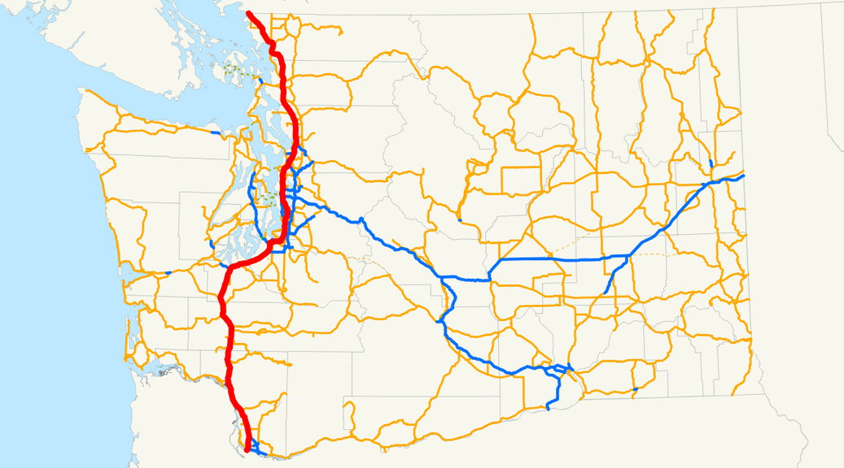
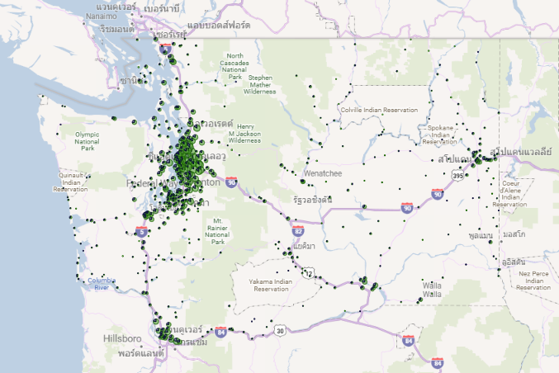
B.E.A.N.N.S GROUP
I-5 Highway
https://commons.wikimedia.org/wiki/File:Washington_Interstate_5.svg
20
Notes:
The dashboard offers key insights for policy makers, such as the Department of Licensing and Department of Energy, to assess the impact of EV incentives and plan infrastructure.
Analysis shows that EV adoption in Washington accelerated after 2018, reaching over 225,000 registered vehicles by 2024. Of these, around 71,000 vehicles, or 31%, are Clean Alternative Fuel Vehicle (CAFV) eligible, demonstrating the effectiveness of state incentive programs in promoting cleaner transportation.
County-level data highlights strong adoption in urban areas — led by King County with 110,000 EVs, followed by Snohomish (28,000) and Pierce (19,000) — while rural counties like Thurston, Kitsap, and Spokane lag behind. These disparities point to opportunities for targeted policy and infrastructure investments to ensure equitable access to EVs.
Geographic visuals show dense EV clusters along the Seattle–Bellevue–Tacoma corridor, particularly along I-5 and I-90, with slower adoption in eastern Washington. This helps regulators identify low-penetration regions, evaluate policy impact over time, and prioritize funding for charging networks where adoption is limited.

Slide 22
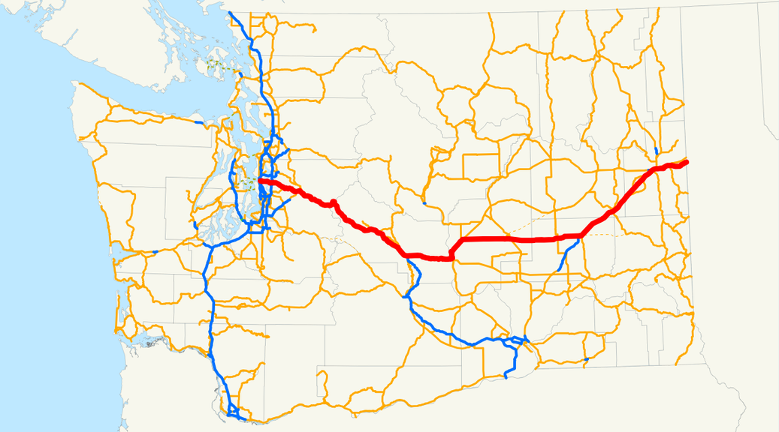
B.E.A.N.N.S GROUP
I-90 Highway
https://commons.wikimedia.org/wiki/File:Washington_Interstate_90.svg
21

Slide 23
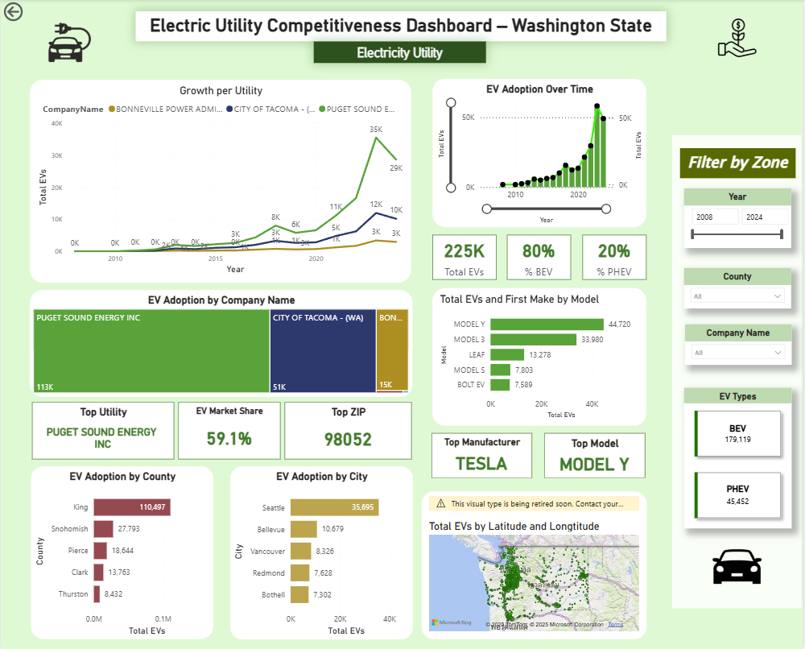
B.E.A.N.N.S GROUP
DASHBOARD 2
22

Slide 24
B.E.A.N.N.S GROUP
DASHBOARD 2
INSIGHT/ANALYSIS
Electric Utilities & Charging Operators
Uneven EV Distribution Across Utilities
EV adoption in Washington State is highly concentrated within the territories of a few major electric utilities.
Puget Sound Energy (PSE) collectively serve over 59% of all registered EVs.
Geographic Concentration in the Puget Sound Corridor
Within PSE’s territory, approximately 60,000 EVs are registered in King County, 25,000 in Snohomish, and 19,000 in Pierce.
Strategic Link Between EV Density and Transportation Corridors
High EV adoption areas align closely with major highway systems—notably Interstate 5 (I-5) and Interstate 90 (I-90).
Guidance for Charging Infrastructure Deployment
Charging network operators can use this data to identify high-demand zones and optimize DC Fast Charging (DCFC) station locations.
Aligning charging infrastructure with traffic flow and EV density improves utilization rates, customer accessibility, and return on investment.
23

Slide 25
B.E.A.N.N.S GROUP
I-5 Highway
https://commons.wikimedia.org/wiki/File:Washington_Interstate_5.svg
24
Notes:
The dashboard offers key insights for policy makers, such as the Department of Licensing and Department of Energy, to assess the impact of EV incentives and plan infrastructure.
Analysis shows that EV adoption in Washington accelerated after 2018, reaching over 225,000 registered vehicles by 2024. Of these, around 71,000 vehicles, or 31%, are Clean Alternative Fuel Vehicle (CAFV) eligible, demonstrating the effectiveness of state incentive programs in promoting cleaner transportation.
County-level data highlights strong adoption in urban areas — led by King County with 110,000 EVs, followed by Snohomish (28,000) and Pierce (19,000) — while rural counties like Thurston, Kitsap, and Spokane lag behind. These disparities point to opportunities for targeted policy and infrastructure investments to ensure equitable access to EVs.
Geographic visuals show dense EV clusters along the Seattle–Bellevue–Tacoma corridor, particularly along I-5 and I-90, with slower adoption in eastern Washington. This helps regulators identify low-penetration regions, evaluate policy impact over time, and prioritize funding for charging networks where adoption is limited.

Slide 26
B.E.A.N.N.S GROUP
I-90 Highway
https://commons.wikimedia.org/wiki/File:Washington_Interstate_90.svg
25

Slide 27
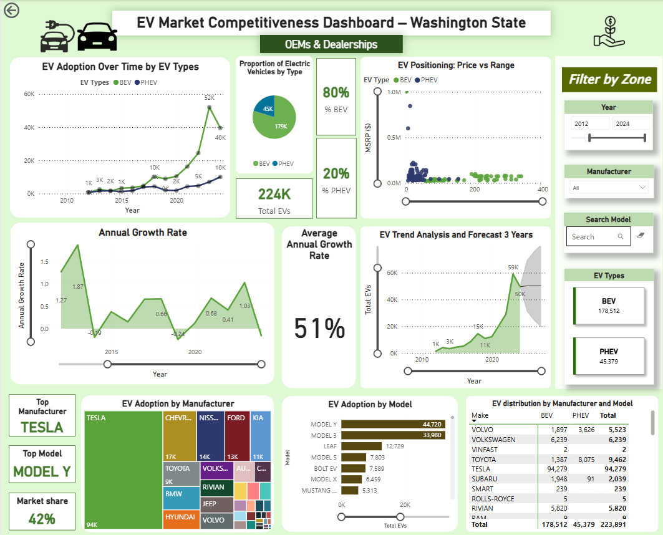
B.E.A.N.N.S GROUP
DASHBOARD 3
26

Slide 28
B.E.A.N.N.S GROUP
DASHBOARD 3
INSIGHT/ANALYSIS
OEMs &
Dealerships
Key Insights:
Over 225K EVs registered by 2024, showing strong post-2018 growth momentum.
BEVs lead with 80% share, PHEVs 20% — marking a clear consumer shift to full electrification.
Average annual growth rate (230%) from 2008-2024 indicates steady, long-term expansion.
Market & Brand Performance:
Tesla dominates with ~94K units (≈42% share), led by Model Y and Model 3.
Chevrolet, Nissan, Ford, and Kia show stable competition across mid-price tiers.
Toyota remains key in the PHEV segment, reflecting its hybrid-to-EV transition.
Product & Pricing Trends:
BEVs span $30K–$80K with ranges of 250–350 miles, appealing to mainstream consumers.
PHEVs occupy lower-price, shorter-range segments — signaling gradual decline.
Range and zero-emission capability are now primary purchase drivers.
Emerging Competitors:
Chevy Bolt, Nissan Leaf, Ford Mach-E show rising adoption and growth potential.
Rivian gains traction in premium adventure EVs; Hyundai and Kia expand diversification.
Strategic Implications:
OEMs should focus on BEV innovation and refine pricing strategy to stay competitive.
Invest in infrastructure partnerships to accelerate adoption.
Align product portfolios with Washington’s consumer trends toward sustainable mobility.
27

Slide 29
GROUP 1 (B.E.A.N.N.S TEAM)
ELECTRIC AND HYBRID VEHICLE
THANK YOU FOR YOUR ATTENTION
GROUP 1
28

