Slide 1
Overview of Simulation
  When do we prefer to develop simulation model over an analytic model?
    When not all the underlying assumptions set for analytic model are valid.
    When mathematical complexity makes it hard to provide useful results.
    When “good” solutions (not necessarily optimal) are satisfactory.
  A simulation develops a model to numerically evaluate a system over some time period.
  By estimating characteristics of the system, the best alternative from a set of alternatives under consideration can be selected.

Slide 2
Overview of Simulation
  Continuous simulation systems monitor the system each time a change in its state takes place.
  Discrete simulation systems monitor changes in a state of a system at discrete points in time.
  Simulation of most practical problems requires the use of a computer program.

Slide 3
Overview of Simulation
  Approaches to developing a simulation model
    Using add-ins to Excel such as @Risk or Crystal Ball
    Using general purpose programming languages such as: FORTRAN, PL/1, Pascal, Basic.
    Using simulation languages such as GPSS, SIMAN, SLAM.
    Using a simulator software program.
  Modeling and programming skills, as well as knowledge of statistics are required when implementing the simulation approach.

Slide 4

Monte Carlo Simulation
Monte Carlo simulation generates random events.
Random events in a simulation model are needed when the input data includes random variables.
To reflect the relative frequencies of the random variables, the random number mapping method is used.

Slide 5
JEWEL VENDING COMPANY – an example for the random mapping technique
Jewel Vending Company (JVC) installs and stocks vending machines.
Bill, the owner of JVC, considers the installation of a certain product (“Super Sucker” jaw breaker) in a vending machine located at a new supermarket.

Slide 6

JEWEL VENDING COMPANY – an example of the random mapping technique
Data
  The vending machine holds 80 units of the product.
  The machine should be filled when it becomes half empty.
  Daily demand distribution is estimated from similar vending machine placements.
    P(Daily demand = 0 jaw breakers) = 0.10
    P(Daily demand = 1 jaw breakers) = 0.15
    P(Daily demand = 2 jaw breakers) = 0.20
    P(Daily demand = 3 jaw breakers) = 0.30
    P(Daily demand = 4 jaw breakers) = 0.20
    P(Daily demand = 5 jaw breakers) = 0.05
Bill would like to
estimate the
expected number
of days it takes
for a filled machine
to become half empty.

Slide 7
Random number mapping –
The Probability function Approach
Random number mapping uses the probability function
to generate random demand.
A number between 00 and 99
is selected randomly.
The daily demand is determined
by the mapping demonstrated below.
34
34
0.30
34
34
34
0.20
0.20
34
0.15
34
34
0.10
34
45-74
0.05
26-44
00-09
10-25
26-44
75-94
95-99
Demand
0
1
2
2
3
4
5

Slide 8
Random number mapping –
The Cumulative Distribution Approach
1.00
0.95
1.00
0.75
The daily demand X is
determined by the random
number Y between
0 and 1, such that X is the
smallest value for which
F(X) ≥Y.
F(1) = .25 < .34
F(2) = .45 > .34
0.45
Y = 0.34
0.34
0.25
0.10
0.00
0
1
2
2
3
4
5

Slide 9
Simulation of the JVC Problem
A random demand can be generated by hand (for small problems) from a table of pseudo random numbers.
Using Excel a random number can be generated by
  The RAND() function
  The random number generation option (Tools>Data Analysis)

Slide 10
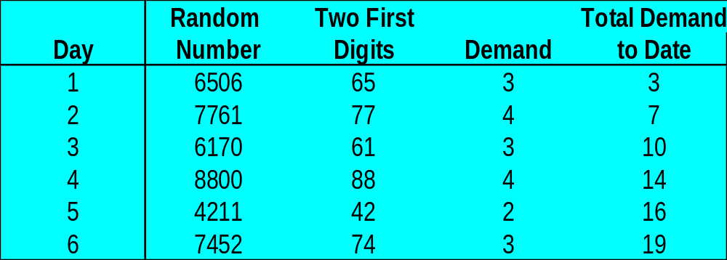
Simulation of the JVC Problem
  An illustration of generating a daily random demand.
  Since we have two digit probabilities, we use the first two digits of each random number.
00-09
10-25
26-44
45-74
75-94
95-99
0
1
2
3
3
4
5

Slide 11
Simulation of the JVC Problem
The simulation is repeated and stops once total demand reaches 40 or more.
The number of “simulated” days required for the total demand to reach 40 or more is recorded.

Slide 12
JVC – A Flow Chart
Flow charts help guide the simulation program
Trials = 1
Max=…; sales = 0
S = 0; S2 = 0
Day = 0
Yes
Sales < 40
No
Determine
Daily demand (D)
Record day
S = S + day
S2 = S2 + Day²
Sales = Sales + D
Day = Day + 1
No
End
Trials< Max
Trials = Trials + 1
Sales = 0
Day = 0
Yes

Slide 13
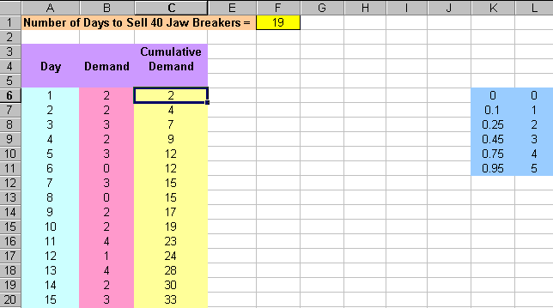
JVC – Excel Spreadsheet
=MAX(A5:A105)
=IF(C5<40,A5+1,"")
=IF(C5<40,B6+C5,"")
=IF(C5<40,VLOOKUP(RAND(),$K$6:$L$11,2),"")
VLOOKUP TABLE
Enter this data
Drag A5:C5 to A105:C105

Slide 14
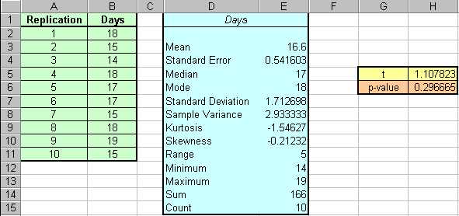
JVC – Excel Spreadsheet
=(E3-16)/E4
The p-value =.2966… This value is quite high compared to any reasonable significance level.
Based on this data there is insufficient evidence to infer that the mean number of days differs from 16.
=TDIST(ABS(H5),9,2)

Slide 15
Simulation of a Queuing System
In queuing systems time itself is a random variable.
Therefore, we use the next event simulation approach.
The simulated data are updated each time a new event takes place (not at a fixed time periods.)
The process interactive approach is used in this kind of simulation (all relevant processes related to an item as it moves through the system, are traced and recorded).

Slide 16
Simulation of an M / M / 1 Queue
Applying the process interaction approach we have:
  New arrival time = Previous arrival time + Random interarrival time.
  Service finish time = Service start time + Random service time.
  A customer joins the line if there is a service in progress (its arrival time < current service finish time ).
  A customer gets served when the server becomes idle.
  Waiting times and number of customers in line and in the system are continuously recorded.

Slide 17
LANFORD SUB SHOP
An example of the M/M/1 queuing simulation
Lanford Sub Shop sells sandwiches prepared by its only employee, the owner Frank Lanford.
Frank can serve a customer in 1 minute on the average according to an exponential distribution.
During lunch time, 11:30 a.m. to 1:30 p.m., an average of 30 customers an hour arrive at the shop according to a Poisson distribution.

Slide 18
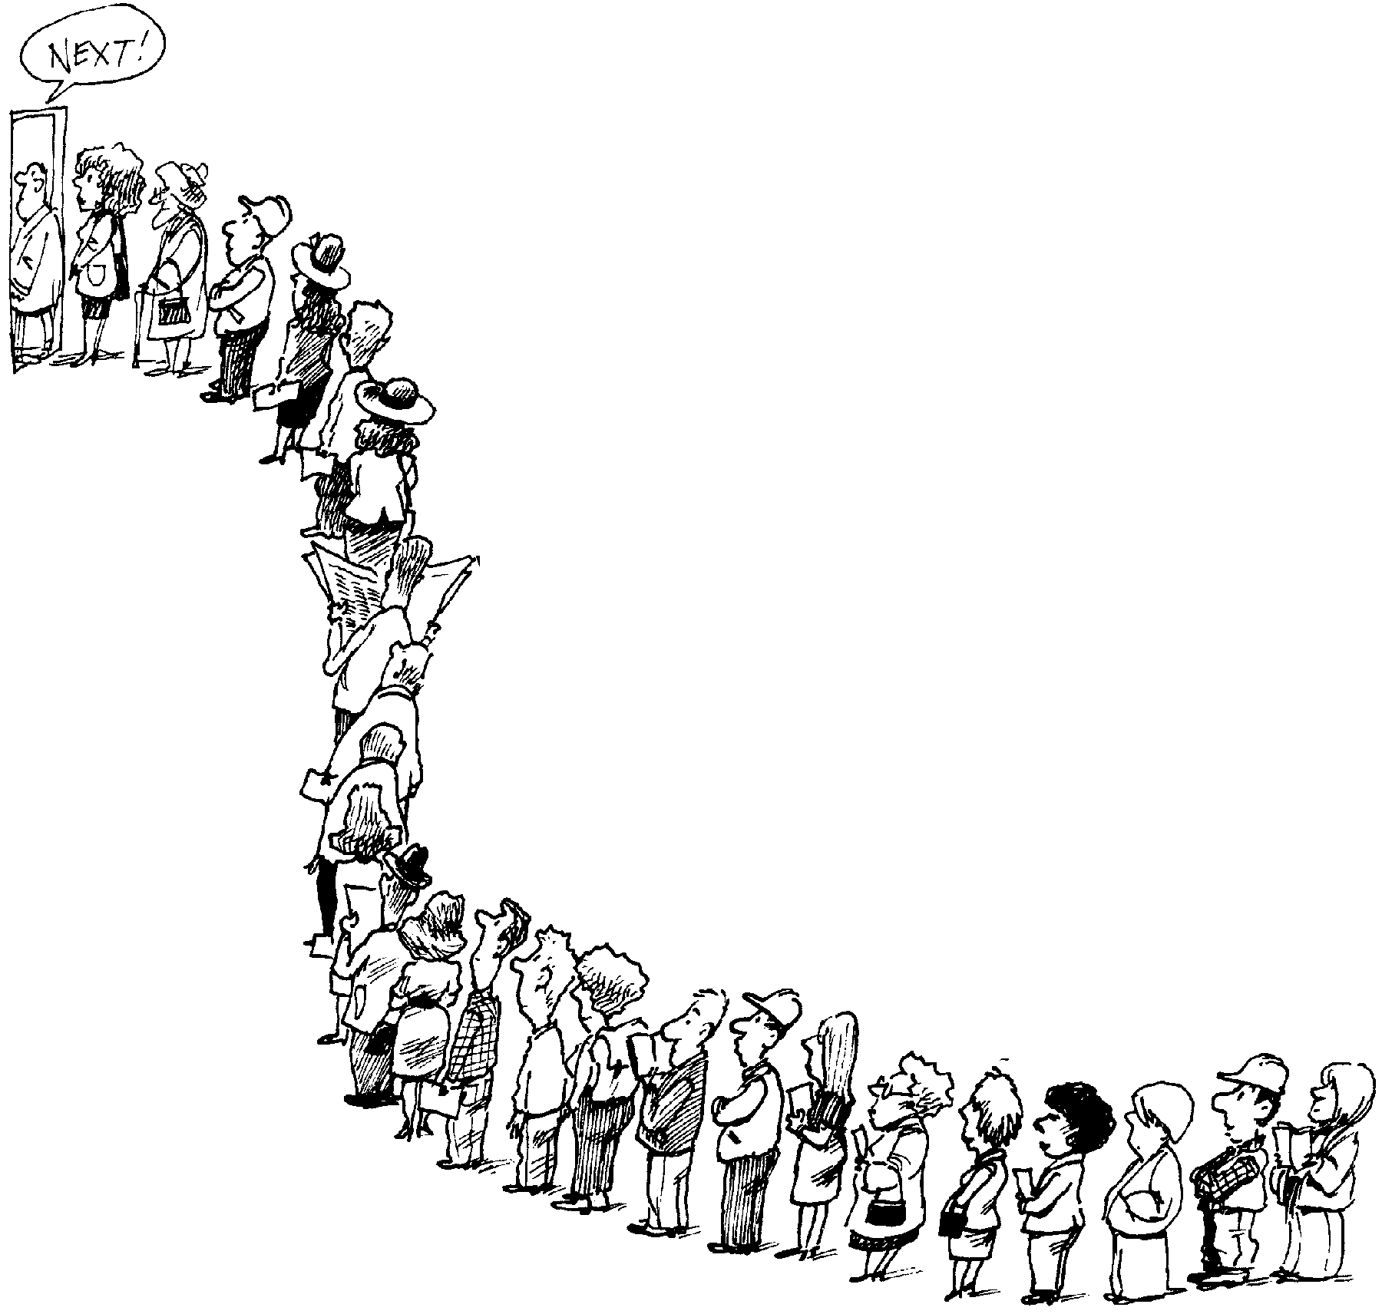
LANFORD SUB SHOP
Using simulation, Frank wants to determine the
average time a customer must wait for service

Slide 19
LANFORD SUB SHOP - Solution
Input Data
λ = 30, μ = 60.
Data generated by the simulation:
  C# = The number of the arriving customer.
  R#1 = The random number used to determine interarrivals.
  IAT = The interarrival time.
  AT = The arrival time for the customer.
  TSB = The time at which service begins for the customer.
  WT = The waiting time a customer spends in line.
  R#2 = The random number used to determine the service time.
  ST = The service time.
  TSE = The time at which service end for the customer

Slide 20
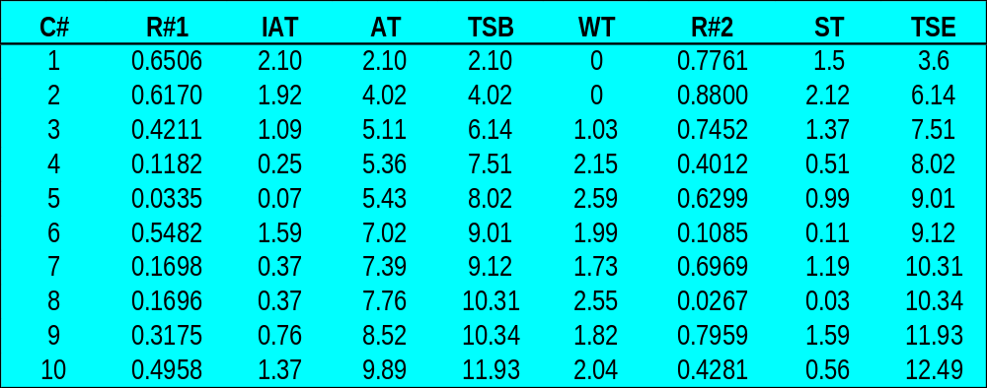
LANFORD SUB SHOP –
Simulation for first 10 Customers
Arrival Time
Time Service Begins
Service Time
Time Service Ends
Average waiting time =
(0 + 0 +1.03 + ... +2.04) / 10 = 1.59
The interarrival time = - ln(1-0.4211) / 30 = 0.0182 hours = 1.09 minutes
End of service = 6.14+1.37
The explicit inverse method
Waiting time = 6.14 - 5.11
Arrival time of customer 3 = Arrival time of customer 2 + 1.09 = 4.02 + 1.09

Slide 21
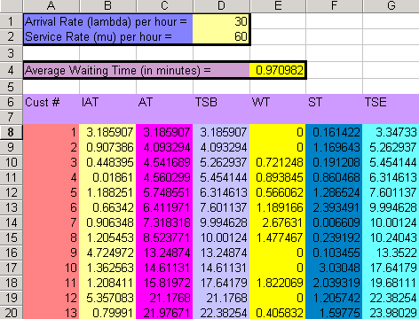
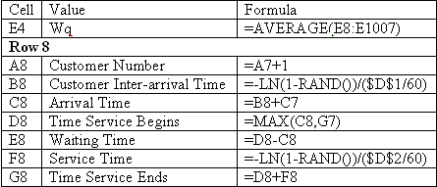
LANFORD SUB SHOP –
Simulation for first 1000 Customers

