Slide 1
Inside a Router
ECS 152A
Acknowledgement: slides from S. Kalyanaraman & B.Sikdar

Slide 2
Overview
Network Layer Performance Modeling & Analysis
  Part I: Essentials of Probability
  Part II: Inside a Router
  Part III: Network Analysis

Slide 3
Network Layer Performance Modeling & Analysis: Part II
Inside a Router
Basic Single Queue Model
Poisson Arrival Model
The M/M/1 Queue
Read any of the queuing theory references, e.g. Schwartz (Sections 2.1-3), Molloy, Kleinrock.

Slide 4
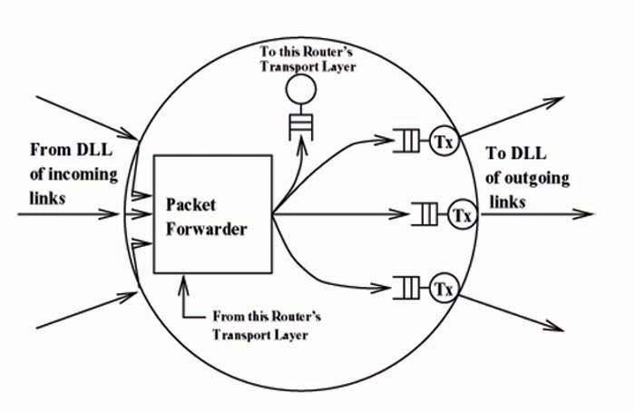
Queuing in the Network Layer at a Router

Slide 5

Basic Single Queue Model
Classical queuing theory can be applied to an output link in a router.

Slide 6
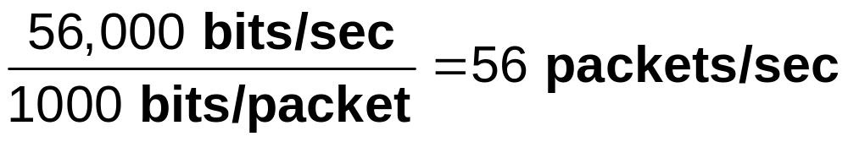
Basic Single Queue Model
For example, a 56 kbps transmission line can “serve” 1000-bit packets at a rate of

Slide 7
Applications of Queuing Analysis
Outside of Networking
Checkout line in a supermarket
Waiting for a teller in a bank
Batch jobs waiting to be processed by the CPU

Slide 8
Applications of Queuing Analysis
Outside of Networking
“That’s the way the whole thing started,
Silly but it’s true,
Thinking of a sweet romance
Beginning in a queue.”
-G. Gouldman, “Bus Stop” The Hollies

Slide 9

The Poisson Arrival Model
A Poisson process is a sequence of events “randomly spaced in time”

Slide 10
The Poisson Arrival Model
Examples
  Customers arriving to a bank
  Packets arriving to a buffer
The rate λ of a Poisson process is the average number of events per unit time (over a long time).

Slide 11

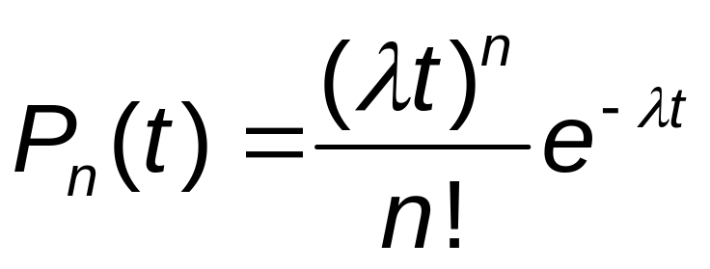
Properties of a Poisson Process
For a length of time t the probability of n arrivals in t units of time is

Slide 12

Properties of a Poisson Process
For 2 disjoint (non-overlapping) intervals, (s₁, s₂) and (s₃, s₄), (i.e. s₁ < s₂ s₃ < s₄), the number of arrivals in (s₁, s₂) is independent of the number of arrivals in (s₃, s₄)

Slide 13
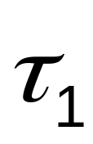
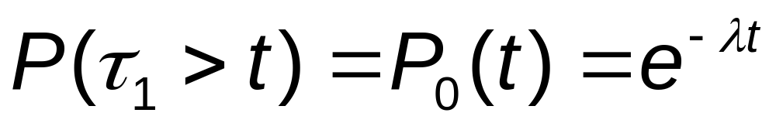
Interarrival Times of a Poisson Process
Pick an arbitrary starting point in time (call it 0).
Let = the time until the next arrival

Slide 14
Interarrival Times of a Poisson Process
So
,the time until the first arrival,
Has an exponential distribution!

Slide 15

Interarrival Times of a Poisson Process
Let = the length of time between the first and second arrival.
We can show that
i.e. is exponential and independent of !

Slide 16
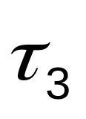

Interarrival Times of a Poisson Process
Similarly define as the time between the second and third arrival; as the time between the third and fourth arrival;…
The random variables , , , … are called the interarrival times of the Poisson process

Slide 17
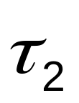
Interarrival Times of a Poisson Process
The interarrival time random variables, , , …
  Are (pair-wise) independent.
  Each has an exponential distribution with mean 1/λ.

Slide 18
The M/M/1 Queue
An M/M/1 queue has
  Poisson arrivals (with rate λ)
  Exponential service times (with mean 1/μ, so μ is the “service rate”).
  One (1) server
  An infinite length buffer
The M/M/1 queue is the most basic and important queuing model.

Slide 19

Queuing Notation
“M/M/1” is a special case of more general (Kendall) notation: X/Y/m/k, where
X is a symbol representing the interarrival process
  M = Poisson (exponential interarrival times, )
  D = Deterministic (constant ).

Slide 20

Queuing Notation
Y is a symbol representing the service distribution
  M = exponential, D = deterministic
  G = General (or arbitrary).
m = number of servers
k = number of buffer slots (omitted when k = )

Slide 21
Aside: The D/D/1 Queue
The D/D/1 queue has
  Deterministic arrivals (periodic with period = 1/λ).
  Deterministic service times (each service takes exactly 1/μ).
  As well as 1 server and an infinite length buffer.

Slide 22
Aside: The D/D/1 Queue
If λ < μ then there is no waiting in a D/D/1 queue.
Randomness is a major cause
of delay in a network node!

Slide 23
State Analysis of an M/M/1 Queue
Let n be the state of the system = the number of packets in the system (including the server).
Let p_{n} be the steady state probability of finding n customers waiting in the system (including the server).

Slide 24
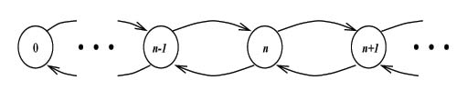
State Analysis of an M/M/1 Queue
How to find p_{n}? The state diagram:

Slide 25


State Analysis of an M/M/1 Queue
If the system is stable (i.e. p_{n} 0 for each n), then in a steady state it will drift back and forth across the dotted line. So,
the number of transitions from left to right = the number of transitions from right to left.

Slide 26
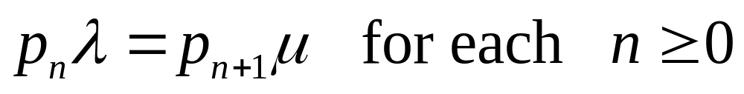
State Analysis of an M/M/1 Queue
Thus we obtain the balance equations

Slide 27
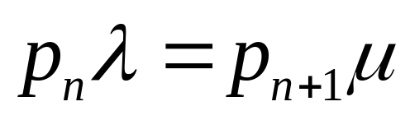
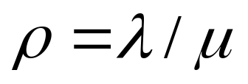
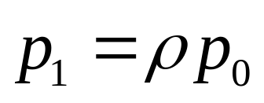
State Analysis of an M/M/1 Queue
Lets solve the balance equations:
For n = 0 we get
If we let , this becomes

Slide 28
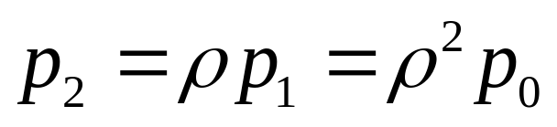
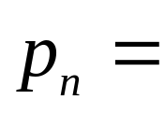
State Analysis of an M/M/1 Queue
Similarly
And if general

Slide 29
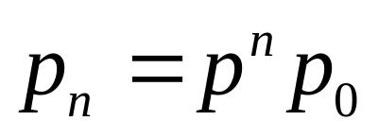
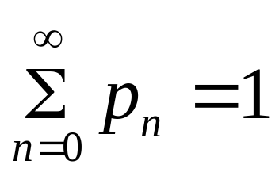
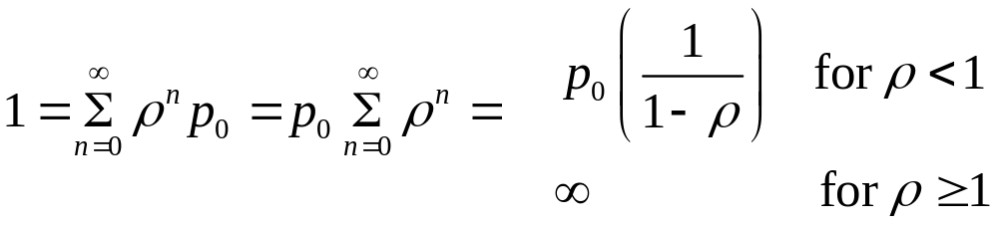
State Analysis of an M/M/1 Queue
We have for n =1,2,3,...
We need to solve for p₀ , so we need one more equation. Use
We obtain
{

Slide 30
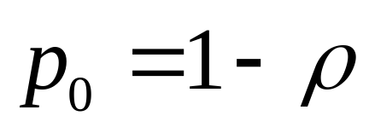
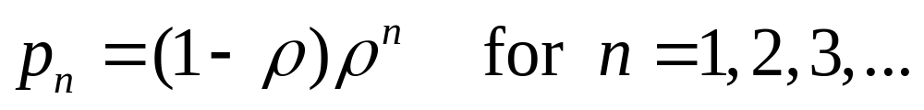
State Analysis of an M/M/1 Queue
So we must have
and

Slide 31

State Analysis of an M/M/1 Queue
Note that requiring ρ < 1 for stability (i.e. λ < ) makes intuitive sense.
Also ρ=1-ρ₀
= probability that the queuing system is NOT empty
= probability the server is working

Slide 32
State Analysis of an M/M/1 Queue
So ρ is sometimes called the “server utilization”
Finally note that p_{n} = (1- ρ)p^{n}, n = 0,1,2,3,… is a geometric distribution

Slide 33

The Finite Buffer Case: M/M/1/N
Infinite buffer assumption is unrealistic in practice.
N = total number of buffer slots (including server).
New state diagram:

Slide 34
The Finite Buffer Case: M/M/1/N
Get the same balance equations, but now only for n = 0,1,2,…,N - 1 with N < . So
as before, but we get a different p₀.

Slide 35
The Finite Buffer Case: M/M/1/N
From for n = 0,1,2,…, N < and = 1 we get
So

Slide 36
The Finite Buffer Case: M/M/1/N
Note that this holds for any . No need to assume ρ < 1. We always have the stability in the finite buffer case.

Slide 37
Blocking Probability and the Right Size Buffer
So in the finite buffer case,
Note that P_{N} is the probability that the buffer is full at an arbitrary point in time.

Slide 38
Blocking Probability and the Right Size Buffer
Since arrivals are independent of buffer state, we have P_{N} = P_{B} = probability an arriving packet is turned away due to a full buffer.
P_{B} is called blocking probability.

Slide 39
Blocking Probability and Buffer Size
P_{B} is very important!
We can use P_{B} to choose the correct buffer size.
Example: For ρ= 0.5, p_{N} > 10⁻⁶ for N 18, while p_{N} < 10⁻⁶ for N 19.

Slide 40
Blocking Probability and Buffer Size
Thus, if we desire a blocking probability less than 10⁻⁶, we need a buffer capable of holding 19 or more packets.

Slide 41
Throughput in the Finite Buffer Case
The throughput of any queuing system is the rate at which customers successfully leave the system.
For the M/M/1 infinite buffer case, if the system is stable. (Everything that arrives must eventually depart.)

Slide 42
Throughput in the Finite Buffer Case
For the M/M/1/N finite buffer case, (Everything that arrives and is not blocked must eventually depart.)

Slide 43
Throughput in the Finite Buffer Case
Alternate way to compute throughput of M/M/1/N: Look at the output side.
P (server is busy) =
When the server is busy, the output rate =
when the sever is idle, the output rate = 0
So the average rate =

Slide 44
Aside: Derivation of P_{N} = P_{B} Using Throughput
Equating our two formulas for we get
Solving for P_{B} we get
Isn’t that neat?

Slide 45
Approximation of a Finite Buffer System by the Infinite Buffer Model
For a infinite buffer,
For a finite buffer,
For ρ = 0.8 and N = 16 packets, these probabilities differ by less than 2.3%
For ρ = 0.8 and N = 32, the difference is only 0.06%

Slide 46
Approximation of a Finite Buffer System by the Infinite Buffer Model
The infinite buffer model is a very good approximation of a finite buffer system.
Even for moderate buffer sizes!

Slide 47
How Long is that Line?
Lets look again at the M/M/1 queuing system.
n = the number in the system (including the server)
So the average number in the system is

Slide 48
Little’s Formula and Queuing Delay
Let T = time spent by a customer in a queuing system (waiting and being served).
E(T) = the average delay for a customer.

Slide 49
Little’s Formula and Queuing Delay
Little’s Formula says
where λ is the “arrival rate for customers eventually served” (which we called )
Little’s Formula holds for very general queuing systems (not just M/M/1). Even whole networks!

Slide 50
Little’s Formula and Queuing Delay
Little’s Formula is either deep of obvious. Intuition:
Pick a “typical customer”
When it arrives to the queuing system, it should find E(n) customers waiting.

Slide 51
Little’s Formula and Queuing Delay
When it leaves the system, it has been in the system for E(T). Thus λE(T) customers should have arrived during its time in the system.
In steady state, the average number of customers left behind on the departure should equal the average number found on the arrival, i.e. λE(T) = E(n)

Slide 52
Little’s Formula and Queuing Delay
Let’s apply Little to the M/M/1 queue
E(T) is measured in units of time. Sometimes it is more convenient to consider
which is unitless

Slide 53
Little’s Formula and Queuing Delay
Sometimes we consider the waiting time W, i.e. the time spent waiting in the queue (not in service). So,

Slide 54

Single Link Example
Poisson packet arrivals with rate λ = 2000 p/s
Fixed link capacity C = 1.544 Mb / s (T1 Carrier rate).

Slide 55
Single Link Example
We approximate the packet length distribution by an exponential with mean L = 515 b/p
Thus the service time is exponential with mean
i.e. packets are served at a rate of

Slide 56
Single Link Example
Using our formulas for an M/M/1 queue
So
and

Slide 57
Other Queuing Models
There are many other important queuing models which are useful in networking.
M/M/k for k>1. Multiple servers
  Good model of a link which is made up of multiple channels, either physically of through multiplexing (e.g. a T1 carrier is typically time division multiplexed with k = 24).
  Has worse performance at lower loads than M/M/1 with same total capacity.

Slide 58
Other Queuing Models
M/M/k/k for k 1. One or more servers, no buffers (except one in each server).
  Important model in circuit switched networks.
  Models a trunk line with k circuits available.

Slide 59
Other Queuing Models
  Any customer (a call) which doesn’t get a circuit is blocked (gets a busy signal).
  Blocking probability is given by the Erlang B (or Erlang Loss) Formula

Slide 60
Other Queuing Models
M/G/1. Arbitrary service (packet length) distribution.
  Can still compute the mean number in the system via the Pollaczek-Khinchine (P-K) Formula

Slide 61
Other Queuing Models
where is the variance of the service time distribution. Again, variablility (randomness) causes delay.
Can apply Little’s Formula to get the mean delay

Slide 62
Other Queuing Models
M/D/1. Deterministic service times (packet length).
  Special case of M/G/1 with
  Under heavy load ( ), M/D/1 has half the delay of an M/M/1
  This is one motivation for a fixed-packet-length system like ATM

Slide 63
Other Queuing Models
Can also model and analyze other queuing systems
  With priority
  With more general arrival process
  With “vacations”
  Many others

Slide 64
Other Queuing Models
See Schwartz (Ch. 2), Kleinrock (Vol. I & II) or take ECSE-6820/DSES-6820, Queuing (sic) Systems & Applications
Queuing theory is also used in analysis of Operating Systems, e.g. in CSCI-6140

