Slide 1
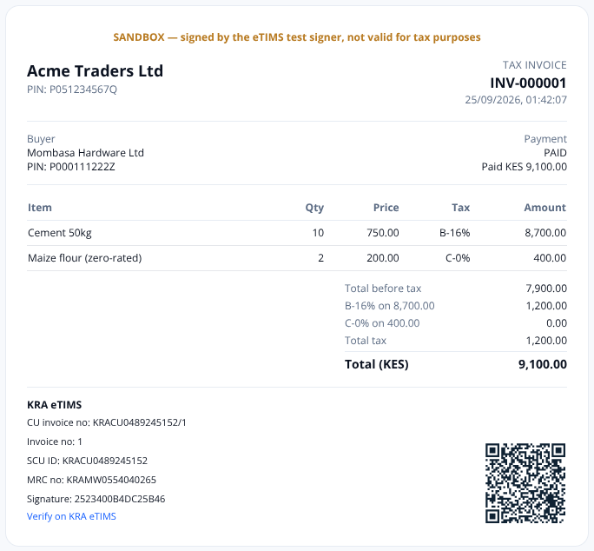
Z
Z-float
The money & tax OS
for Kenyan businesses
Pay suppliers and staff, collect from customers, and issue KRA eTIMS invoices — from one account.
Pitch deck · 2026
Notes:
Hook: every Kenyan business must now invoice through KRA eTIMS, and nearly all of them already move money on M-Pesa. Z-float joins the two.

Slide 2
WHY NOW
M-Pesa is how Kenya pays. eTIMS is how it taxes.
KES 38.3T
2.4M
0%
moved on M-Pesa in FY2025 (37.2 billion transactions)
M-Pesa merchants — 0.9M Lipa na M-Pesa tills + 1.5M Pochi la Biashara
of an expense is deductible without an eTIMS invoice
Safaricom Annual Report 2025
Safaricom H1 FY2026 results (Nov 2025)
Tax Procedures Act, Finance Act 2025
From the 2025 accounting period KRA validates declared income and expenses against eTIMS data on iTax. Failing to issue an eTIMS invoice costs double the tax due or KES 2 million, whichever is higher.
Every business that collects on M-Pesa now needs a compliant invoice or receipt for each sale — and a way to link it to the payment.
Z-float · Business payments for Kenya
2 / 12
Notes:
Two forces collide: mobile money is how Kenya pays, and eTIMS is now how Kenya taxes.

Slide 3
PROBLEM
Five tools and a spreadsheet to run the money
M-Pesa portal
payouts one by one
Paybill statement
who paid what?
Invoicing app
not linked to payments
eTIMS portal
retype every sale
Spreadsheet
reconcile by hand
→
→
→
→
• Hours lost every week matching payments to invoices
• Tax exposure: sales without eTIMS invoices, expenses disallowed
• Fraud risk: payees identified only by phone numbers, no approvals
• No single balance that finance, owners and auditors agree on
Z-float · Business payments for Kenya
3 / 12
Notes:
Today a finance team stitches together 4–5 tools and a spreadsheet.

Slide 4
SOLUTION
One account: pay out, get paid, stay compliant
Pay out
• Bulk & single M-Pesa / bank payouts
• Payroll, suppliers, bills
• Approvals & limits
Get paid
• STK request-to-pay
• Paybill routing to invoices
• Links & bank transfers
Comply
• KRA eTIMS invoices & receipts
• Auto receipt on every payment
• ID + KRA PIN on every party
The loop no one else closes:
invoice → M-Pesa prompt → wallet credited → invoice PAID → KRA-signed receipt
Z-float · Business payments for Kenya
4 / 12
Notes:
Z-float replaces the patchwork with one account and one ledger.

Slide 5
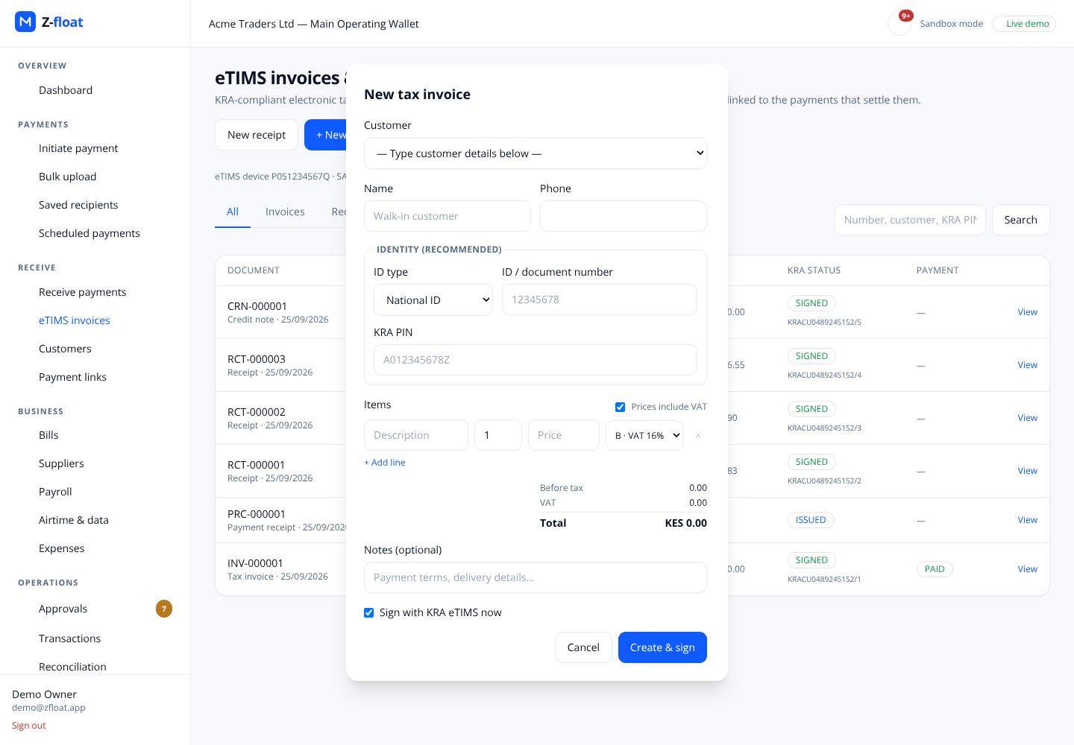
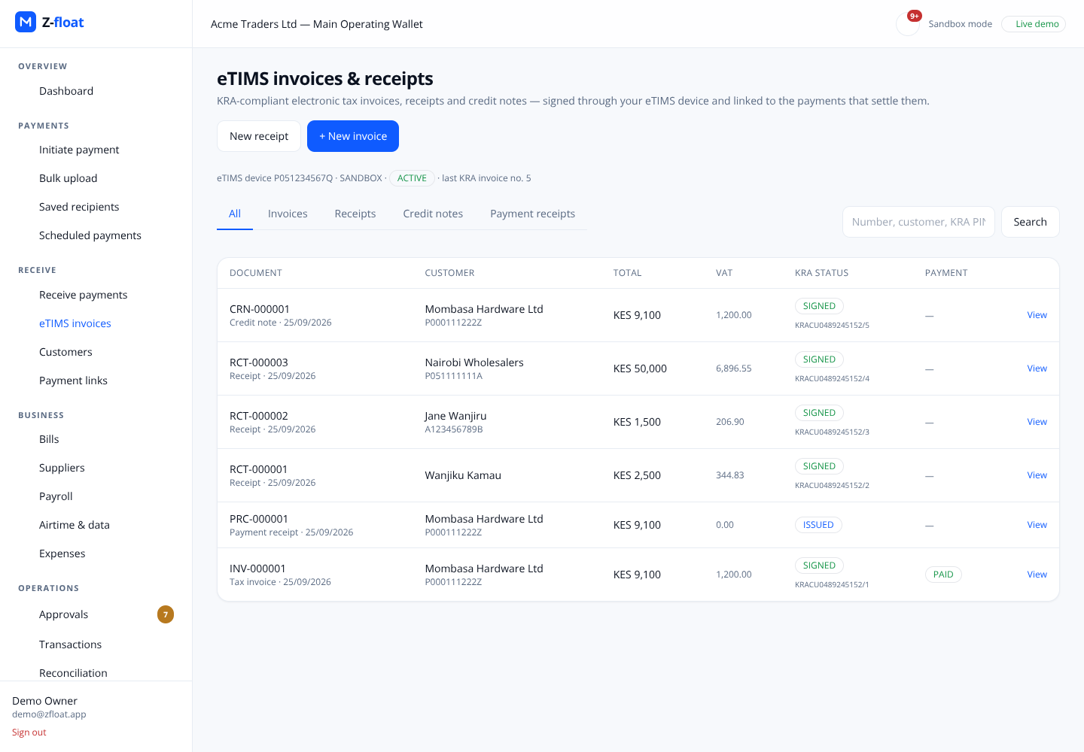
PRODUCT
Invoice → prompt → paid → KRA receipt, in one screen
Live product screens (sandbox). Left: new tax invoice with KRA tax bands. Right: signed invoices, receipts and credit notes with KRA CU numbers.
Z-float · Business payments for Kenya
5 / 12
Notes:
Product walkthrough: issue a tax invoice with VAT computed per line, send an STK prompt, and the receipt is issued automatically.

Slide 6
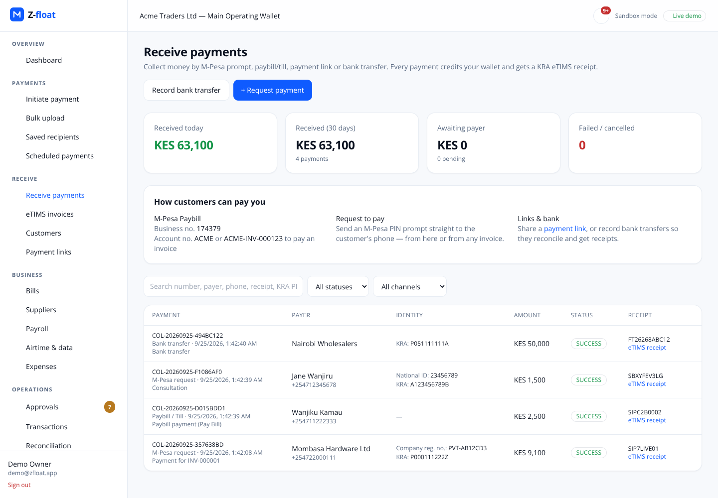
PRODUCT
Every shilling in, with who paid and the receipt
• Received today, 30-day totals, pending prompts
• Payer name, phone, ID and KRA PIN
• M-Pesa receipt number + linked eTIMS receipt
• Unmatched paybill money parked for reconciliation — never lost
• Webhooks: collection.received, invoice.fiscalised
Z-float · Business payments for Kenya
6 / 12
Notes:
Collections view: every channel lands in one list, with payer identity and the eTIMS receipt.

Slide 7
CUSTOMERS
Built for businesses that already live on M-Pesa
Distributors & wholesalers
• High volumes of paybill receipts to match to invoices; VAT-registered buyers demand PIN-bearing invoices.
Service businesses
• Clinics, schools, agencies: request-to-pay and automatic receipts replace manual books.
Employers & agri-aggregators
• Bulk payouts to staff and farmers, with ID-verified payees and approvals.
Accountants & bookkeepers
• Manage many clients' eTIMS compliance and reconciliation from one login.
Z-float · Business payments for Kenya
7 / 12
Notes:
Who we sell to first.

Slide 8
BUSINESS MODEL
Subscription + transaction revenue
Platform subscription
per month
• Tiered by users & eTIMS devices
• Includes invoices, receipts, approvals
Payout fees
per transaction
• Margin over M-Pesa / bank tariffs
• Bulk & payroll bundles
Collection fees
% of value
• STK, paybill routing, payment links
• Waived on higher tiers
Compliance add-ons
per client
• Accountant multi-client workspace
• Expense validation & reports
Pricing to be validated with design partners; fee levels are set per tier in the platform’s fee schedules today.
Z-float · Business payments for Kenya
8 / 12
Notes:
Revenue lines. Numbers are illustrative pricing to validate with design partners.

Slide 9
COMPETITION
Others do one piece. Z-float closes the loop.
Payouts
Collections
eTIMS invoices
Invoice ↔ payment link
Approvals & ledger
M-Pesa business portals
Yes
Yes
No
No
No
Invoicing / accounting apps
No
Partial
Yes
Partial
No
Payment gateways
Partial
Yes
No
Partial
No
Z-float
Yes
Yes
Yes
Yes
Yes
Category comparison, not a claim about any named vendor.
Z-float · Business payments for Kenya
9 / 12
Notes:
Where we compete and why we win.

Slide 10
TRACTION & READINESS
Production-grade engineering, ready for pilots
4
5
100%
0
collection channels live in sandbox
KRA tax bands (A–E) computed per line
of payments balanced on a double-entry ledger
editable fields on a signed KRA document
• Built: payouts, approvals, reconciliation, collections, eTIMS (OSCU/VSCU adapter + sandbox signer), identity
• Automated tests on real PostgreSQL cover money movement, idempotency and fiscal immutability
• Next: KRA OSCU certification + Safaricom production go-live with design partners
Z-float · Business payments for Kenya
10 / 12
Notes:
What is real today.

Slide 11
ROADMAP
Next 12 months
Q1
KRA OSCU certification · Daraja production · 10 design partners
Q2
Item catalogue sync · recurring invoices · SMS reminders
Q3
Purchase-invoice validation · accountant workspace
Q4
Airtel Money & cards · multi-branch devices
→
→
→
Goal: the default way a Kenyan SME moves money and proves it to KRA.
Z-float · Business payments for Kenya
11 / 12
Notes:
Milestones for the next 12 months.

Slide 12
THE ASK
Partner with us to go live
We are looking for
• Design-partner businesses (distributors, clinics, schools)
• Accounting firms managing eTIMS for SMEs
• Banking / PSP partners for settlement and collections
• Seed funding for certification, go-to-market and support
What you get
• Early access and influence on the roadmap
• Preferential pricing for the first year
• Hands-on onboarding to eTIMS and M-Pesa collections
• A single view of money in, money out and tax
Z-float · Business payments for Kenya
12 / 12
Notes:
Close: what we are asking for.

