Slide 1
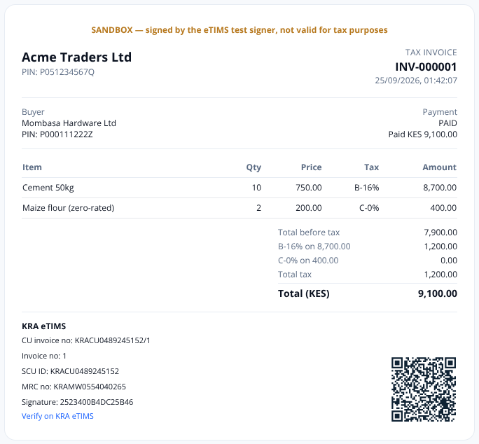
Z
Z-float
Pay out. Get paid.
Stay KRA-compliant.
Z-float is the business payments platform for Kenya — M-Pesa & bank payouts, inbound collections and KRA eTIMS invoicing on one double-entry ledger.
System overview · 2026 release: collections, eTIMS e-invoicing & identity
Notes:
Introduce Z-float in one line: the operating account for a Kenyan business. This release adds the receiving side (collections), KRA eTIMS electronic invoices and receipts, and full identity (ID number + KRA PIN) on every person we deal with.

Slide 2
THE PROBLEM
Kenyan businesses run money on scattered tools
Money in, money out — separately
• Payouts on one portal, M-Pesa paybill statements in another
• Manual matching of who paid which invoice
• No single balance the team trusts
Tax compliance went digital
• Every sale needs an eTIMS invoice or receipt
• Expenses without an eTIMS invoice are no longer deductible (Finance Act 2025)
• Penalty: double the tax due or KES 2M
A phone number is not an identity
• Numbers are shared, recycled, and mistyped
• Two “John Otieno”s in the payee book
• Buyers need their KRA PIN on invoices to claim VAT
Sources: Tax Procedures Act as amended by Finance Act 2025 (s.23A, eTIMS); KRA income & expense validation notice.
Z-float · Business payments for Kenya
2 / 10
Notes:
Three pains we hear from finance teams: money moves in many rails, tax compliance is now digital and mandatory, and phone numbers alone do not identify people.

Slide 3
THE PLATFORM
One account for every shilling that moves
Pay out
• M-Pesa B2C, paybill, till & bank
• Bulk CSV, payroll, suppliers, bills, airtime
• Schedules & payment links
Get paid · NEW
• M-Pesa STK request-to-pay
• Paybill/Till C2B with invoice routing
• Payment links & bank transfers
Comply · NEW
• KRA eTIMS invoices, receipts, credit notes
• OSCU / VSCU device integration
• ID number + KRA PIN on every party
Control
• Maker-checker approvals & limits
• Double-entry ledger, reconciliation
• Audit trail, webhooks, public API
Customer pays
STK · C2B · link · bank
Wallet credited
balanced journal
Invoice settled
PAID / PARTIAL
eTIMS receipt
KRA-signed, QR
→
→
→
Z-float · Business payments for Kenya
3 / 10
Notes:
Four pillars. Everything posts to the same double-entry ledger, so the balance, the invoices and the tax records always agree.

Slide 4
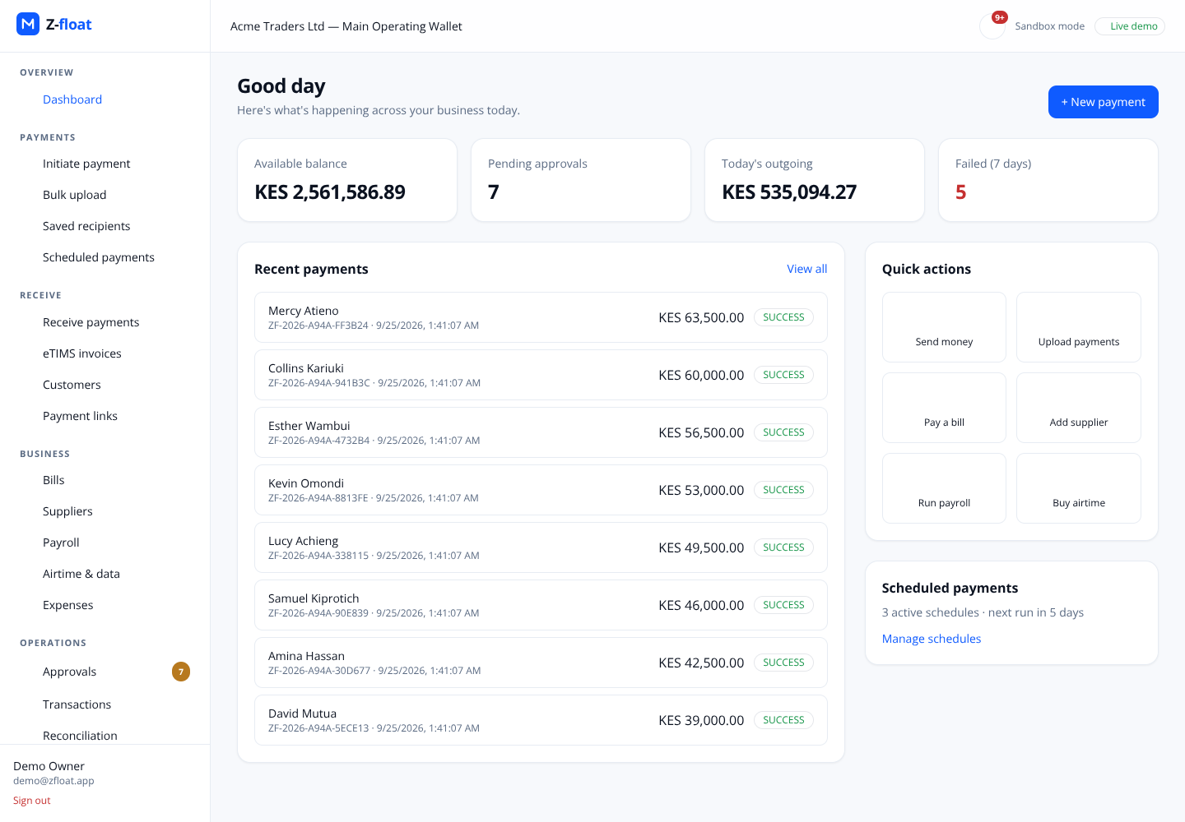
PAYING OUT
Disburse to anyone on M-Pesa or bank — safely
Single, bulk and scheduled payments to phones, tills, paybills and bank accounts.
• Approval policies by amount, role and payee risk (maker-checker)
• New payees need an independent approver before they receive funds
• Funds reserved on the ledger before the provider is called
• Idempotent APIs, provider circuit breakers, stuck-payment monitor
• Payroll, supplier bills, airtime and expense claims built in
Z-float · Business payments for Kenya
4 / 10
Notes:
The payout engine that already exists: every payment is idempotent, policy-checked and approved before it moves; the ledger reserves funds first.

Slide 5
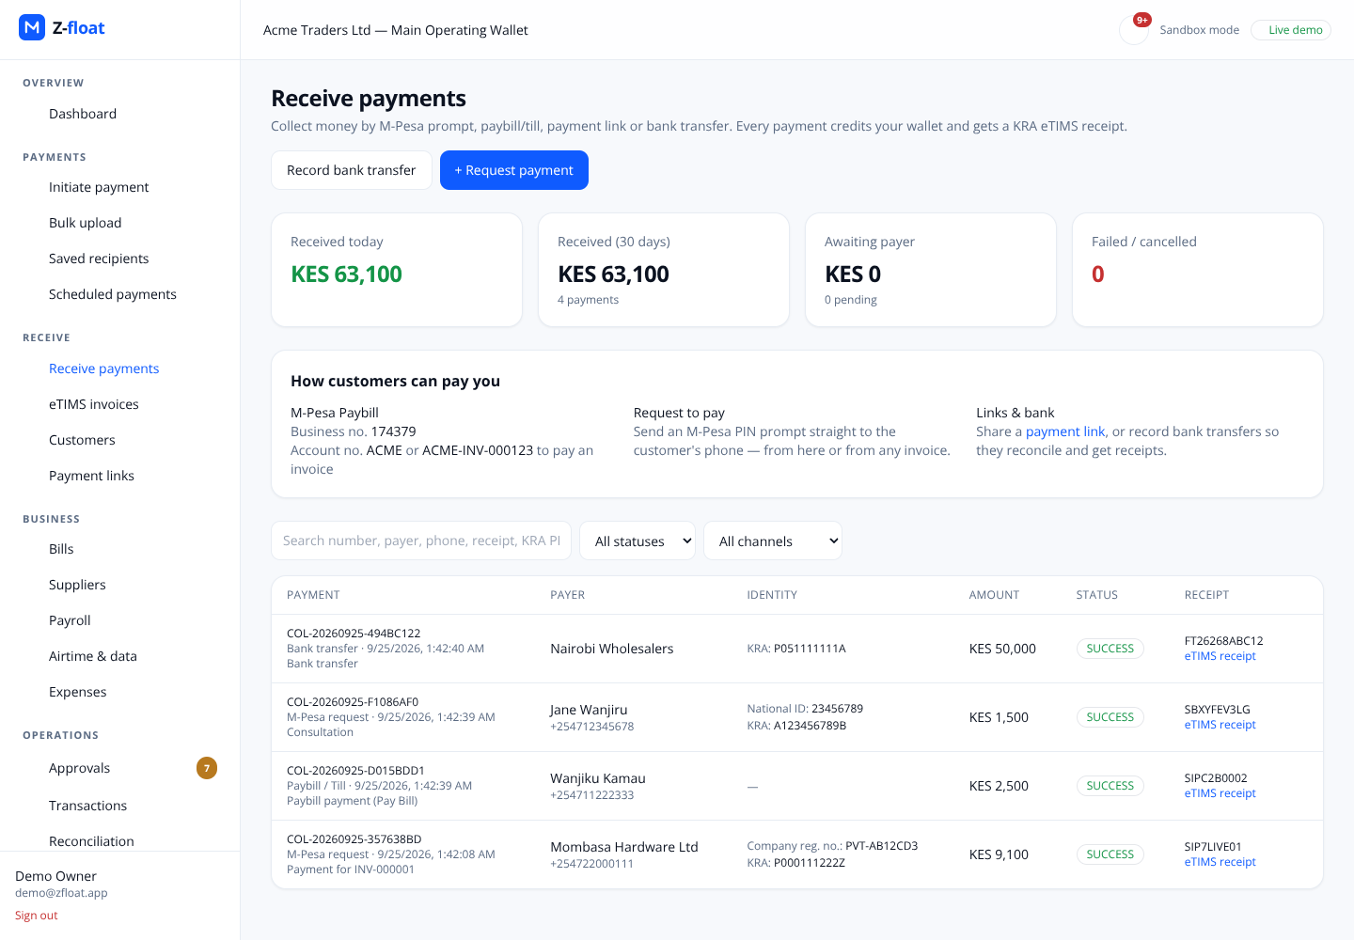
RECEIVING PAYMENTS · NEW
Collect by M-Pesa prompt, paybill, link or bank
M-Pesa STK push
PIN prompt on the payer’s phone; callback settles it.
Paybill / Till (C2B)
Account ACME-INV-000123 routes to the business and the invoice. Unknown accounts rejected at validation or parked for recon.
Payment links & bank transfers
Links cap uses atomically; bank references can only be recorded once.
Safe by construction
Idempotent on CheckoutRequestID / TransID; late callbacks after expiry still credit; row locks prevent double credit.
Z-float · Business payments for Kenya
5 / 10
Notes:
New: the receiving side. Four channels, one collections ledger. Each successful payment credits the wallet through a balanced funding journal, settles the linked invoice and triggers an eTIMS receipt through the outbox.

Slide 6
KRA ETIMS · NEW
Electronic tax invoices & receipts, signed by KRA
What the business gets
• Tax invoices, receipts and credit notes with VAT A–E computed per line
• Automatic eTIMS receipt for every payment received
• Buyer KRA PIN printed so customers can claim input VAT
• Shareable link + QR that verifies on the KRA portal
How it works
• OSCU API: selectInitOsdcInfo → cmcKey (encrypted at rest) → saveTrnsSalesOsdc
• Sequential invoice numbers per device under a row lock
• KRA outage? Documents queue and retry; rejections surface for a human
• Signed documents are immutable in the database — corrections are credit notes
Z-float · Business payments for Kenya
6 / 10
Notes:
eTIMS: we integrate with KRA's OSCU API (VSCU for high volume). Device initialisation returns a communication key we store encrypted. Each sale is sent to saveTrnsSalesOsdc; KRA returns the receipt number, signature, SCU ID and MRC which we print with the verification QR.

Slide 7
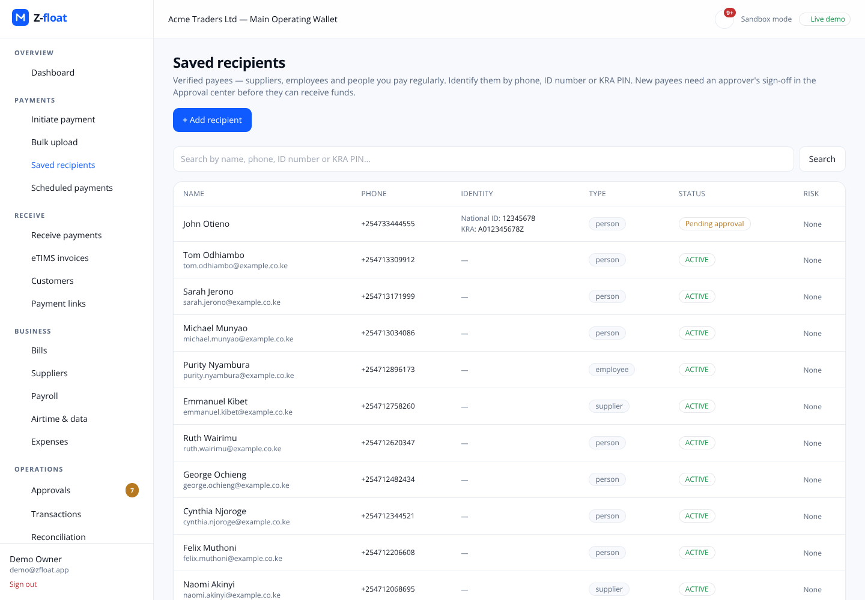
IDENTITY · NEW
ID number + KRA PIN — not just a phone number
Captured on recipients, customers, payers and team members
• National ID, Alien ID, Passport, Military ID, Company registration
• KRA PIN validated (A/P + 9 digits + letter) and classified individual vs business
• Duplicate guard: the same PIN or ID can’t be added twice by accident
• One search box: phone, ID number or KRA PIN
• ID numbers masked in lists; changes are audited
• Payer PIN flows straight onto their eTIMS receipt
Z-float · Business payments for Kenya
7 / 10
Notes:
Identity everywhere: recipients, customers, payers and team members carry ID type, ID number and KRA PIN, validated and normalised. One search box resolves a phone, ID number or KRA PIN.

Slide 8
CONTROLS & TRUST
Built like a bank ledger, not a spreadsheet
Double-entry ledger
• Every credit and debit is a balanced journal; a health check proves it every 10 minutes.
Maker-checker
• Payments, reversals, new payees and privileged roles need an independent approver.
Idempotency everywhere
• API keys, provider callbacks (CheckoutRequestID, TransID) and bank refs dedupe.
Transactional outbox
• Receipts, notifications and webhooks are published exactly once, after commit.
Immutable fiscal records
• A database trigger blocks edits/deletes of KRA-signed documents.
Secrets & audit
• Device keys AES-GCM encrypted; callbacks token-checked; every change audited.
Z-float · Business payments for Kenya
8 / 10
Notes:
Trust is the product. These are the invariants tests enforce on every change.

Slide 9
ARCHITECTURE
Typed monorepo, adapters at the edges
Channels
Portal (Next.js 14) · Public API · Hosted pay & receipt pages · Provider webhooks
Domain packages
payments-core · collections · etims · ledger · approvals · validation · auth/RBAC · audit
Async
Worker (BullMQ/Redis): executions, callbacks, reconciliation, eTIMS retries, STK expiry · Outbox relay
Adapters
M-Pesa Daraja (B2C, STK, C2B) · Bank PSP · Airtime · KRA eTIMS OSCU / VSCU / sandbox signer
Data
PostgreSQL (Drizzle, SQL migrations, triggers) · Redis · Object storage
Z-float · Business payments for Kenya
9 / 10
Notes:
Monorepo: Next.js 14 web + API, a BullMQ worker and an outbox relay, all sharing typed packages. Providers and the eTIMS client are adapters, so sandbox and production differ only by configuration.

Slide 10
GO-LIVE & ROADMAP
From sandbox to production
Go-live checklist
• KRA: apply for OSCU (or VSCU) on the eTIMS portal / GavaConnect; receive device serial
• Set ETIMS_DRIVER=oscu, ETIMS_ENVIRONMENT=production
• Map items to KRA item classification codes (placeholder today)
• Safaricom Daraja production app: STK passkey, C2B URL registration
• Set MPESA_C2B_CALLBACK_TOKEN; enable external validation
• Run the certification test cases in the KRA sandbox first
Roadmap
• Item catalogue synced with KRA (saveItem, stock movements)
• Purchase invoices: pull supplier eTIMS invoices to validate expenses
• Recurring invoices & automatic payment reminders by SMS
• Customer statements and aged-receivables report
• Card and Airtel Money collections
• Multi-branch eTIMS devices (bhfId per branch)
Z-float · Business payments for Kenya
10 / 10
Notes:
Close with what it takes to go live: KRA OSCU approval and device serial, Safaricom Daraja production credentials with STK and C2B, and the configuration flags. Then the roadmap.

