Slide 1


Every worker. Every site. One live record
BharatShramSetu
One Nation, One ID, One Platform
A Unified Digital Platform for Workforce Identity, Welfare and Empowerment
India’s Digital Workforce Governance Infrastructure
Company and product presentation · October 2026
Photo: foundry in Guwahati, Assam · Donvikro, CC BY-SA 4.0
Notes:
BharatShramSetu is India's Digital Workforce Governance Infrastructure: a worker-first movement that gives every worker one verified, portable identity and connects them with contractors, employers and compliance teams through one QR, in 16 Indian languages. Tagline from the portal: One Nation, One ID, One Platform.

Slide 2
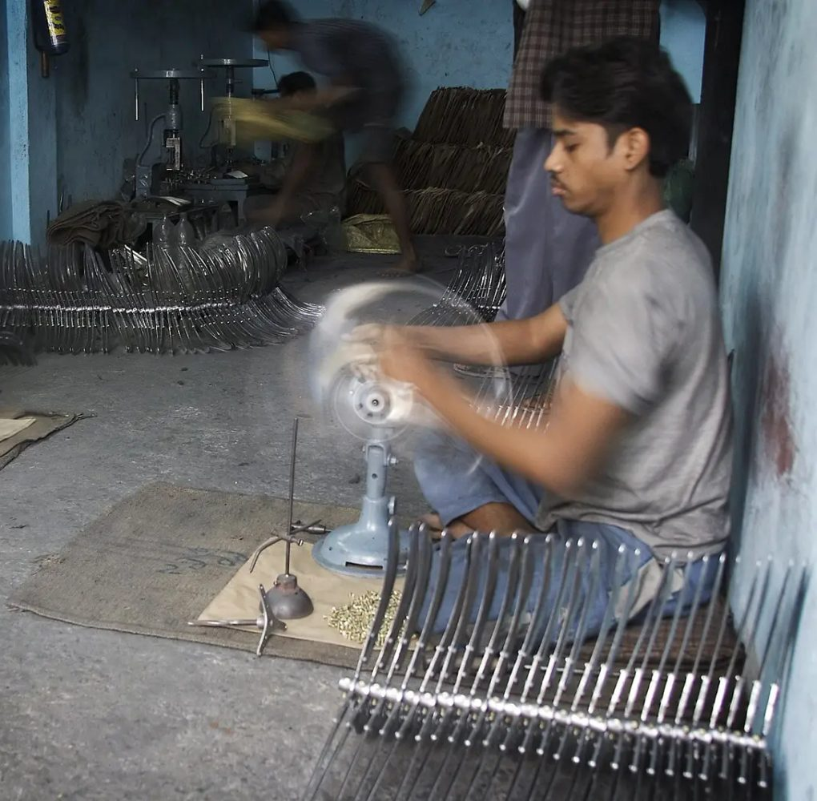
Agenda
1
About us and the movement
Mission, values and why we are worker-first
2
The problem and why now
How contract work is recorded today
3
One QR, four solutions
Onboarding, attendance, gate pass, verification, in 16 languages
4
Governance and impact
Stakeholders, audit, reporting, nation building, paperless
5
Market and business model
Who pays, pricing, unit economics, SWOT
6
Traction, team and next steps
Where we are, who we are, how to work with us
Electric fan factory, Varanasi · Jorge Royan, CC BY-SA 3.0
Notes:
Walk through the agenda in about 30 seconds. Clients usually care most about sections 3 and 4; investors about 5 and 6.

Slide 3




About us
“A developed Bharat begins with an empowered worker.”
Company at a glance
Company | [Registered legal name]
Founded | [Year]
Headquarters | [City, State]
Team size | [Number of people]
Website | www.bharatshramsetu.com
Portal | login.bharatshramsetu.com
Email | info@bharatshramsetu.com
BharatShramSetu (Bharat for the nation, Shram for labour, Setu for the bridge) is India’s Digital Workforce Governance Infrastructure. It starts with the worker, then connects every contractor, employer and compliance team responsible for them, across India.
Trust
Transparency
Inclusivity
Empowerment
Secure & Verified
Clear & Accountable
For Every Worker
Growth & Welfare
One Nation, One ID, One Platform · Building a Stronger, Safer and Empowered Bharat
Notes:
Who we are and what we stand for. The four values are the same as on the portal login. Fill in the bracketed company facts.

Slide 4



India’s contract workforce still runs on paper registers
Workers
50+ Crore
No portable record of days worked, wages or PF, and forms in a language that is not theirs. Short payments are hard to prove.
workers in India
Contractors
Millions
Manual musters, CLRA registers and PF/ESIC returns, with different wage, PT and LWF rules in every state.
of establishments
Principal employers
Legally liable for wages and dues of workers they never hired directly, with little visibility into contractors.
Scale figures as used on the BharatShramSetu portal
Notes:
The evidence of work (attendance, wages, PF) lives in paper musters and contractor spreadsheets. When something goes wrong, the evidence is the first thing missing. Principal employers carry the liability under the CLRA Act without the visibility.

Slide 5




Why now
Labour law is being re-plumbed
Digital public infrastructure is ready
The four Labour Codes consolidate 29 central labour laws. Registers, wages and social security move to new, uniform definitions.
Aadhaar, UPI, DigiLocker and e-Shram make verification at source and digital payment practical for every worker.
Worker data must be consented
Principal employers are accountable
The DPDP Act, 2023 makes consented, purpose-limited and auditable handling of personal data a legal requirement.
Audits, ESG reporting and supply-chain reviews now reach the contract workforce, not only direct employees.
Notes:
Four forces make this the right moment: a once-in-a-generation consolidation of labour law, mature digital public infrastructure, a new data-protection law, and accountability moving down the supply chain.

Slide 6
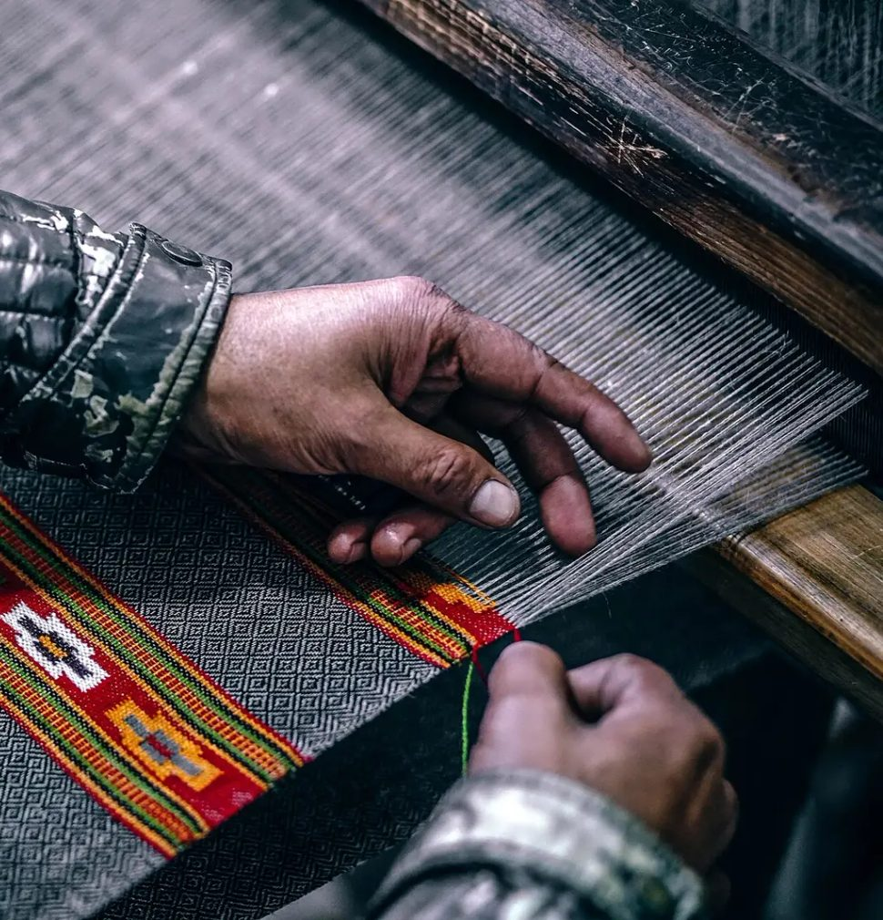



A movement for the people who build India
Fifty crore people build our roads, run our looms and keep our plants alive. Most still prove who they are with photocopies, in a language that is not theirs, at a gate where no one knows their name.
BharatShramSetu starts with them: their identity, their consent, their attendance and their voice. When the worker is protected, the contractor, the employer and the nation are too.
As simple as a scan
As easy as the apps India already loves. No forms, no agent, no training day.
In your own language
16 Indian languages and a voice guide. Nobody signs what they cannot read.
Yours wherever you go
One identity across employers, contractors and states.
Hands at a loom · Igor Ovsyannykov, CC0
Notes:
This is the emotional core. We are not selling software to manage workers; we are building a movement that puts the worker first, with the convenience people know from everyday consumer apps, in their own language, anywhere in India.

Slide 7
Ramesh’s first day at a new site
07:40
07:42
07:45
07:51
08:00
Any day
Darbhanga to Pune
One scan, in Maithili
Onboarded and verified
Gate pass, safe to work
Present, on site
Heard, on the clock
1,700 km from home. No agent, no photocopies.
The app greets him in his language.
Contractor approves; documents checked at source.
Induction, PPE and fitness checked first.
Vision AI and geo-fencing mark him in.
A spoken grievance gets an SLA and an owner.
Twenty minutes. One QR. Zero paper.
A sample morning for a sample worker. This is what convenience looks like for someone who has never had it.
Notes:
Tell this as a story. Ramesh is a sample worker from Darbhanga, Bihar, arriving at a site in Pune. Every step he takes uses the same QR and the same identity, in Maithili.

Slide 8
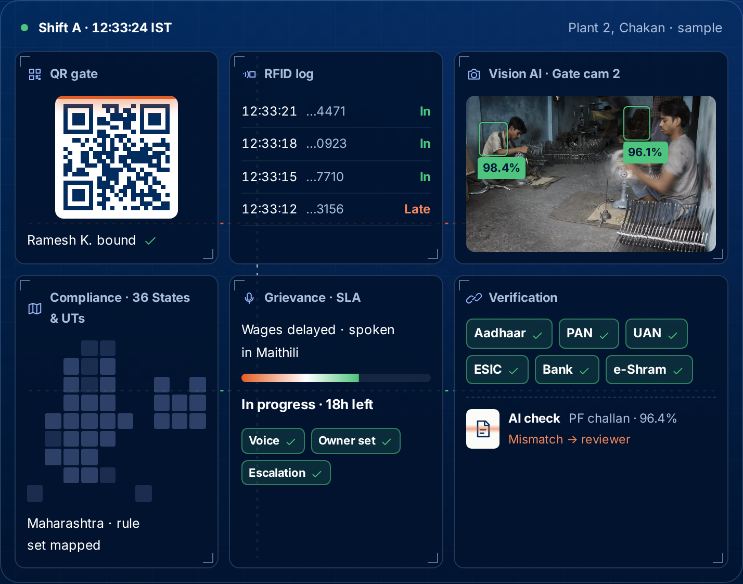

One verified record shared by the three parties
Employer
Site
Contractor
Worker
E·C·S·W binding
One worker, one site, one contractor at a time, with consent on both sides. Everything else follows from it.
Notes:
The unit of the platform is the binding: Employer, Contractor, Site, Worker. Every combination is unique and needs consent from both sides. Because every later record hangs off the binding, nothing is re-keyed. The screenshot is the live operations view from the website with sample data, including grievance SLA tracking.

Slide 9



One QR. Four solutions
Onboarding
Attendance
Join a contractor and site with one scan and dual consent.
Vision AI, RFID, site QR and geo-fencing, in one record.
Gate pass
Verification
Only after induction, PPE, fitness and compliance clear.
Aadhaar, PAN, UAN, ESIC, bank, e-Shram, DigiLocker at source.
One worker · One QR
Our vision: the UPI of compliance. One scan every worker carries, every site recognises and every authority can trust.
Notes:
UPI made paying anyone in India a single scan. Our vision is to do the same for compliance. The same QR onboards, marks attendance alongside Vision AI, RFID and geo-fencing, clears the gate pass and verifies the worker.

Slide 10
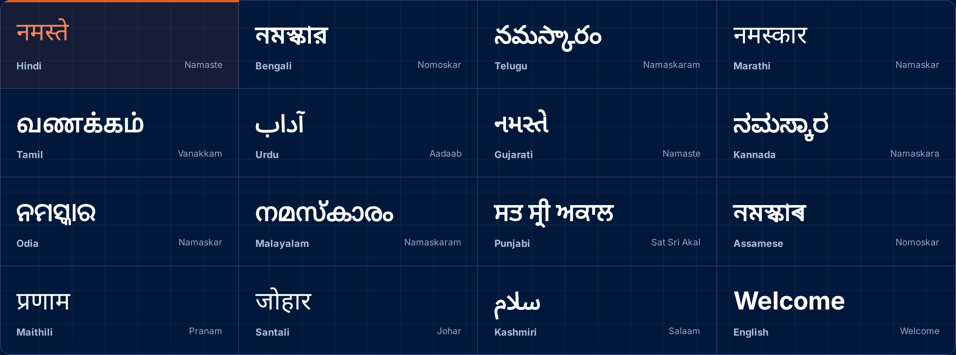
16 languages. No worker left out
Our USP: no one else speaks to India’s workforce in 16 Indian languages, with a voice guide.
A worker from Odisha on a site in Gujarat should never sign something they cannot read. Every screen, alert and grievance works in the worker’s own language, from Kashmir to Kanyakumari.
Hindi · Bengali · Telugu · Marathi · Tamil · Urdu · Gujarati · Kannada · Odia · Malayalam · Punjabi · Assamese · Maithili · Santali · Kashmiri · English
Notes:
Language is the single biggest barrier for a migrant worker. Sixteen languages with a voice guide is what makes BharatShramSetu pan-India and worker-centric, and it is unique in this space.

Slide 11
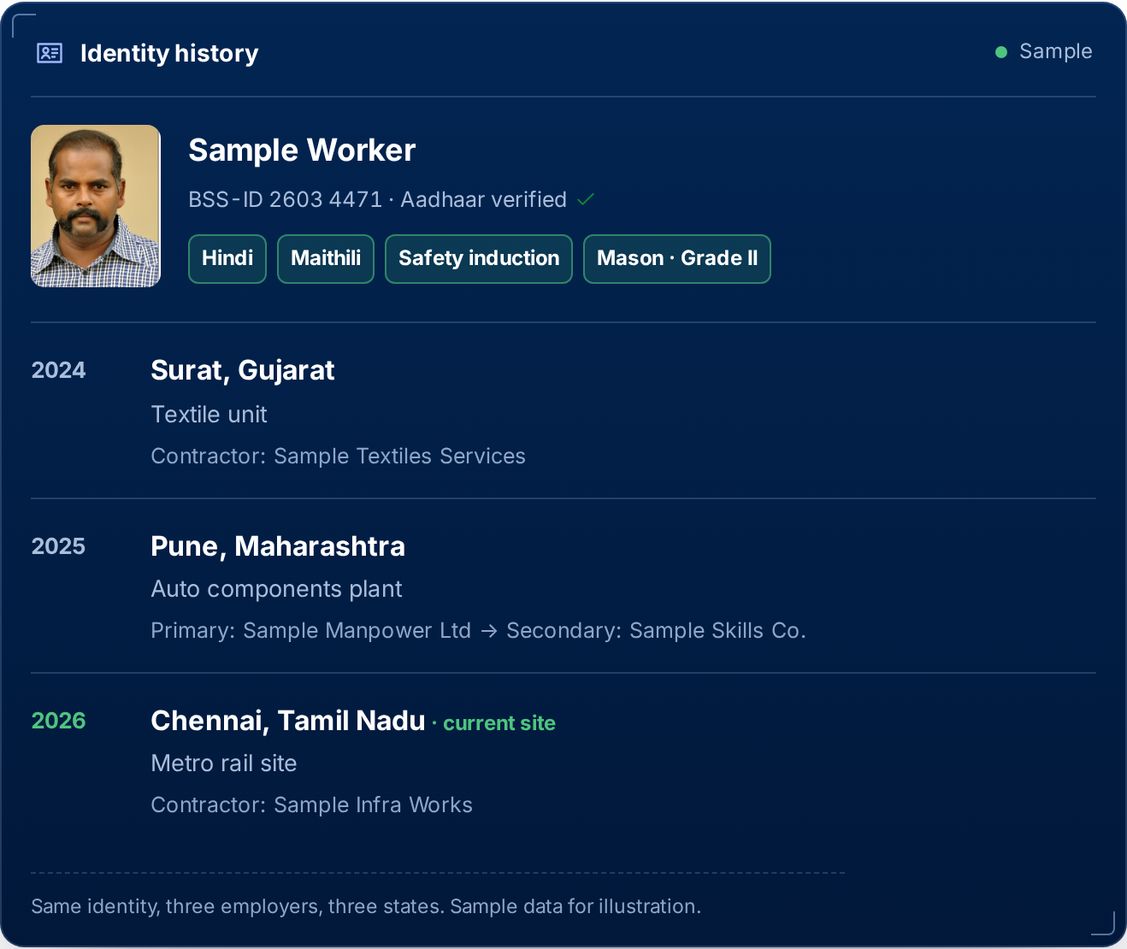
One identity that travels with the worker
Portable identity
Across employers, contractors and locations. Verified documents, training and history move with the worker; nothing is collected twice.
Primary and secondary contractors
The full chain is recorded, so accountability never slips between a contractor and a sub-contractor.
Aligned with the new Labour Codes
Wages, Social Security, OSH and Industrial Relations codes, layered with state rules, applied almost automatically.
Notes:
Workers move; their records should not stay behind. The identity history shown is sample data: one worker, three employers, three states, including a primary and secondary contractor chain.

Slide 12
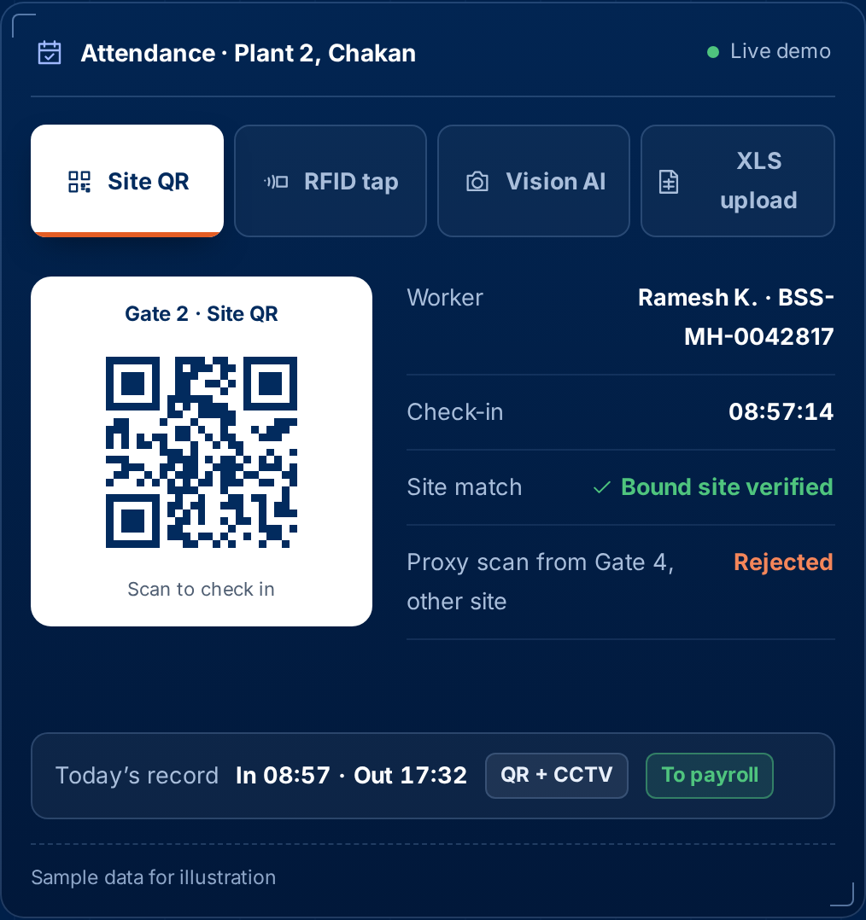
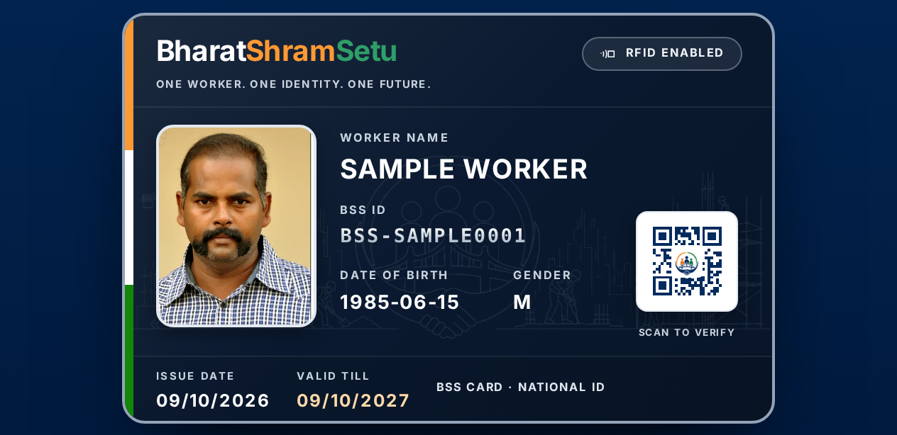
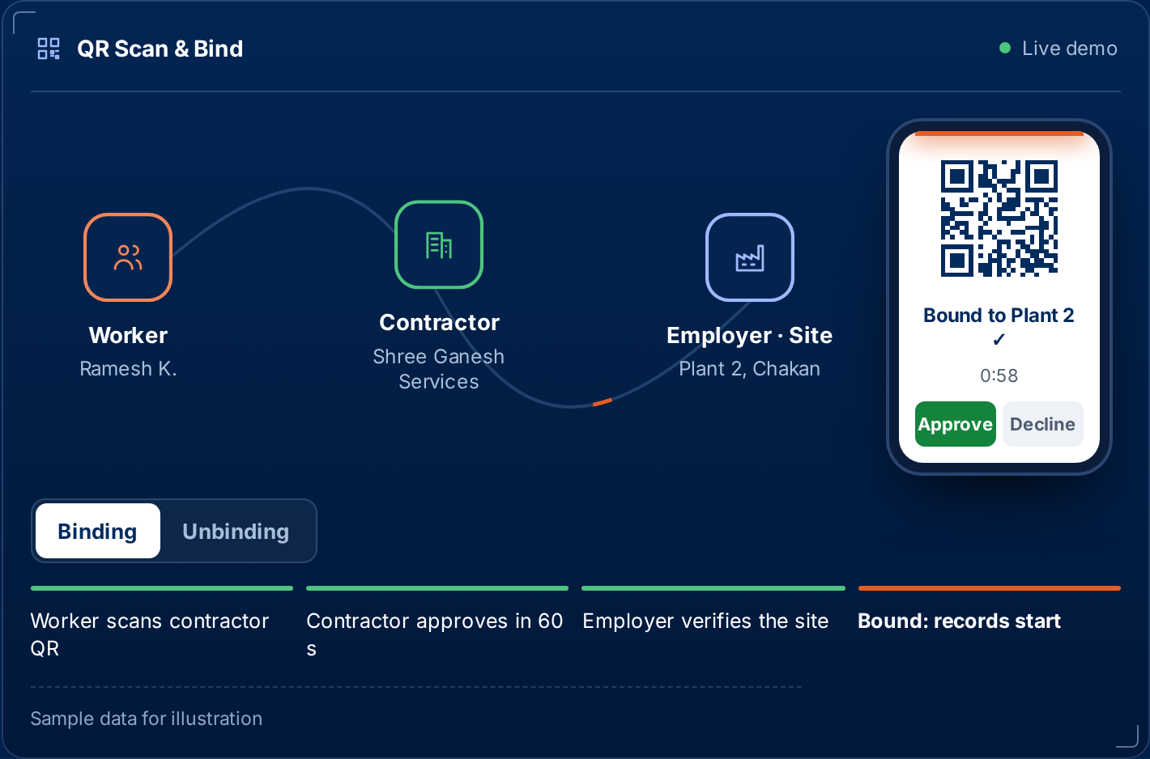
Identity, binding and attendance at the gate
QR binding and unbinding
Scan to bind with dual consent and IVR/OTP fallback. Release with an end date; re-binding needs the worker’s MPIN.
Four ways to mark attendance
Vision AI face recognition, RFID tap, site-specific QR and geo-fencing, with Excel upload as a fallback, in one daily record.
BharatShramSetu ID card
CR-80 card with photo, QR verification and RFID. Identity and history move with the worker.
Product views from the BharatShramSetu website, sample data
Notes:
The gate is where records start. A worker is bound once by QR, then every attendance method lands in the same daily record, which feeds the gate, the registers and the FORM XVI muster roll.

Slide 13
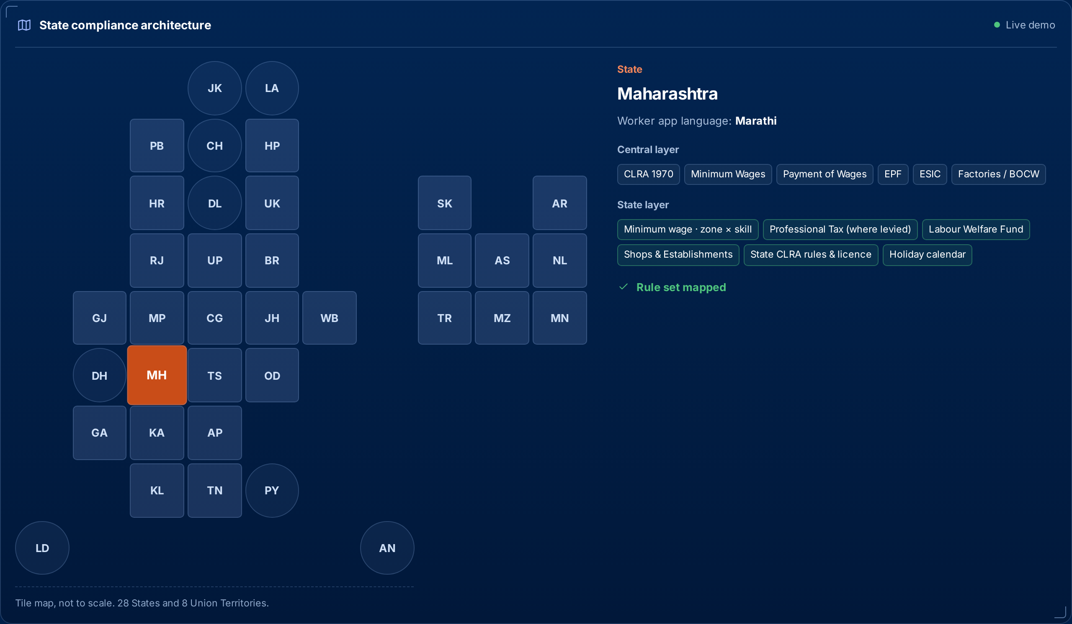
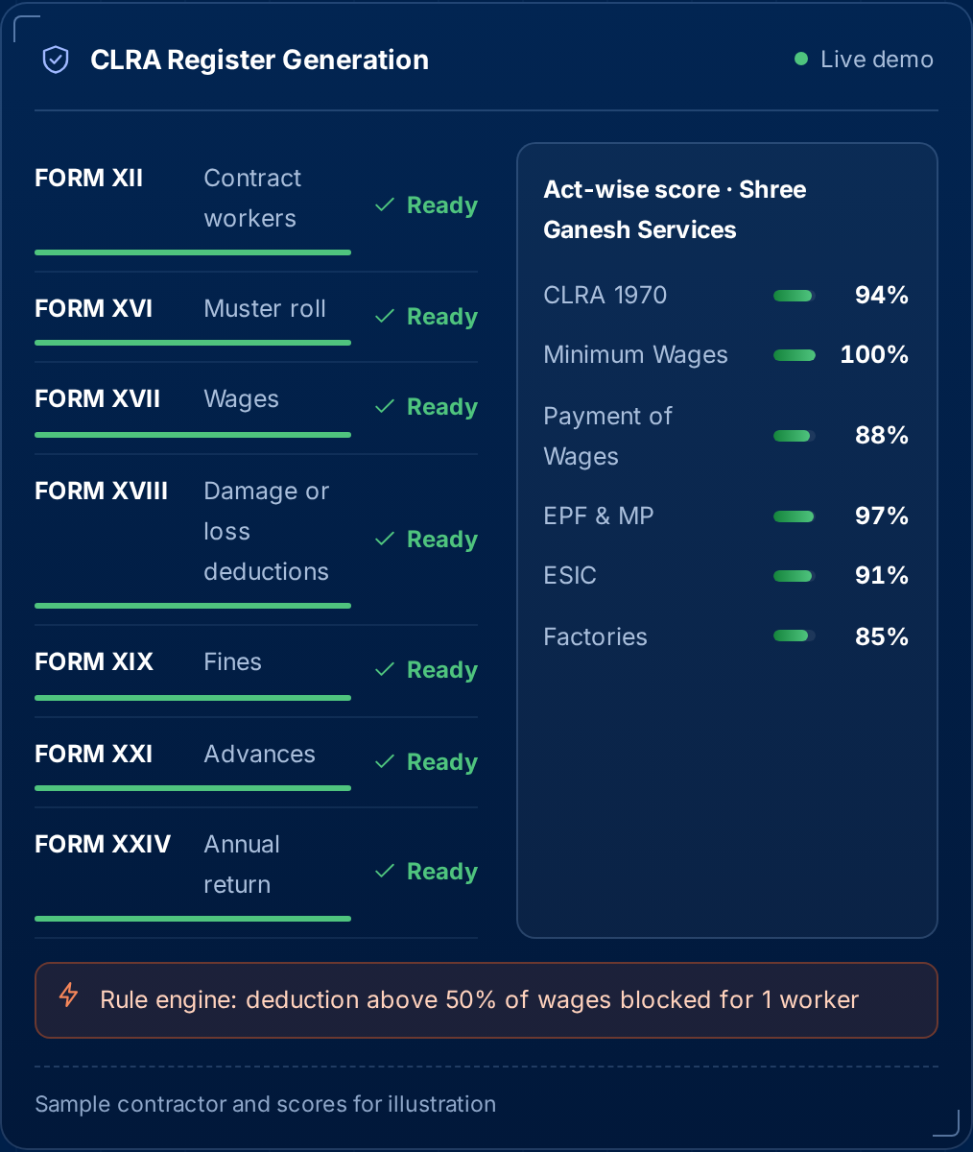
Compliance built from the same record
28 States + 8 UTs
CLRA FORM XII–XXIV
New Labour Codes
Central acts plus each state’s wage, PT, LWF and licence rules
Registers generated in bulk by state, site and location
Central codes layered with state rules, applied as notified
Notes:
Labour law in India is central law plus 36 state rulebooks. BharatShramSetu layers each state over the central acts, and generates CLRA registers from real attendance. Payroll arrives in the next phase.

Slide 14
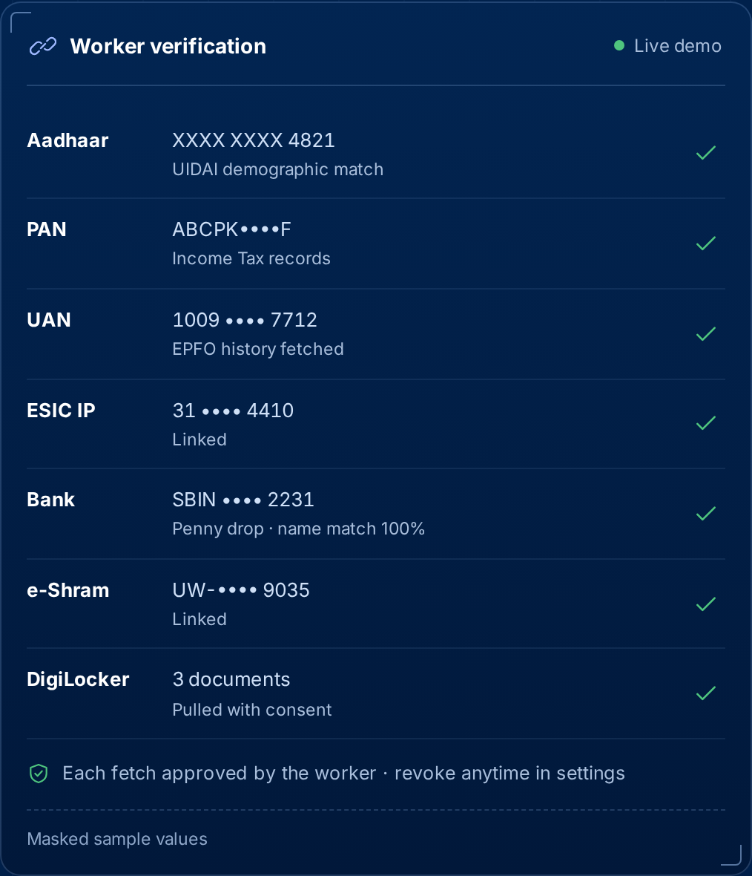
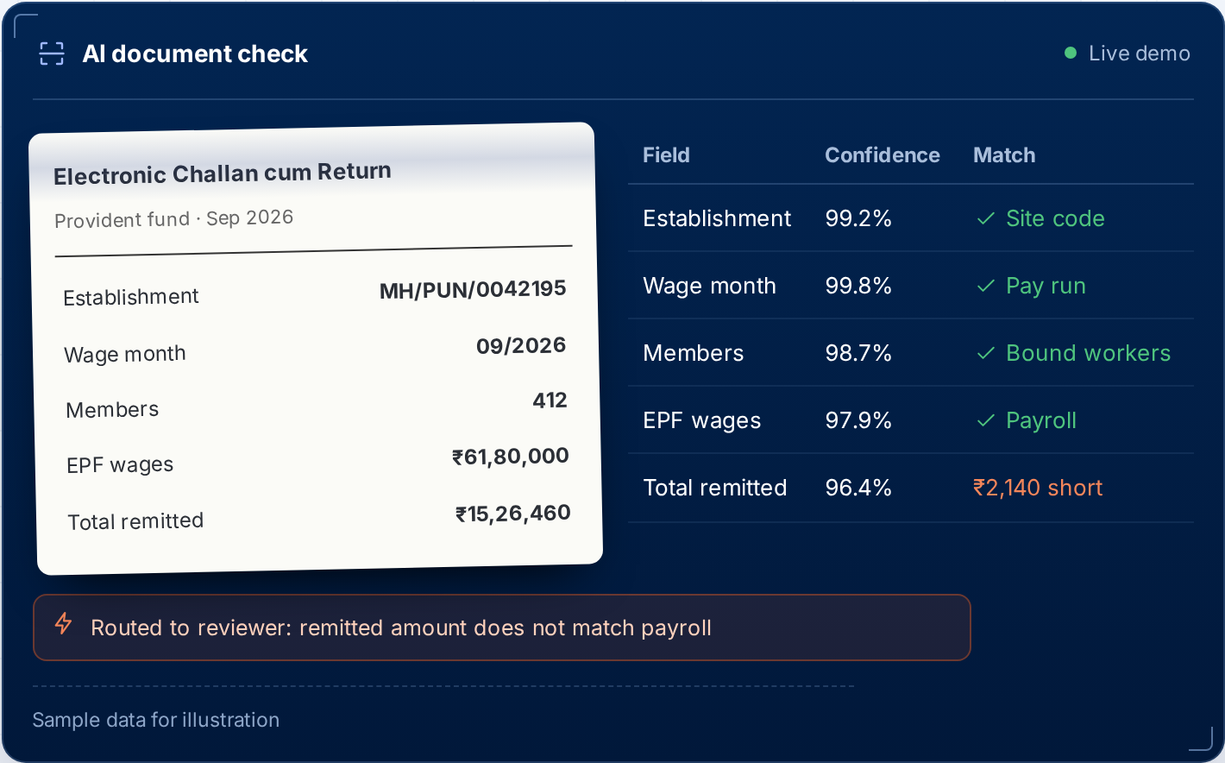
Verified at the source, checked by AI
Government data, with consent
Aadhaar, PAN, EPFO UAN, ESIC, bank penny drop, e-Shram and DigiLocker. Each fetch approved by the worker.
AI document verification
AI-enabled audit: challans, returns and certificates are read, matched against identity and attendance, and only mismatches reach an auditor.
Masked values everywhere. Consents can be revoked from settings, in line with the DPDP Act, 2023.
Notes:
Most worker files today are photocopies. Verification at source means the person on the payroll is the person on the PF and bank account. AI reads every uploaded document first so reviewers only look at exceptions.

Slide 15
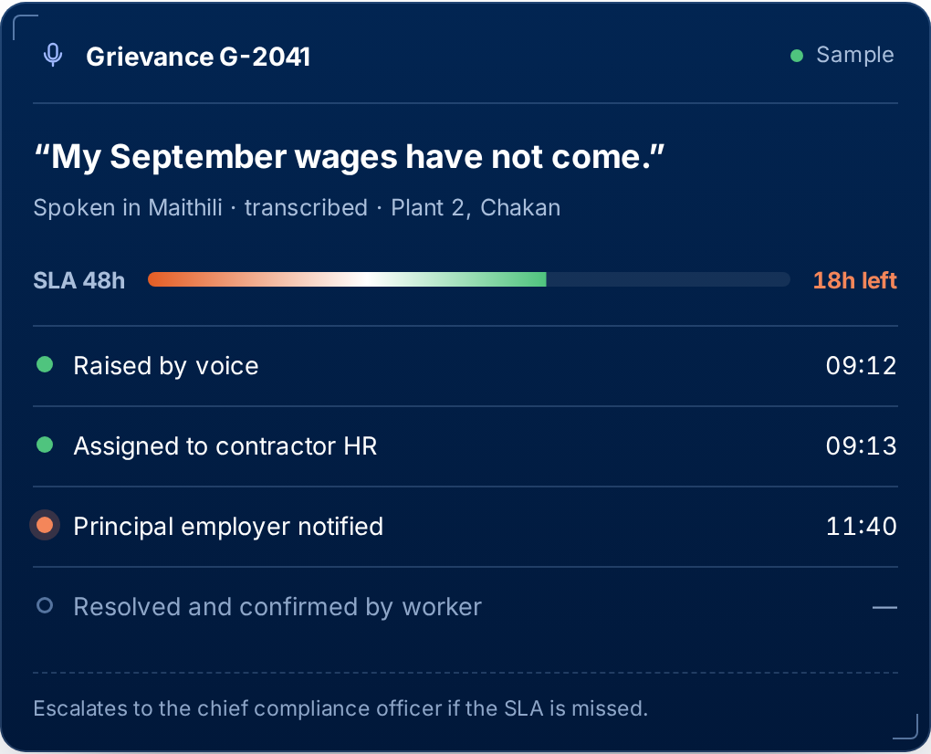


Every stakeholder, on the same page
Workers
Primary & secondary contractors
At the centre: identity, consent, voice
The full chain, one accountability
Principal employers
Chief compliance officers
Who is on site and where the risk is
Registers and scores, ready before asked
Health & safety officers
Trainers
PPE, fitness and induction at the gate
Inductions and skills recorded per worker
Grievance management with SLA tracking: spoken in any language, owned, timed and escalated.
Notes:
Effective communication between every stakeholder: workers, contractors, employers, the chief compliance officer, the health and safety officer and trainers all read the same record. Grievances get an owner, an SLA timer and an escalation path.

Slide 16

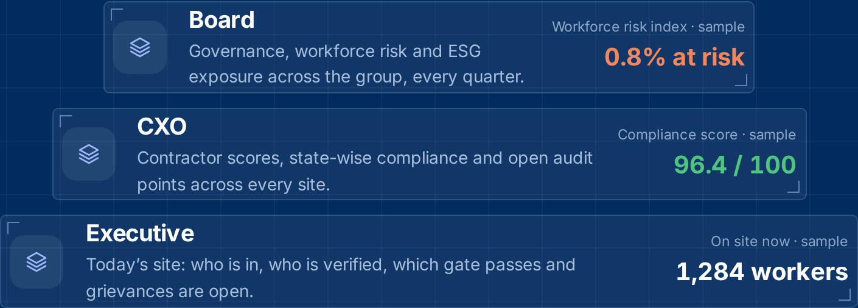
Audit-ready every day. Reported at every level
AI-enabled audit
Every document read and matched; only exceptions reach a person.
Audit readiness
Registers, returns and evidence always current and exportable.
Government integration
Documents validated against the systems that issued them.
Three layers of reporting from one live record: Executive (today’s site), CXO (contractors, states, audit points) and Board (governance, risk, ESG).
Notes:
Compliance stops being a scramble before an inspection. The same record is summarised for the people who run the site, the company and the board. Figures in the panel are sample data.

Slide 17


Three transformations. One Bharat
Social
Digital
Governance
transformation
transformation
transformation
Dignity, consent and a voice for workers who have never had a record of their own. Rights that are visible are rights that are kept.
Fifty crore working lives move from paper registers and photocopies to one verified, portable, multilingual record.
Employers, contractors and authorities read the same trusted record, so compliance becomes continuous.
Nation building, aligned with India’s digital public infrastructure
Aadhaar
DigiLocker
e-Shram
EPFO UAN
ESIC
NPCI bank validation
New Labour Codes
Notes:
BharatShramSetu is built to work with the national systems workers already use. It is aligned with DPI, not endorsed by any government body.

Slide 18
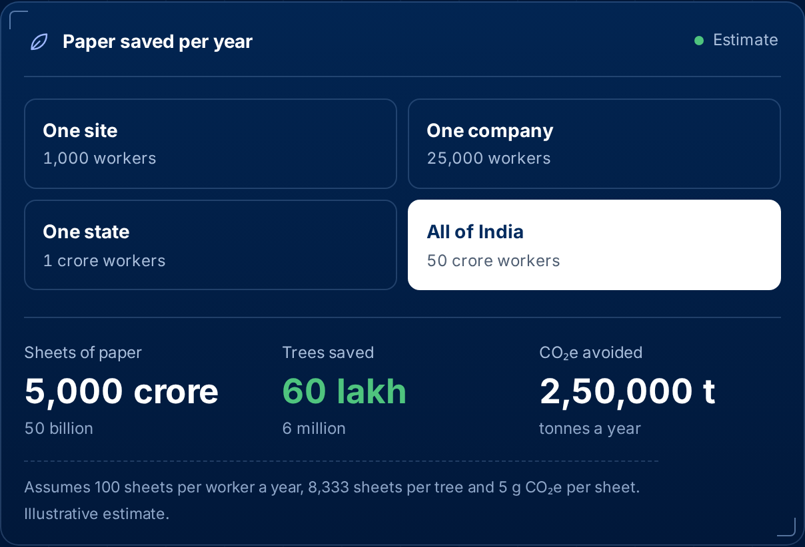
Paperless, at the scale of a nation
50 billion
sheets of paper saved a year
6 million
trees left standing a year
2.5 lakh t
CO₂e avoided a year
At 50 crore workers. Assumes 100 sheets per worker a year, 8,333 sheets per tree and 5 g CO₂e per sheet. Illustrative estimate.
Notes:
Musters, wage slips, gate passes and photocopies add up to a forest every year. The calculator on the website lets a client see the saving for one site, one company, one state or all of India. Figures are estimates with stated assumptions.

Slide 19
Value for every party on the record
Workers
Contractors
Principal employers
A verified ID that moves between jobs and states
Every day worked and every rupee paid, visible
Grievances by voice, in their own language
Onboard a crew at the gate in minutes
CLRA registers and returns generated, not typed
One submission centre for every client
Know who is on each site, under which contractor
Audit-ready reporting for executives, CXOs and the board
Act-wise compliance scores across all sites
[Outcome metric, e.g. wage queries resolved within x days]
[Outcome metric, e.g. x hours saved per 100 workers per month]
[Outcome metric, e.g. x% fewer compliance gaps]
Notes:
Each party gets something different from the same record. Add measured outcomes from pilots in the dashed boxes.

Slide 20



Security and data privacy by design
Consent for every fetch
Masked identifiers
Role-based access
Workers approve each government data fetch and can revoke consent from settings
Aadhaar and bank numbers are masked in every view
Admin, site manager, compliance officer and viewer roles per organisation
Full audit trail
Attestation, not documents
Compliance never blocked
Every approval, edit and payment logged with who did what and when
Verification returns valid or invalid status, never the raw document
Billing issues can never stop a statutory filing or a worker’s welfare action
[Hosting, data residency and certifications, e.g. India-region cloud, ISO 27001, VAPT report: add]
Notes:
Clients ask about data before price. Consent, masking, roles and audit trail are built into the product. Add hosting and certification details before client meetings.

Slide 21
Going live: from first call to first audit-ready report
1 Configure
2 Onboard contractors
3 Bind and attend
4 Comply and report
[Week x]
[Week x]
[Week x]
[Week x]
Sites, states, applicable acts, pay structures and roles
QR invitations, licence and document verification
Workers bound at the gate; Vision AI, RFID, site QR and geo-fencing live
CLRA registers, monthly submissions and three-layer reporting
What we need from you
What you get
Site list with state and location
Contractor contacts and licences
Wage structures and current registers
A project owner on your side
Dedicated onboarding lead
Configured state rules and registers
Training for site and contractor teams
[Support SLA: add]
Notes:
A typical rollout in four steps. Fill in week estimates once pilot timelines are known.

Slide 22


Compliance is mandatory, so demand is built in
Every principal employer and contractor must keep wage, attendance, PF, ESIC and safety records. Today that is a cost centre run on spreadsheets and consultants.
Principal employers
Labour contractors
State welfare boards
Third parties
Builders, plants, infra, factories
Run crews across sites and states
Benefit disbursal and analytics
Insurers, auditors, verifiers
Per-site subscription and modules
Per active worker per month
Annual licence and AMC (B2G)
Verification API and commissions
[Add sourced TAM / SAM / SOM for India contract labour compliance and payroll]
Notes:
Four paying segments, one free core. Workers never pay. The market sizing line is a placeholder: add a sourced TAM/SAM/SOM before sending the deck to investors.

Slide 23
Free compliance core, paid modules around it
Buyer | Indicative price band | Anchor modules
Contractor | ₹25–60 / active worker / month | Compliance auto-pilot, Attendance Pro
Employer | ₹3,000–12,000 / site / month | Contractor risk & due diligence, site access
Enterprise | ₹8–25 lakh / year | All suites, integrations, SSO and SLA
State board (B2G) | ₹50 lakh–2 crore / year | Licensed board edition with AMC
Verify API | ₹1–5 / verification | Insurers, auditors, site gates
Next phase | To be disclosed | Rozgar, Upskill and Payroll
Free core
Verified identity and ID card
E·C·S·W binding and QR verify
Statutory register submission
Compliance scorecards
Welfare, grievances, gate passes
Indicative bands from the BharatShramSetu business plan, to be validated with customers
Workers are never charged
Notes:
Statutory compliance is the free core: charging for a legal duty invites resistance. Revenue comes from modules that turn that cost into ROI. Pricing rule: avoided penalties plus saved admin must be at least 3x the fee within a quarter.

Slide 24
Unit economics that pay back in months
Mid-size contractor
300 workers · core + Attendance Pro + auto-filing
₹12,000
≈₹1.2 lakh annual gross profit at ~85% margin; acquisition ≈₹15–25k
per month
Principal employer
5 sites × 400 workers · risk + access + analytics
₹35,000
Before module uplift; replaces compliance consulting and penalty exposure
≥115%
≥80%
≤9 mo
per month
net revenue retention
gross margin
CAC payback
Notes:
Worked examples and targets are from the business plan and are illustrative until pilots confirm them. A 300-worker contractor at about Rs 40 per worker per month pays Rs 12,000, well under what register admin and penalty risk cost them today.

Slide 25
One of its kind, and hard to replace
Worker-centric by design
16 Indian languages
Built around worker rights, consent and voice
Pan-India with no language barrier
Network effect
Every binding adds a verified worker–contractor–employer link that add-ons reuse without re-verification.
One QR, four solutions
Portable identity
Onboarding, attendance, gate pass, verification
Across employers, contractors and locations
DPI and Labour Code aligned
AI audit, 3-layer reporting
System of record
Govt validation; codes applied as notified
Executive, CXO and Board from one record
Registers and evidence are generated from the record, which makes the platform hard to replace.
Notes:
We do not position against HR software: BharatShramSetu is Digital Workforce Governance Infrastructure. What makes it one of its kind is the combination of a worker-first approach, 16 languages, one QR for four jobs, a portable identity, DPI and Labour Code alignment, and audit-ready reporting. The consented multi-party graph is the asset every module reads from.

Slide 26



SWOT analysis
Strengths
Weaknesses
16 Indian languages: a USP no one else has
Worker-centric, portable identity across employers
One QR for onboarding, attendance, gate pass, verification
AI-enabled audit and three-layer reporting
Early stage: pricing still to be validated
Several government integrations in pilot stage
Contractor segment is price-sensitive and informal
[Add internal weakness]
Opportunities
Threats
Labour Code transition across all states
State welfare board (B2G) editions
Next phase: Rozgar, Upskill and Payroll
Green impact: paperless at national scale
New entrants in workforce compliance
Policy and rate changes across states
Perception risk around worker data
Long government sales cycles
Notes:
An honest SWOT builds trust. Weaknesses and threats come from the business plan risk register; replace the bracketed lines with your own.

Slide 27
Land with the free core, expand with modules
Land
Expand
Multiply
Free core with friendly employers and contractors; first verified binding and first auto-filed return
Lead with compliance auto-pilot and Attendance Pro, the two modules that pay back fastest
Board editions for states, Verify API and marketplace take-rate without extra sales headcount
Channels: contractor associations · builders’ and employer bodies · insurance brokers · ERP and Tally resellers
Q1 Foundations
Q2 Next phase
Q3 Safety & welfare
Q4 Strategic layer
Billing & entitlements, Attendance Pro, Compliance Auto-Pilot MVP, pilot cohort
Rozgar, Upskill and Payroll (to be disclosed), contractor diligence, Verify API beta
Safety academy, site access pro, insurance desk with a broker partner
Labour intelligence, marketplace pro, integration hub, state board edition
Notes:
Go-to-market and roadmap from the business plan. Quarters are relative to funding close.

Slide 28
Built today and early traction
6
role portals: worker, contractor, employer, government, staff, help desk
[Sites live]
[Workers bound]
11
product modules from QR binding to grievances
[Pilot customers]
[LOIs / MoUs signed]
36
state and UT rule layers in the compliance architecture
“[Client testimonial quote]” — [Name, designation, company]
16
Indian languages with a voice guide: our USP
[Client logo]
[Client logo]
[Client logo]
[Client logo]
Notes:
Left: what the product does today. Right: fill in live metrics, a client quote and logos as they come in.

Slide 29

Our team
[Full name]
[Full name]
[Full name]
[Full name]
[Founder & CEO]
[Co-founder & CTO]
[Head of Compliance]
[Head of Growth]
[Prior roles, domain expertise, education]
[Prior roles, domain expertise, education]
[Prior roles, domain expertise, education]
[Prior roles, domain expertise, education]
Advisors
[Advisor name, expertise, organisation]
[Advisor name, expertise, organisation]
[Advisor name, expertise, organisation]
Notes:
Replace each card with a photo, name, role and one line of relevant experience. Investors weigh the team heavily; clients look for compliance and domain depth.

Slide 30

Partner with us
For employers and contractors
For investors and partners
Discovery call to map your sites, states and contractors
Pilot on [x] sites over [x] weeks
Review outcomes together, then scale across sites
[₹ X crore] round to fund product, go-to-market and B2G
Use of funds: [x%] product · [x%] sales · [x%] B2G · [x%] team
Strategic partners: insurers, ERP vendors, state welfare boards
[Pilot terms and pricing: add]
[Round details and timeline: add]
Notes:
Close with a clear next step for whoever is in the room: a pilot for clients, or the round for investors.

Slide 31
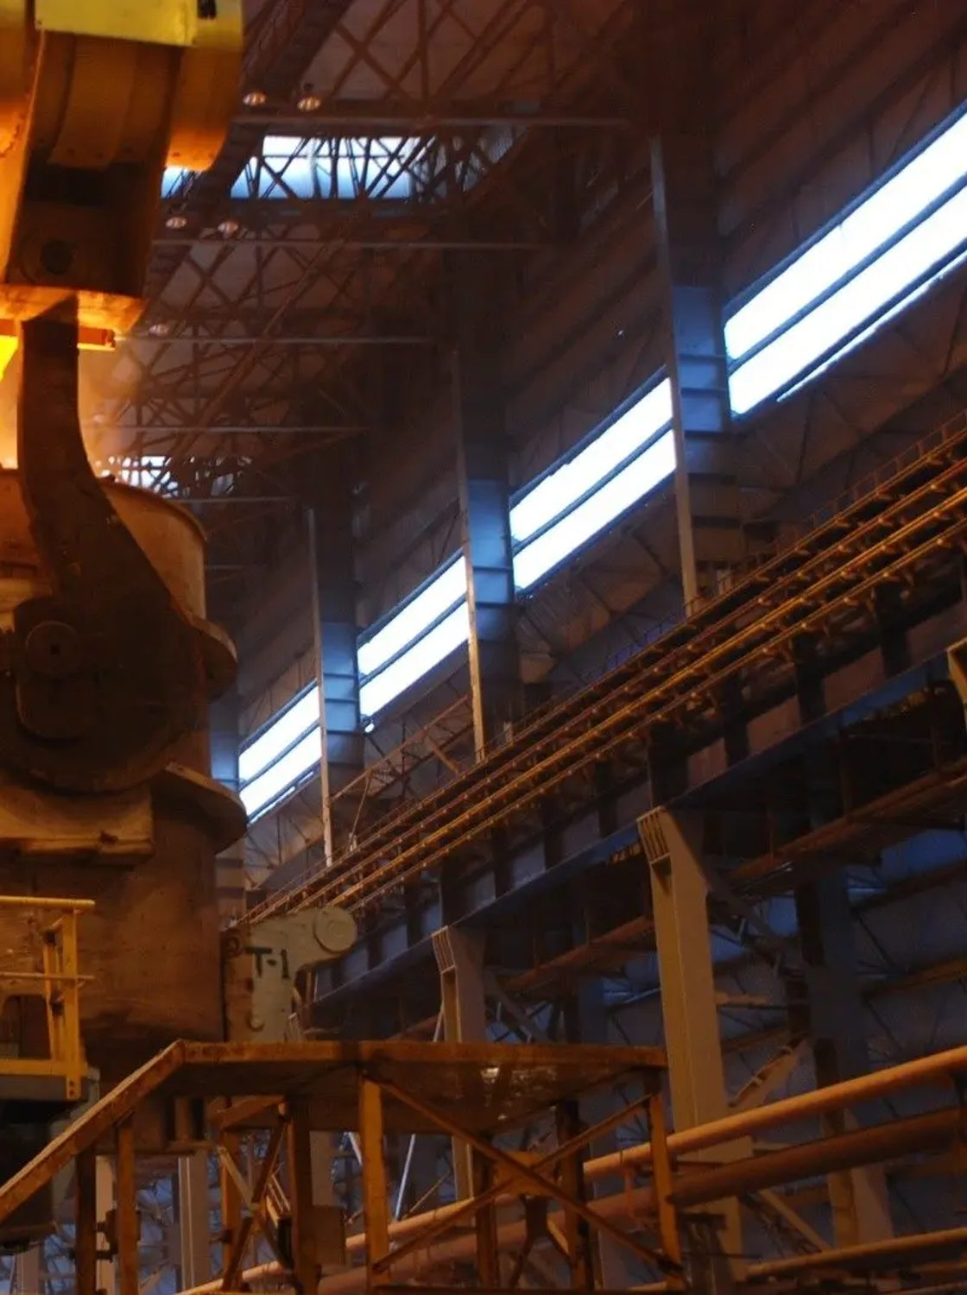




BharatShramSetu
One Nation, One ID, One Platform
Contact us
info@bharatshramsetu.com
www.bharatshramsetu.com
login.bharatshramsetu.com
[Phone number]
[Office address]
[Contact person, designation]
Join the movement. Make every worker count.
Building a Stronger, Safer and Empowered Bharat
Photo: IISCO Steel Plant, Burnpur · GODL-India
Notes:
Thank the audience and leave this slide up during questions.

