Slide 1
Optimized Quantization using Psychoacoustic Loss Function and Lagrange Multiplier for Bitrate Control
Suprabha Ghosh
Matric-Nr: 64365
In Audio Coding
Technische Unversität Ilmenau
Project supervised by
Prof. Dr.-Ing Gerald Schuller
Dr. rer. nat. Muhammad Imran

Slide 2
Introduction
This approach that employs a psychoacoustic loss function to determine optimal quantization step sizes, ensuring perceptual quality.
Additionally, a Lagrange multiplier method is applied to control bitrate allocation efficiently.
The proposed methodology considers masking thresholds derived from psychoacoustic analysis to refine quantization decisions, ensuring high-fidelity audio compression.

Slide 3
Methodology
Quantization: Convert audio to 24-bit & 16-bit.
Psychoacoustic Analysis: Compute masking thresholds.
Subband Analysis: Decompose into 64, 128, 512 subbands.
Bit Allocation: Use psychoacoustic loss function.
Lagrange Optimization: Distribute bits under bitrate constraints.
Final Optimization: Combine results for optimal quantization.

Slide 4
Audio Quantization & Analysis
Load 32-bit floating-point WAV, convert to mono.
Normalize signal and apply uniform quantization.
Compute Signal-to-Noise Ratio (SNR).
Perform frequency-domain analysis.
Generate visualizations and save quantized output.

Slide 5
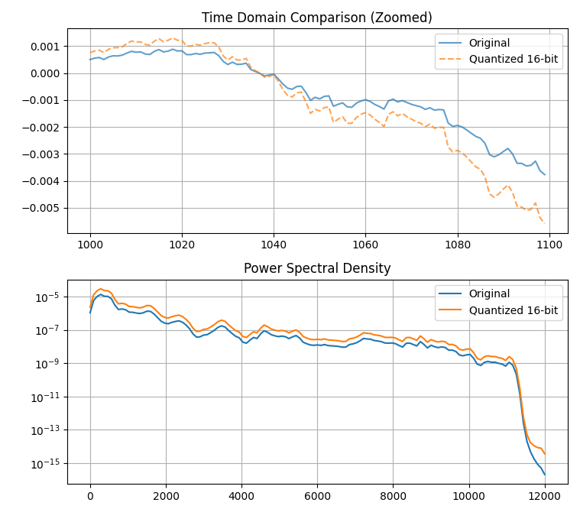

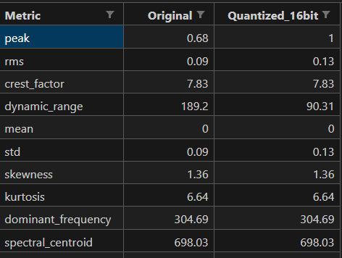
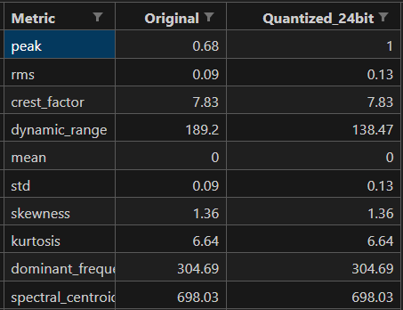
Audio Quantization & Analysis

Slide 6
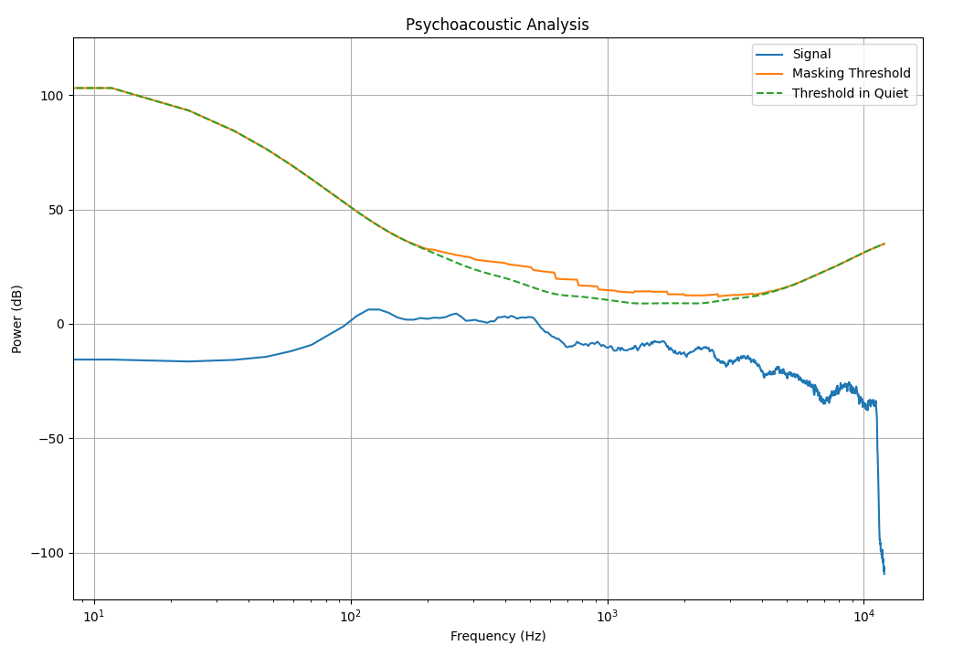
Psychoacoustic Analysis
Perform STFT & windowing.
Map power spectrum to Bark scale.
Compute masking threshold using spreading function.
Visualize power spectrum and save results.

Slide 7
Bit Allocation & Lagrange Optimization
Compute subband variance for bit allocation.
Apply Lagrange multiplier for optimal bit distribution.
Estimate SNR per subband.
Compare results for 64, 128, 512 subbands.

Slide 8
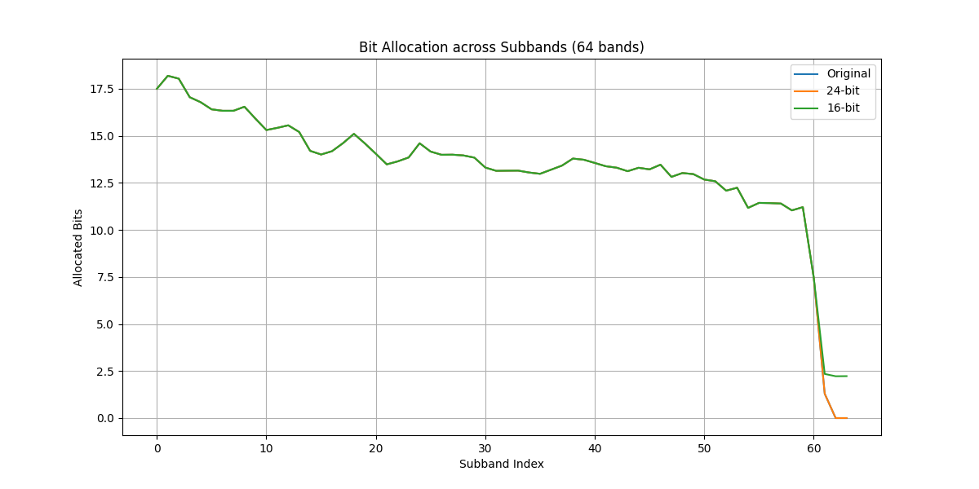
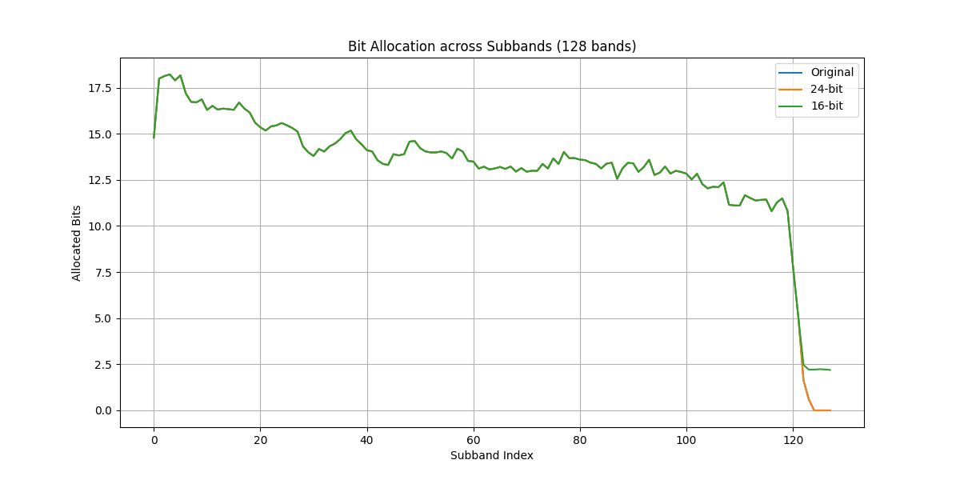
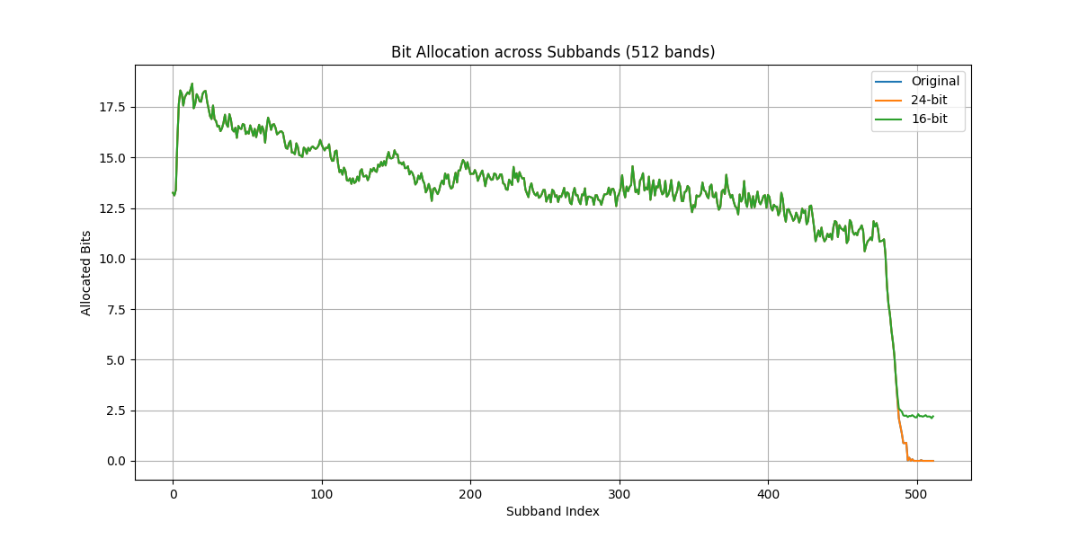
Bit Allocation

Slide 9
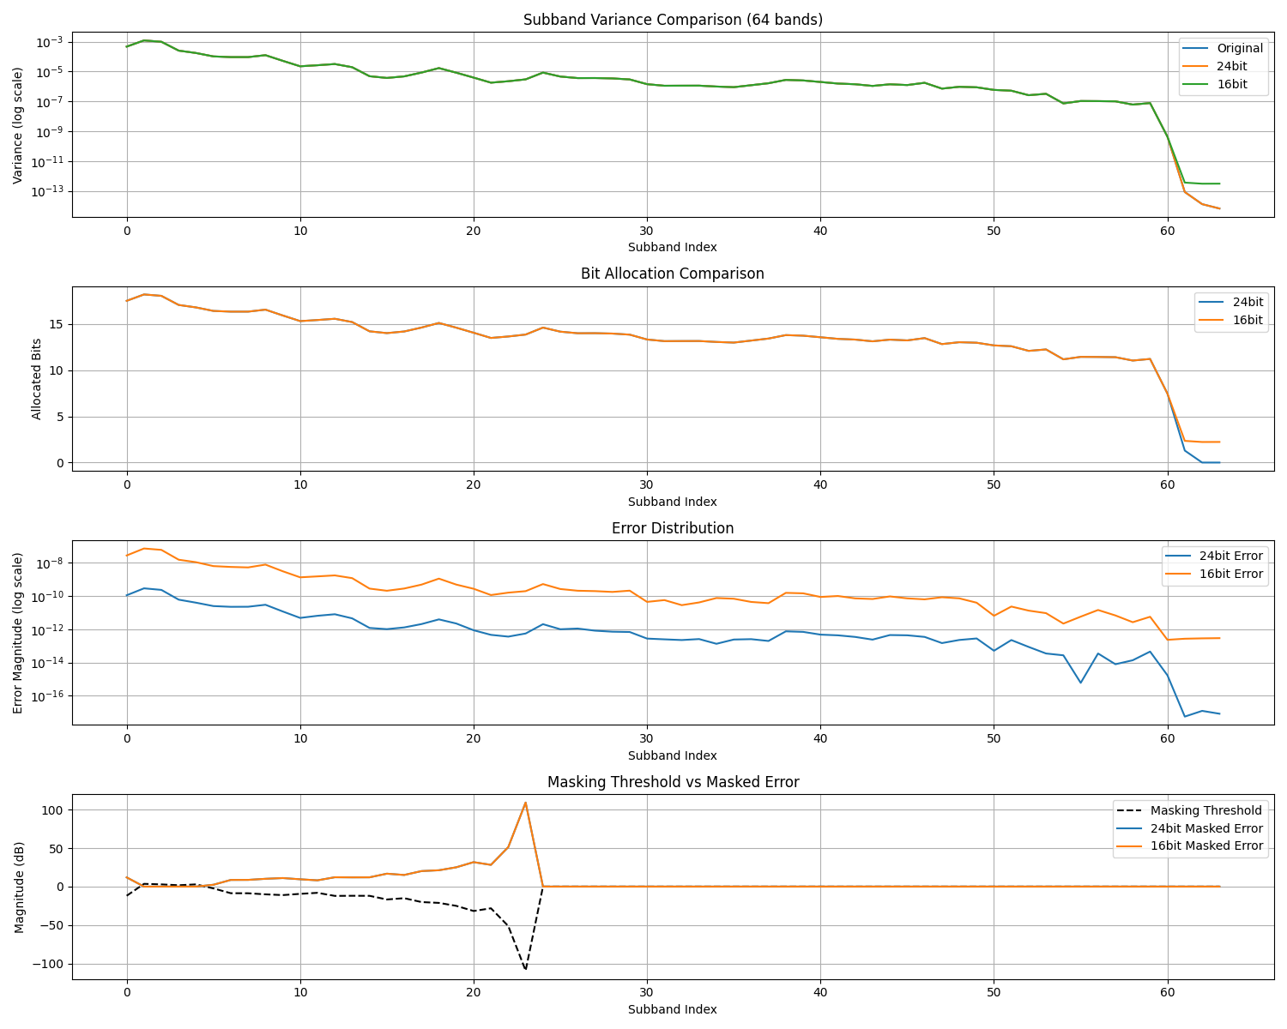
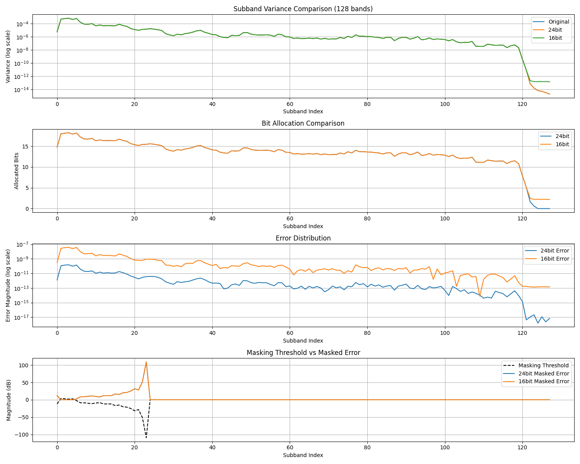
Loss Function

Slide 10
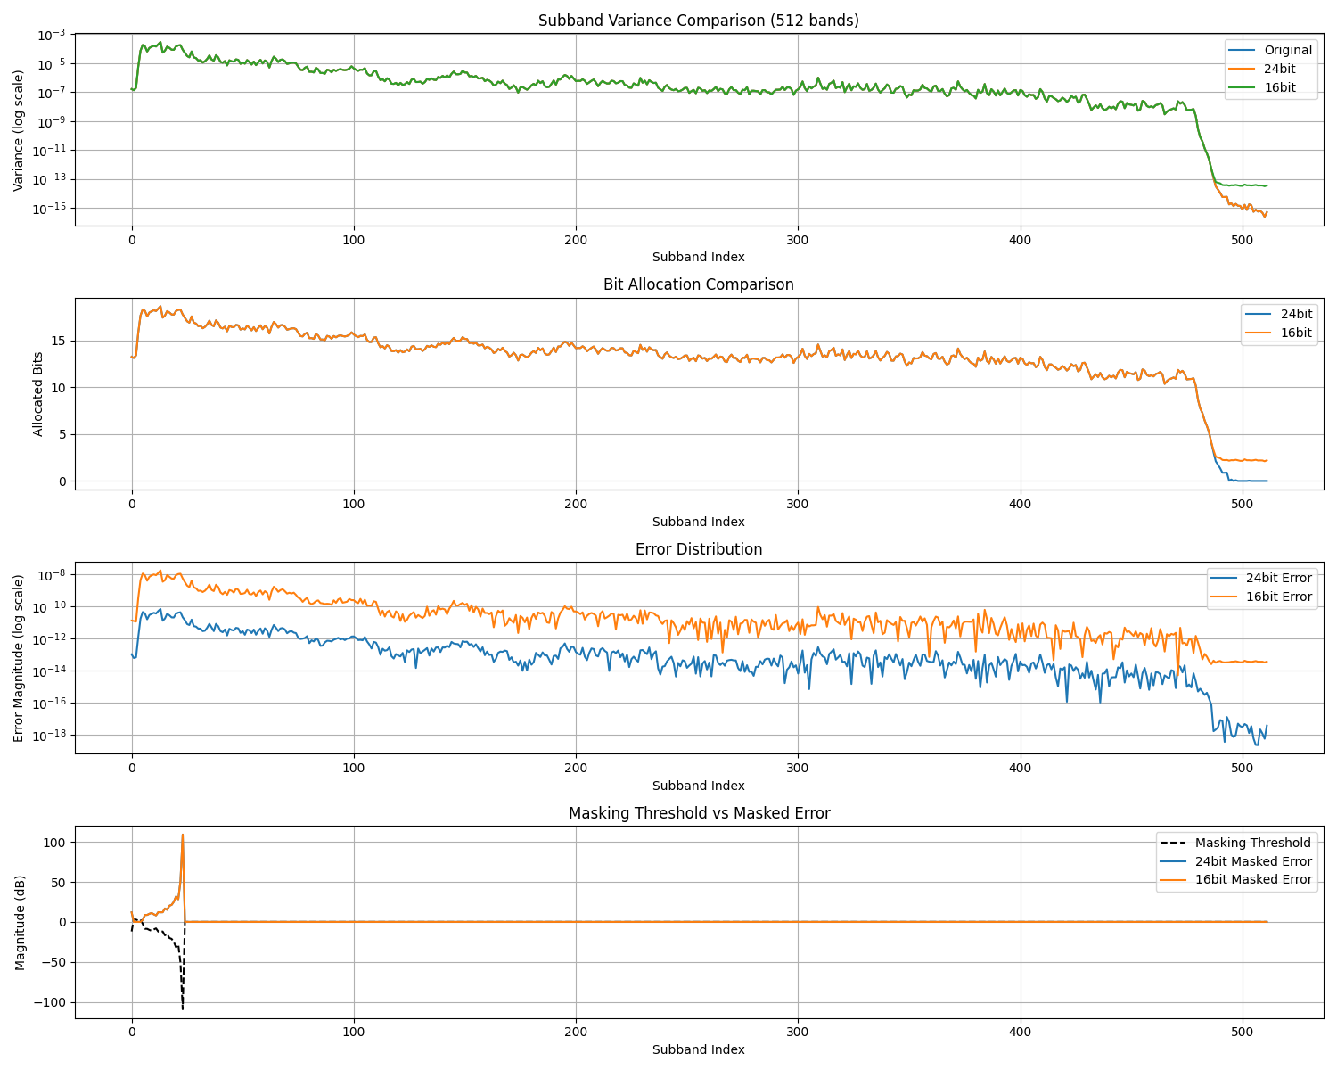
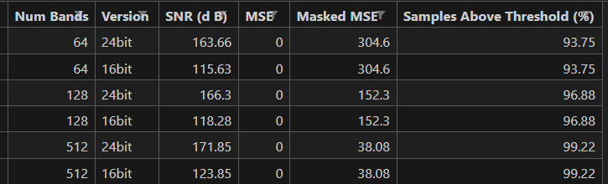
Loss Function

Slide 11
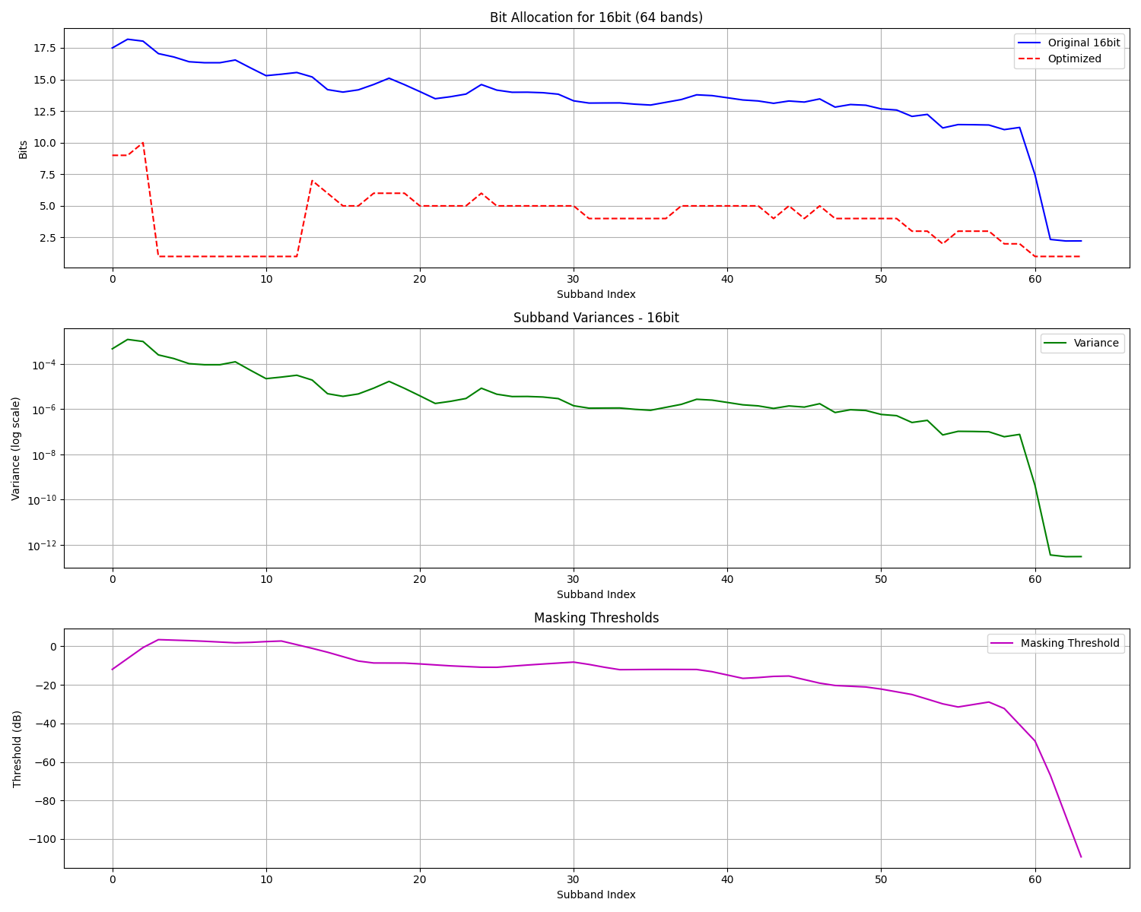
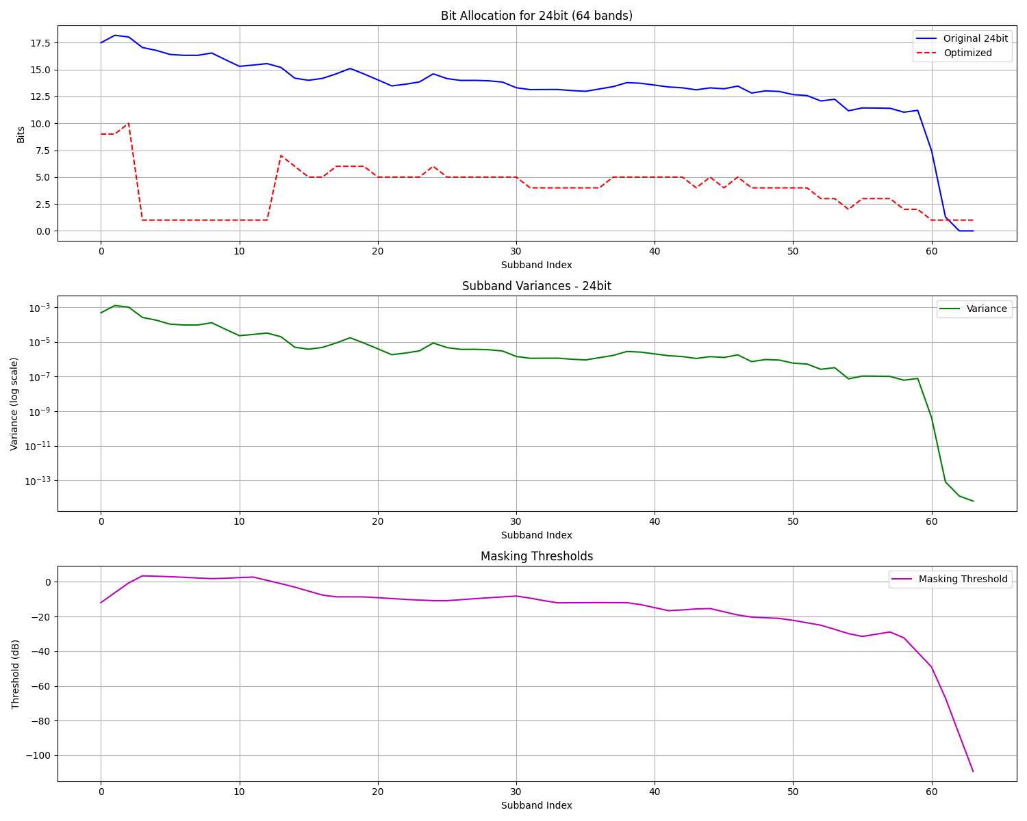
Lagrange Optimization Analysis

Slide 12
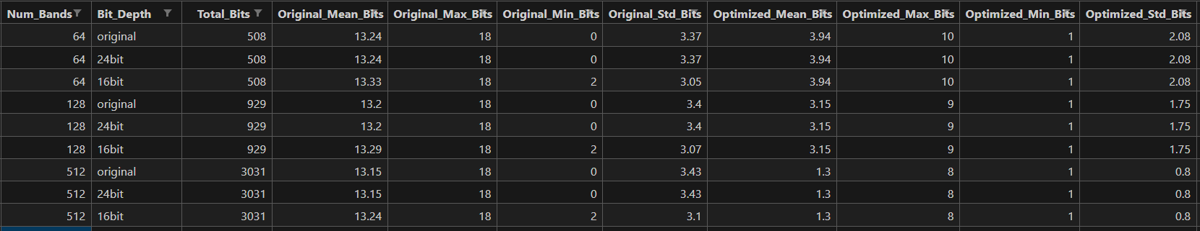
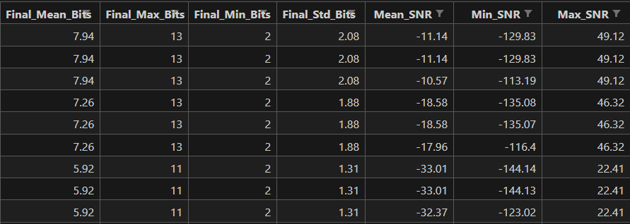
Final optimization
A final optimization step integrates masking thresholds, psychoacoustic loss results, and Lagrange optimization to compute the best quantization step sizes for all subbands.

Slide 13
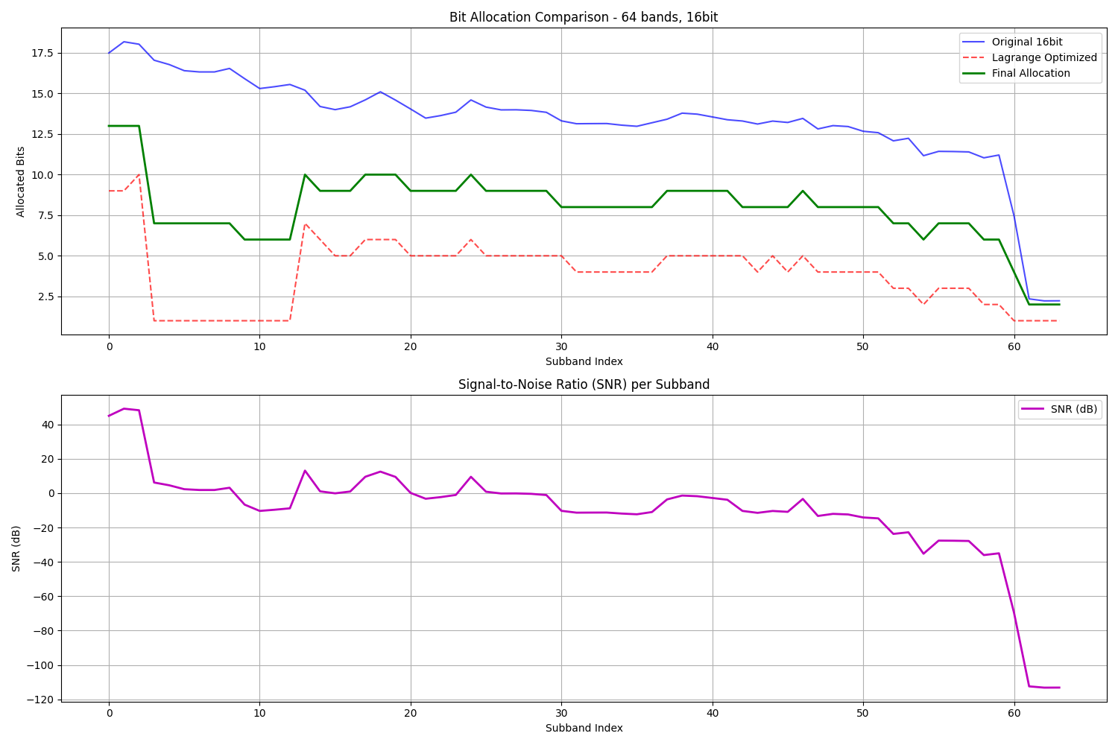
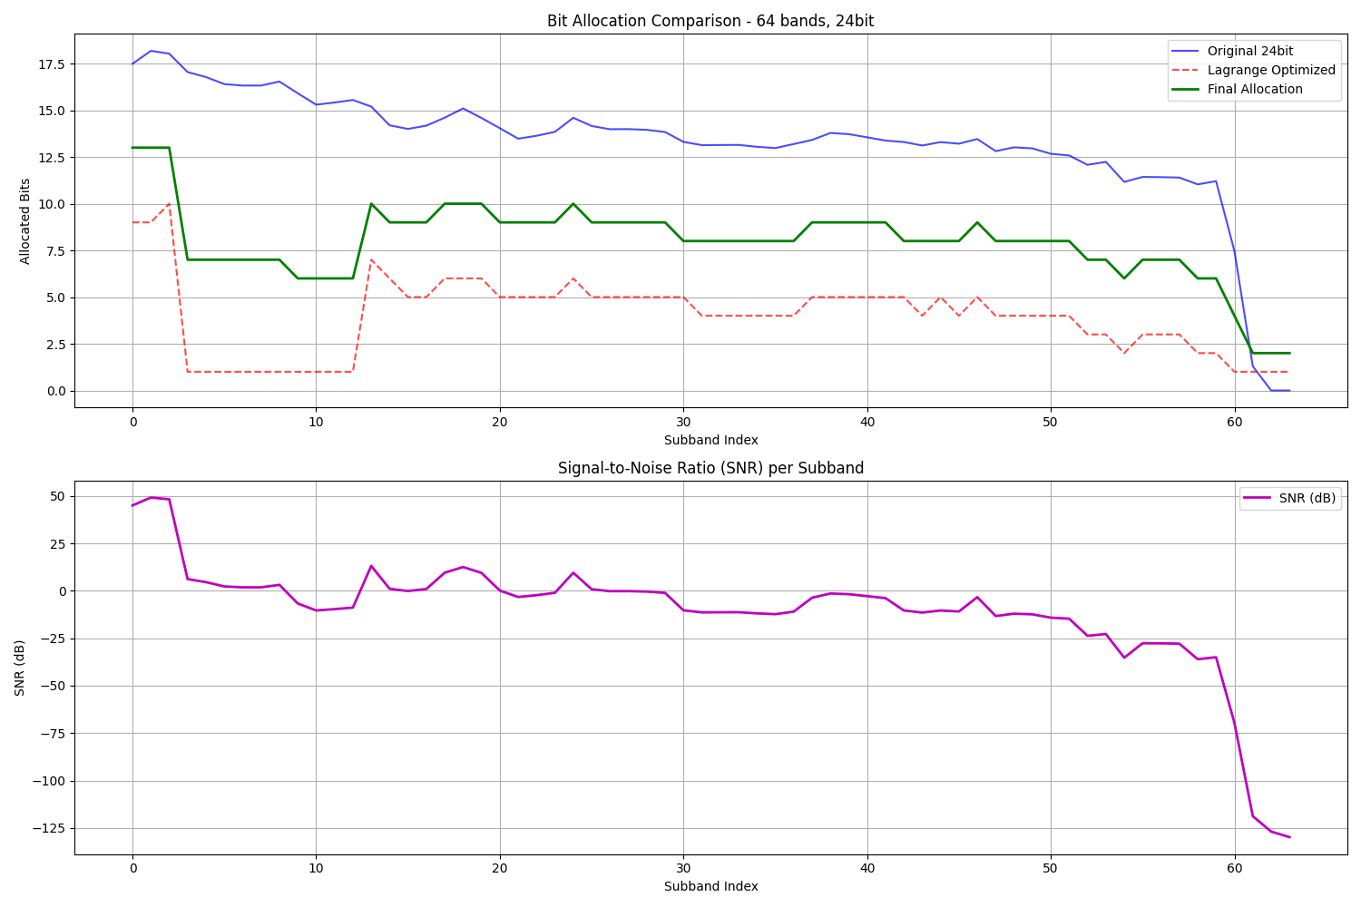
Final optimization

Slide 14
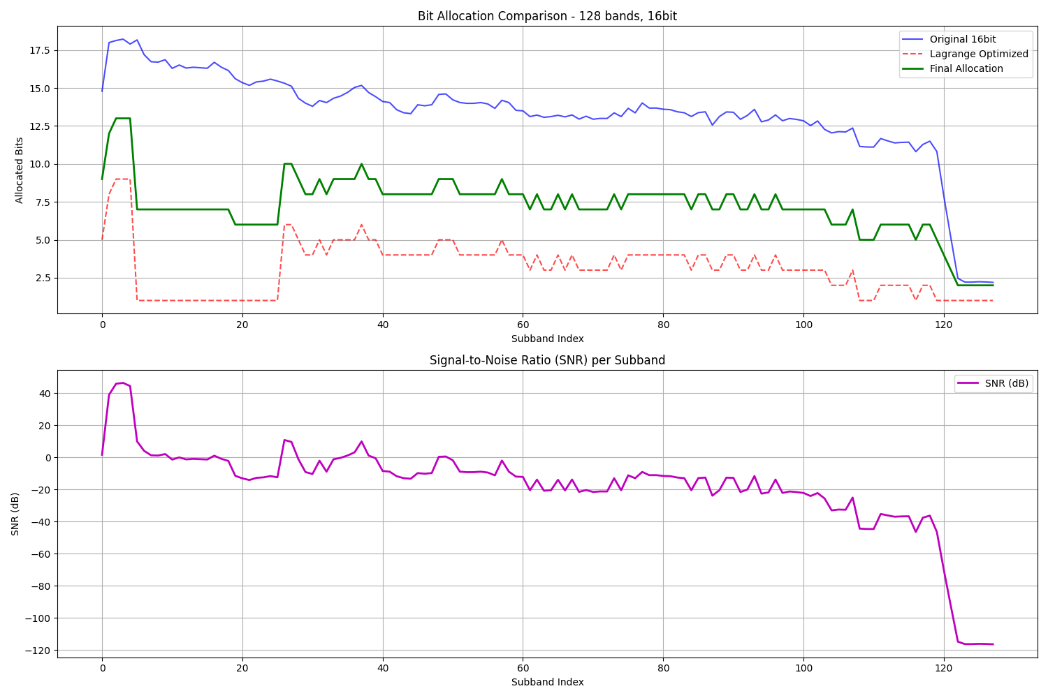
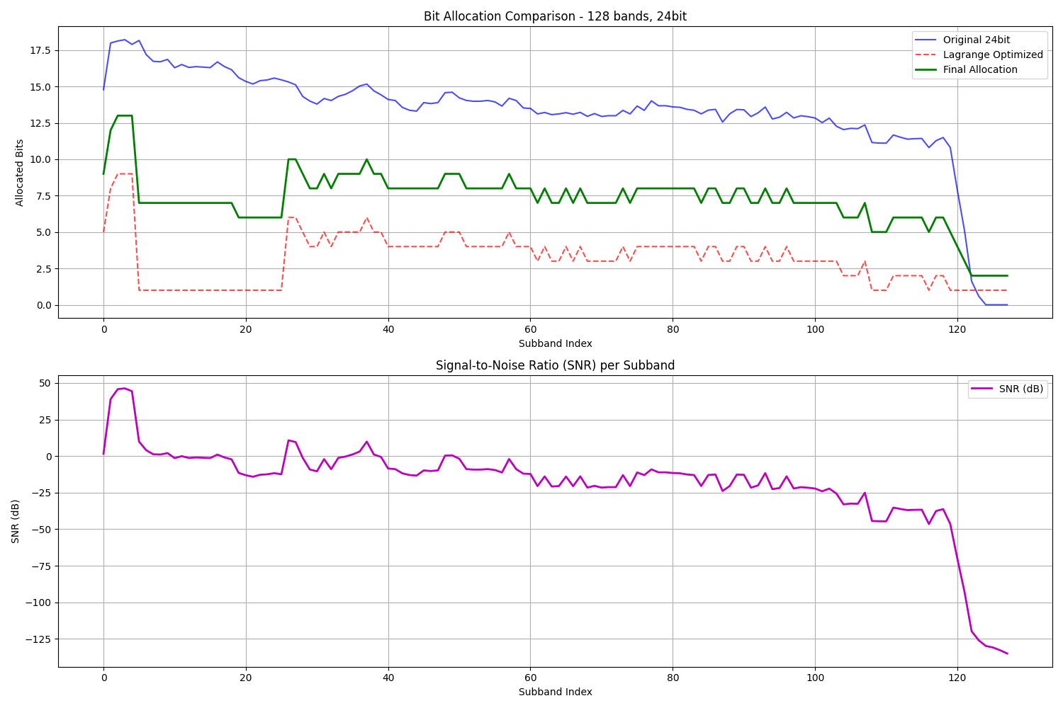
Final optimization

Slide 15
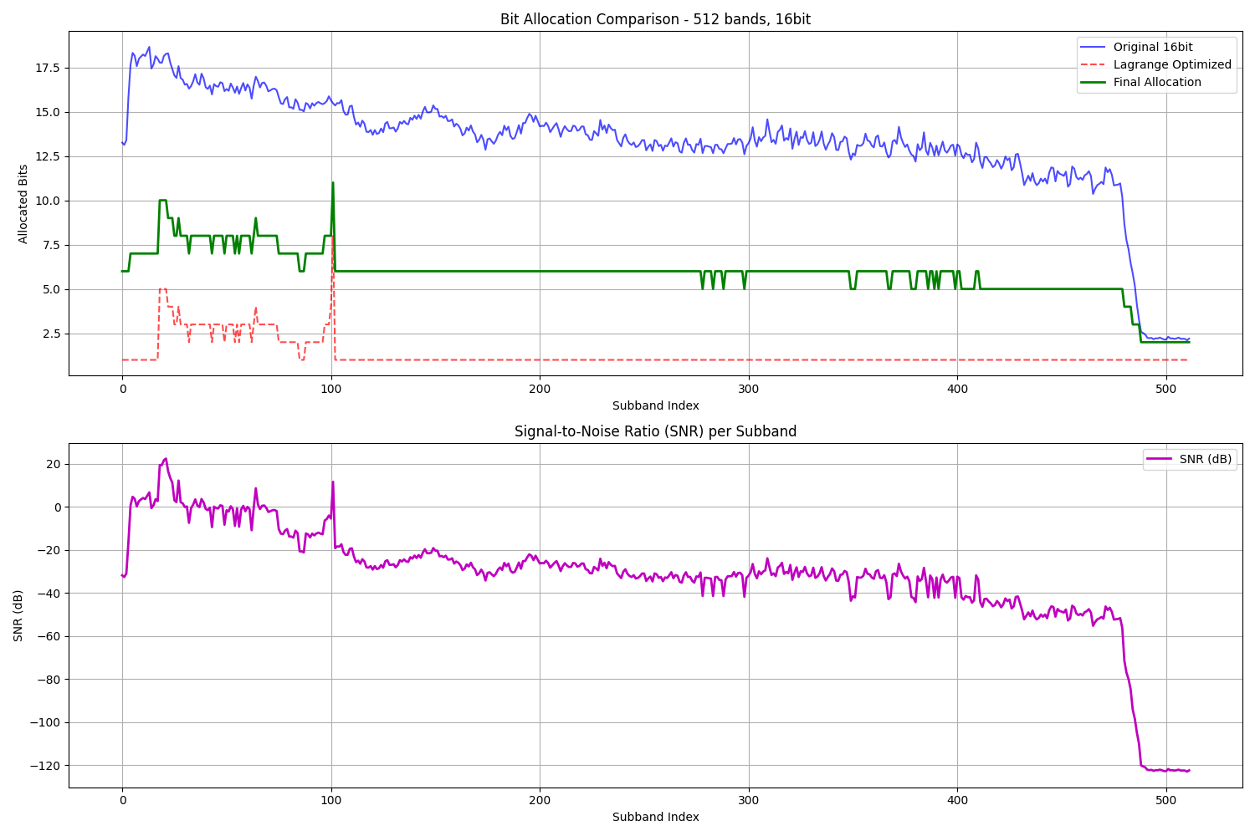
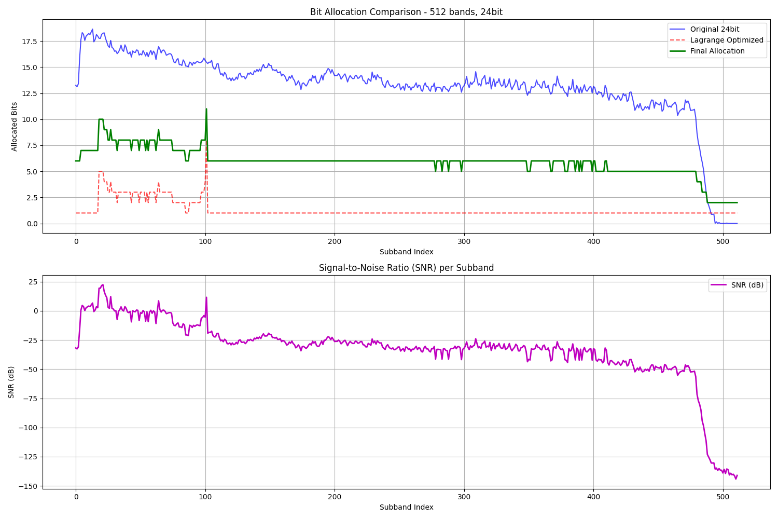
Final optimization

Slide 16
Conclusion
This method optimizes quantization using a psychoacoustic loss function and Lagrange optimization.
Results confirm a balance between compression efficiency and perceptual fidelity, making it suitable for high-quality audio coding.

Slide 17
References
.Painter, T., & Spanias, A. (2000). Perceptual coding of digital audio. Proceedings of the IEEE, 88(4), 451-515.
Brandenburg, K., & Bosi, M. (1997). Overview of MPEG audio: Current and future standards for low-bit-rate audio coding. Journal of the Audio Engineering Society, 45(1/2), 4-21.
Johnston, J. D. (1988). Transform coding of audio signals using perceptual noise criteria. IEEE Journal on Selected Areas in Communications, 6(2), 314-323.
Gersho, A., & Gray, R. M. (1992). Vector quantization and signal compression. Springer Science & Business Media.
Pulkki, V., & Karjalainen, M. (2015). Communication acoustics: An introduction to speech, audio, and psychoacoustics. Wiley.

