Slide 1
MRSP Seminar Project
Perceptual Similarity between Different Audio Stimuli
Azmat Sultan Awan - 65821
Bharani Jayakumar - 66451
Umair Khalid - 66512
Tarun Devidas Ramani - 66160
Suprabha Ghosh - 64365

Slide 2
Introduction
Identify perceptual similarities between different audio stimuli.
Approach
Prepare Audio Data
Computing Perceptual Loss
MUSHRA Test Preparation
Conducting Listening Experiments
Report and Coordination

Slide 3
Task 1: Preparing Audio Data
Prepare five dry audio files with distinct spectral characteristics.
Generate three versions of each audio type in different acoustic environments:
Small Office Environment
Opera Hall
Reverb Hall with at least 1.5 sec reverberation time
Result: 20 audio files, each group containing four versions of an audio type.

Slide 4
Task 2: Compute Perceptual Loss
Perceptual loss was computed between:
Original and quantized sound
Original and AAC encoded sound
Results show AAC encoding outperforms quantization for most genres except poetry.
Example Data:
Poetry: Quantization better
Ambient: AAC better
Drum Beat: AAC better
Instrumental: AAC better

Slide 5
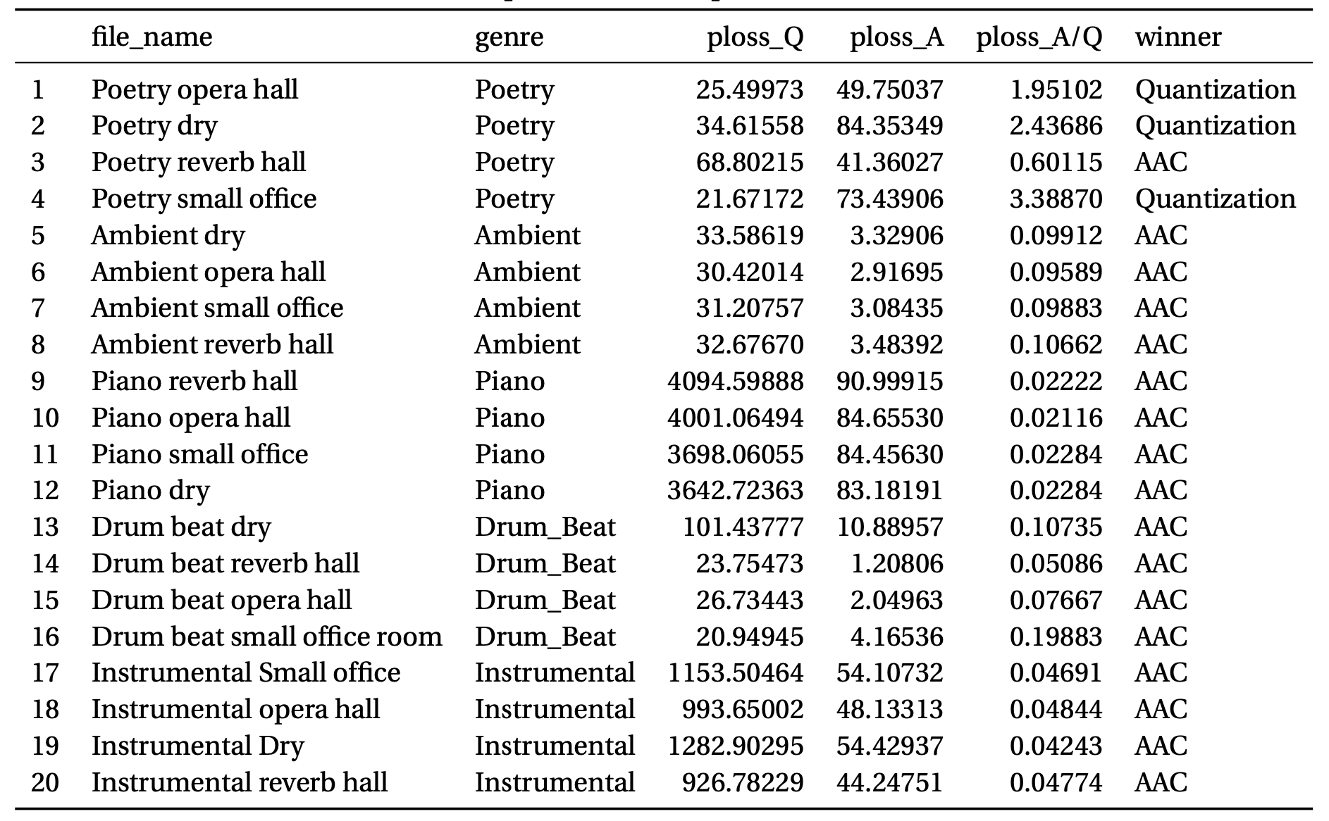
Task 2: Results Table

Slide 6
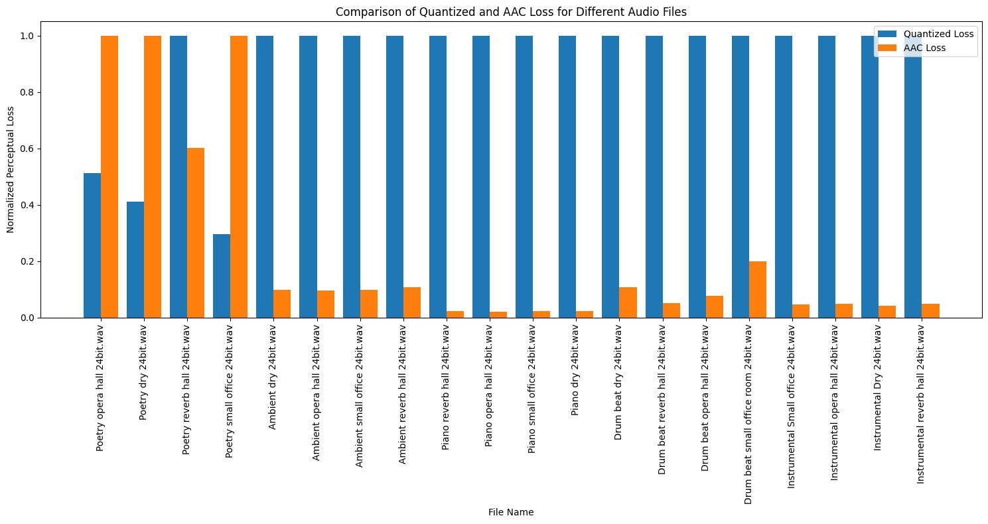
Task 2: Comparison of Quantized & AAC Loss

Slide 7
Task 3: MUSHRA Subjective Measures
Evaluation: Compare perceived audio quality of different sound types to assess impact of acousting environments
Listener Ratings: Detailed ratings on a scale from 0 to 100
Standardization: ITU-R BS.1534 for consistency
Environment Impact: Understanding influence on sound quality perception
Reference: https://audiogroup.web.th-koeln.de/scale.html

Slide 8
Task 4: Listening Experiment Management
Participants trained on MUSHRA interface and task
Subjects rated audio samples on a 0-100 scale in randomized order to prevent bias
Equipment: High-quality circum-aural headphones provided
Duration: Over 2 days (with 19 participants)
Analysis: Created graphs of individual audio samples for detailed analysis of perceptual differences

Slide 9
Task 4: Listening Experiment Management
Recognisable Differences: Poetry, Drum Beat
Similar Perceptions: Piano, Instrumental, Ambient
Acoustic Environment Preferences
Dry Sound: Preferred with consistent liking and fewer outliers
Reverb Hall, Small Office: Lower mean scores, indicating lower overall preference
Opera Hall: Moderate preference with fewer outliers

Slide 10
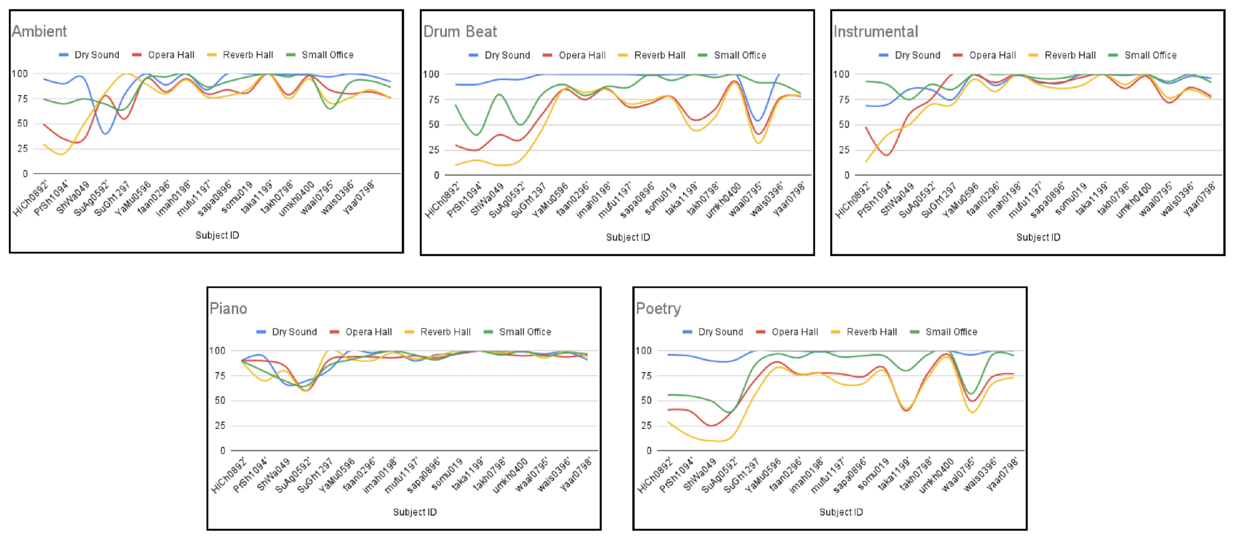
Task 5: Report and Coordination
Outliers: 2 outliers removed from the dataset

Slide 11
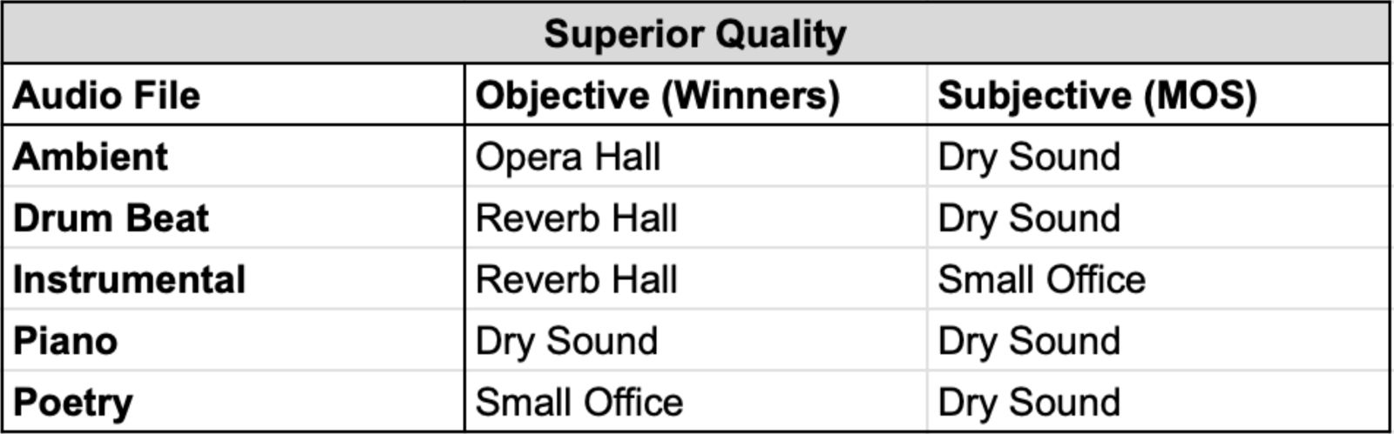
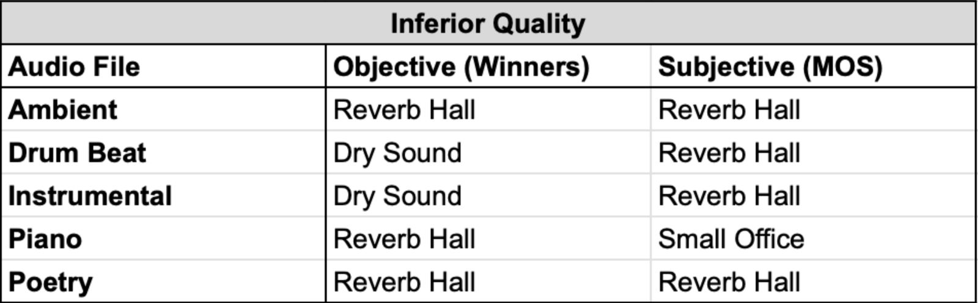
Task 5: Report and Coordination
Comparison: Objective Test Results (Winners) vs. Subjective Test Results (MOS)

Slide 12
Conclusion
AAC Superiority: AAC encoding causes less perceptual loss than quantization.
Genre Impact: Encoding performance varies by genre, with AAC excelling overall.
Content Influence: Complex audio benefits more from AAC encoding.
Environment Factor: Acoustic environments affect perceptual loss.
Optimized Processing: Tailored processing ensures quality with smaller file sizes.

Slide 13
Thank You
Azmat Sultan Awan - 65821
Bharani Jayakumar - 66451
Umair Khalid - 66512
Tarun Devidas Ramani - 66160
Suprabha Ghosh - 64365

